Slide 1

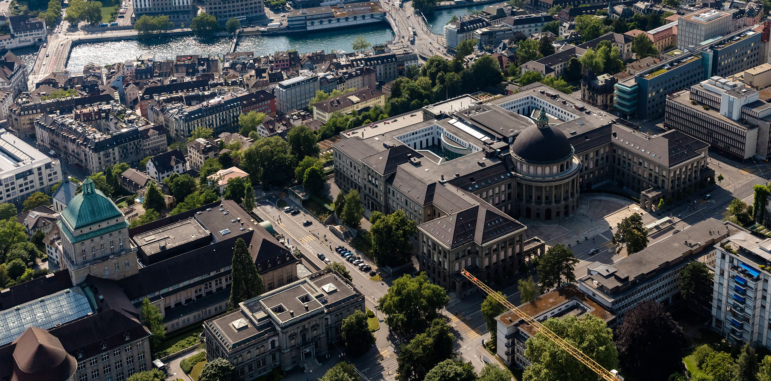
Extended Kalman Filter & Particle Filter from MATLAB to Python
Noah Baumann
Supervisors:
Enrico Mion Bhavya Sukhija Jin Cheng Prof. Raffaello D’Andrea

Slide 2
Content
Comparing python & MATLAB RNGs
Extended Kalman Filter (EKF)
2021 Exercise plots
2022 Exercise plots
2021 vs 2022 performance & accuracy comparison
Particle Filter (PF)
Evaluation function
Conclusion
End

Slide 3
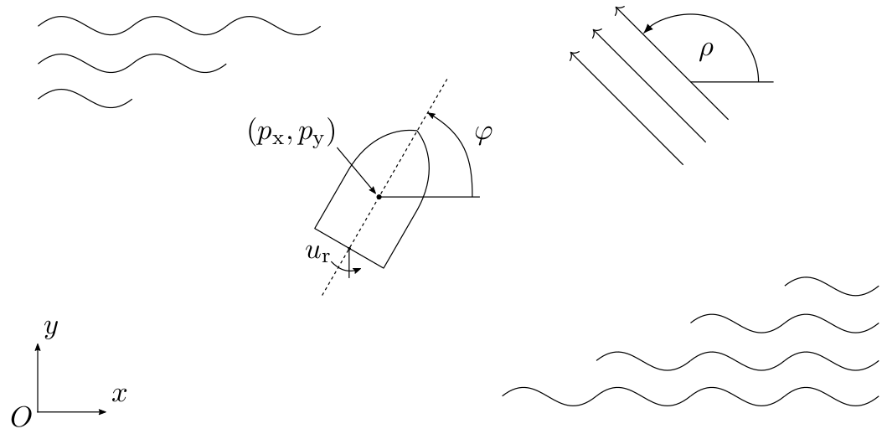
Extended Kalman Filter (EKF) Exercise
The EKF exercise consists of keeping track of all the five states of the boat: x- & y-position, x- & y-velocity and the rotation
2021 version:
Distance sensors A,B are availbla at constant time steps
Distance sensor C is given at random
2022 version:
Distance sensor A,B & C are all given at the same random time step
Problem: implementing Simulator.p python will not be the same as for the MATLAB version, due to python & MATLAB different RNGs

Slide 4
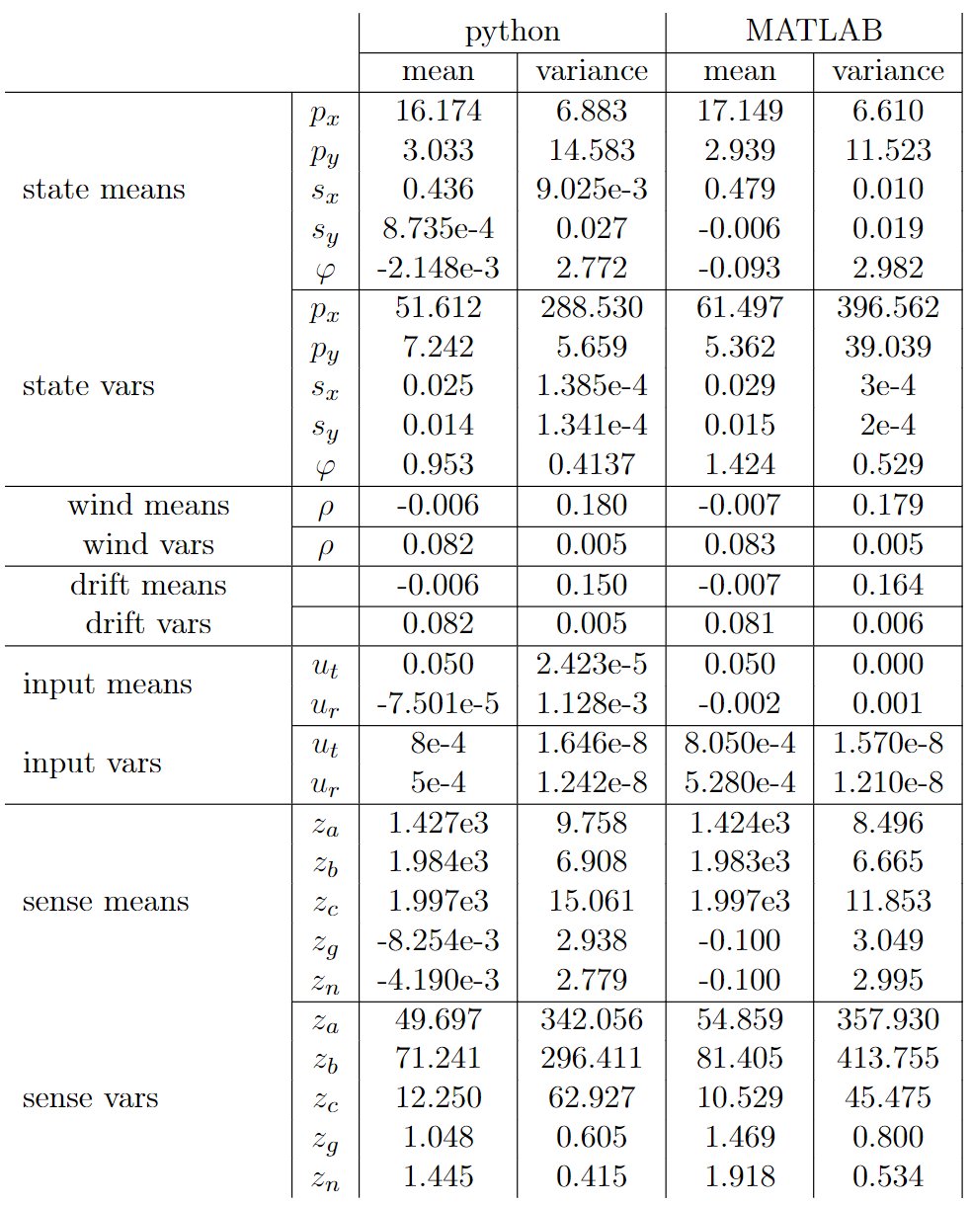
Comparing python & MATLAB RNGs
Python & MATLAB use the same kind of uniform distribution
But different Type of normal distr. RNGs:
NumPy: Box-Muller algorithm
MATLAB: Ziggurat algorithm
This meant no side-to-side comparison
But we can compare them over multiple runs and take the mean & var
Simulator.p from the EKF 2021 & 2022 exercise accuracy over 1000 runs ->

Slide 5
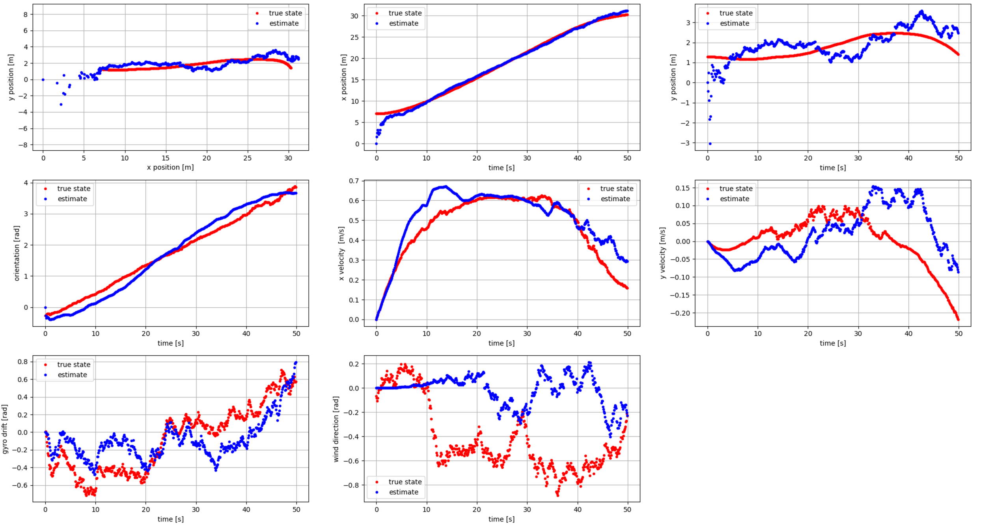
EKF Exercise 2021 plots
Titel Inhalt 1
Titel Inhalt 2
usw.

Slide 6
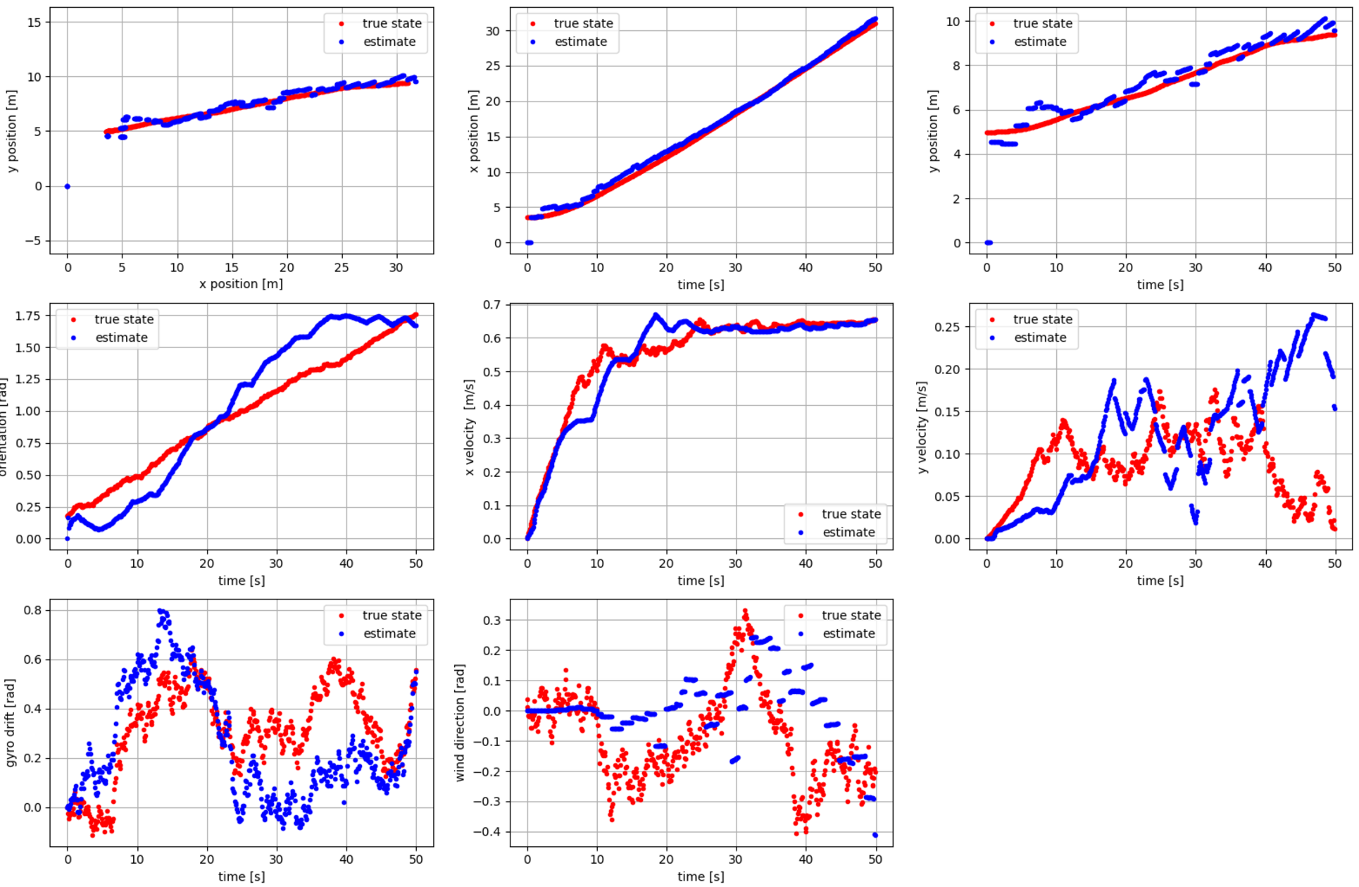
EKF Exercise 2022 plots
Titel Inhalt 1
Titel Inhalt 2
usw.

Slide 7
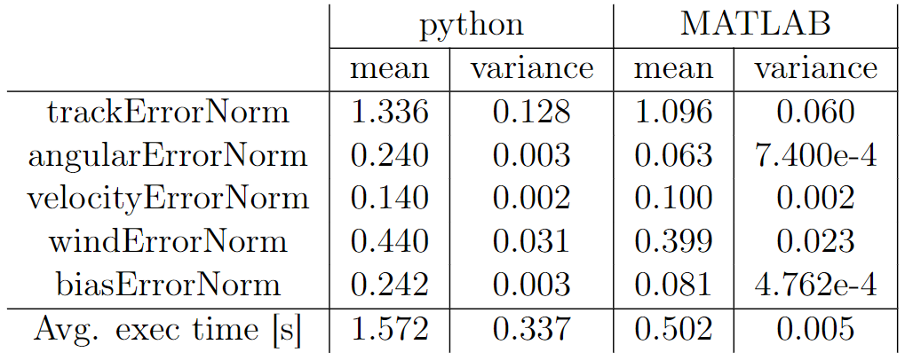
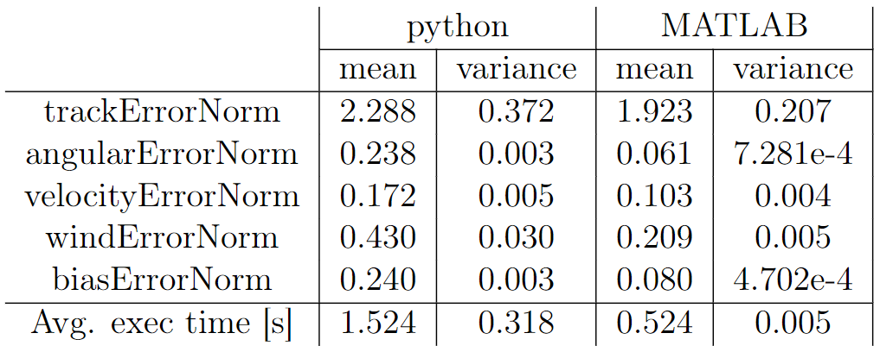
EKF Exercise 2021 vs 2022
Exercise 2021
Performance & accuracy run of the 2021 & 2022 implementation.
Each 1000 runs on a R9 5950x CPU 3.4Ghz
Both 2021 & 2022 use the same default set of SimulationConst.m & EstimatorConst.m parameters
Exercise 2022

Slide 8
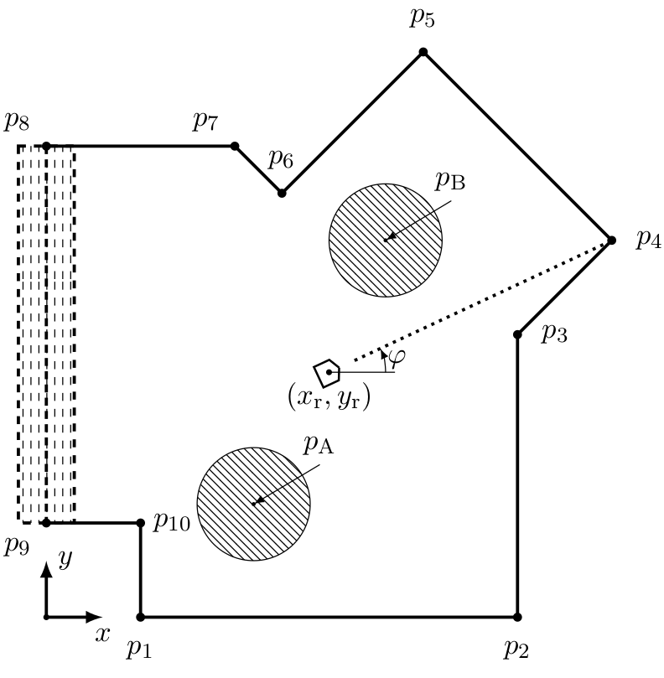
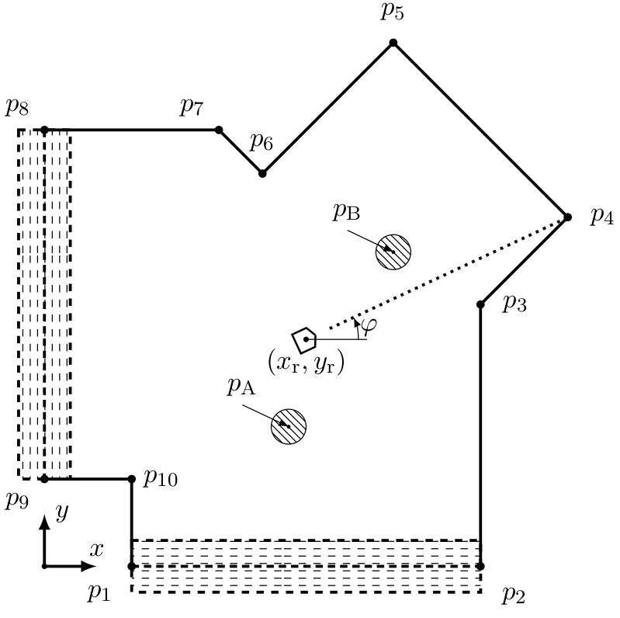
Particle Filter (PF)
Tracking the movement of a Robot in a closed room
PF exercise 2021: One wall depth is not known and has to be estimated
PF exercise 2022: Two walls are not known
The Simulator.p only consists of uniform RNGs, hence no need for comparing the outputs of python & MATLAB
PF exercise 2021:
PF exercise 2022:

Slide 9
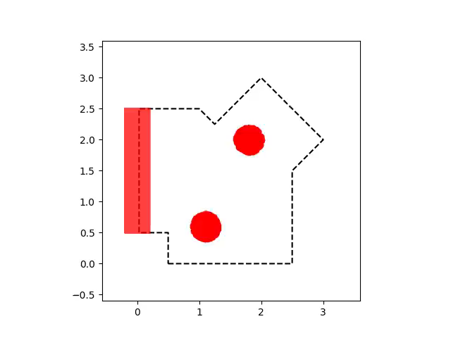
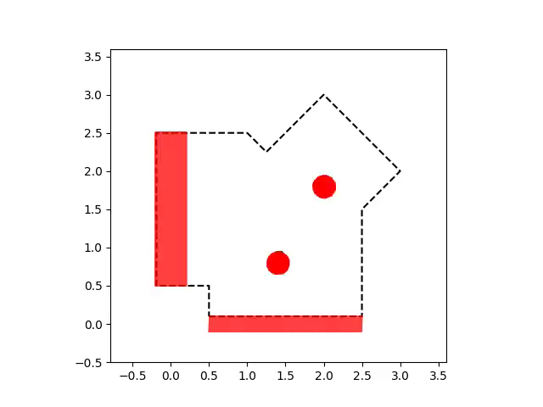
PF Exercise animation
Comparing the 2021 & 2022 python animation
Python exercise 2021 animation
Python exercise 2022 animation

Slide 10
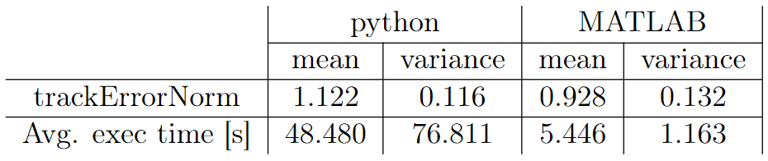
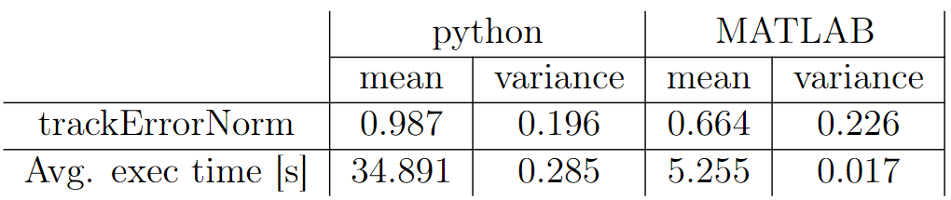
PF Exercise
1000 runs on R9 5950x 3.4Ghz
Exercise 2021 & Exercise 2022 have different set of SimulationConst.m & EstimatorConst.m parameters
Exercise 2022 python only 200 runs were made. No time to do more
Exercise 2021
Exercise 2022

Slide 11
Evaluation function 2022
Show git reposetory…

Slide 12
Conclusion
EKF 2021 & 2022 are working
PF 2021 & 2022 are working
Evaluation Function improved
Still open problems:
All of the python implementations are not as accurate as the MATLAB versions
All the python codes have no code coverage

Slide 13
Thank you for your attention and have a nice summer!

