Slide 1
$5 Methylation array
8/7/23

Slide 2
מה יש כרגע
המרה מרצפים או מיקום גנומי לערכי סימולציה כולל ייצוג ויזואלי
המרה מערכי הסימולציה לערכי בטא כולל נרמול

Slide 3
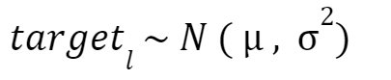
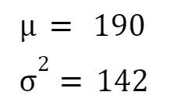

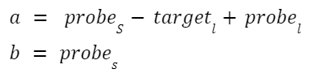
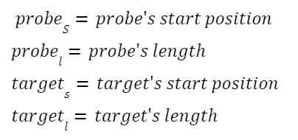
target’s length of sequences generated randomly from a normal distribution
Target’s starting positions generated from a uniform distribution where the lower bound dependent on target’s length
target
target
Min(a)
max(b)
Right flank (1,000bp)
Probe (45bp)
Left flank (1,000bp)

Slide 4
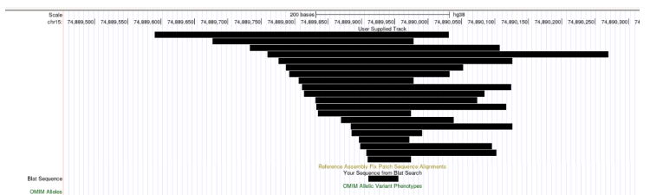
1M simulated targets and their distribution around the probe
(starting position was sorted)
targets
probe

Slide 5
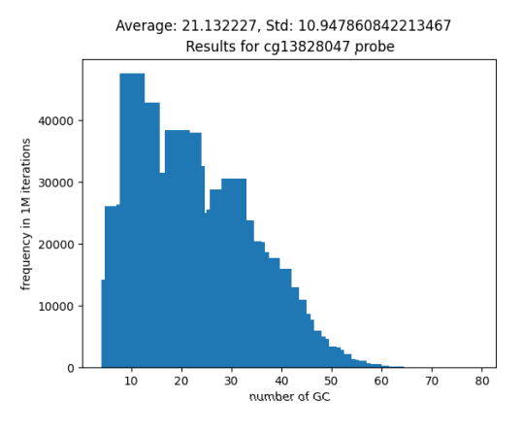
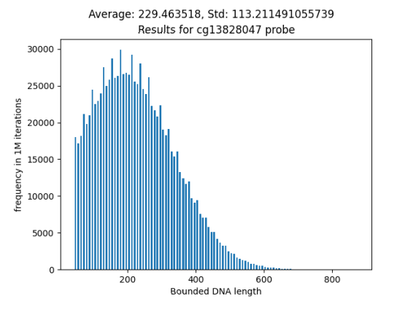
1M simulated targets and their distribution around the probe
(starting position was sorted)

Slide 6
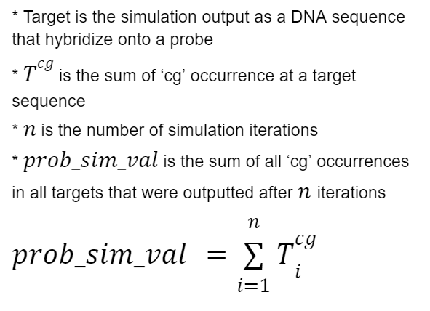
EXAMPLE:
GC
GC
target
4
GC
8
GC
target
GC
CG
GC
target
GC
target
GC
Right flank (1,000bp)
Probe (45bp)
Left flank (1,000bp)
Notes:
GC/CG

Slide 7

Sim_val: represent the bias that stems from the sequence characteristics *
Actual_beta_val: a value between 0 to 1
Norm_const: a value that results from local measuring changes
Sim_val x (1-Actual_beta_val ) x Norm_const = measured value
Norm_const calculated by the following equation:
**
* relevant sequence characteristics are CpG positioning and their distance from the probe area
** assuming the actual_beta_val is a normal distribution between 0 to 1

Slide 8
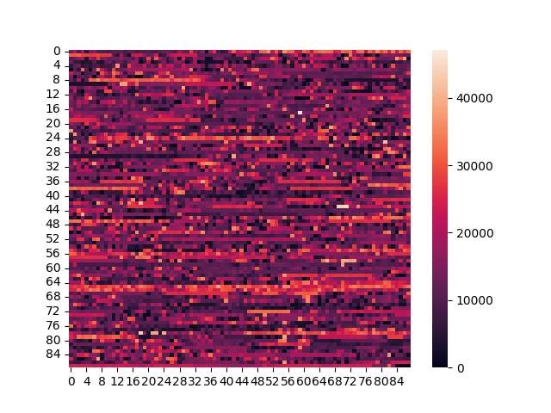
All agilent sites simulation (sum for 1000 runs)

Slide 9
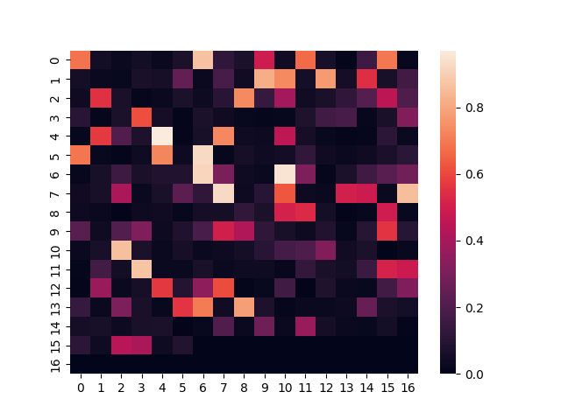
All horvarth clock sites (beta value - average from horvarth’s lab example table)
Why 561 and not 334?
Overlapping
Lots and lots of overlapping

Slide 10
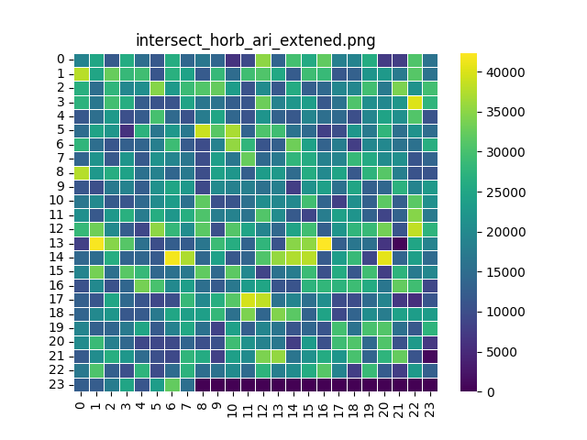
Agilent ∩ horvath ∩ available beta_vals
Simulation output

Slide 11
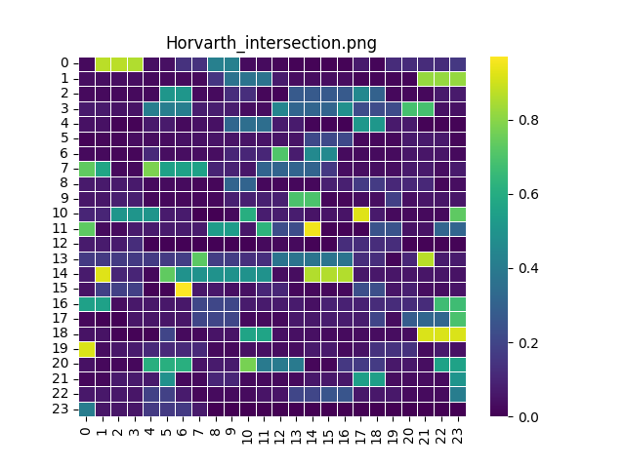
Agilent ∩ horvath ∩ available beta_vals
Beta-values

Slide 12
Tasks 8/8/23
Robust and validated code V
Find set of overlapping pixels on the right arrays
Find 5 horvath samples and show linear graph between age and methylation age (illumina)
For the same samples, find values for the 345 horvath pixels( from simulation)
Calculate and plot Jax-methylation age

Slide 13
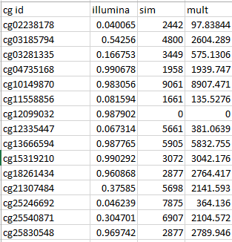

Slide 14
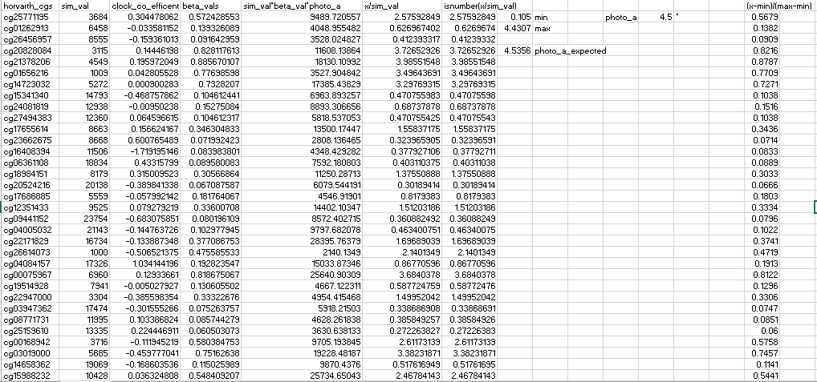

Slide 15
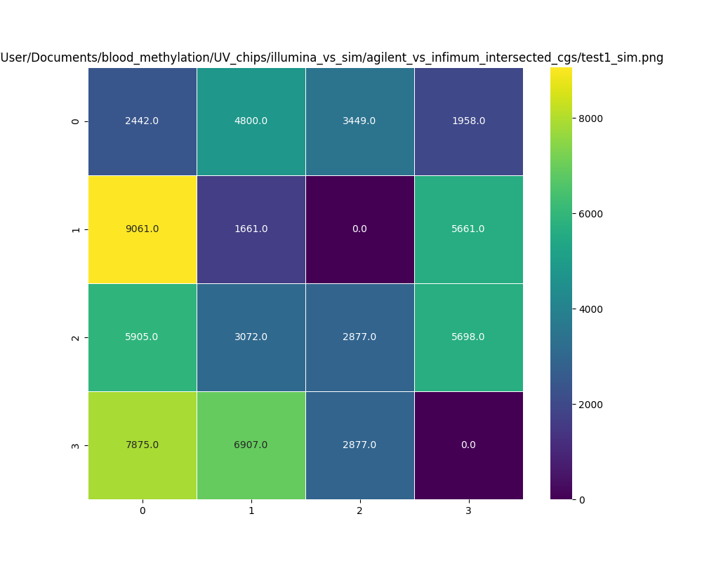
Simulation
Results
values=integrated number of CpG for 100 molecules per pixel
Notes:
Define overlapping pixels as illumina CpG within 100 bp of Agilent probe
Work with illumina epic 850k and agilent CGH 60k
Write the number of CpGs in every pixel (Avg and min-max) V
Check cg vs CG (we are expecting number of CpGs to be number of molecules X number of CpGs in probe +- 100bp from each end V
We are labeling unmethylated CpGs on agilent. Use 1-beta as illumina signal

Slide 16
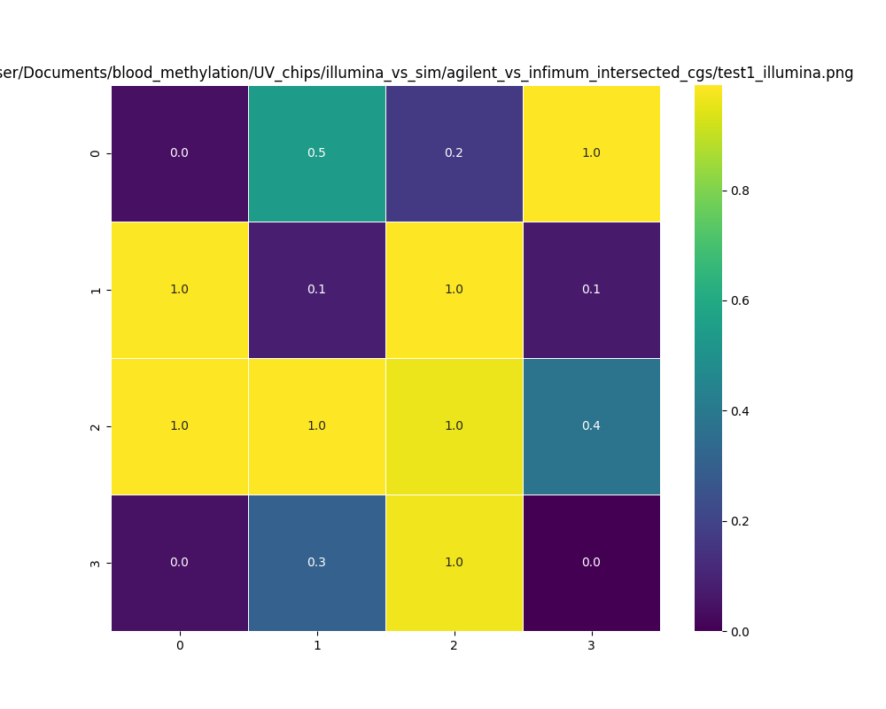
Ilummina
Beta values for same pixels

Slide 17
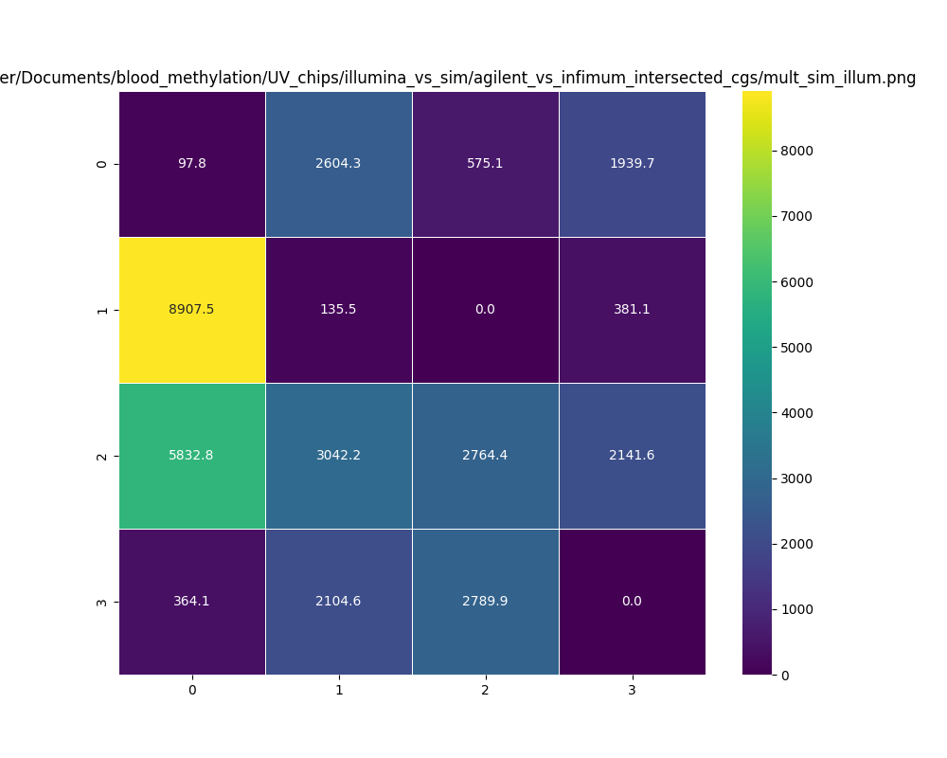
Ilummina
Multiplied by sim
Results (beta times number of CpG)

