Slide 1

Front-End Styling
<h1 align="absolute" class="title_heading">
UMKC DOCUMENT RETRIEVAL
</h1>
.title_heading{
text-align: center;
color: #ffff00;
background-color:blue;
width:20px
}

Slide 2
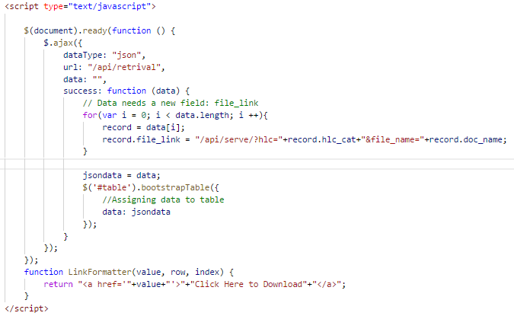
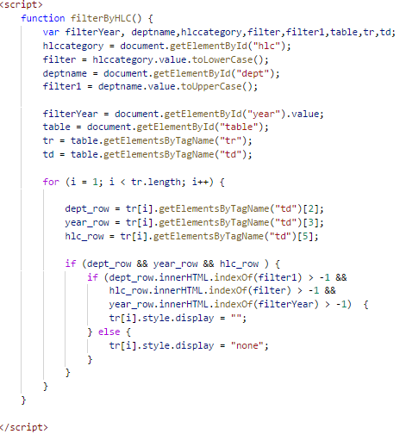
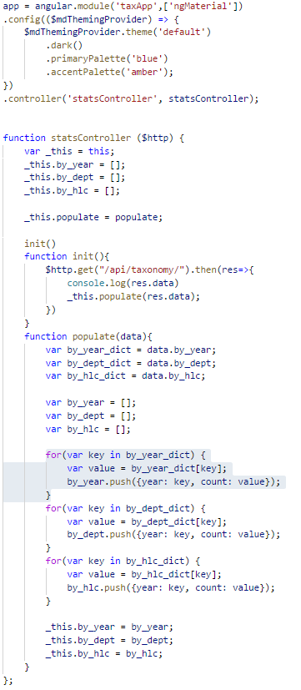
Upload, Retrieval, Taxonomy

Slide 3
API Endpoints
Upload
Retrieval
Taxon.
Upload API
Retrieval API
Serve API
Taxon API
Metatable
Filestore

