Slide 1
Team Blue & Gold
UMKC Hackathon – Fall 2017
Use Case 4 – Argument Assurance Writer
Team: Noah, Pranoop, Archana, Ahlam

Slide 2
Use Case
Like many institutions, UMKC is required to maintain levels of quality and excellence to remain accredited.
This is carried out via a review process, which requires gathering thousands of documents
Our team was tasked with creating an app to upload & store files, retrieve & filter files, and show statistics

Slide 3
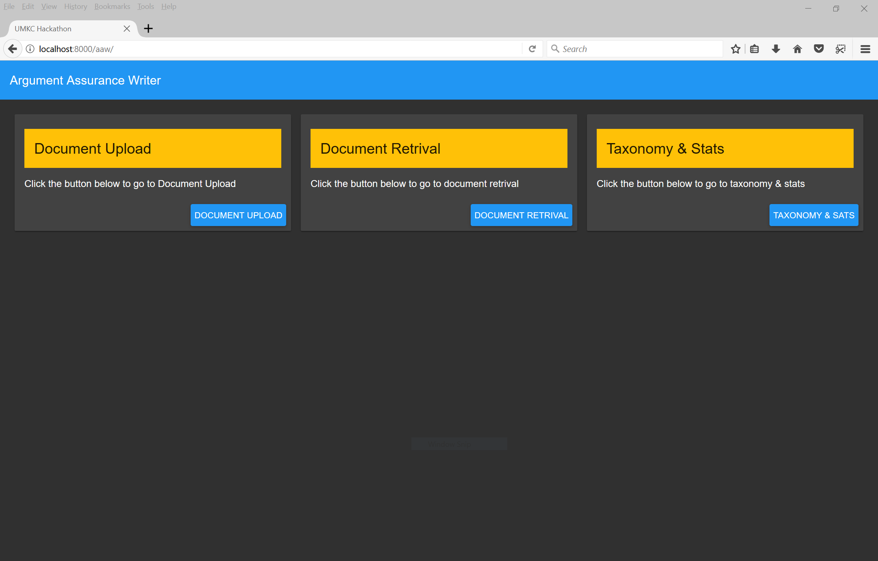
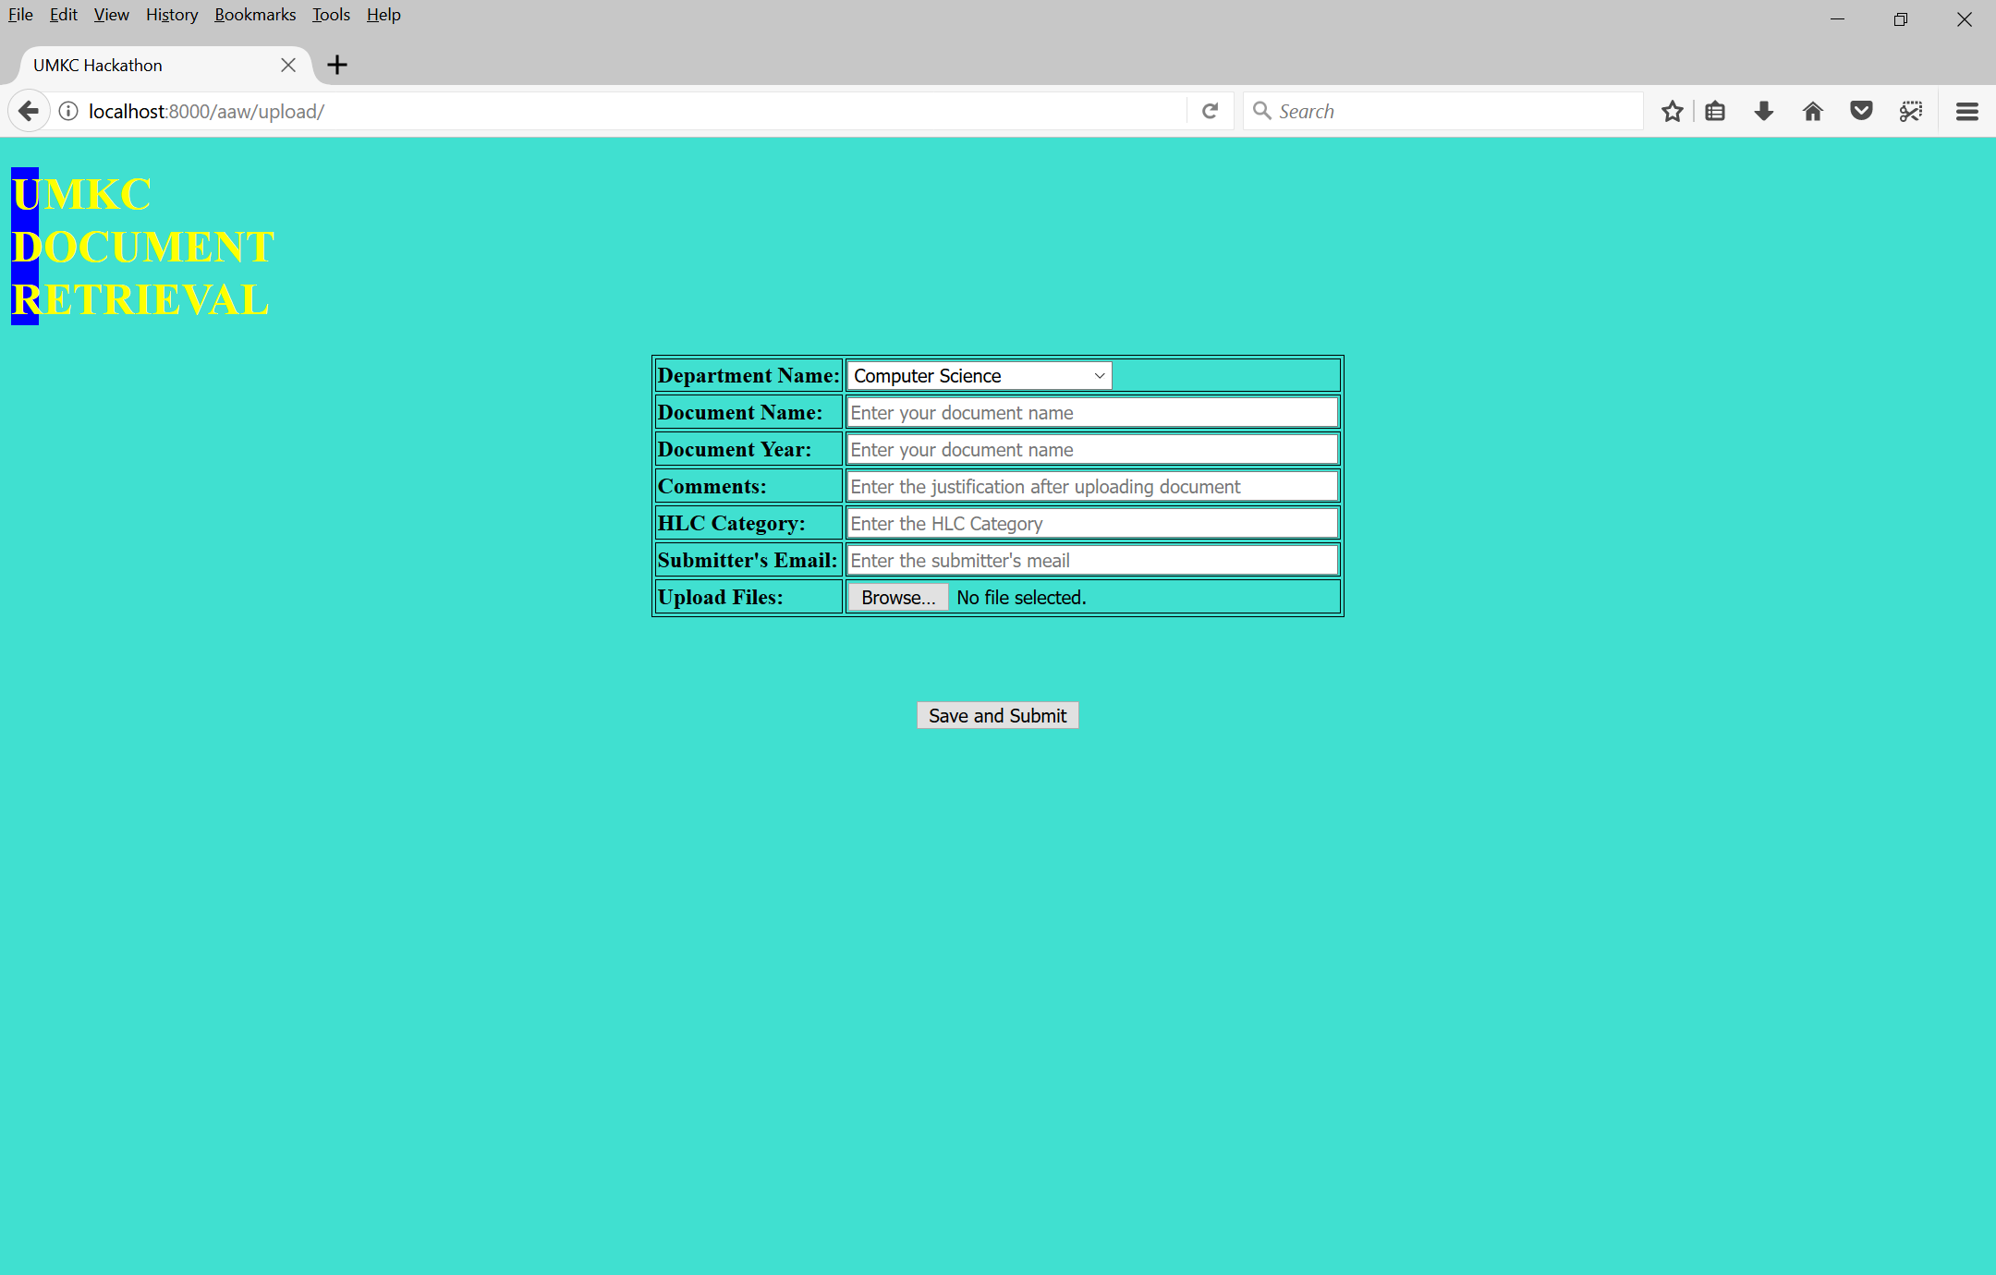
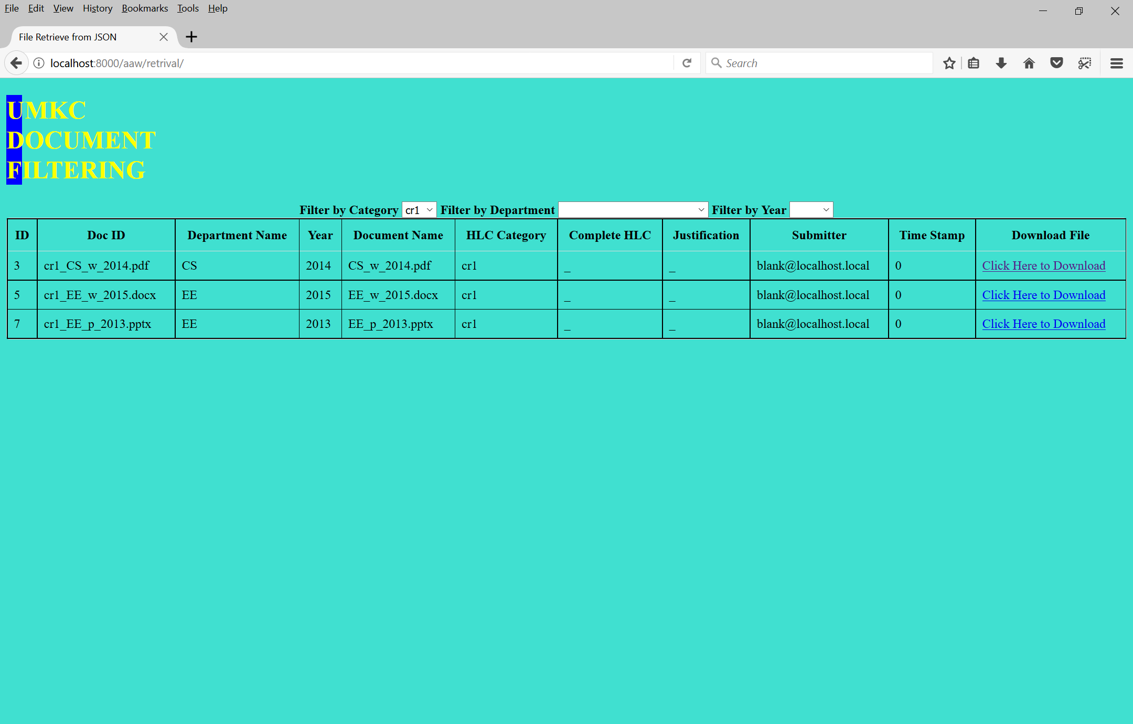
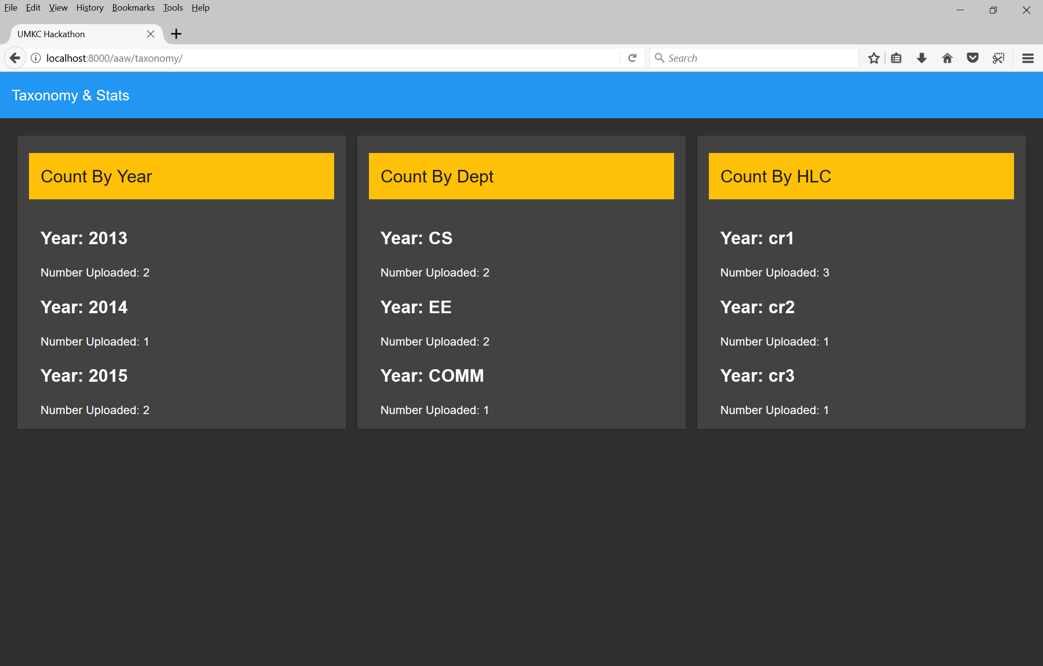
Front-end

Slide 4
API
Upload
Retrieval
Taxon.
Upload API
Retrieval API
Serve API
Taxon API
Metatable
Filestore

Slide 5
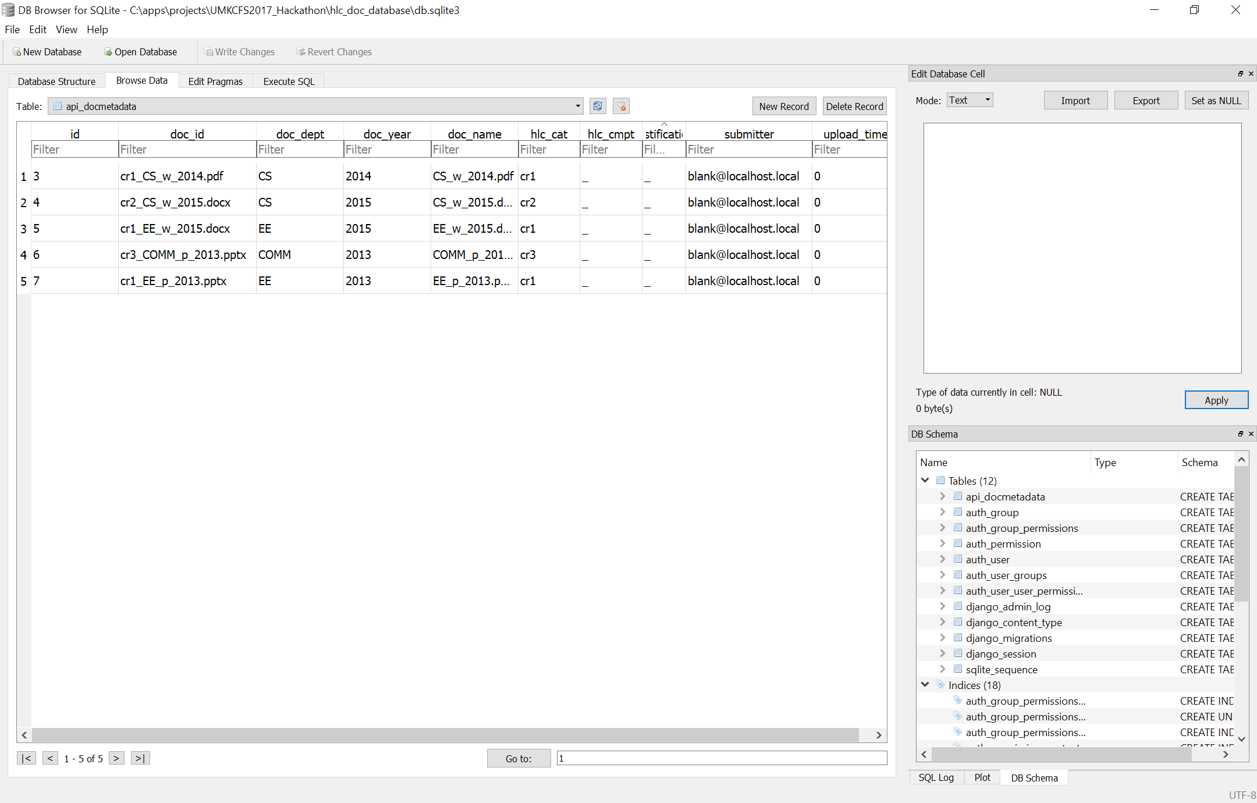
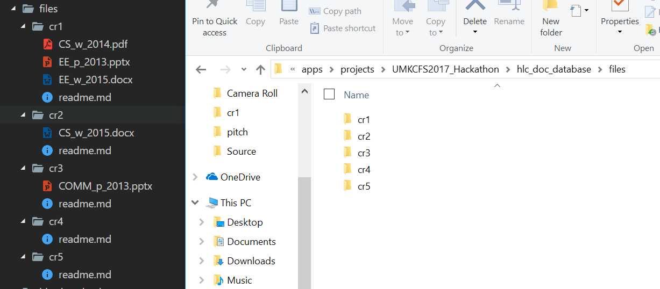
Database & Filestore

