Slide 1
Python Development Quick-Start
Make coding easier, better, and faster!

Slide 2



Why Learn Tools?
VS
Notes:
As you may have guessed from the title slide, learning programming tools can give you a leg-up. Coding can be a daunting thing to tackle, so let’s imagine we want to go somewhere.

Slide 3
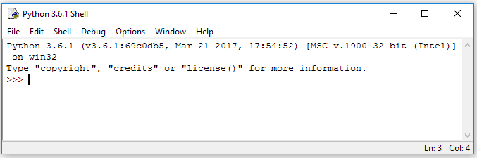
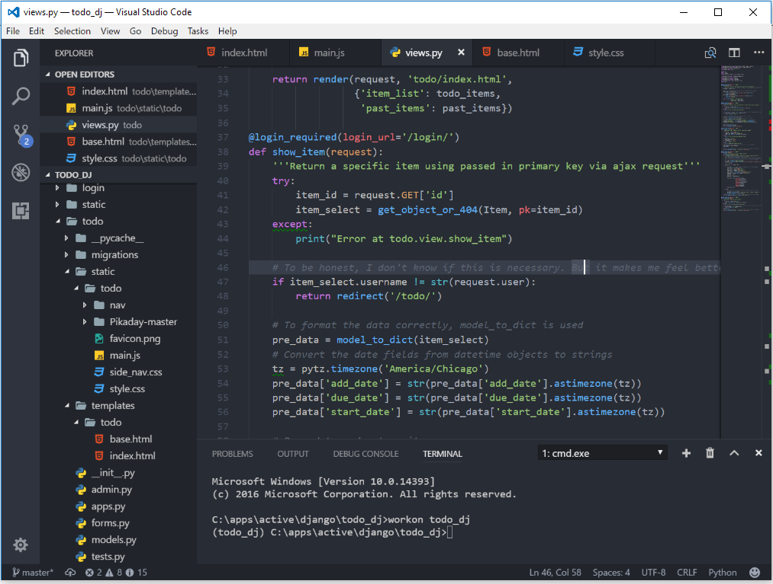
Agenda
The Tools:
Python IDLE
Visual Studio Code
Git & GitHub

Slide 4






Disclaimer
Every developer is different
Find tools that work for you
Hopefully you will be better informed to find the tools you do want.

Slide 5
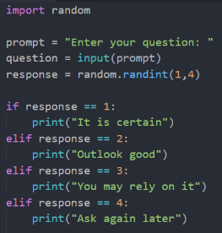
What is Python?
High level language. Do more, faster
Nice syntax. Makes coding easier
Great Community. Google is A+

Slide 6
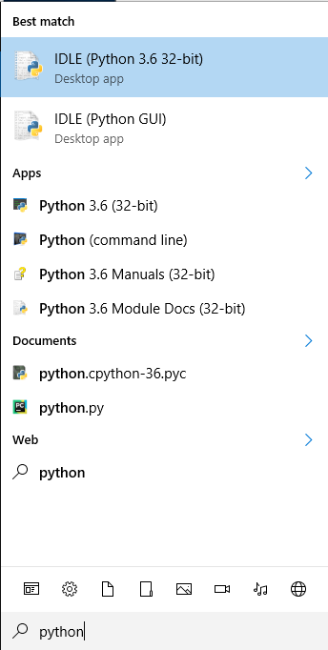
Setup Python
Setup for Windows
Download at: python.org/downloads/
Install Python 3.6.2
Search for “Python” and select IDLE

Slide 7
Using Python IDLE
Learn faster – save time
Run code directly and modify easily
Save files and build projects
Lets do a live demo

Slide 8
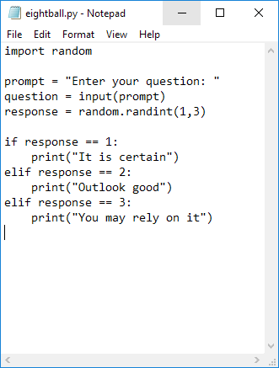
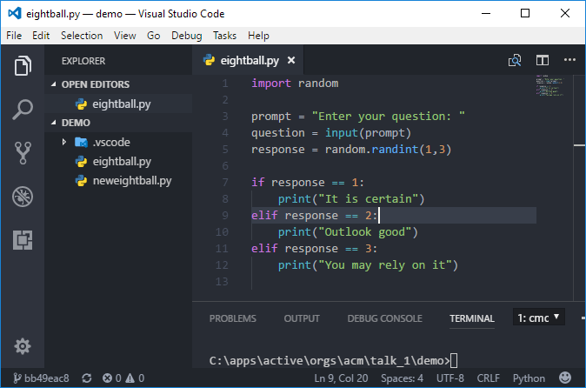
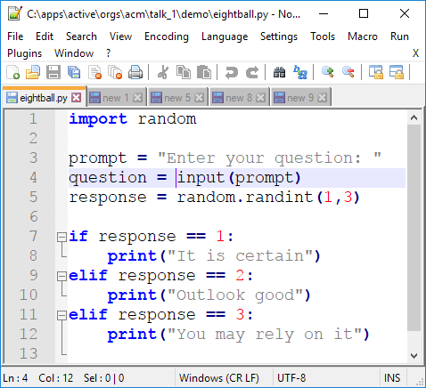
What is VS Code?
Okay?
Great!
Better

Slide 9
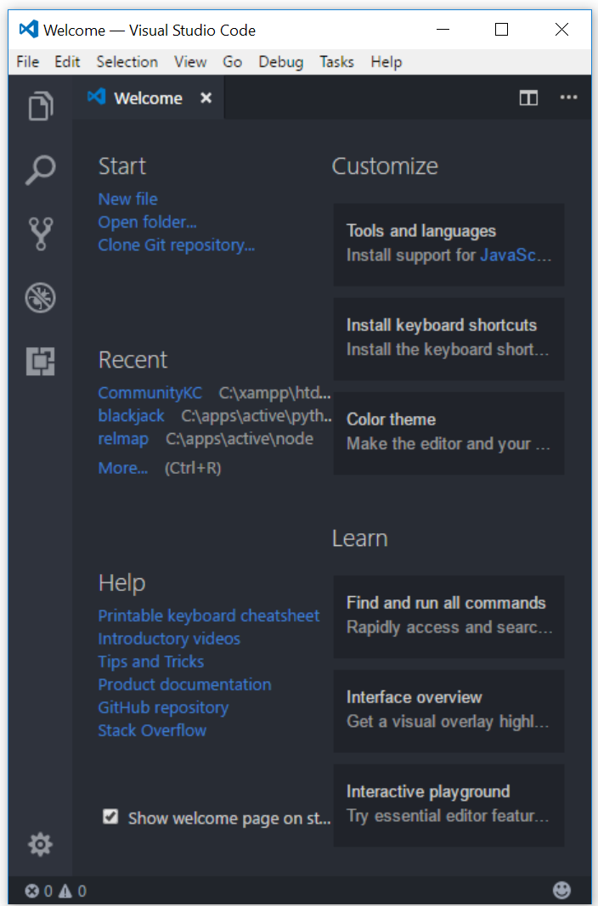
Setup VS Code
Setup For Windows
Download at: https://code.visualstudio.com/
Install VS Code
Install Python extension
Optional: Install a theme

Slide 10
Using VS Code
Manage files easily & quickly
Code easier with syntax highlighting
Catch errors faster with linting
Lets do a live demo

Slide 11
Using a Terminal
Before there was the GUI, it was terminal
Run Python code from VS Code
Try: (Use CTRL + C to exit commands)
python eightball.py
python -m idlelib eightball.py
(Careful: While open, changes to file do not auto update from the VS Code side)

Slide 12
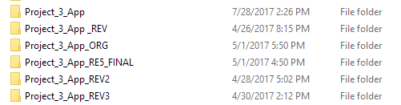
Version Control
Ever done this?
Is there a better, easier, faster way?

Slide 13
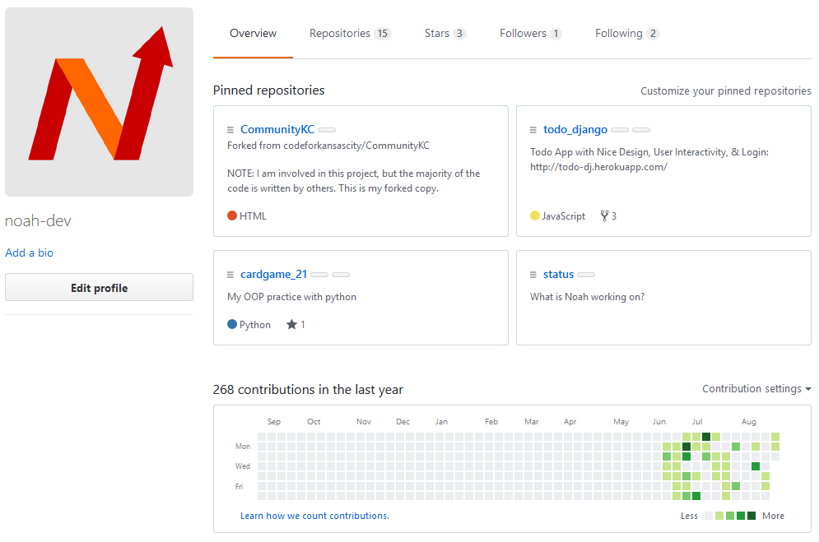
What is Git & GitHub?
Backup your code, locally & in the cloud
Share your code with others
Show off your awesome skills

Slide 14
Setup a Git Repo
What I am about to show you might be scary…
Don’t worry: it scared me too
Exposure will be beneficial.
No pressure. Something to learn later on.

Slide 15
Setup a Git Repo
From terminal, do…
git init
git add –A
git commit –m $message
git add remote add origin $repo
git push origin master

Slide 16
Alternatives
Python IDE
PyCharm
Visual Studio
PyDev
And More
Editors
Atom
Sublime Text
Notepad++
And More
Source Control
Mercurial
SVN
Bitbucket
And More

Slide 17
Coming up…
Build a GUI with TkInter!
Terminal is nice, but what about buttons?
Send a Tweet with Python!
Learn what an API is, and use it
Python Flask – Building a Web App
Learn how Web Apps work, and build one

