Slide 1
Author’s Note
This document was created as a reference for how Project 3’s code is laid out. A high level overview is covered in slides 4-6. In slides 8-23, the algorithm to generate, plot and show Task 3 is explained step by step.
Revision 2 – Last Updated 05/15/2017
Although built with PowerPoint, it is not meant to be used for a presentation as is. (Too much text)

Slide 2
ATTENTION: BUG FIX
A major bug was identified in Task 2. It did not properly aggregate by the rt_rt_cnt, instead just doing a simple count.
Furthermore duplicates were being counted, further polluting the data. The code has been rebuilt and the new results are shown on the next page.
Changes were made to:
t2_csv.py: Added a new field – the rt rt id, so as to remove duplicates
t2_csv.txt: Added a new column for the rt rt id (called "id")
query.py: Replaced qRDD_t2 with new code. Scrapped t2_map function in favor of splitting into one RDD for each bar on the chart.
graph.py: Modified graph_t2. Now uses a log scale to show results. Also added raw numbers, below bar labels.

Slide 3
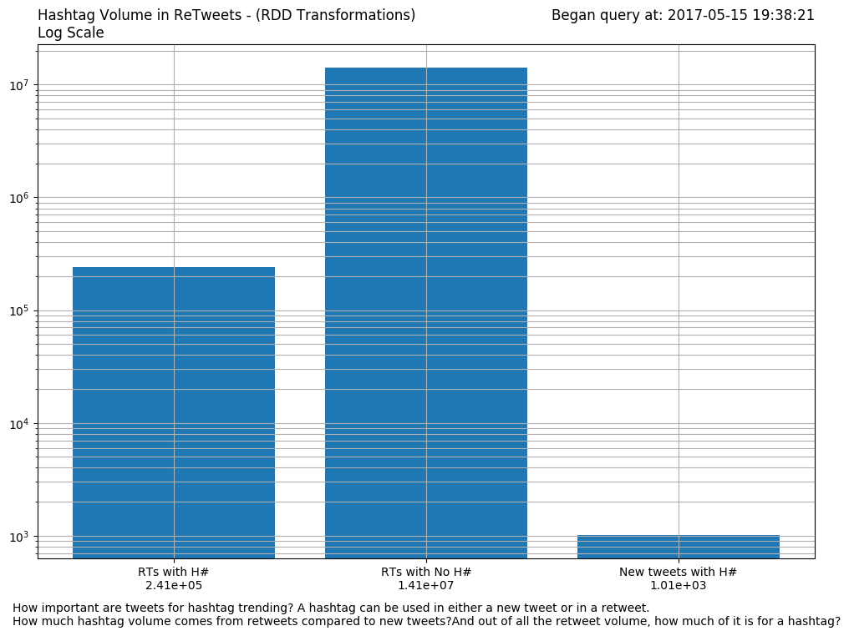
ATTENTION: BUG FIX

Slide 4
Source Code
Files
Front-End | Server | Back-End
home.html | app.py | query.py
results.html | config.py | graph.py
Dependencies (Library/Module)
Python 2.7 Modules | Python numpy
Apache Spark (PySpark) | Python matplotlib
Python Flask + Depend.

Slide 5
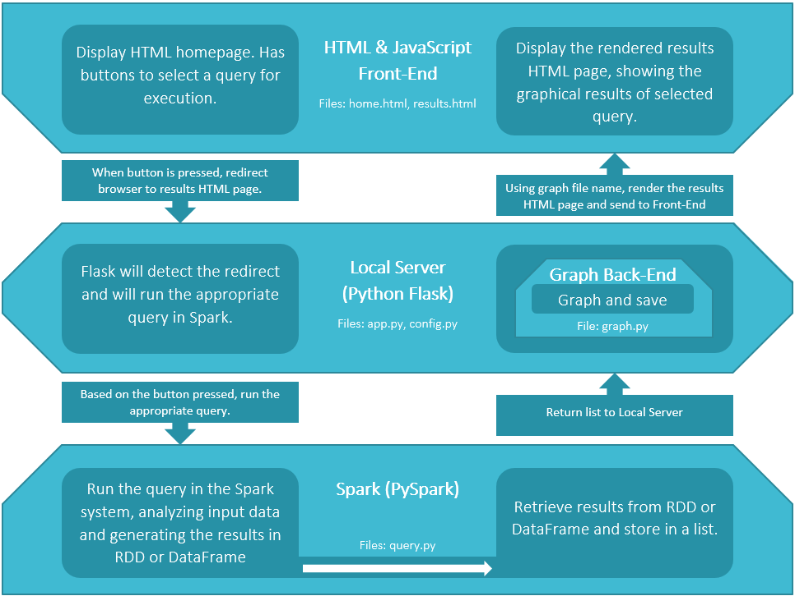
Layer-View Front-End Server Back-End

Slide 6
home.html
Function calls by app.py Start with 1, go to 7
Note: query.py returns a list of numbers
results.html
1
App.route(‘/results/<int:q>’)
7
return render_templae(‘res…’
config.py
app.py
2
Retrieved via conf_Q methods
6
no return value
3
runQuery(q,source)
5
makeFig(q, result, name…)
4
return result
query.py
graph.py

Slide 7
query.py
After the server has retrieved the name of the input data file, it calls the runQuery function, passing arguments q and source.
source is the absolute path and name of the file holding the input data.
q is a number representing the task (1,2 or 3)
Based on q, the arguments are passed into one of three functions:
qSQl_t1, qRDD_t2, or qSQL_t3
Each function will run an analysis on Spark using the input data and will return a list object. The list object contains the results of the analysis.
Let’s walk through Task 3, from generating results, to plotting the figure and showing it on the GUI.
NOTE: MS Access is used for the visualizing Task 3’s SQL queries.

Slide 8
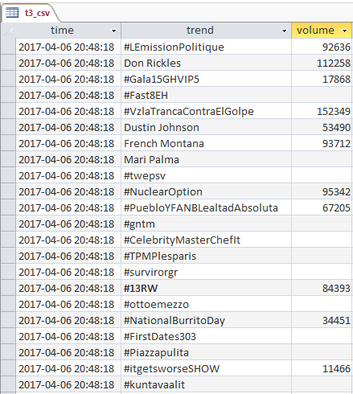
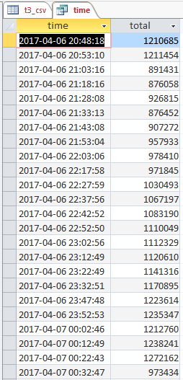
query.py Task 3
Task 3 uses Spark SQL & DataFrames to conduct the analysis. The input data in “t3_csv.txt” is read into the DataFrame df_t3, and is labeled as “t3_csv”. Starting from there, the analysis will the desired results.

Slide 9
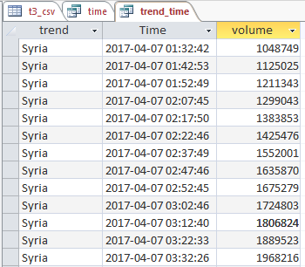
query.py Task 3
Using input, task 3 will generate two DataFrames:
df_time, which holds the aggregate sum of tweet volume by time across all trends
df_trend_time, which holds the top 3 trends, when they appear, and how much tweet volume at that time

Slide 10
query.py Task 3 – df_time
Starting with “t3_csv”, run an SQL query and store the results in df_time.
q_time = "SELECT time, Sum(volume) AS `total` FROM t3_csv GROUP BY time ORDER BY time“
df_time = spark.sql(q_time)

Slide 11
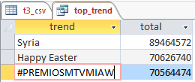
query.py Task 3 – df_trend
Starting with “t3_csv”, run an SQL query and store the results in df_trend. Label DataFrame as “trend”
q_time = "SELECT trend, Sum(volume) AS `total` FROM t3_csv GROUP BY trend ORDER BY Sum(volume) DESC LIMIT 3“
df_trend = spark.sql(q_trend)

Slide 12
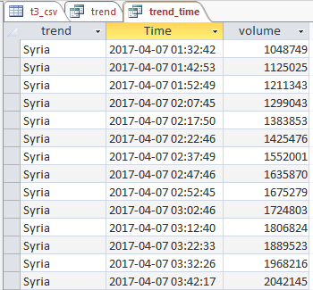
query.py Task 3 – df_trend_time
Using “trend” & “t3_csv, run an SQL query and store the results in df_trend_time.
q_trend_time = "SELECT trend.trend, t3_csv.time, t3_csv.volume FROM trend INNER JOIN t3_csv ON trend.trend = t3_csv.trend“
df_trend_time = spark.sql(q_trend_time)

Slide 13
query.py Task 3
Both of the final DataFrames, df_time & df_time_trend, are now complete. The results will now be passed to graph.py to be plotted.
The graph.py needs to be able to access the results via an index, so both df_time & df_time_trend are converted via the collect method and returned in a list.
result = [df_time.collect(),df_trend_time.collect()]
return result
This concludes the qSQL_t3 function. The result will be returned to runQuery, which in turn returns the result to the flask server. The flask server will pass the result, along with other arguments, to the graph.py

Slide 14
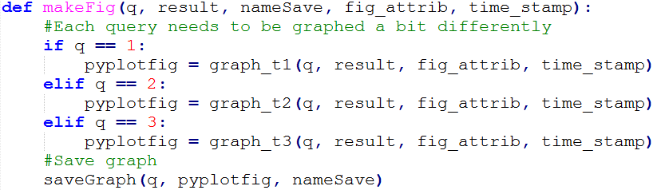
graph.py
After the server has retrieved the result from query.py, the server will call makeFig from graph.py to plot the results.
Along with the results, figure save name, figure attributes and time stamp are passed in. Figure attributes include information such as title, axis and description.
Each task has a specific function in graph.py. Depending on what q is, makeFig will call the appropriate one. The figure is plotted using the matplotlib module and is stored in a pyplot object. Using the pyplot object, the figure is saved using saveGraph.

Slide 15
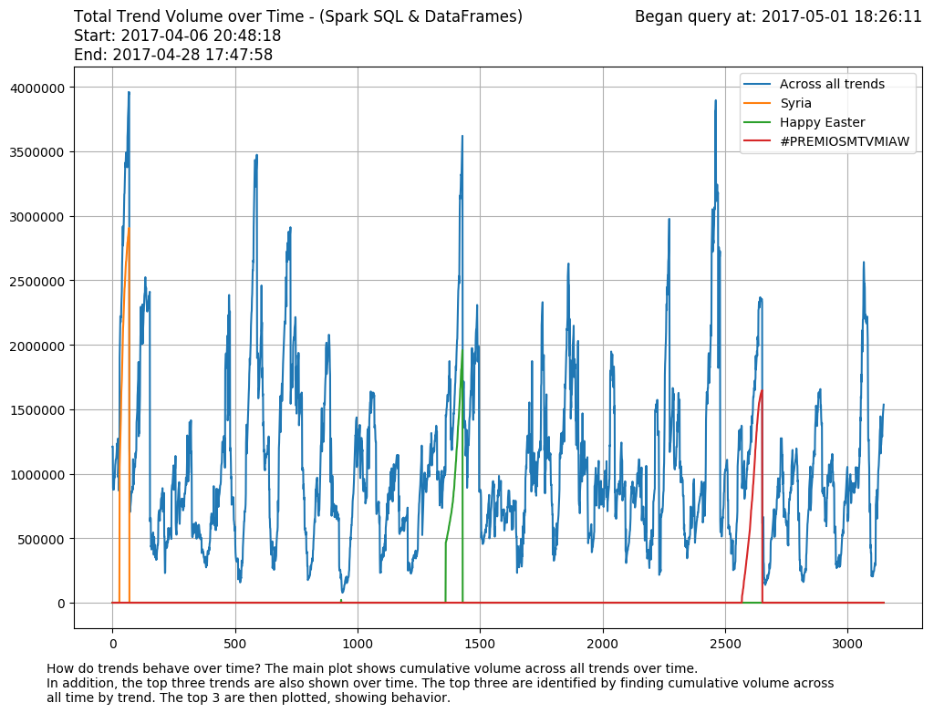
graph.py Task 3
For task 3, four sets of data need to be plotted:
The main plot, which shows cumulative tweet volume across all trends over time.
Three secondary plots, which show how the top 3 trends’ tweet volume vary over time.
Main plot in blue. Three Secondary plots in orange, green and red.

Slide 16
graph.py Task 3
The raw input, the results from query.py, is a list containing two tables. The main plot, using the collected results from df_time, can more or less be used as is; just need to split the time and total fields into separate lists.
The secondary plots will need to be prepared before plotting. Each secondary plot may be shorter than the main plot, as they only include the times at which trend volume was significant. (Data collection limitation).
If the main plot has N data points but a secondary plot has M data points, where M < N, then N - M additional data points need to be added to enable plotting. The additional N – M data points will all be zero, as these are times when the trend did not have significant volume.

Slide 17
graph.py Task 3
To illustrate, imagine a toy example. Say the main plot has 7 data points, starting at 11 AM and ending at 5 PM as shown to the left. A secondary plot has 3 data points, as shown in the middle. So M = 7, N = 3. Since 7 > 3, M – N = 4 data points need to be added to enable plotting. The new secondary plot’s 7 data points are shown in the rightmost table.
Main
Secondary
New Secondary
Time | Total
11:00:00 | 5
12:00:00 | 10
13:00:00 | 15
14:00:00 | 30
15:00:00 | 40
16:00:00 | 60
17:00:00 | 10
Time | Total
14:00:00 | 20
15:00:00 | 30
16:00:00 | 50
Time | Total
11:00:00 | 0
12:00:00 | 0
13:00:00 | 0
14:00:00 | 20
15:00:00 | 30
16:00:00 | 50
17:00:00 | 0

Slide 18
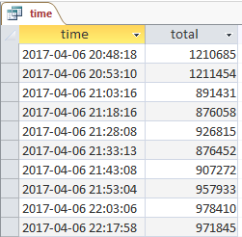
graph.py Task 3
Before discussing the implementation, it is important understand how the plot’s data is made. Data from df_time is used for the main plot. Only the “total” field’s values are used, with the “time” field’s values mapped to the list indexes. The mapping of time to index is shown on the right. The list of data for plotting is shown in the lower right.
Time | Index
2017-04-06 20:48:18 | 0
2017-04-06 20:53:10 | 1
2017-04-06 21:03:16 | 2
… | 4 – 3146
2017-04-28 17:47:58 | 3148
Index | Total
0 | 1210685
1 | 1211454
2 | 891431
3-3146 | …
3147 | 1535997

Slide 19
graph.py Task 3
We’ll use the toy problem to explain the implementation.
Since time is mapped to index, let’s update both the primary (below) and secondary (right) examples.
Time | Total
11:00:00 | 0
12:00:00 | 0
13:00:00 | 0
14:00:00 | 20
15:00:00 | 30
16:00:00 | 50
17:00:00 | 0
Idx | Total
0 | 0
1 | 0
2 | 0
3 | 20
4 | 30
5 | 50
6 | 0
Time | Total
11:00:00 | 5
12:00:00 | 10
13:00:00 | 15
14:00:00 | 30
15:00:00 | 40
16:00:00 | 60
17:00:00 | 10
Idx | Total
0 | 5
1 | 10
2 | 15
3 | 30
4 | 40
5 | 60
6 | 10

Slide 20
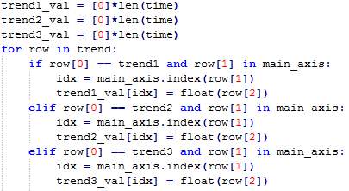
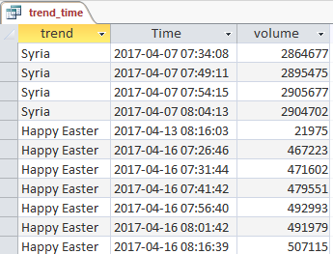
graph.py Task 3
In the implementation, the new secondary plots’ data will be stored in trend1_val, trend2_val & trend3_val; all are initialized as N long lists full of zeroes. The assigning of non-zero values is done in the for loop.
Below the for loop, the first conditional (e.g. row[0] == trend1 ) sorts the data from trend (which holds all 3 trends) into the appropriate bucket. The second conditional (e.g. row[1] in main_axis) checks if the trend’s time appears in the main plot’s data.
If true, use the time to locate what index the volume should be mapped to. (e.g. idx = main_axis.index(row[1]) ).
Using that index, assign the trend volume to the new secondary (e.g. trend1_val[idx] = float(row[2]) )

Slide 21
graph.py Task 3
To illustrate, let’s use the toy problem again. To simplify, we’ll only walk through the algorithm using a single trend.
Going through the rows in the Secondary, the first time is 14:00:00.
1st Conditional: N/A, since only 1 trend
2nd Conditional: yes 14:00:00 appears in Main
What is index of 14:00:00 in Main? 3
Assign value of 20 to the new Secondary at index 3
The next two rows, 15:00:00 and 16:00:00 appears in Main and correspond to indexes of 4 and 5. Hence values 30 and 50 are assigned to the new Secondary at indexes of 4 and 5 respectively.
Main
Time | Total
11:00:00 | 5
12:00:00 | 10
13:00:00 | 15
14:00:00 | 30
15:00:00 | 40
16:00:00 | 60
17:00:00 | 10
Secondary
Time | Total
14:00:00 | 20
15:00:00 | 30
16:00:00 | 50
Idx | 0 | 1 | 2 | 3 | 4 | 5 | 6 | 7
Total | 0 | 0 | 0 | 20 | 40 | 50 | 0 | 0

Slide 22
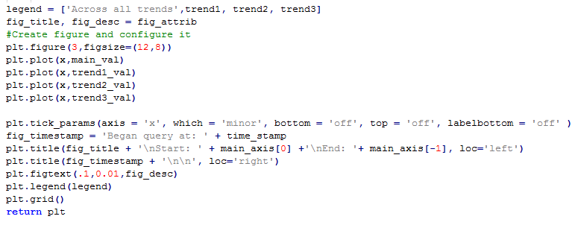
graph.py Task 3
With the plot data read, the main plot and three secondary plots are ready to be plotted to a figure.
plt.plot(x, main_val) and subsequent plt.plot() will plot the data.
x is a list of numbers from 0 to N-1. ( x = range(len(time)) )
The rest of the code manages attributes such as description, title, legend, etc. When complete, the plot is returned as a pyplot object.

Slide 23
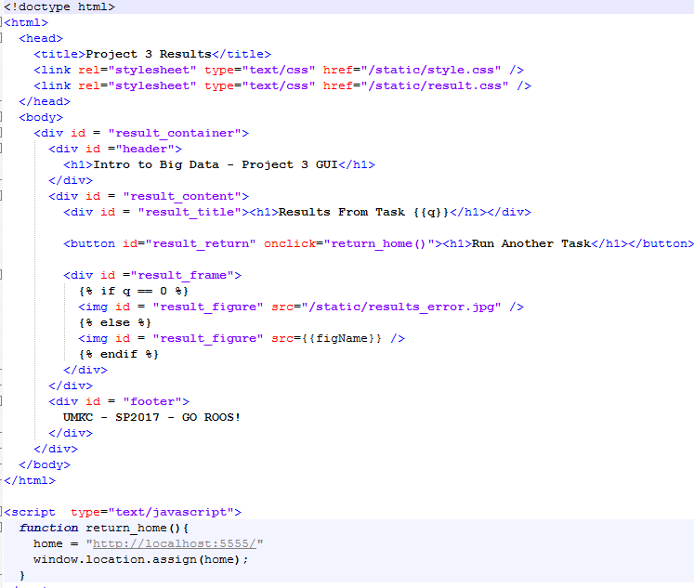
results.html
After the figure is saved, the flask server renders the result page, passing on which task was selected and what the file’s save name is.
Flask renders a jinja2 template, which is an HTML file but some of the content are variables that are decided at render time. (e.g. {{q}} )
A jinja2 template also supports conditional statements. If the q is equal to zero (not valid query) an error message is shown. Otherwise figure is shown. The figure’s path is stored in the variable {{figName}}

