Slide 1
Emily Venuto
Library Visitors Project
Fall 2017

Slide 2
Business Goals
Address need for visitor counting application for Sojourner Truth Library
Application will be merged into the already existing library website/staff-side service
Will utilize a web interface, server, and SQL database

Slide 3
My Responsibilities
Creating a login system
Designing web interface
Initializing SQL tables
Creating server files that act as go between for user input and SQL tables

Slide 4
Technologies Used
Web: HTML, CSS, Bootstrap, JavaScript
Server: PHP
Database: MySQL

Slide 5
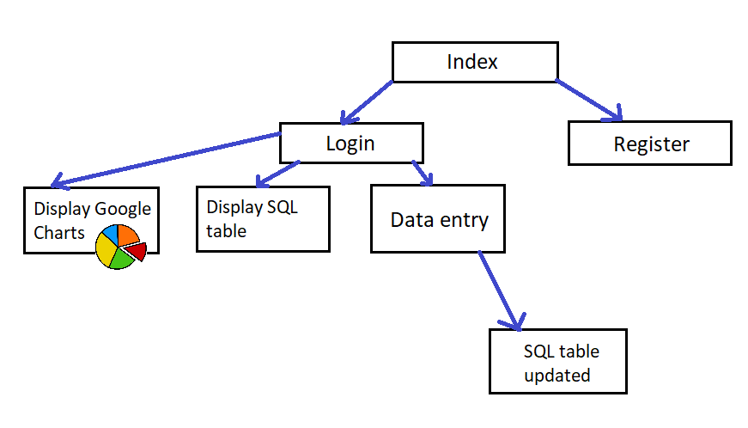
Architecture

Slide 6
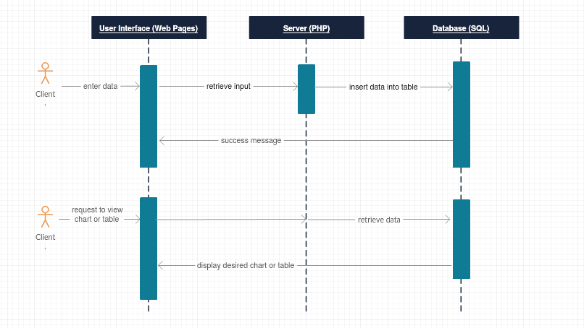
System Protocol

Slide 7
SQL Visit table
Holds number of visitors for each floor
Table is instantiated ahead of time
Web application is used to update
Chart updates dynamically when table is updated

Slide 8
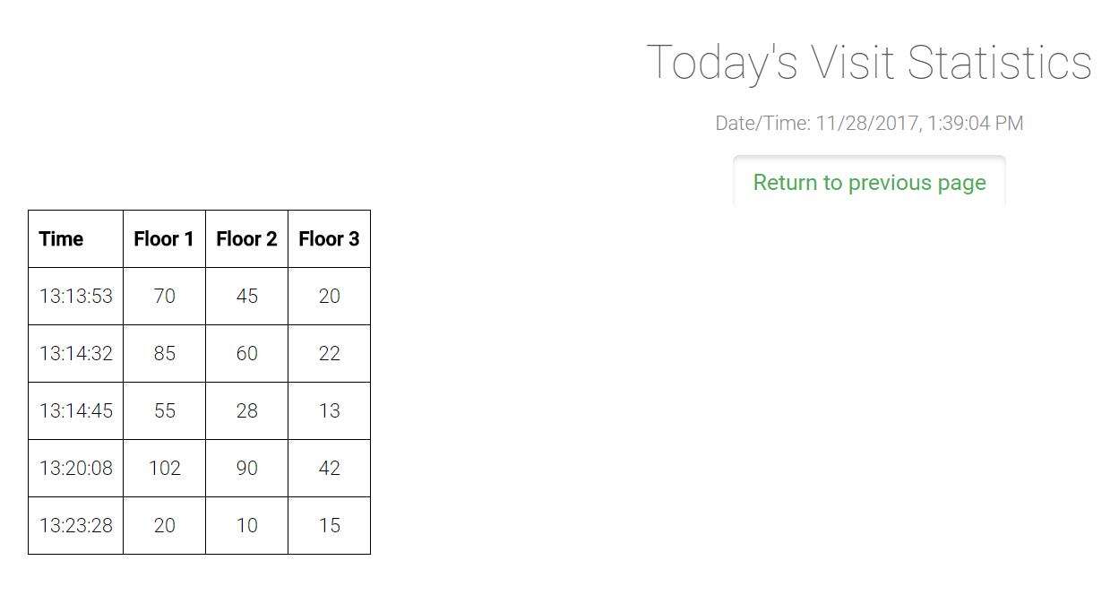

Slide 9
Data Entry
Entry.htm → insertData.php → Visit table
Entry.htm takes input using Bootstrap web form
insertData.php defines a variable for each input field, uses $_POST[ ] function to get input.
Uses SQL command to insert time of day and floor counts to Visit table

Slide 10
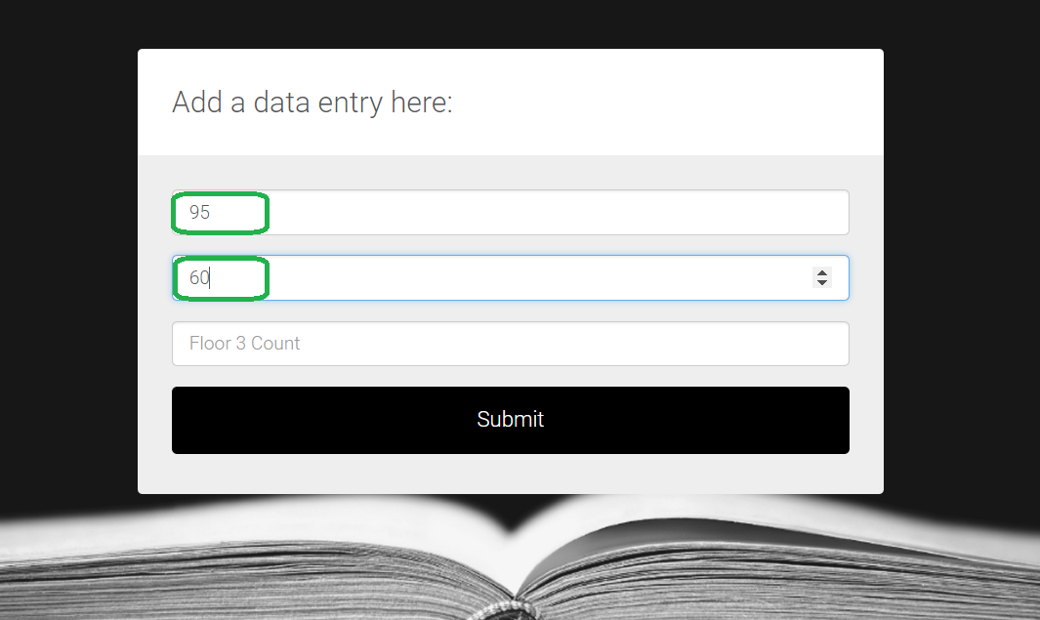

Slide 11
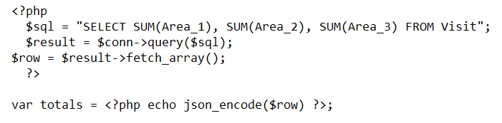
Chart display
To create Google chart, must Google AJAX API and appropriate chart packages
I want my chart to show cumulatively how many people have been on each floor for a given day
Must define a createChart() function – will bring in data and format for chart
Use PHP to query SQL table, collect sum of each floor count

Slide 12
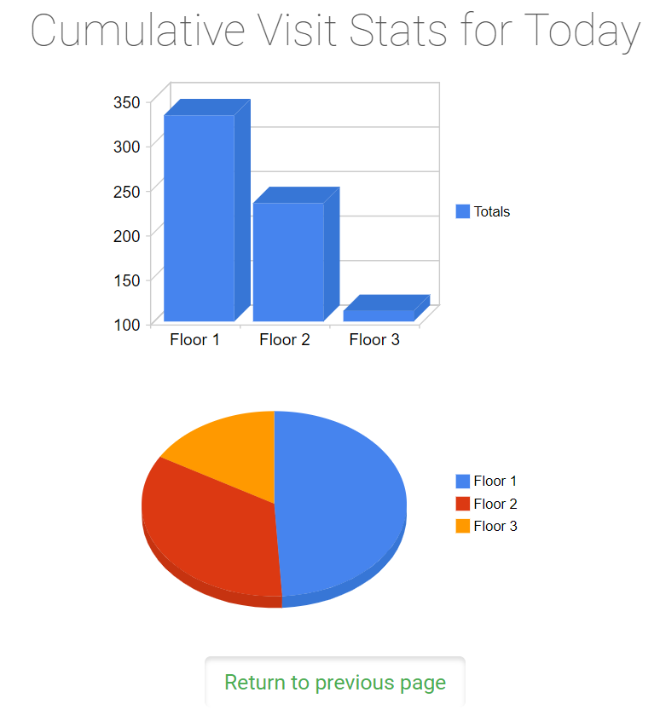

Slide 13
Career Benefits
Much of today’s computer science work is going to those who are knowledgeable in web service production. At the beginning of the semester, I had just begun to delve into Full Stack Web Development. This project aided me in learning new technologies that bolstered this interest. I spent many hours poring over PHP and MySQL, coordinating my web pages, and understanding how JavaScript played a part in Google Charts. I know that these will be important skills to have as I pursue my student and professional career.

Slide 14
References
https://www.w3schools.com/
https://www.tutorialspoint.com/php/php_mysql_login.htm
http://getbootstrap.com/docs/4.0/getting-started/introduction/
https://developers.google.com/chart/interactive/docs/quick_start

