Slide 1
RING ATTRACTOR NETWORKS · 2026
3D Spherical Ring Attractor Network for Aerial Target Tracking
Extending a 2D mean-field ring attractor network onto a sphere to represent full 3D heading on a Crazyflie drone.
PRESENTED BY
LAB / TEAM
DURATION
[Your Name]
[Research Group · Advisor]
[June – August 2025]
Notes:
Open with the project in one line: what problem, what platform, what you set out to do. Introduce yourself and the lab.

Slide 2
OVERVIEW
Agenda
01
The Network
Ring attractors and the move from 2D to 3D
02
Methods
Icosphere nodes, connection kernel, and dynamics
03
Results
Tracking, target selection, and benchmarks
04
Conclusions
Lessons learned and next steps
Notes:
Give the roadmap in ~20 seconds so the audience knows the shape of the talk.

Slide 3
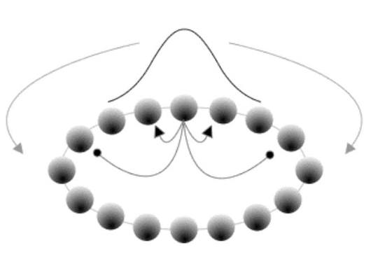
CONTEXT
Background & Motivation
A ring attractor network (RAN) is a recurrent network that forms a stable bump of activity which tracks a sensory direction.
In 2D, nodes lie on a ring and the network encodes a single heading angle.
A drone manoeuvring in 3D needs a full heading direction, not just a planar angle.
Goal: extend the 2D mean-field RAN onto the surface of a sphere for onboard heading tracking on a Crazyflie.
Notes:
State the gap plainly. The third bullet is where you name the specific problem you took on.

Slide 4
OBJECTIVES
Project Goals
01
02
03
Represent a full 3D heading direction as an activity bump on a spherical attractor.
Select one target via winner-take-all dynamics and track its direction accurately.
Observe and record flight data on real hardware, and optimize performance
Primary objective
Secondary objective
Performance target
Notes:
Three goals, no more. Make the primary one concrete and measurable.

Slide 5
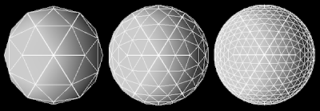
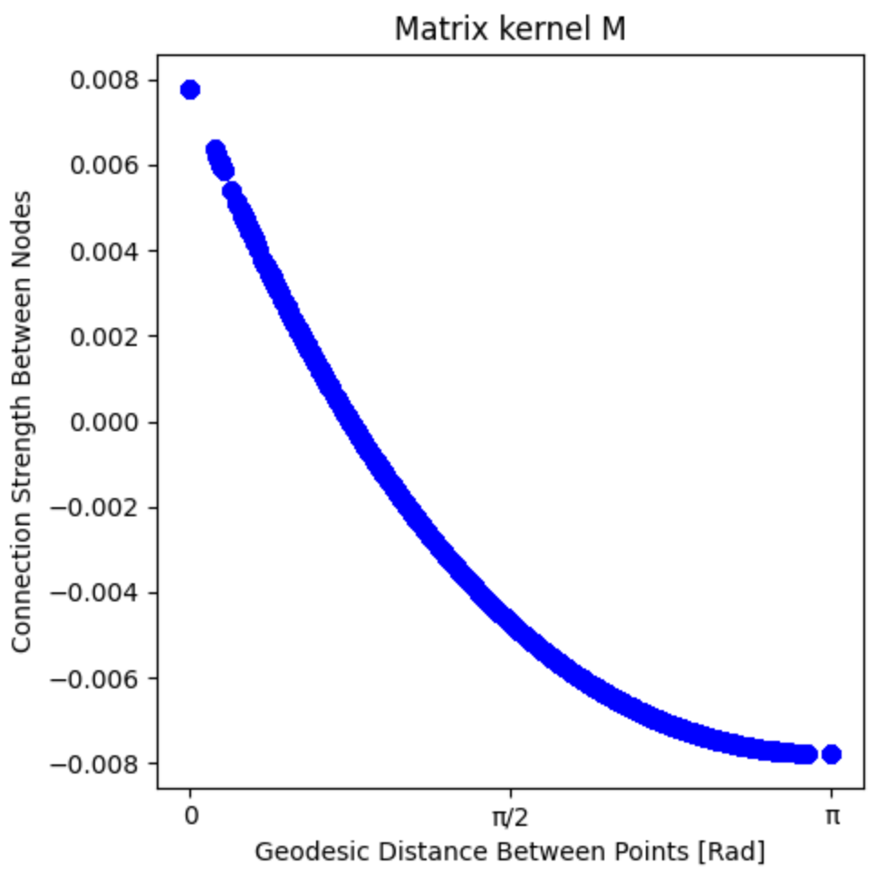
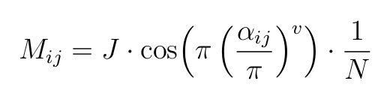
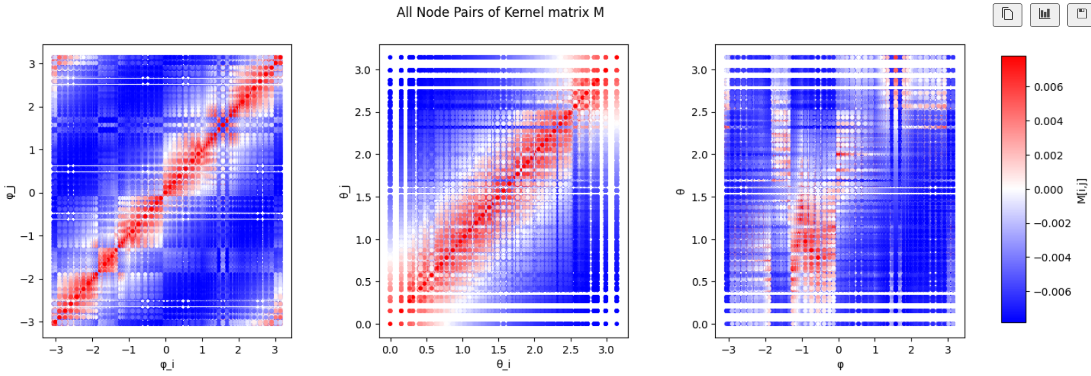
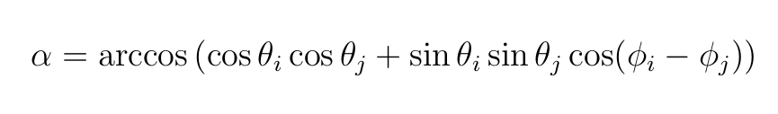
METHOD
Methodology
NODE PLACEMENT
Icosphere at subdivision level n gives N = 10·4ⁿ + 2 near-equidistant, antipodally symmetric nodes.
CONNECTION KERNEL
Mexican-hat kernel over geodesic distance: local excitation, global inhibition, normalized by 1/N.
Notes:
Walk left column top to bottom. Use the photo to show the actual hardware.

Slide 6
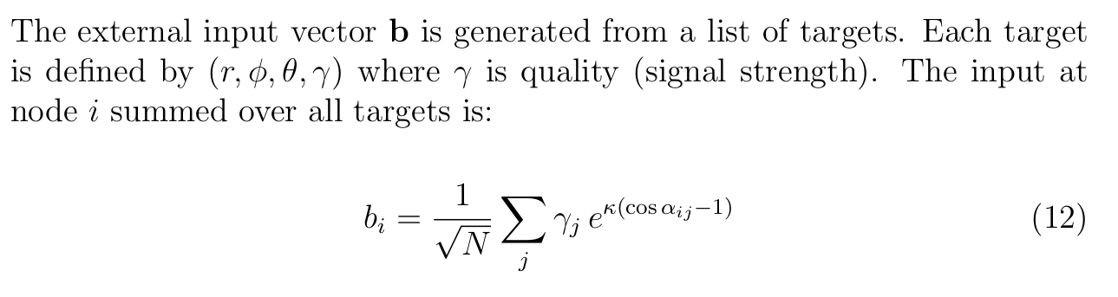
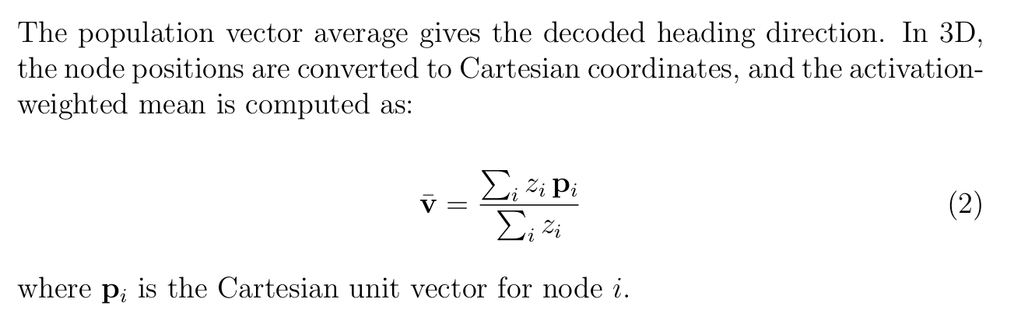
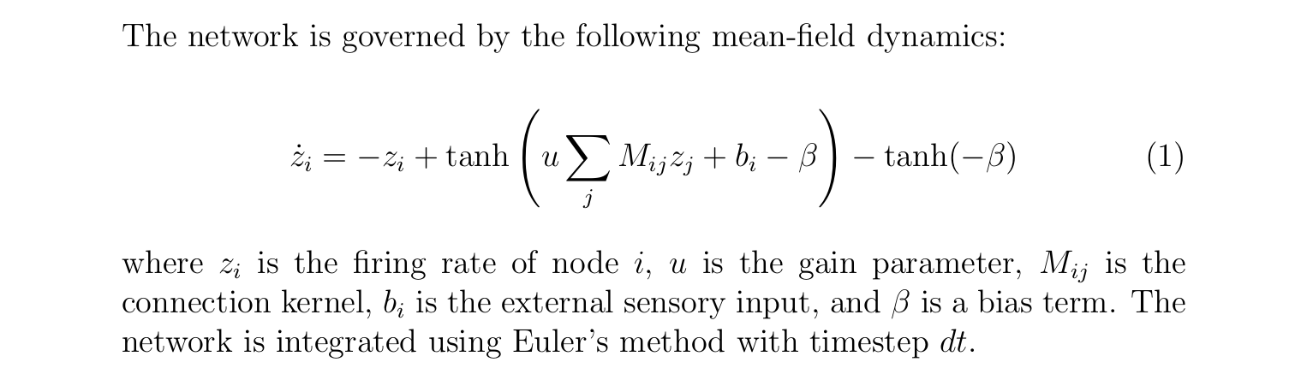
METHOD
Methodology
Sensory Input Generation
RAN Dynamics
Notes:
Walk left column top to bottom. Use the photo to show the actual hardware.

Slide 7
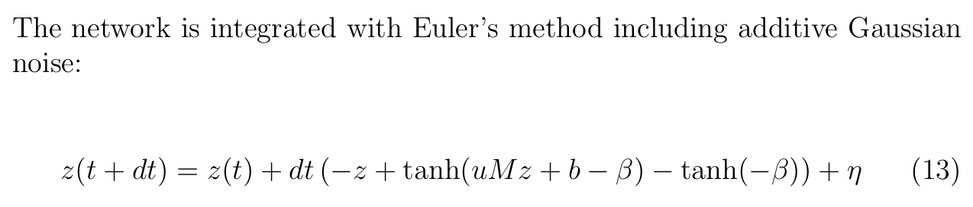
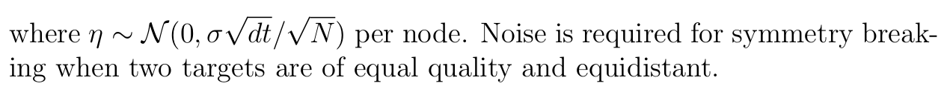
PIPELINE
From Sphere to Heading
STEP 01
STEP 02
STEP 03
Build the Sphere
Drive the Network
Read the Heading
Generate icosphere nodes
Compute geodesic distances
Build the connection kernel M
Inject sensory input from targets
Integrate the mean-field dynamics
Let a stable bump form
Decode the population vector
Sweep parameters (u, σ, κ, v, γ)
Benchmark real-time performance
Notes:
One sentence per month. This is the spine of the whole talk — keep it brisk.

Slide 8
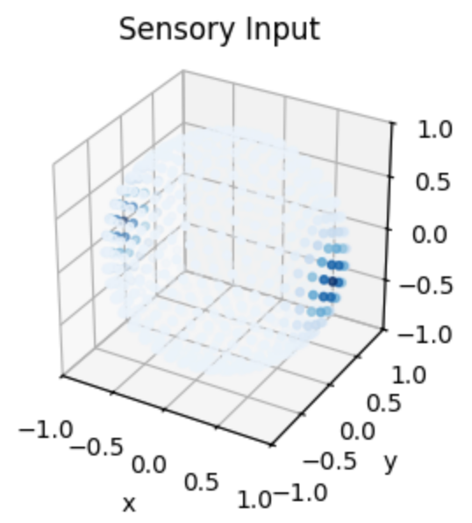
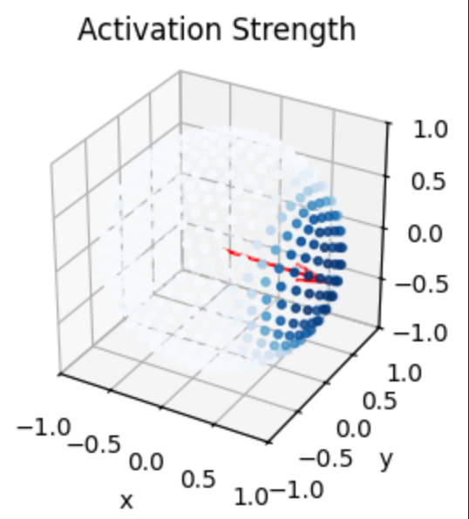
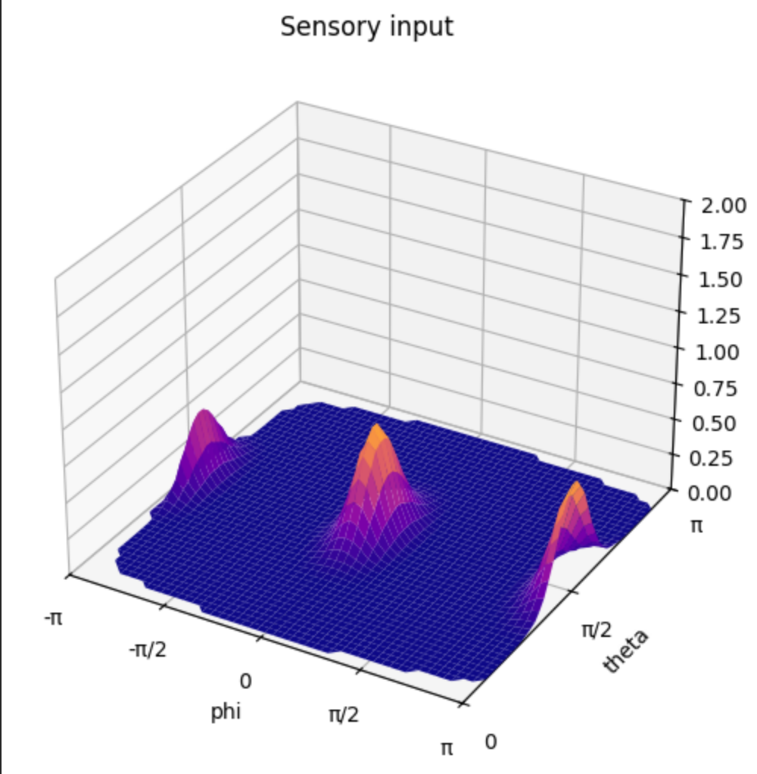
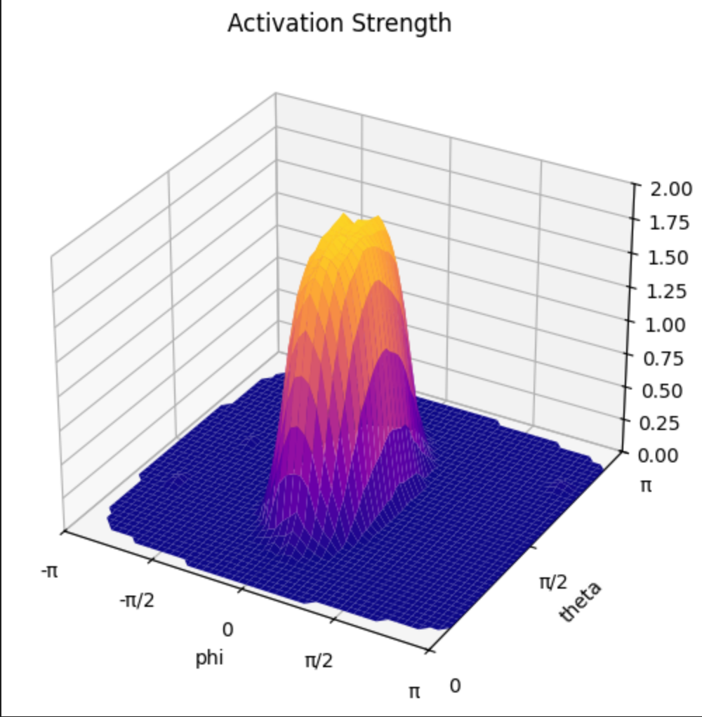
VISUALIZATION
Network Dynamics on the Sphere
Sensory input on the sphere
Activation bump + decoded heading (red)
Sensory input — φ / θ surface
Activation strength — φ / θ surface

Slide 9
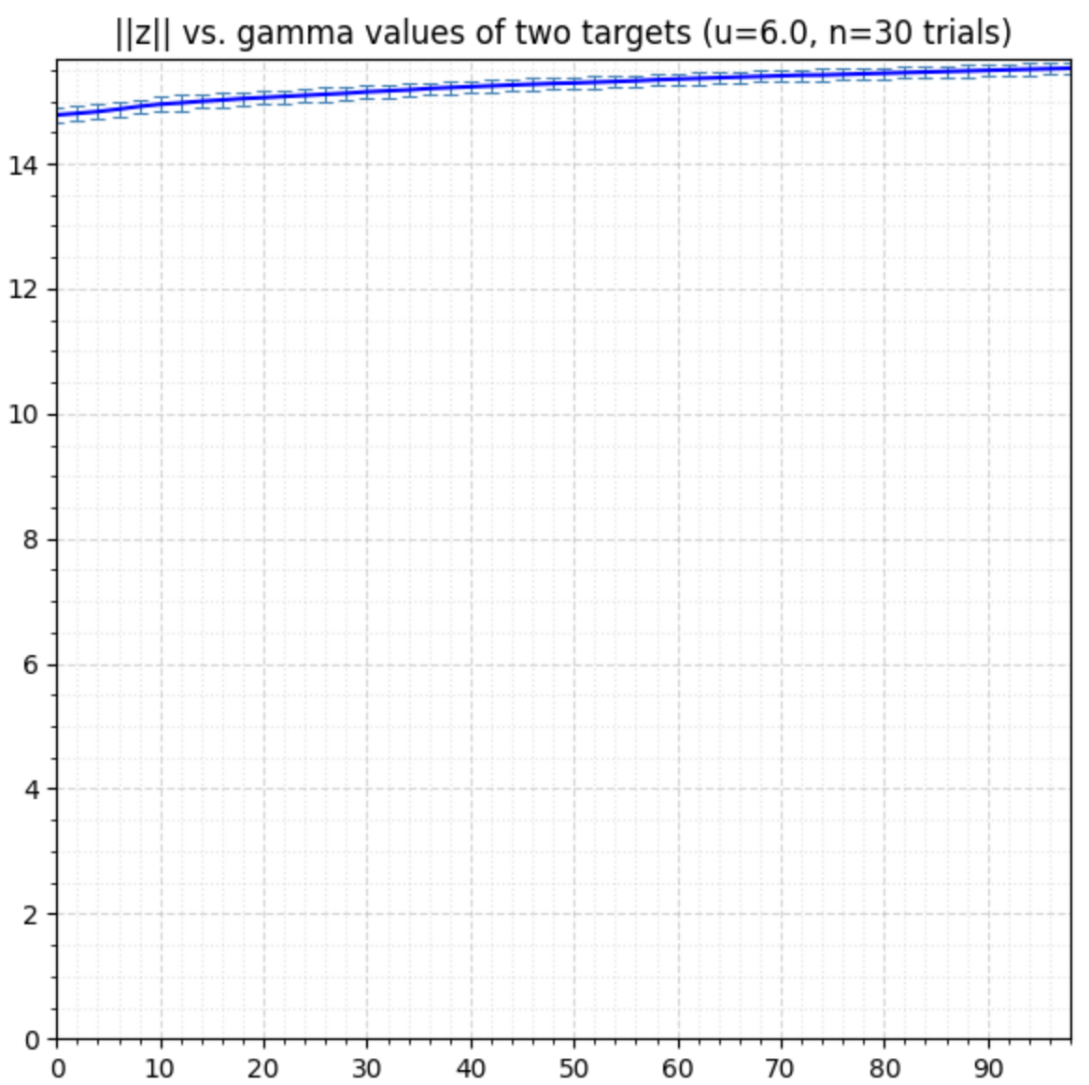
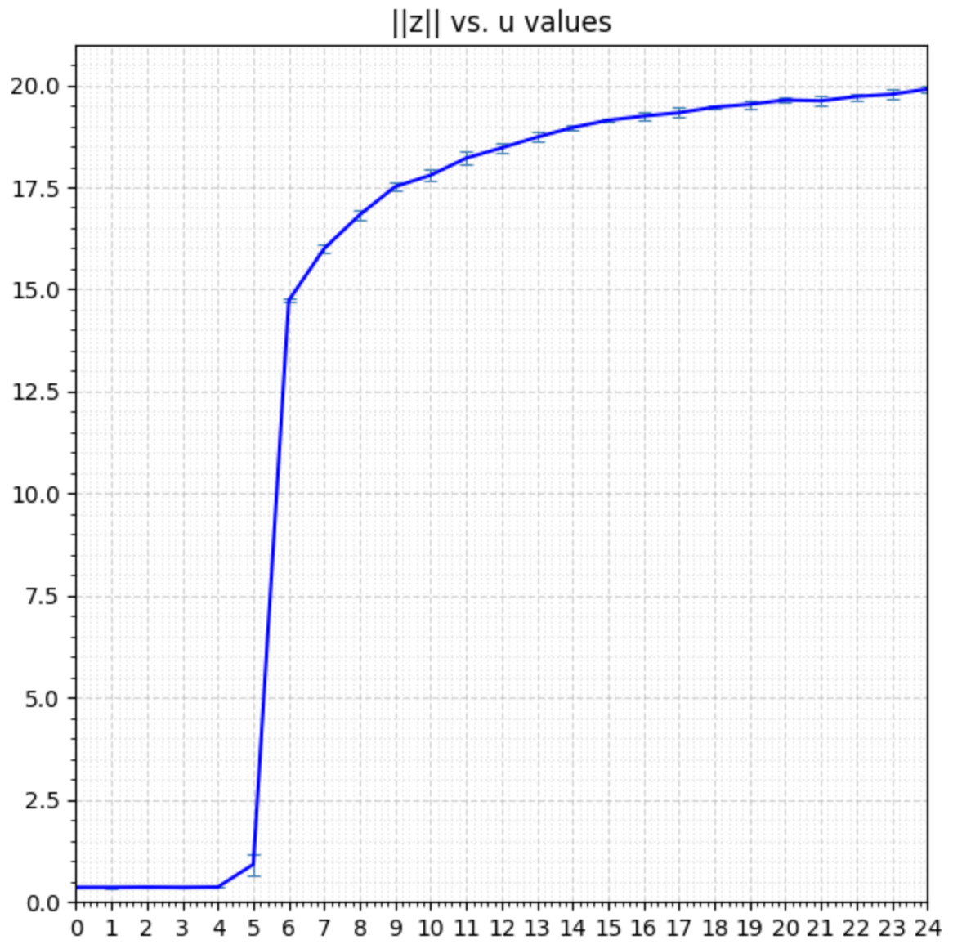
BY THE NUMBERS
Quantitative Results & Benchmarks

Slide 10
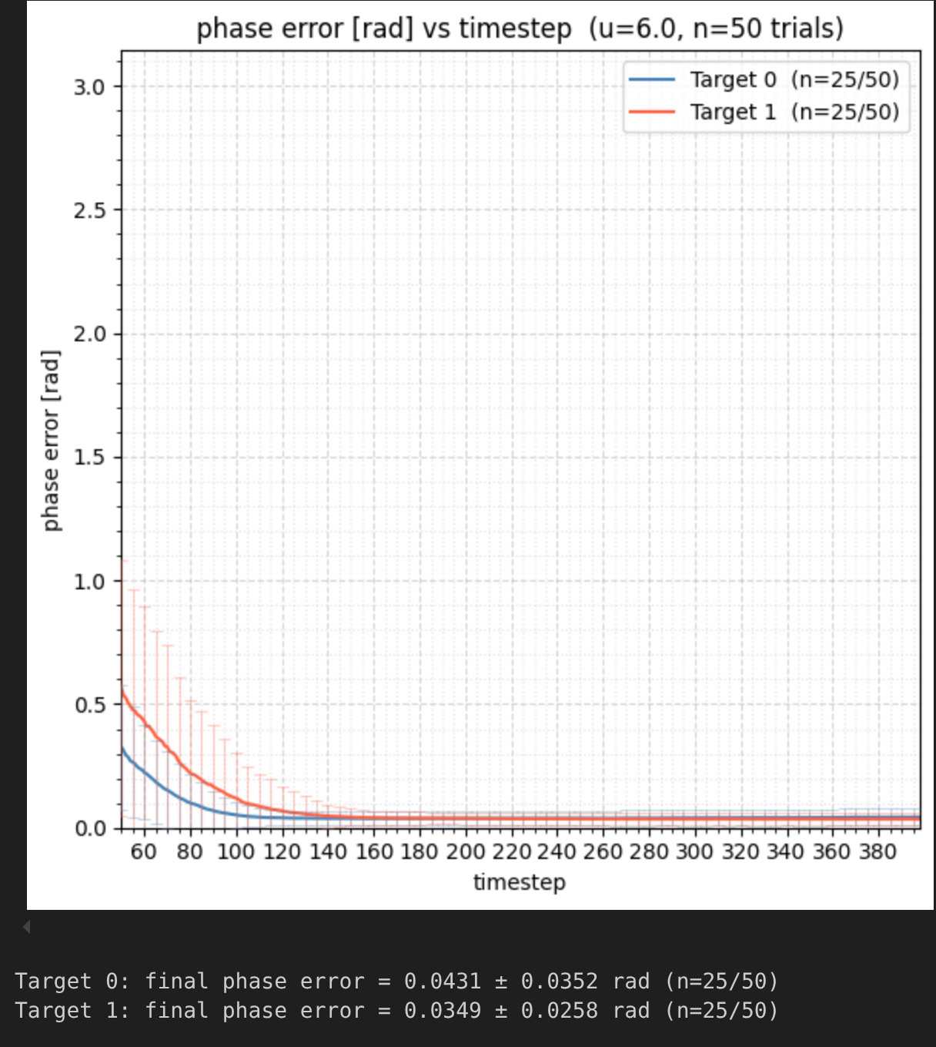
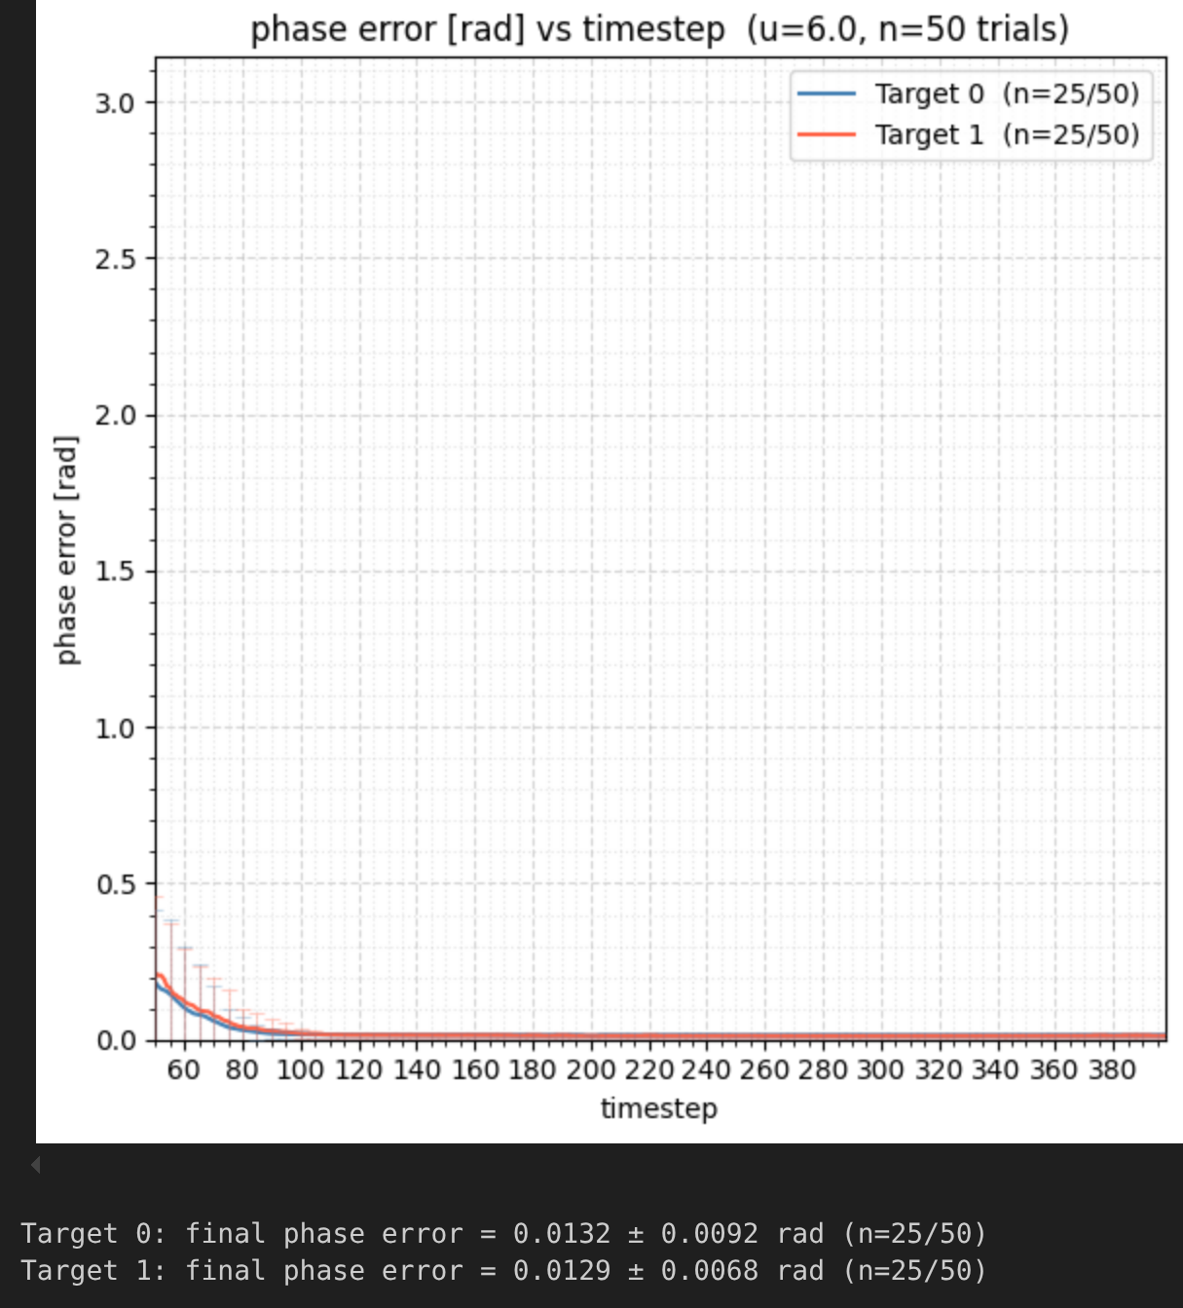
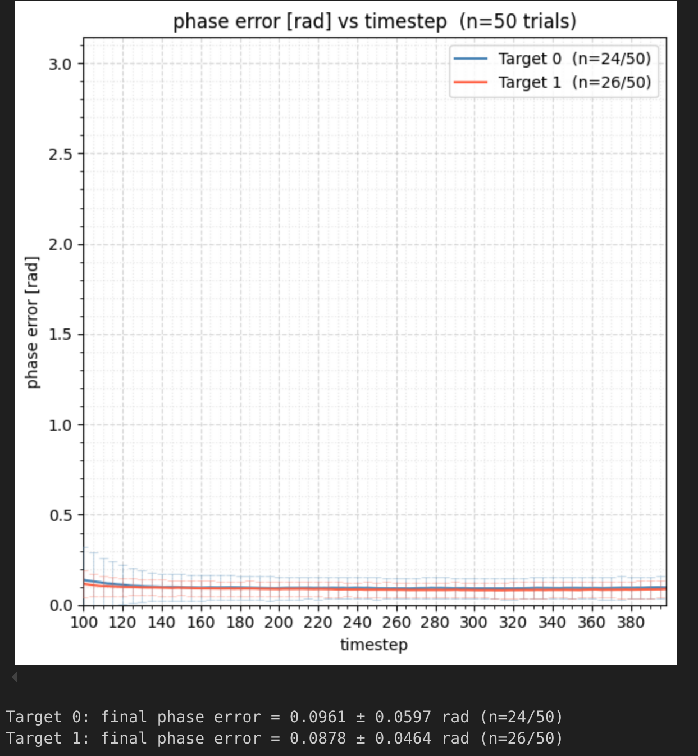
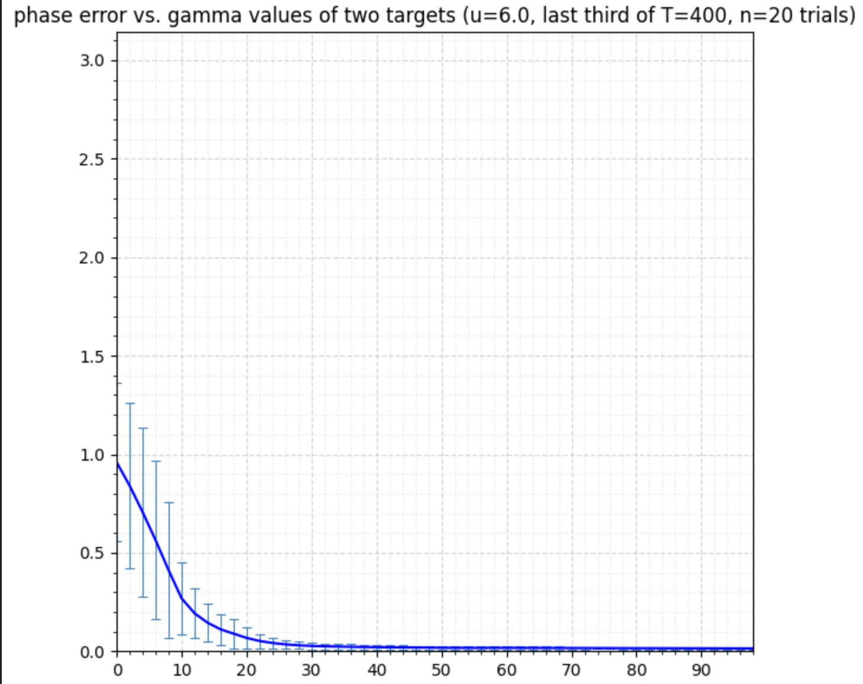
BY THE NUMBERS
Quantitative Results & Benchmarks
Phase error vs quality γ

Slide 11
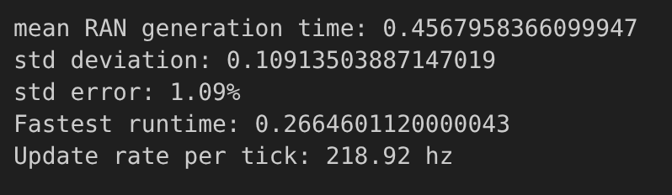
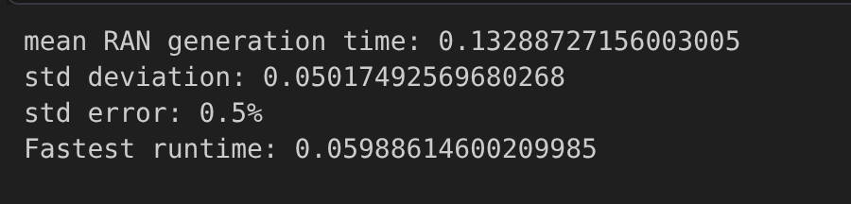
BY THE NUMBERS
Quantitative Results & Benchmarks
BENCHMARK — 400-step static RAN run, 100 trials

Slide 12
RING ATTRACTOR NETWORKS · 2026
Thank you
Questions & discussion
CONTACT
ACKNOWLEDGEMENTS
Noah Ginzburg · noah.ginzburg@gmail.com
Thanks to [Advisor], [Team], and [Lab] for their support.
Notes:
Thank your advisor and team by name. Invite questions.

Slide 13
REFLECTION
Challenges & Learnings
CHALLENGES
WHAT I LEARNED
Discretization bias: a target between nodes gets a wider sensory input bump and is selected over 50% of the time.
The icosphere gives the antipodal symmetry a uniform connection kernel needs.
Total integrated input over a target’s Voronoi region — not peak input — drives selection.
The 2D critical-gain formula u_crit = 1/(λ_max·sech²β) does not predict the 3D bifurcation.
Equalizing only the input peaks fails: bump shape matters too.
Kernel amplitude must be tuned and 1/N-normalized to keep behaviour stable across resolutions.
Notes:
Be honest about what was hard — it makes the learnings land. Pair each challenge with growth.

Slide 14
CONTRIBUTION
Impact & Contributions
A working 3D spherical RAN that decodes heading from a population vector on an icosphere.
Documentation of kernel design, critical-gain tuning, and real-time compute limits.
A parameter-sweep workflow for u, σ, κ, v, and target quality γ.
Notes:
What did the team gain that outlasts your internship? Concrete deliverables only.

Slide 15
LOOKING AHEAD
Next Steps & Recommendations
→
Resolve discretization bias using Voronoi-integrated input rather than peak input.
→
Derive a 3D critical-gain relation to replace the 2D formula.
→
Deploy the model on the Crazyflie and close the loop with live target input.
Notes:
End the body on momentum: what you'd do next and what you'd recommend the team pursue.

