Slide 1






Levels of Congruency
The mismatch across representational levels
Laura Cardós-Vicente, Noah Mba, Carlos González-García, Javier Ortiz-Tudela
Grant ID: 101161992_CONNECTS

Slide 2

What is a Prediction Error?
Context
Prior Knowledge
The human brain predicts likely occurrences in our environment based on past experiences
(Friston, 2010; Henson & Gagnepain, 2010)

Slide 3

What is a Prediction Error?
Context
Predicted Event
Prior Knowledge
The human brain predicts likely occurrences in our environment based on past experiences
(Friston, 2010; Henson & Gagnepain, 2010)
Expected Outcome
Highly probable
Congruent event occurs
Matches the built prediction.

Slide 4

What is a Prediction Error?
Context
Predicted Event
Unpredicted Event
Prior Knowledge
The human brain predicts likely occurrences in our environment based on past experiences
(Friston, 2010; Henson & Gagnepain, 2010)
Expected Outcome
Highly probable
Congruent event occurs
Matches the built prediction.
Prediction Error !
Unforeseen possibility
incongruent event occurs
Triggers a strong prediction error.

Slide 5
What is a Prediction Error?
Context
Predicted Event
Unpredicted Event
Prior Knowledge
The human brain predicts likely occurrences in our environment based on past experiences
(Friston, 2010; Henson & Gagnepain, 2010)
Expected Outcome
Highly probable
Congruent event occurs
Matches the built prediction.
Prediction Error !
Prediction Error !
Unforeseen possibility
Incongruent event occurs
Triggers a strong prediction error.
Functional Role: PEs are assumed to be useful to update and refine the brain’s model of the world to increase the accuracy of its predictions for the future (Kanai et al., 2015).

Slide 6
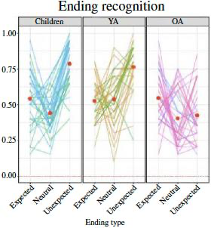
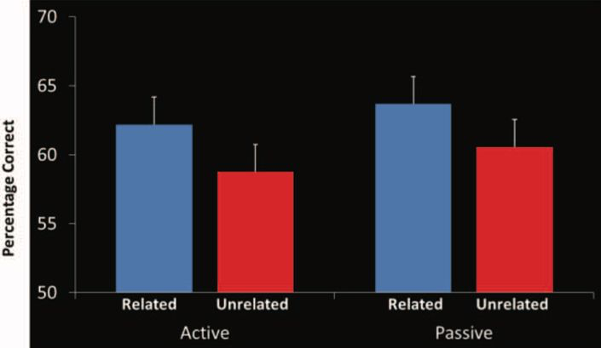
Previous literature
Prediction Errors
bookmark
Encoding benefit
psychology
Reinforcing Predictions
A lifespan shift: youth encode memories better via prediction errors, while older adults benefit from schema integration.
(Ortiz-Tudela et al., 2024)
Reinforcing predictions actively improves processing speed and performance accuracy within highly predictable environments.
(Brod & Shing, 2019; Gronau & Shachar, 2015; Ortiz-Tudela et al., 2017; Wynn et al., 2020)

Slide 7
Project Framework
There can be hierarchical levels
Hierarchical Prediction Errors
visibilityLow-level (Perceptual)
Violations of lower-level perceptual features of stimuli or basic visual dimensions, such as color..
psychologyHigh-level (Action Schemas)
Violations of complex, higher-level expectations or cognitive schemas.
Understand and anticipate actions.

Slide 8
Low-level (Perceptual)
High-level (Action Schemas)

Slide 9

Low-level (Perceptual)
High-level (Action Schemas)

Slide 10

Low-level (Perceptual)
High-level (Action Schemas)
Expectation

Slide 11

Low-level (Perceptual)
High-level (Action Schemas)
Reality
Expectation

Slide 12
Low-level (Perceptual)
High-level (Action Schemas)
Reality
Expectation
Expectation

Slide 13
Low-level (Perceptual)
High-level (Action Schemas)
Reality
Reality
Expectation
Expectation

Slide 14


PROJECT FRAMEWORK
The conceptual confusion
MEMORY MODELS
layers
Prediction Errors Literature
•Views PEs as a unitary phenomenon
•Simplifies the underlying cognitive processes.
Question further
we should bear in mind….
•Different levels of hierarchy are involved
•The processes are more complex and reflects a multi-layered structure.

Slide 15
RESEARCH QUESTION
helpe
Do PEs at different hierarchical levels lead to different memory consequences?

Slide 16
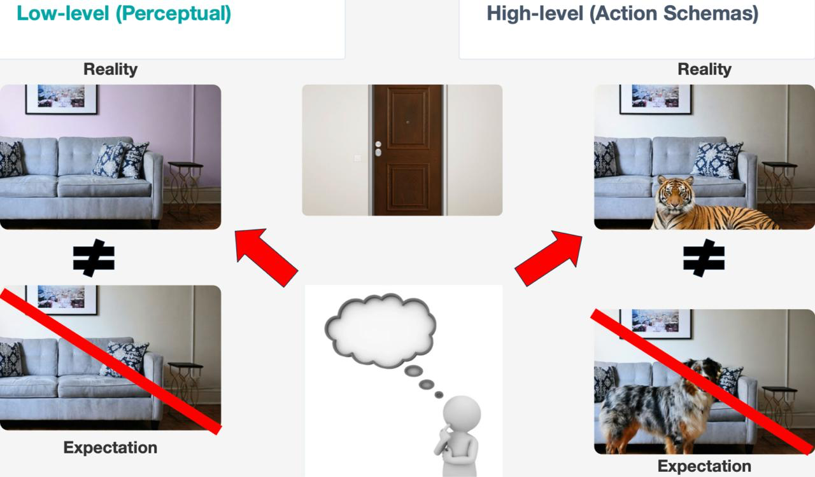
PROJECT FRAMEWORK
Reconceptualization
OWN NAMING FOR EACH →
CLEAR DIFFERENTIATION
Salience
Low-level predictions
Perceptual info. → basic visual dimensions, such as color.
UNPREDICTED STATE
Salient when unpredicted (PE)
PREDICTED STATE
Non-salient when predicted
Congruency
High-level predictions
Action schemas → understanding and anticipating actions.
UNPREDICTED STATE
Incongruent when unpredicted (PE)
PREDICTED STATE
Congruent when predicted

Slide 17
AIM OF THE STUDY
flag
MAIN OBJECTIVE
To investigate whether the effects of prediction errors (PE) on episodic memory generalize across different hierarchical levels of the visual system
Congruency
high lvl: story endings
Salience
low lvl: color patterns
similar memory boost?
HOW TO:
Congruency effects
Test the impact of Action Schema violations (unexpected story endings) on memory performance.
Salience effects
Test the impact of Perceptual Regularity violations (unexpected color patterns) on memory performance.
Interaction Analyses
To examine whether these two levels of prediction error influence and interact with each other to drive episodic memory retrieval

Slide 18
HYPOTHESIS
INTERACTION EFFECTS
Combined impact on retrieval
Determine whether these two types of prediction errors (congruency and saliency) influence and interact with each other to drive the retrieval
H0
Null Hypothesis
if there is no difference between how our brains treat different PEs, there are not going to be distinct effects in memory
H1
Alternative Hypothesis
If there is a difference between how our brains treat both PEs, there are going to be an interaction effect between them

Slide 19

STIMULI - COMIC STRIPS
Cue
Action
Ending
2000 ms
850 ms
850 ms
850 ms
2000 ms

Slide 20
STIMULI - COMIC STRIPS
Cue
Action
Ending
2000 ms
850 ms
850 ms
850 ms
2000 ms

Slide 21
STIMULI - COMIC STRIPS
Cue
Action
Ending
2000 ms
850 ms
850 ms
850 ms
2000 ms

Slide 22

STUDY DESIGN
Experimental Procedure
Comic strips + encoding task questions are presented
(64 trials)
ENCODING
Arithmetic questions
(5 min)
DISTRACTOR
Memory of comics strips is tested by 3 different memory tasks
(84 trials = 64 old + 20 new)
RETRIEVAL

Slide 23
STUDY DESIGN
Crossed 2x2 within-subjects design
Factor 1
Salience
Visual Feature: Color saturation is manipulated in the final frame.
Non-Salient: Color saturation follows the established visual progression.
Salient: The color pattern violates expectations.
Factor 2
Congruency
Story Ending: The flow of the story is manipulated at the final step.
Congruent: The narrative ending is expected and follows the schema.
Incongruent: The ending is unexpectedly interrupted.

Slide 24
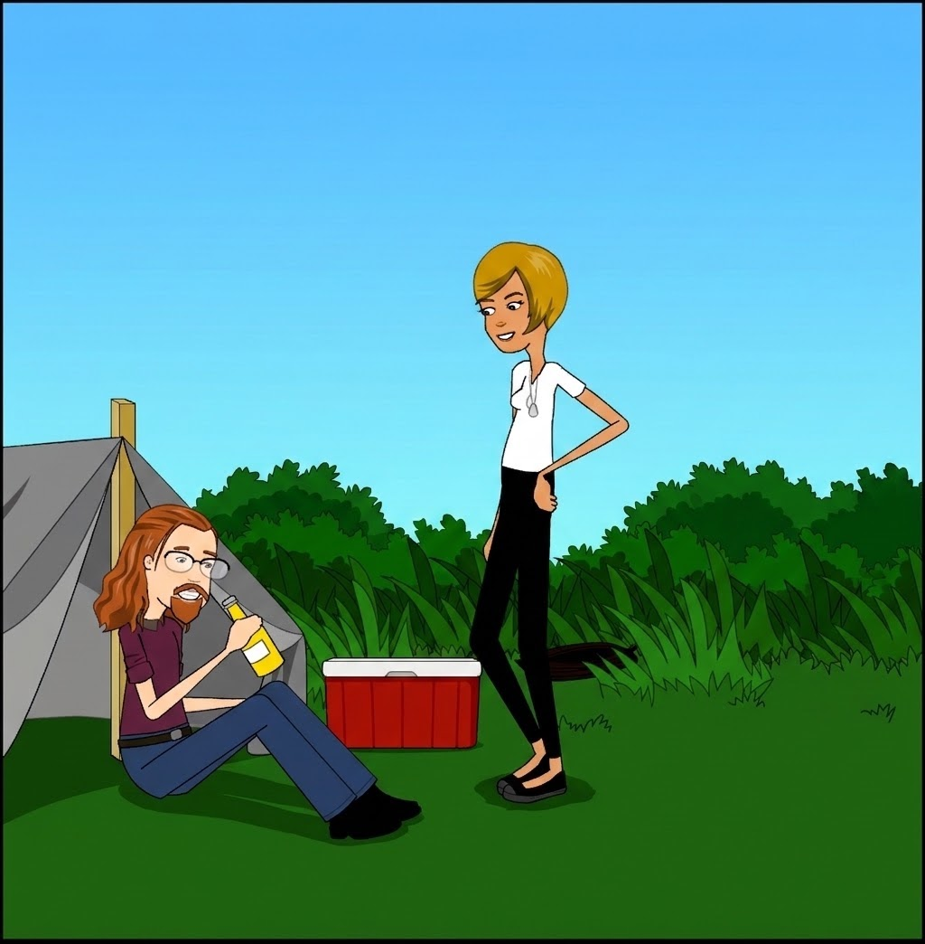


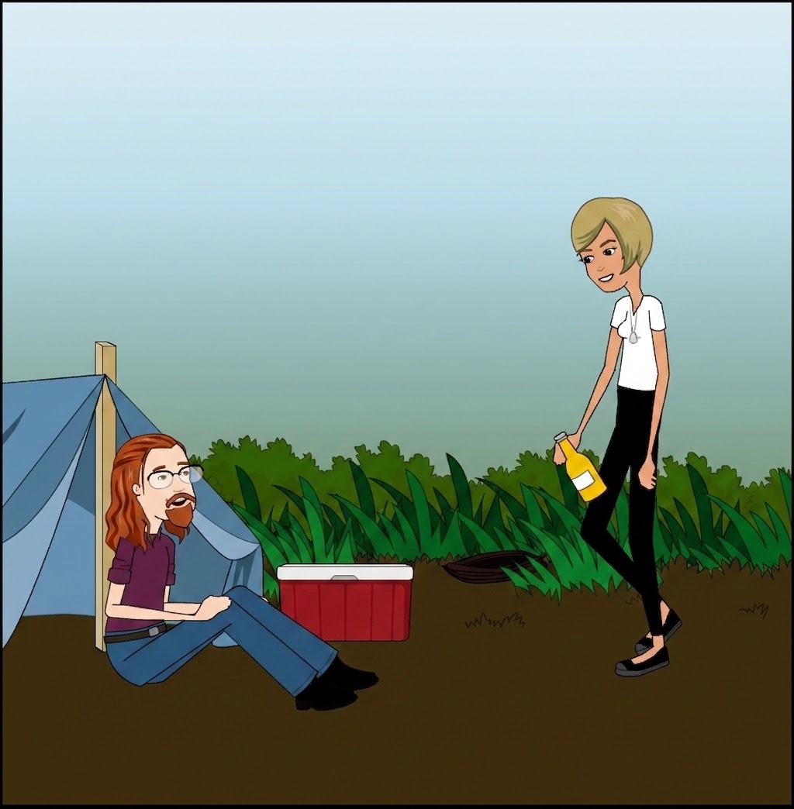
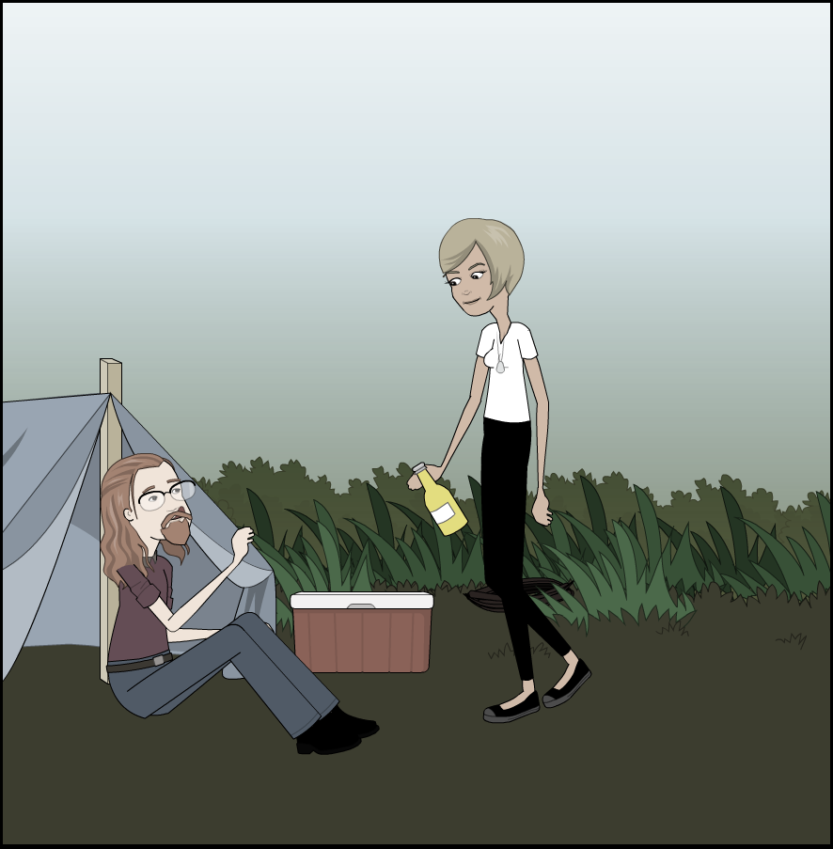
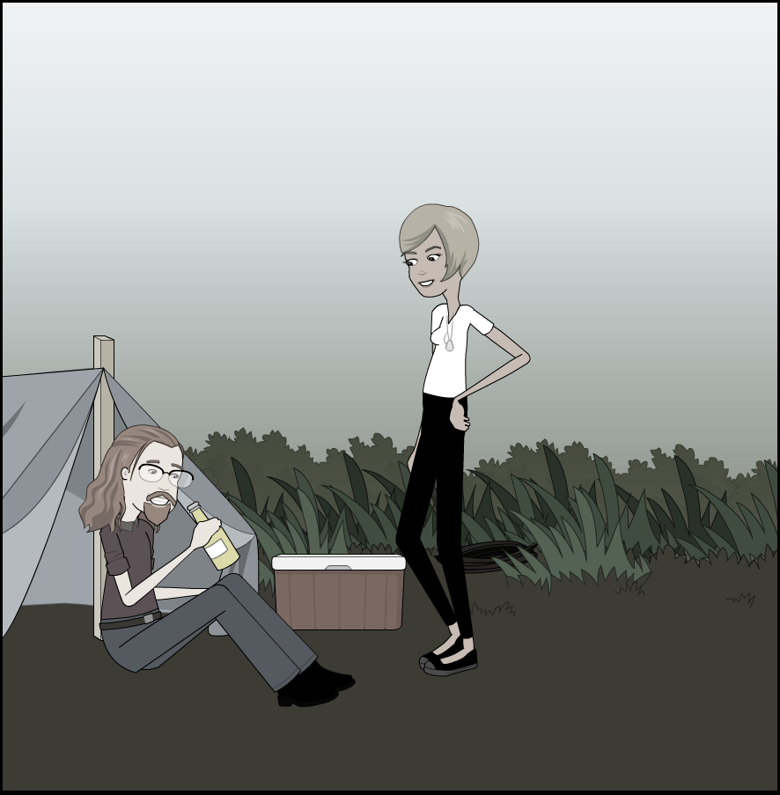
Encoding phase
Ending
Salience manipulation
Non-Salient
Predicted
Cue
Action
2000 ms
850 ms
850 ms
850 ms
Salient
Unpredicted
2000 ms
Notes:
Action sequences with two possible endings
Some more information about the comic strips: There are always two people interaction and passing an object (throwing/giving) from one to the other).
we utilized visual narratives in the form of comic strips, comprising a series of panels that depict an action unravelling over time. On the one hand, this format combines the advantages of discrete presentation with a temporal element, allowing for the controlled unfolding of events akin to videos, yet with greater precision in timing control (Ben-Yakov et al., 2022). On the other hand, unlike static images, these visual narratives naturally prompt the anticipation of future events, making them an ideal tool to manipulate PE and schema congruence. Additionally, visual narratives allow the use of content-rich and outside-the-lab-like stimuli which fosters engagement particularly at both ends of the lifespan continuum.

Slide 25
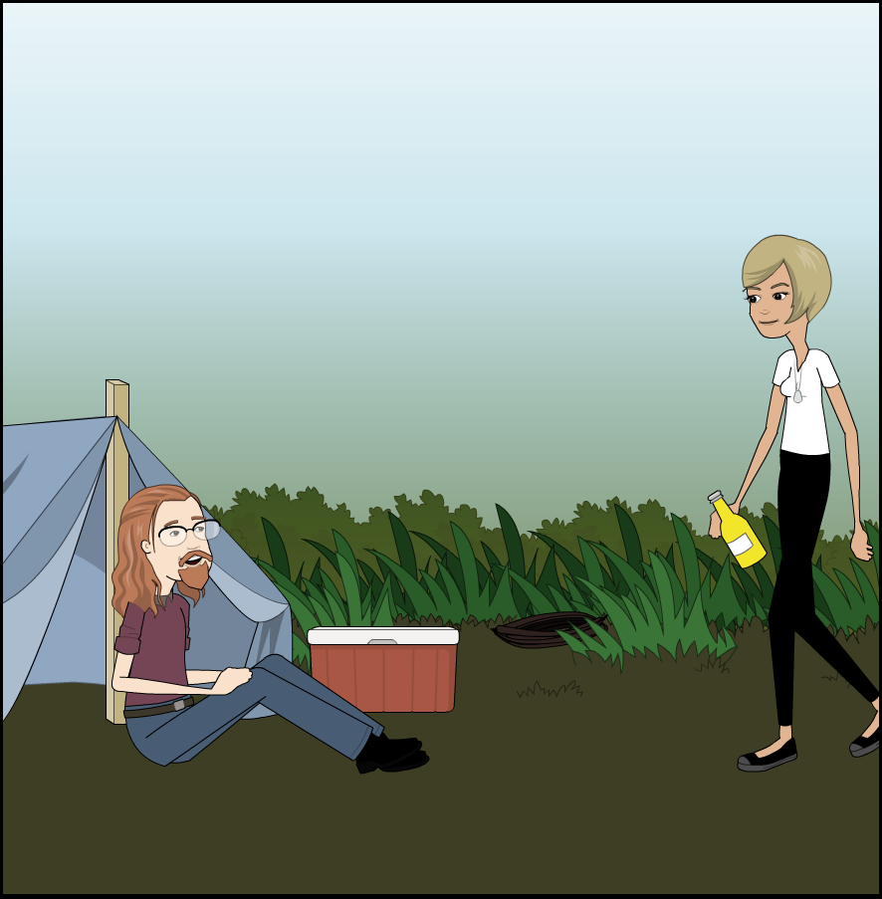
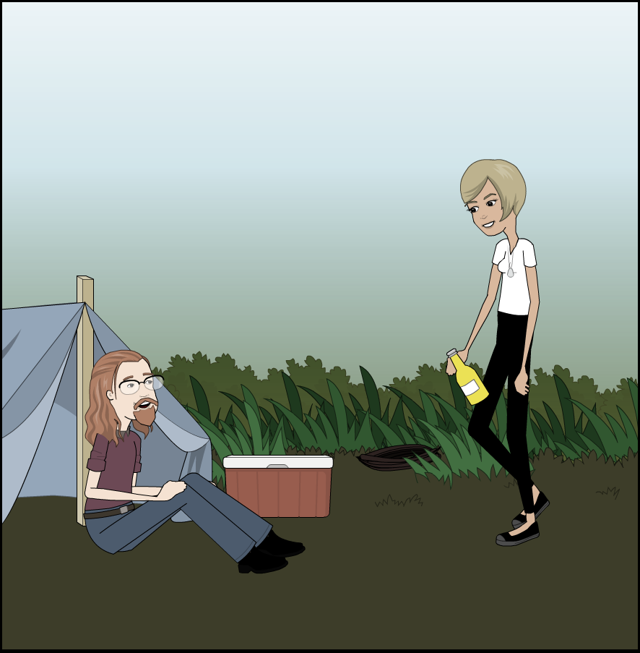

Encoding phase
Ending
Congruency manipulation
Congruent
Predicted
Cue
Action
2000 ms
850 ms
850 ms
850 ms
Incongruent
Unpredicted
2000 ms
Notes:
Action sequences with two possible endings
Some more information about the comic strips: There are always two people interaction and passing an object (throwing/giving) from one to the other).
we utilized visual narratives in the form of comic strips, comprising a series of panels that depict an action unravelling over time. On the one hand, this format combines the advantages of discrete presentation with a temporal element, allowing for the controlled unfolding of events akin to videos, yet with greater precision in timing control (Ben-Yakov et al., 2022). On the other hand, unlike static images, these visual narratives naturally prompt the anticipation of future events, making them an ideal tool to manipulate PE and schema congruence. Additionally, visual narratives allow the use of content-rich and outside-the-lab-like stimuli which fosters engagement particularly at both ends of the lifespan continuum.

Slide 26
Encoding phase
Ending
Salience manipulation
Non-Salient
Predicted
Cue
Action
2000 ms
850 ms
850 ms
850 ms
Salient
Unpredicted
2000 ms
Notes:
Action sequences with two possible endings
Some more information about the comic strips: There are always two people interaction and passing an object (throwing/giving) from one to the other).
we utilized visual narratives in the form of comic strips, comprising a series of panels that depict an action unravelling over time. On the one hand, this format combines the advantages of discrete presentation with a temporal element, allowing for the controlled unfolding of events akin to videos, yet with greater precision in timing control (Ben-Yakov et al., 2022). On the other hand, unlike static images, these visual narratives naturally prompt the anticipation of future events, making them an ideal tool to manipulate PE and schema congruence. Additionally, visual narratives allow the use of content-rich and outside-the-lab-like stimuli which fosters engagement particularly at both ends of the lifespan continuum.

Slide 27
Encoding phase
Ending
Salience manipulation
Salient
Predicted
Cue
Action
2000 ms
850 ms
850 ms
850 ms
Non-Salient
Unpredicted
2000 ms
Notes:
Action sequences with two possible endings
Some more information about the comic strips: There are always two people interaction and passing an object (throwing/giving) from one to the other).
we utilized visual narratives in the form of comic strips, comprising a series of panels that depict an action unravelling over time. On the one hand, this format combines the advantages of discrete presentation with a temporal element, allowing for the controlled unfolding of events akin to videos, yet with greater precision in timing control (Ben-Yakov et al., 2022). On the other hand, unlike static images, these visual narratives naturally prompt the anticipation of future events, making them an ideal tool to manipulate PE and schema congruence. Additionally, visual narratives allow the use of content-rich and outside-the-lab-like stimuli which fosters engagement particularly at both ends of the lifespan continuum.

Slide 28
Encoding phase
Ending
two directi in Salience manipulation
Non-Salient
Predicted
Cue
Action
Salient
Unpredicted
2000 ms
850 ms
850 ms
850 ms
Salient
Unpredicted
Non-Salient
Predicted
2000 ms
Notes:
Action sequences with two possible endings
Some more information about the comic strips: There are always two people interaction and passing an object (throwing/giving) from one to the other).
we utilized visual narratives in the form of comic strips, comprising a series of panels that depict an action unravelling over time. On the one hand, this format combines the advantages of discrete presentation with a temporal element, allowing for the controlled unfolding of events akin to videos, yet with greater precision in timing control (Ben-Yakov et al., 2022). On the other hand, unlike static images, these visual narratives naturally prompt the anticipation of future events, making them an ideal tool to manipulate PE and schema congruence. Additionally, visual narratives allow the use of content-rich and outside-the-lab-like stimuli which fosters engagement particularly at both ends of the lifespan continuum.

Slide 29

Encoding phase
C
I
NS
S
Congruent
Incongruent
Non-Salient
Salient
Labels
2x2 within-subjects design
Possible endings
C
I
Cue
Action
NS
S
64 different comics
Equal proportion of all endings
Notes:
Participants see each comic strip only once. It belongs to one of four condition cells.

Slide 30
Encoding phase
Encoding task
2 RANDOMIZED ENCODING QUESTIONS AS ATTENTIONAL CHECKS
QUESTION A
NARRATIVE CHECK
QUESTION B
PERCEPTUAL CHECK
Did the object reach its intended recipient?
Was the last panel colorized?
Yes
No
Yes
No

Slide 31
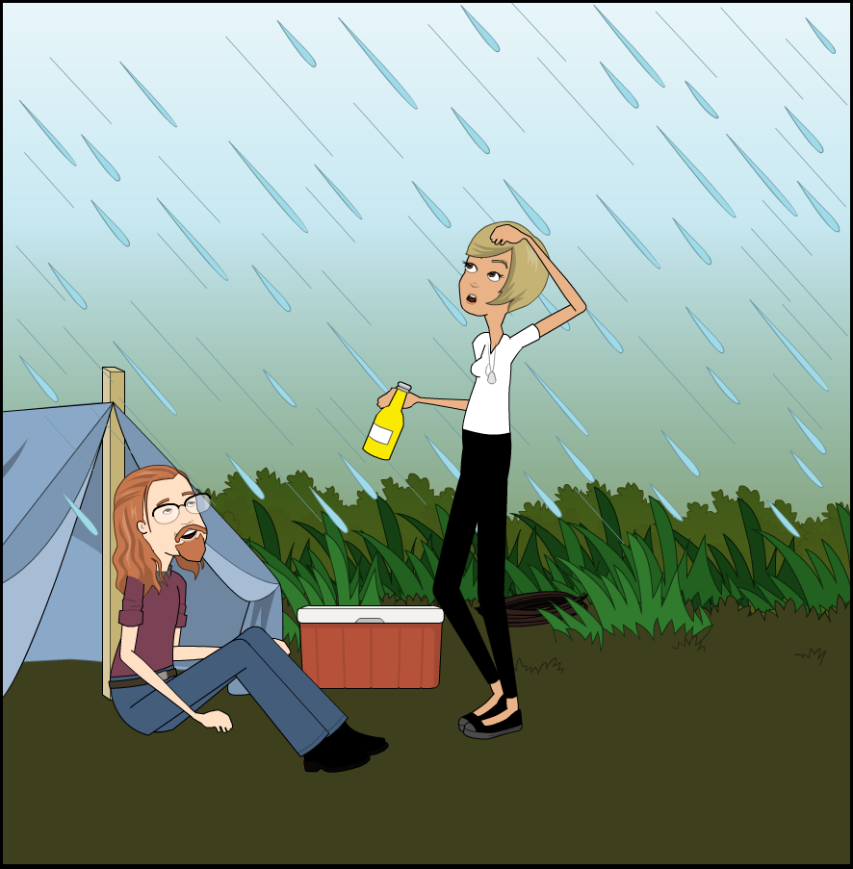
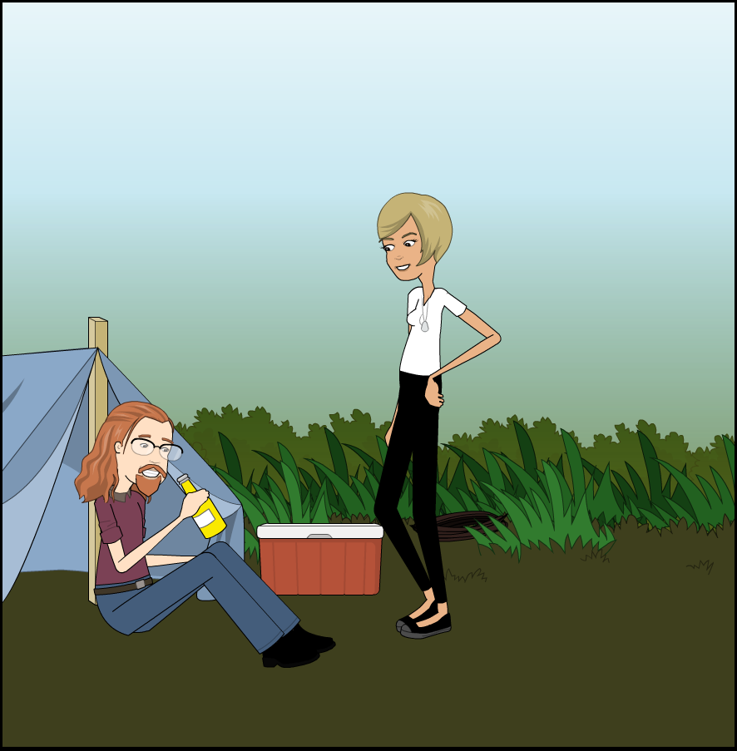
Retrieval phase
Trial structure
1. Cue recognition
2. Outcome memory
3. Ending recognition
How did the story end?
Have you seen this story before?
Did something unexpected happen?
1
2
3
4
Yes
No
Yes
No

Slide 32
Retrieval phase
Trial structure
1. Cue recognition
2. Outcome memory
3. Ending recognition
How did the story end?
Have you seen this story before?
Did something unexpected happen?
1
2
3
4
Yes
No
Yes
No

Slide 33
Retrieval phase
Trial structure
1. Cue recognition
2. Outcome memory
3. Ending recognition
How did the story end?
Have you seen this story before?
Did something unexpected happen?
1
2
3
4
Yes
No
Yes
No

Slide 34

Exclusion Criteria Rules
Encoding Performance: Accuracy < 90% on attentional check questions.
Retrieval Performance: Memory sensitivity (d′) below a dynamic threshold (5,000 permutations) for cue recognition
.
RESULTS
Performance-Based Exclusion
Initial Sample
41
participants
Screening criteria inclusion:
Right-handedness
Absence of neurological/psychiatric history
Absence of psychoactive substances
Excluded
16
participants
Encoding Performance-1
Retrieval Performance-14
Both Criteria-1
Final Sample
25
participants to analyze

Slide 35
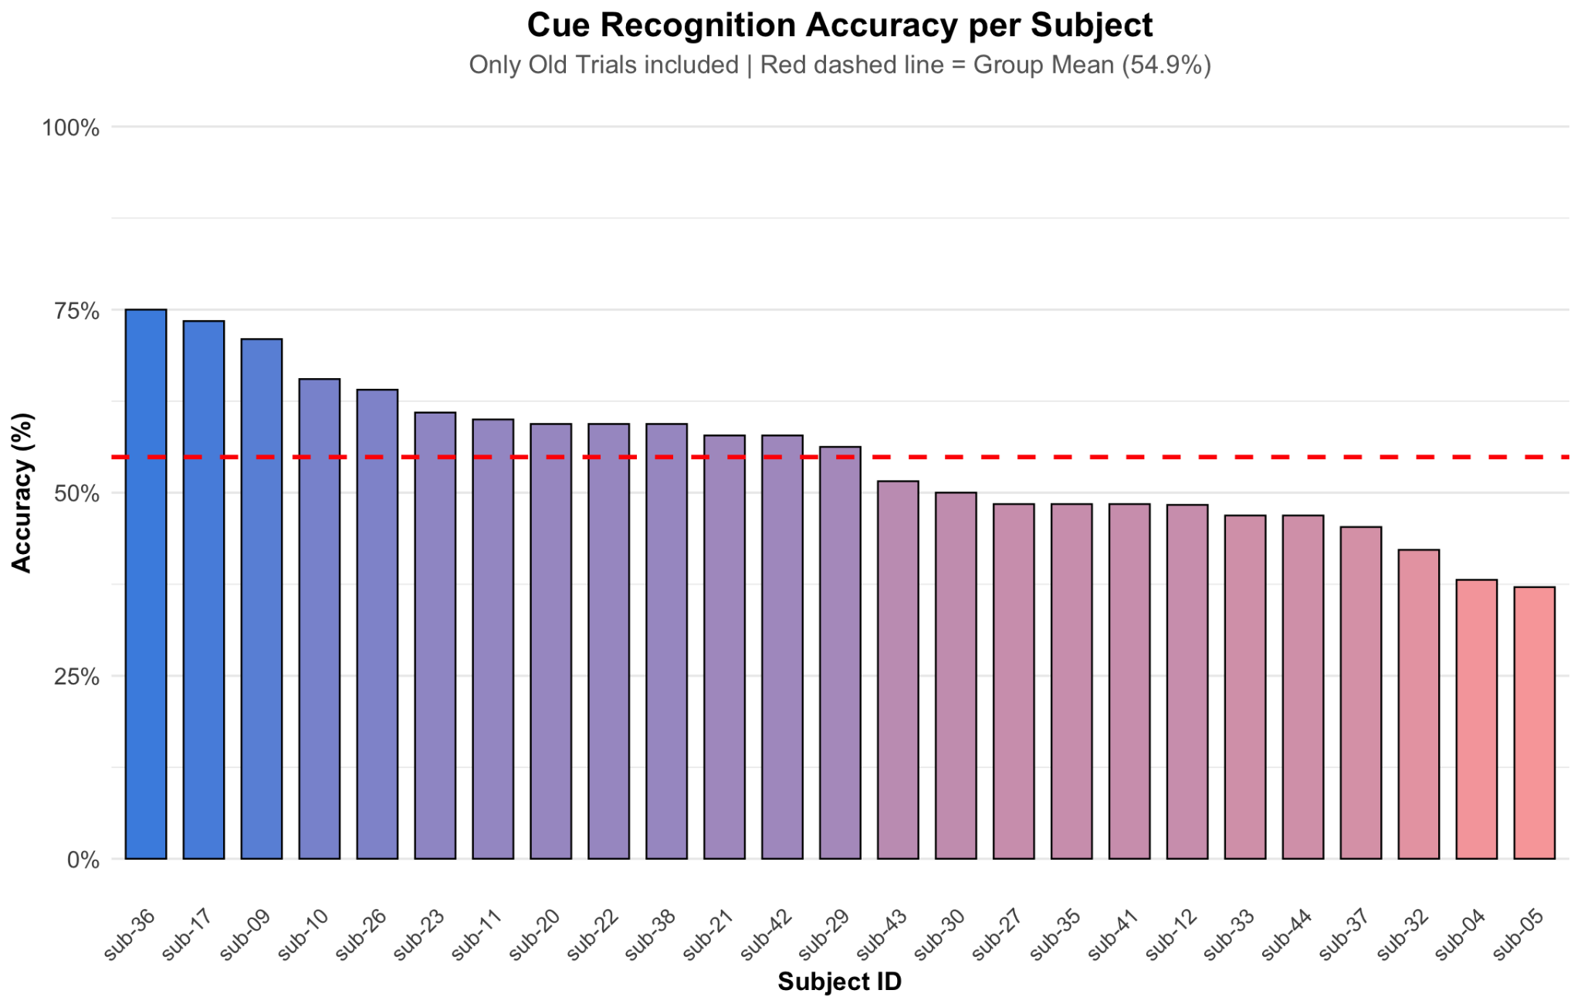
RESULTS
Performance-Based Exclusion
Overall Cue Recognition
Exclusion Criteria Rules
Encoding Performance
Accuracy < 90% on attentional check questions.
Retrieval Performance
Memory sensitivity (d′) below a dynamic threshold (5,000 permutations) for cue recognition.
Initial Sample: n = 41 participants
Final Sample: n = 25 participants (16 excluded)
ACCURACY MEAN
54.86%
SD: 0.10
STUDENT'S T-TEST
t(24) = 2.37
p = 0.01
EFFECT SIZE
d = 0.47
M(d′) = 0.94

Slide 36
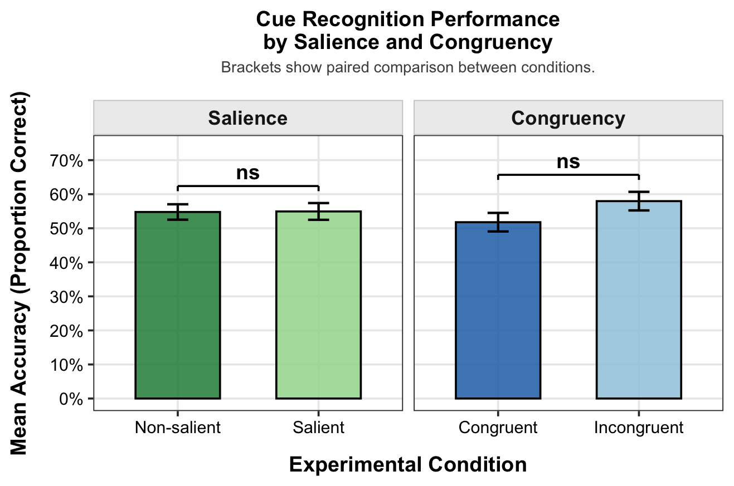
RESULTS
1. Cue recognition
CUE RECOGNITION
T-test performance
Have you seen this story before?
Yes
No
Notes:
Starting with cue recognition, the first memory task.
First, we computed the overall d’ of the group and tested it against 0. They showed an overall performance above chance, confirming that participants were capable of doing the memory task.
Then, we can look into whether our manipulation influenced memory for the first panel. There are no statistically significant differences between any of conditions. Incongruent stories are slightly better recognized than congruent ones (but we only obtained inconclusive bayesian evidence) while the performance in the perceptual level stays exactly the same, regardless of the salience level (with moderate evidence for the lack of an effect here).
We also ran an interaction test and the Bayes Factor confirmed that the factors didn’t influence each other.

Slide 37
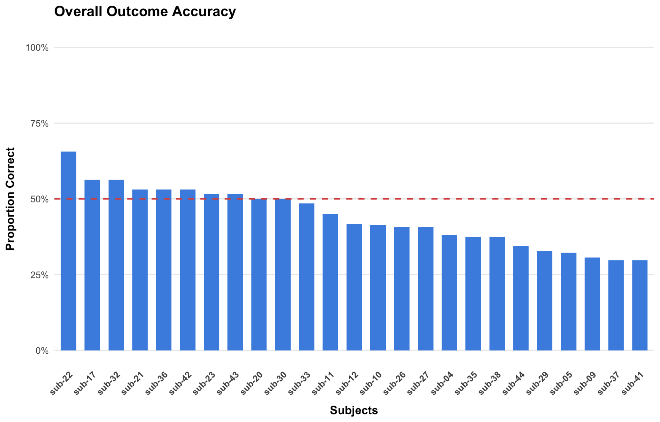
RESULTS
1. Cue recognition
2. Outcome memory
3. Ending recognition
OUTCOME MEMORY
How did the story end?
Performance overall
Have you seen this story before?
Did something unexpected happen?
1
2
3
4
Yes
No
Yes
No
STATISTICS
Group Descriptives
Mean: 44.04% (0.4404)
Standard Deviation: 0.0984
Student's t-test
t-statistic: -3.0315
Degrees of freedom (df): 24
p-value: 0.9971
Effect size (d): -0.6063
NOT SIGNIFICANTLY ABOVE CHANCE
Notes:
About the second memory task, which is Outcome memory, participants didn’t show above chance performance, so I’m not going to stop too much here.

Slide 38
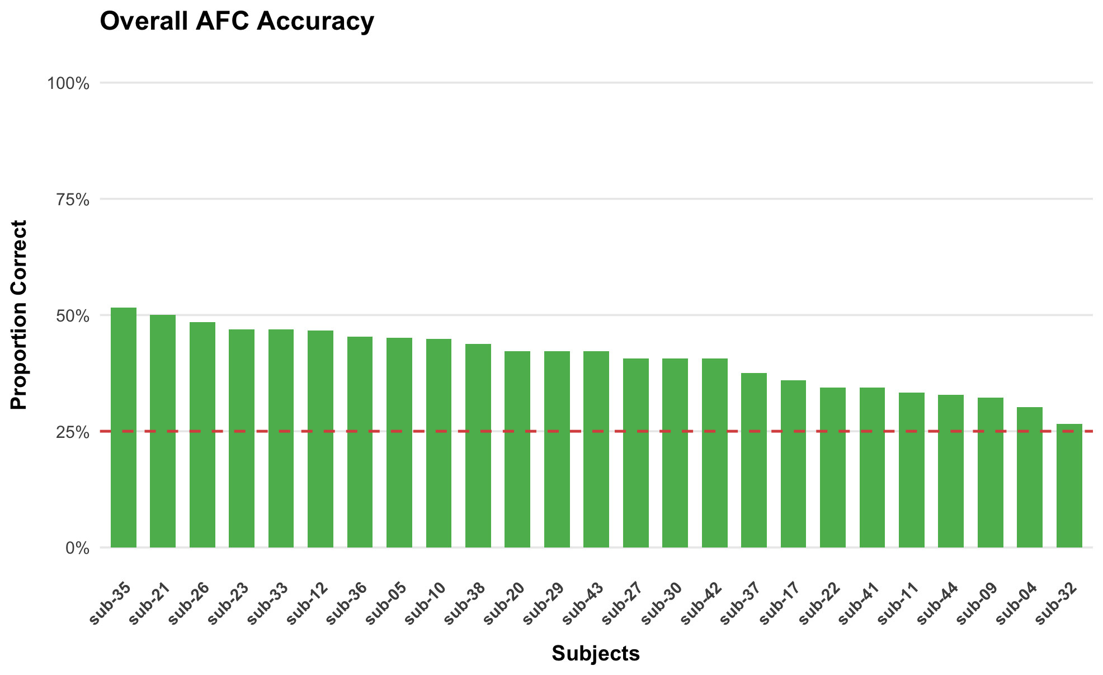
RESULTS
OVERALL
M: 40.61% SD: 0.07
t: 11.73 df: 24
p < 0.01
d: 2.35
1. Cue recognition
3. Ending recognition
ENDING RECOGNITION
How did the story end?
T-test performance
Have you seen this story before?
1
2
3
4
Yes
No
Notes:
Now, we move on to the ending recognition task, where participants needed to choose which ending they had actually seen during encoding in a 4 AFC test.
First of all, we checked that participants performed well above chance in overall accuracy for this test.
Then, we split performance by each factor, we observed a significant difference between the conditions of congruency, finding, in fact, a congruency benefit. On the other hand, there is no significant difference between conditions in Salience and there is even below chance performance in the salient condition.
The stars above the bars denote significant differences in a individual test against chance level for each condition.
In general, it also shows that the performance in Congruency is way more accurate than in Salience: in other words, participants remembered better the ending of the story than the color in which they saw it.

Slide 39
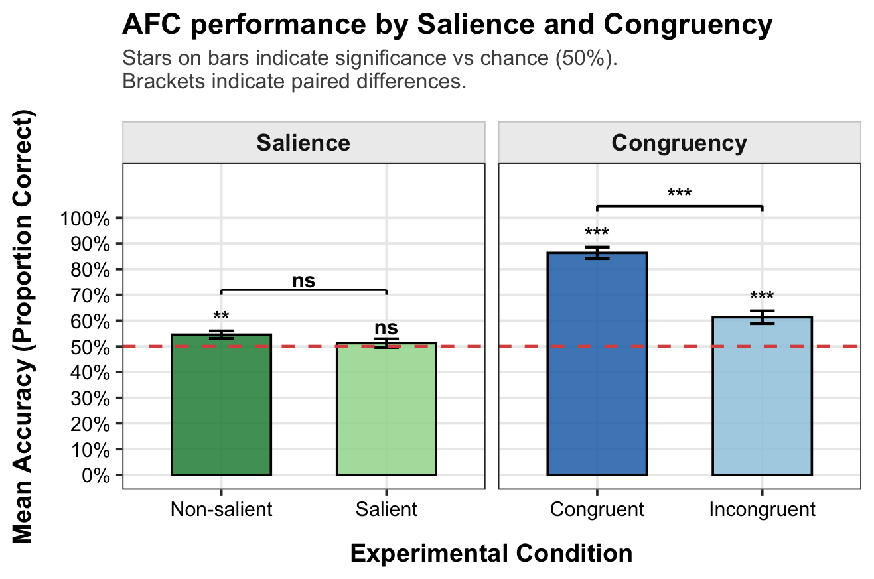
RESULTS
OVERALL
M: 40.61% SD: 0.07
t: 11.73 df: 24
p < 0.01
d: 2.35
1. Cue recognition
3. Ending recognition
ENDING RECOGNITION
How did the story end?
T-test performance
Have you seen this story before?
1
2
3
4
Yes
No
The stars above the bars denote significant differences in an individual test against chance level for each condition
Notes:
Now, we move on to the ending recognition task, where participants needed to choose which ending they had actually seen during encoding in a 4 AFC test.
First of all, we checked that participants performed well above chance in overall accuracy for this test.
Then, we split performance by each factor, we observed a significant difference between the conditions of congruency, finding, in fact, a congruency benefit. On the other hand, there is no significant difference between conditions in Salience and there is even below chance performance in the salient condition.
The stars above the bars denote significant differences in a individual test against chance level for each condition.
In general, it also shows that the performance in Congruency is way more accurate than in Salience: in other words, participants remembered better the ending of the story than the color in which they saw it.

Slide 40
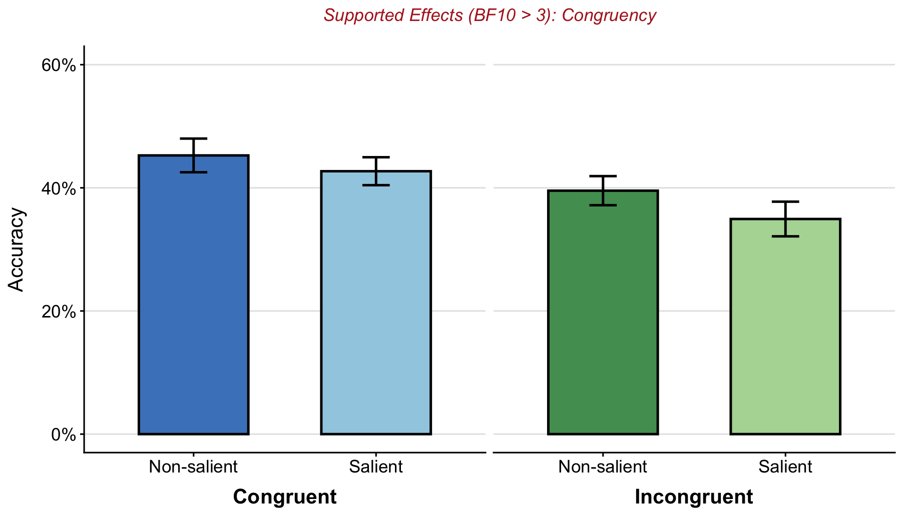
RESULTS
1. Cue recognition
3. Ending recognition
BF₁₀ : How many times more likely the data is if the effect actually exists (H₁) rather than not (H₀)
ENDING RECOGNITION
How did the story end?
Bayesian ANOVA 2X2 Repeated Measures
Have you seen this story before?
1
2
3
4
Yes
No
Effect | BF
Congruency | BF10 6.73
Salience | BF10 0.55
Interaction | BF10 0.32
WHAT WE FIND HERE
Strong evidence for Congruency effect
Moderate evidence against an Interaction Model
Inconclusive for Salience effect
Notes:
Looking deeper into ending recognition, we checked for an interaction in a Bayesian ANOVA, where there was only enough evidence of main effect for Congruency.
Attending to Salience, there was just inconclusive evidence.

Slide 41
LIMITATIONS AND FUTURE DIRECTIONS
Limitations
Lack of robust statistical evidence so far.
Color-only cue presentation in retrieval may have biased decisions.
Next steps
Trends that needs to be clarified but that suggest differences between them.
Continuous data collection is required.
A new study will address the cue presentation method.
Notes:
Looking into the limitations trying to answer our question, we didn’t reach enough robust statistical evidence of this, so we need to keep working on it, and besides of that, in the cue recognition task, the cue was always presented in color, which may have influenced the participants' decisions. We will address this issue in a new study.
To summarize, the tendencies that we can see in our data so far show that our suspicions that these might be treated differently are not far off the mark, but we need to continue collecting data.

Slide 42
MAIN TAKEAWAY
Memory impact
Preliminary evidence points at the idea of different consequences for differentes PEs
Our proposal
Exploring and incorporating different types of PEs to memory models is crucial to further understanding predictive processing and memory dynamics

Slide 43



Thanks for your attention!
Special thanks to co-authors of the study and funders
suggestions and/or questions to lauracardos@ugr.es (poneer QR a la pagina de connects → ongoing projects)
Grant ID: 101161992_CONNECTS

Slide 44
BACKUP SLIDES

Slide 45
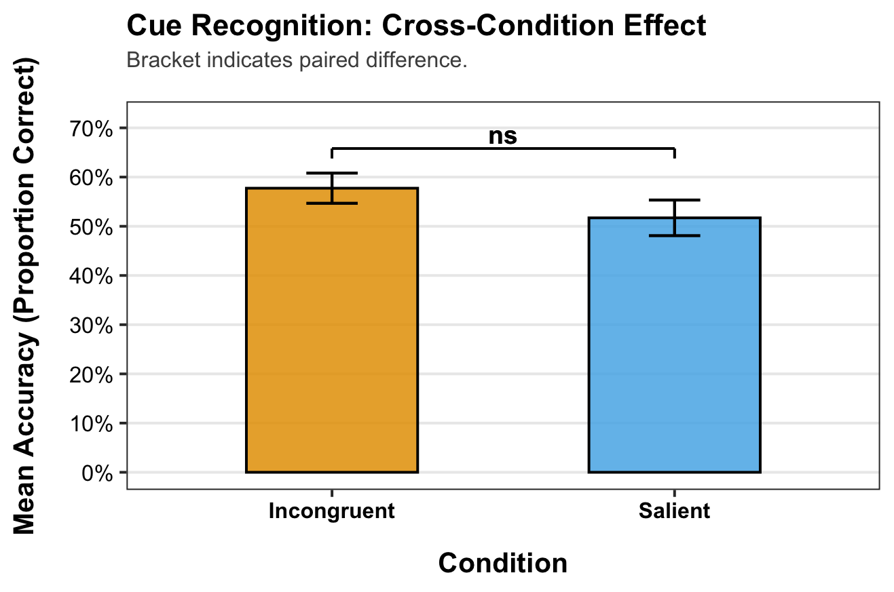
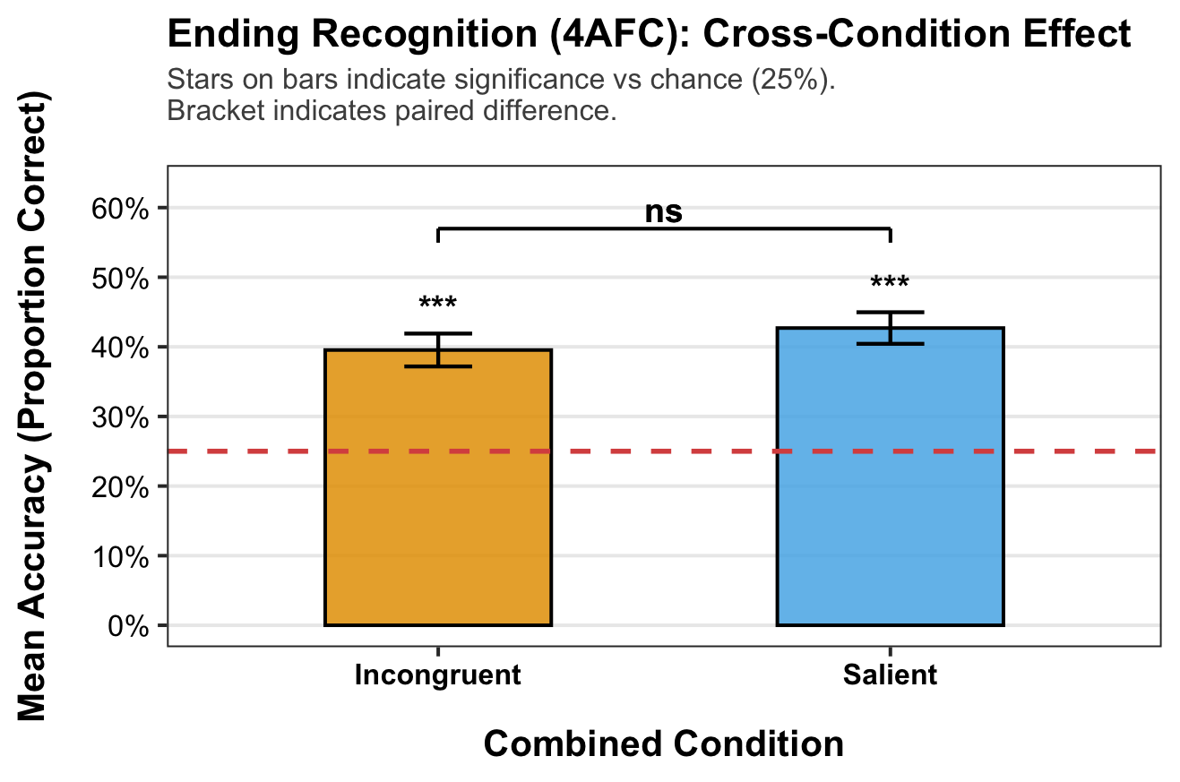
RESULTS
1. Cue recognition
3. Ending recognition
How did the story end?
BOTH MEMORY TASK- Comparing PEs
Have you seen this story before?
1
2
3
4
Incongruent + Non-salient : Congruency PE
Congruent + Salient : Salience PE
Yes
No
Notes:
Finally, in order to answer our main question: Is there a difference between the distinct PEs?
well, in both memory tasks there were no statistic significant differences between PEs.

Slide 46
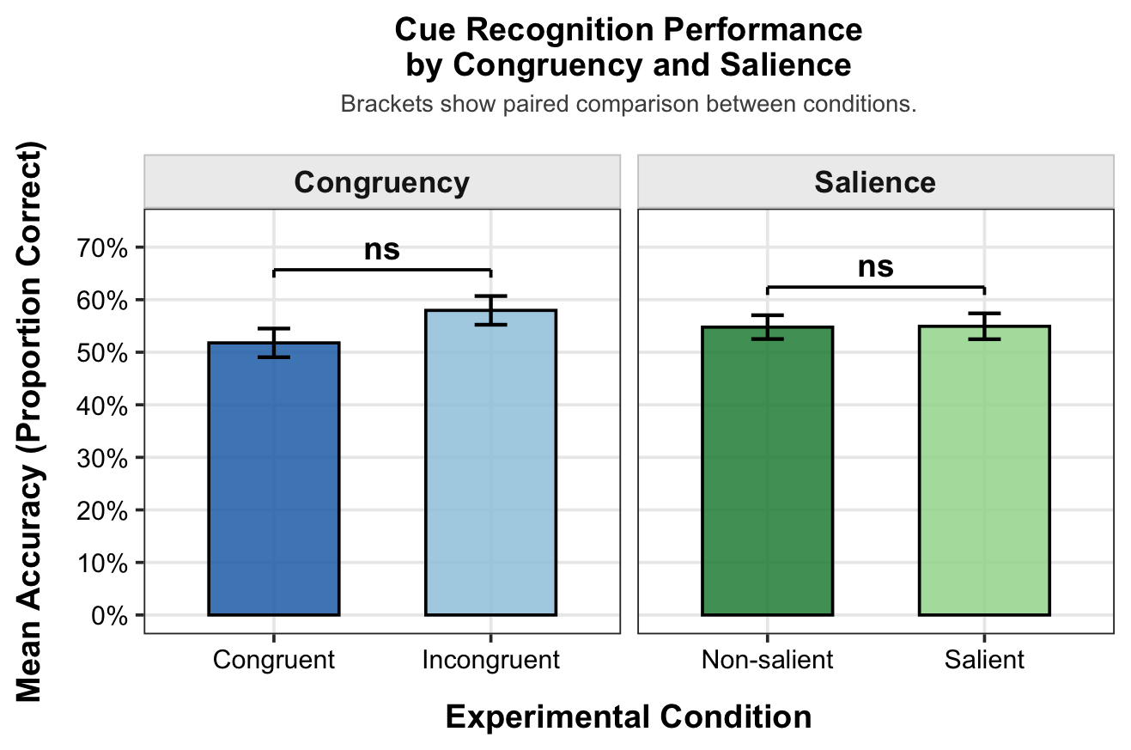
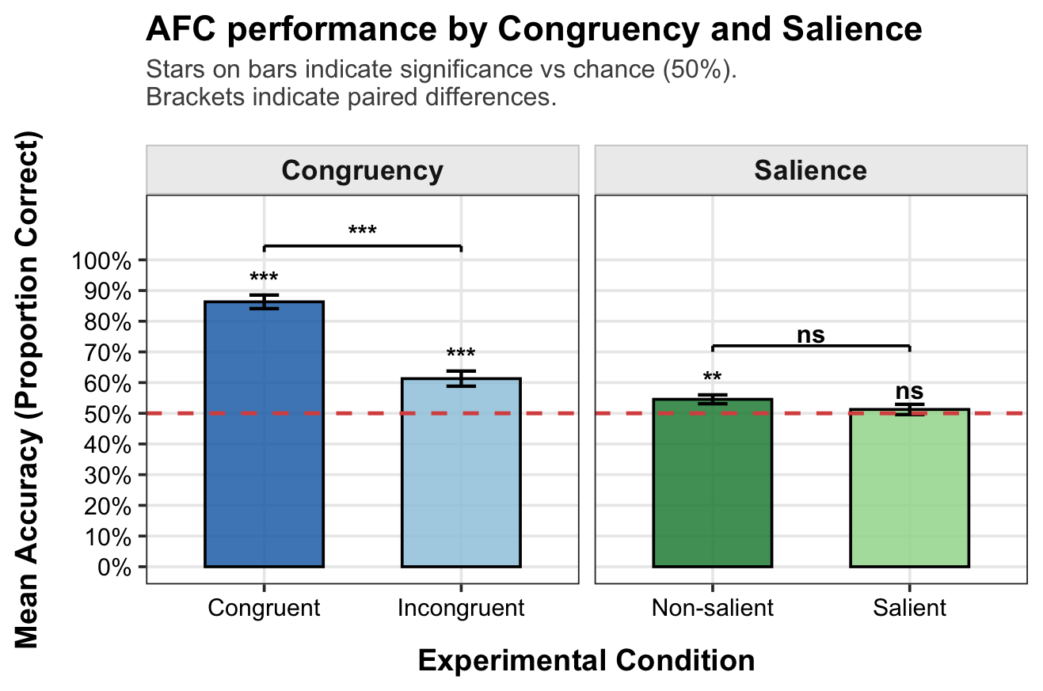
RESULTS
1. Cue recognition
3. Ending recognition
How did the story end?
BOTH MEMORY TASKS
Congruency and Salience
Have you seen this story before?
1
2
3
4
Yes
No
CUE RECOGNITION
ENDING RECOGNITION
Incongruent tendency
Congruent benefit
Notes:
In addition, if we look at the performance splitted by each factor for two different components of episodic memory, cue and ending recognition, there is a distinct pattern for each one.
In cue recognition, even though with no significant relevance, there is a tendency for incongruent trials to be better remembered, meanwhile in contrast, in ending recognition there is a congruency effect in which congruent trials are the better remembered.

Slide 47
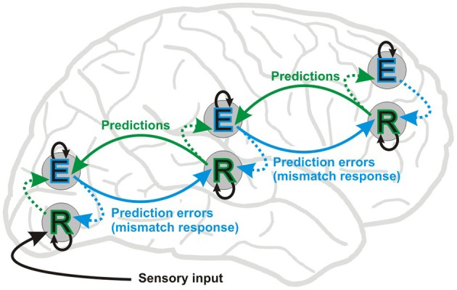
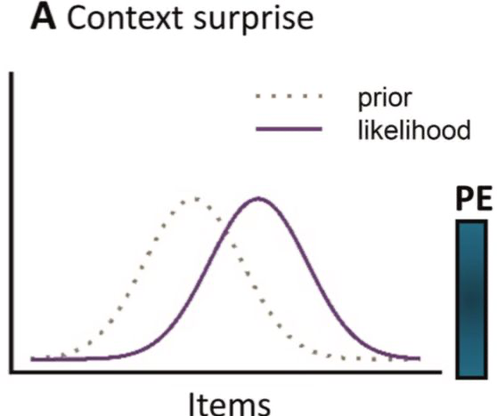
Previous literature
Prediction Errors
visibility
Perceptual Mismatch
The vMMN paradigm illustrates how altering low-level visual features triggers automatic and immediate prediction errors (Stefanics et al., 2014).
book
Encoding
A lifespan shift: youth encode memories better via prediction errors, while older adults benefit from schema integration (Ortiz-Tudela et al., 2024).
Note. From "Schema-Driven Prediction Effects on Episodic Memory Across the Lifespan," by J. Ortiz-Tudela, G. Turan, M. Vilas, L. Melloni, and Y. L. Shing, 2024, Philosophical Transactions of the Royal Society B, 379, Article 20230401
Note. From "Visual Mismatch Negativity: A Predictive Coding View," by G. Stefanics, J. Kremláček, and I. Czigler, 2014, Frontiers in Human Neuroscience, 8, Article 666
psychology
Model Updates & Learning
Unexpected events highlight novelty, triggering learning and subsequent updates to our cognitive models (Henson & Gagnepain, 2010; Quent et al., 2021).
psychology
Reinforcing Predictions
Reinforcing predictions actively improves processing speed and performance accuracy within highly predictable environments (Brod & Shing, 2019; Gronau & Shachar, 2015; Ortiz-Tudela et al., 2017; Wynn et al., 2020).
Note. From "A Predictive Account of How Novelty Influences Declarative Memory," by J. A. Quent, R. N. Henson, and A. Greve, 2021, Neurobiology of Learning and Memory, 179, Article 107382
Note. Adapted from "Contextual Consistency Facilitates Long-Term Memory of Perceptual Detail in Barely Seen Images," by N. Gronau and M. Shachar, 2015, Journal of Experimental Psychology: Human Perception and Performance, 41(4), p. 1095

Slide 48
RESULTS
1. Cue recognition
CUE RECOGNITION
Cross-Condition effect t-test
Have you seen this story before?
Yes
No
Incongruent + Non-salient : Congruency PE
Congruent + Salient : Salience PE

Slide 49
RESULTS
1. Cue recognition
ENDING RECOGNITION
Cross-Condition effect t-test
Have you seen this story before?
Yes
No
Incongruent + Non-salient : Congruency PE
Congruent + Salient : Salience PE

Slide 50
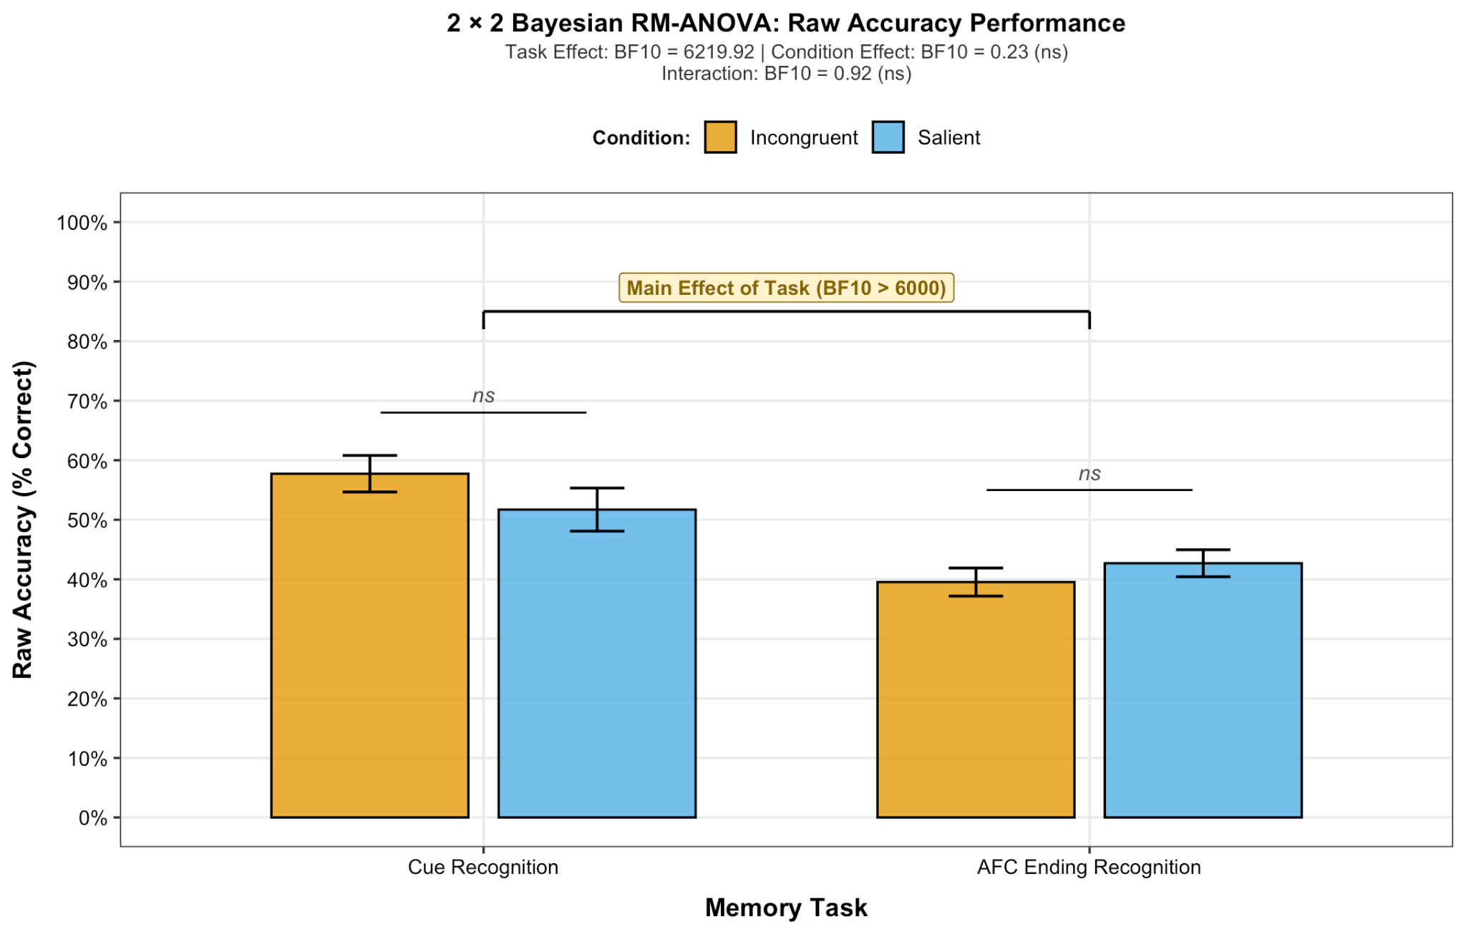
RESULTS
1. Cue recognition
3. Ending recognition
How did the story end?
CROSSING MEMORY TASK- Comparing PEs
Have you seen this story before?
1
2
3
4
Yes
No
Incongruent + Non-salient : Congruency PE
Congruent + Salient : Salience PE
INCONCLUSIVE EVIDENCE FOR INTERACTION
BF10 = 0.95
Not enough evidence to confirm that different PEs have distinct effects between both tasks
MAIN TASK EFFECT
There is a better performance for Ending Recognition compared to Cue Recognition

Slide 51
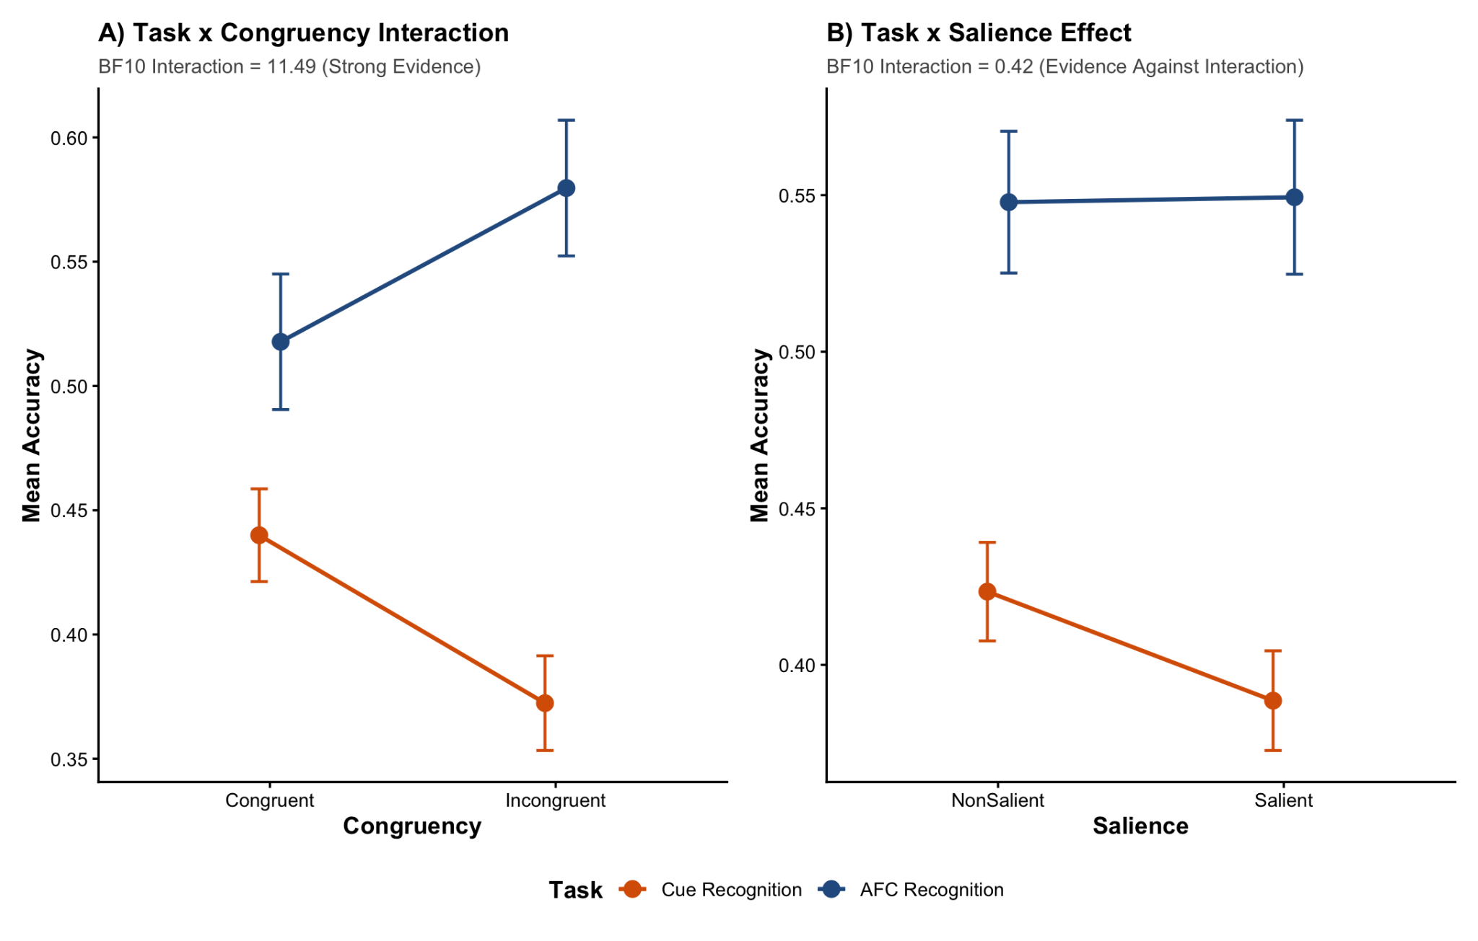
RESULTS
1. Cue recognition
3. Ending recognition
How did the story end?
CROSSING MEMORY TASKS- Congruency and Salience
Have you seen this story before?
1
2
3
4
Yes
No
DIFFERENTIAL TASK SENSITIVITY
Cue Recognition shows inconclusive Congruency effect (BF01 = 1.32)
Ending Recognition is sensitive to Congruency (BF10 = 2.89)
Differences between both tasks drives the strong interaction with Congruency (BF10 = 11.49)

Slide 52
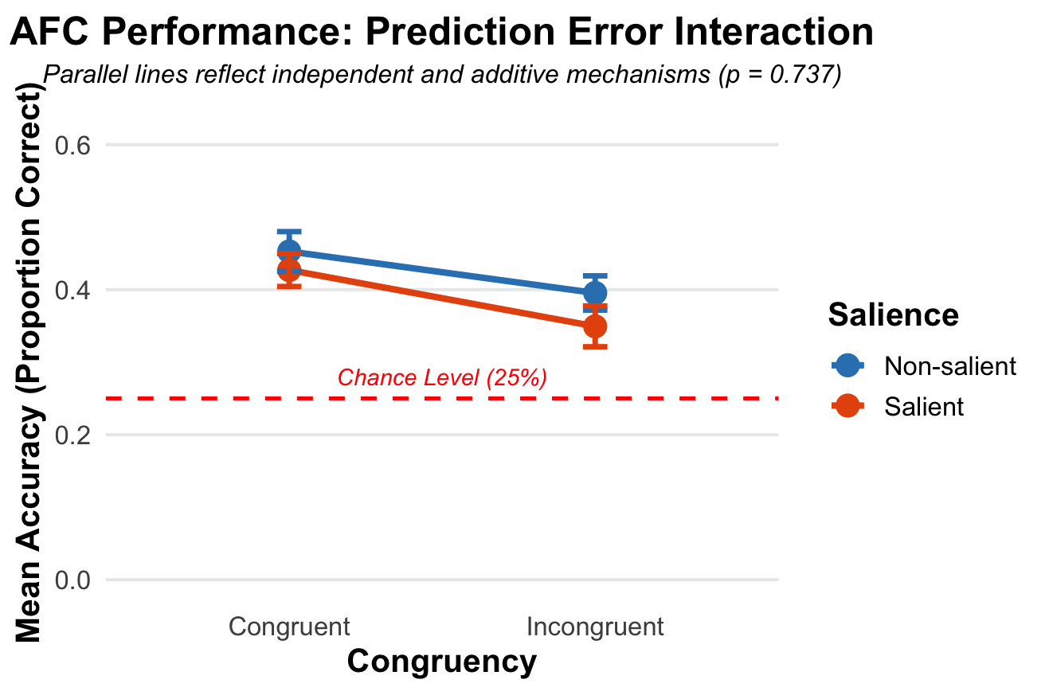
RESULTS
1. Cue recognition
3. Ending recognition
BF₁₀ : How many times more likely the data is if the effect actually exists (H₁) rather than not (H₀)
BF₀₁: How many times more likely the data is if there is NO effect (H₀) rather than if there is one (H₁)
ENDING RECOGNITION
How did the story end?
Bayesian ANOVA 2X2 Repeated Measures
Have you seen this story before?
1
2
3
4
Yes
No
Effect | BF
Congruency | BF10 6.73
Salience | BF10 0.55
Interaction | BF10 0.32
WHAT WE FIND HERE
Strong evidence for Congruency effect
Moderate evidence against an Interaction Model
Inconclusive for Salience effect

Slide 53
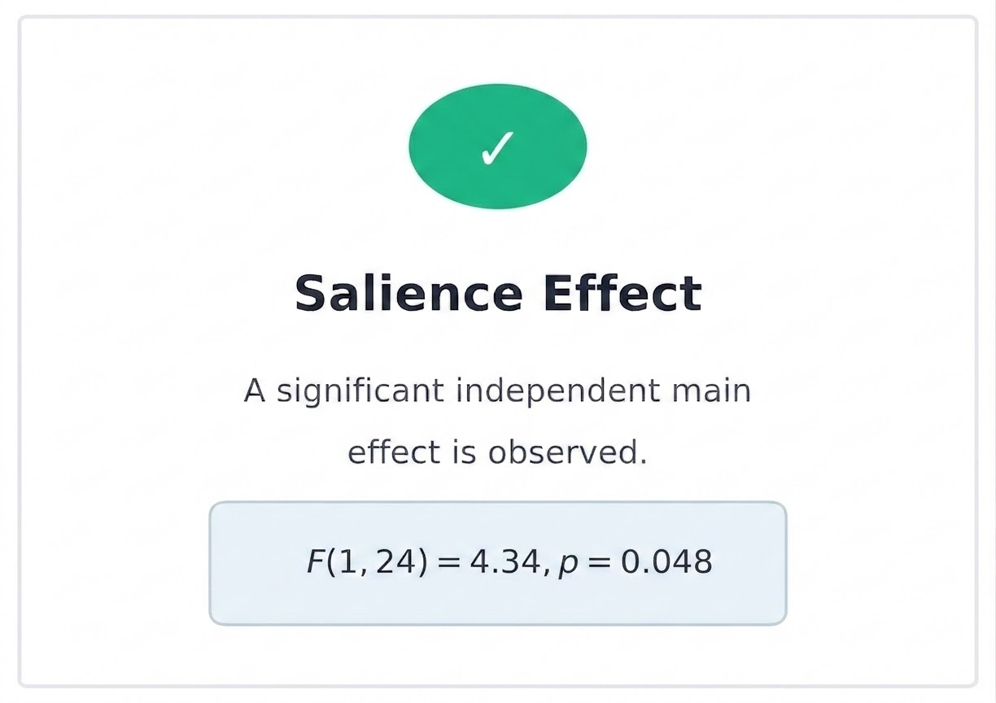
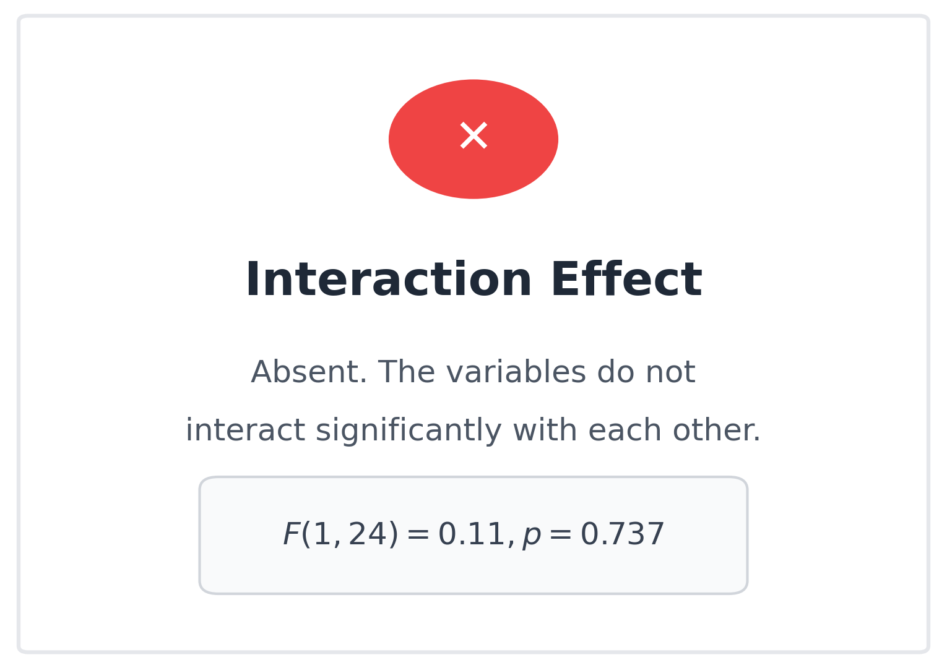
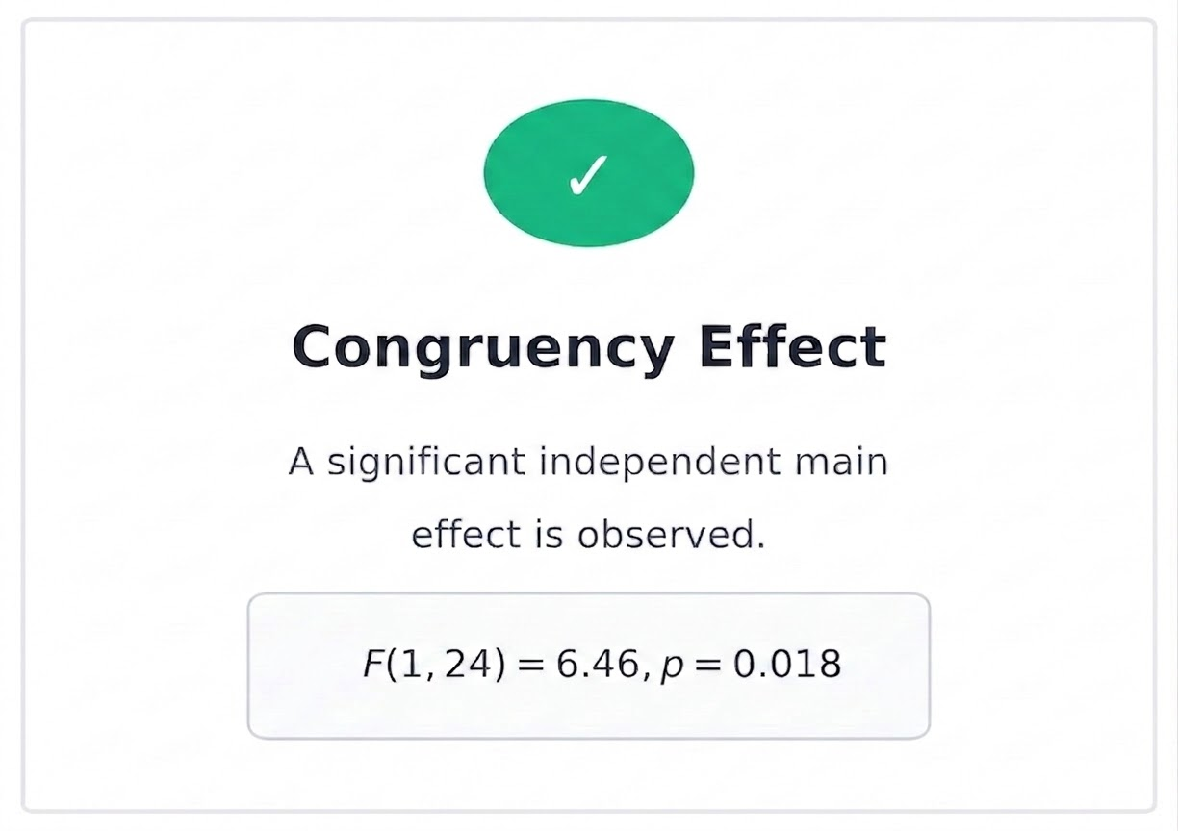
RESULTS
1. Cue recognition
3. Ending recognition
ENDING RECOGNITION
How did the story end?
Frequentist ANOVA 2X2 Repeated Measures
Have you seen this story before?
1
2
3
4
Yes
No

Slide 54
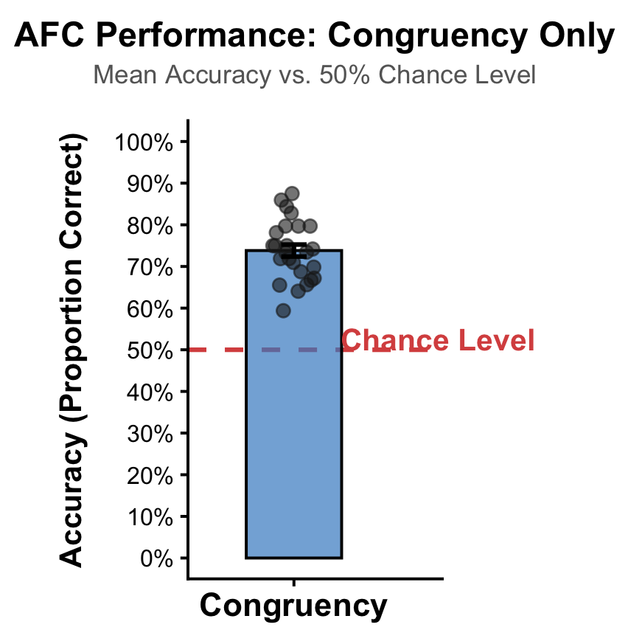
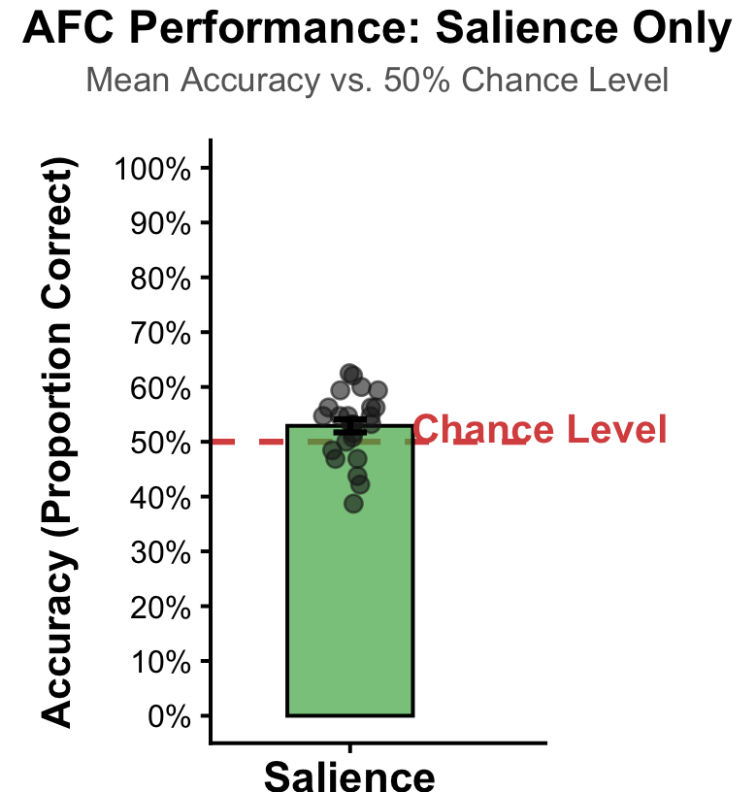
RESULTS
OVERALL
M: 40.61% SD: 0.07
t: 11.73 df: 24
p < 0.01
d: 2.35
1. Cue recognition
3. Ending recognition
ENDING RECOGNITION
How did the story end?
Performance
Have you seen this story before?
1
2
3
4
Yes
No
Overall and both Factors performance
Significantly Above Chance
M = 73.82%, SD = 0.07; t(24) = 16.54, p < .001, d = 3.31
M = 52.91%, SD = 0.06; t(24) = 2.42, p = .012, d = 0.48

Slide 55
RESULTS
1. Cue recognition
3. Ending recognition
ENDING RECOGNITION
How did the story end?
Frequentist ANOVA 2X2 Repeated Measures
Have you seen this story before?
1
2
3
4
Yes
No
WHAT WE FIND HERE
Both exert independent and additive influences on memory
Each variable shows a similar pattern of impact
Smaller effect for Salience

Slide 56
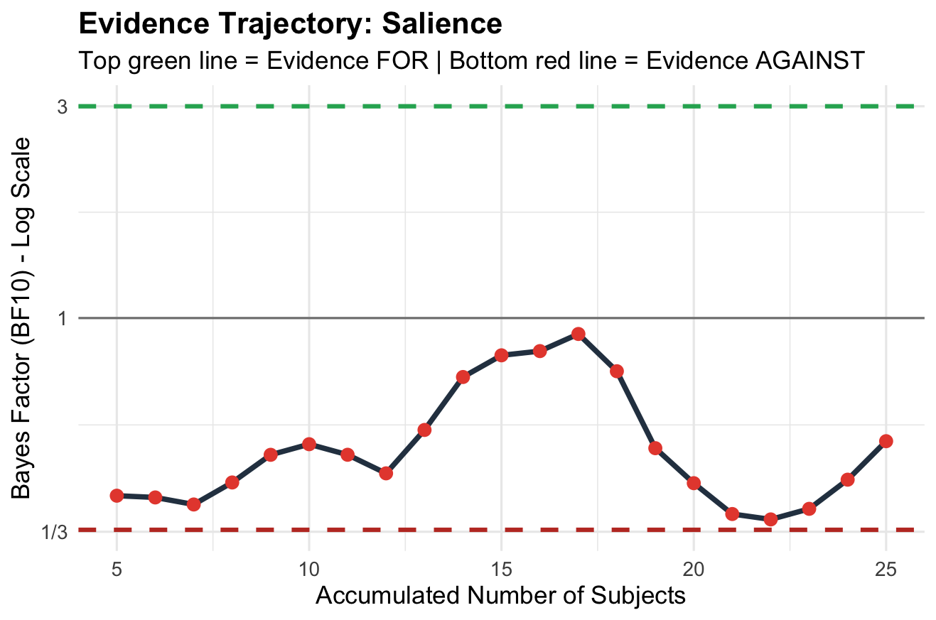
RESULTS
1. Cue recognition
3. Ending recognition
BF₁₀ : How many times more likely the data is if the effect actually exists (H₁) rather than not (H₀)
BF₀₁: How many times more likely the data is if there is NO effect (H₀) rather than if there is one (H₁)
ENDING RECOGNITION
How did the story end?
Evidence Trajectory for Salience
Have you seen this story before?
1
2
3
4
Yes
No
Effect | BF
Congruency | BF10 6.73
Interaction | BF01 3.16
Salience | BF01 1.81
WHAT WE FIND HERE
Strong evidence for Congruency effect
Moderate evidence against an Interaction Model
Inconclusive for Salience effect
Inconclusive effect

Slide 57
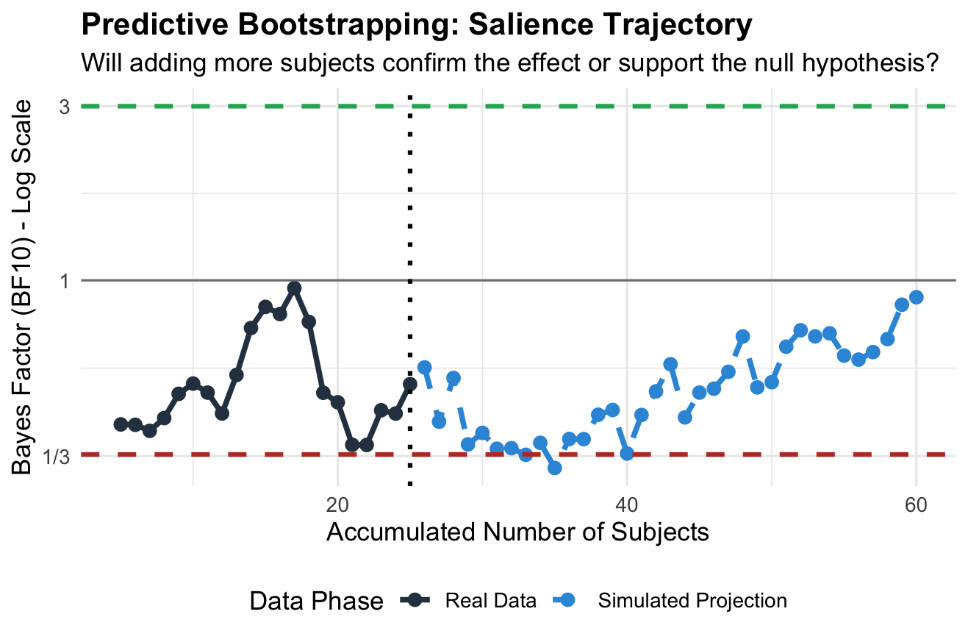
RESULTS
1. Cue recognition
3. Ending recognition
BF₁₀ : How many times more likely the data is if the effect actually exists (H₁) rather than not (H₀)
BF₀₁: How many times more likely the data is if there is NO effect (H₀) rather than if there is one (H₁)
ENDING RECOGNITION
How did the story end?
Have you seen this story before?
Predictive Bootstrapping for Salience Trajectory
1
2
3
4
Yes
No
Effect | BF
Congruency | BF10 6.73
Interaction | BF01 3.16
Salience | BF01 1.81
WHAT WE FIND HERE
Inconclusive trajectory for Salience effect
Salience effect might be too weak

Slide 58
RESULTS
1. Cue recognition
3. Ending recognition
BF₁₀ : How many times more likely the data is if the effect actually exists (H₁) rather than not (H₀)
BF₀₁: How many times more likely the data is if there is NO effect (H₀) rather than if there is one (H₁)
ENDING RECOGNITION
How did the story end?
Sensitivity analysis
Inclusion Bayes Factors (BF₁₀) under different prior scales
Have you seen this story before?
1
2
3
4
Prior
BF₁₀ Salience
BF₁₀ Congruency
BF₁₀ Interaction
Yes
No
Narrow (r = 0.2)
0.91
6.93
0.53
Default (r = 0.5)
0.54
6.66
0.30
Wide (r = 1.0)
0.37
4.53
0.17
WHAT WE FIND HERE
• No robust evidence for the Salience effect, which trended toward the null under wider priors
• Robust evidence for Congruency effect.
• No evidence for the interaction.

Slide 59
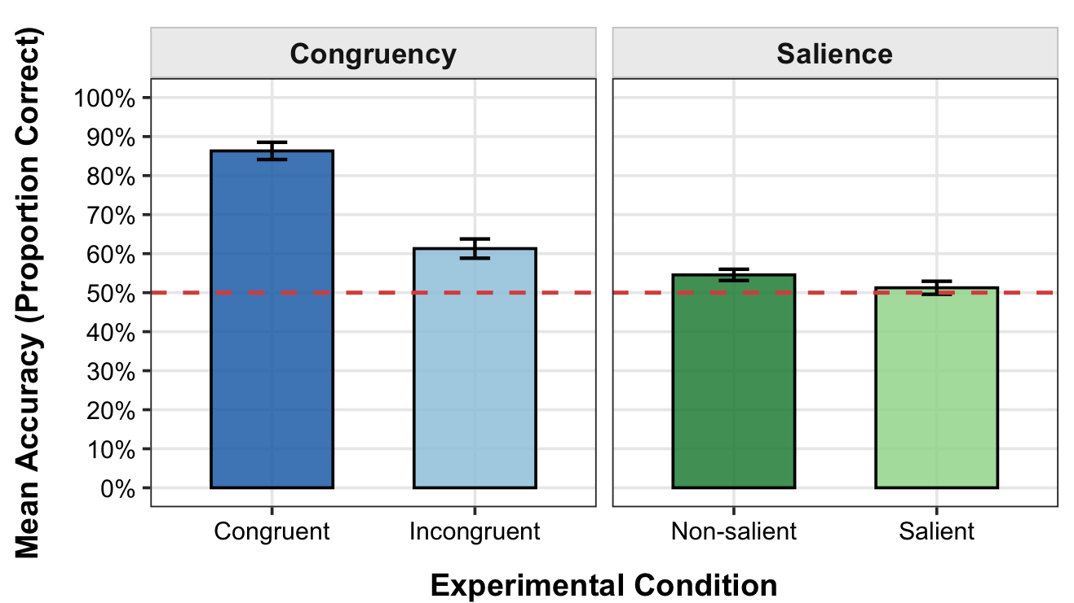
RESULTS
1. Cue recognition
3. Ending recognition
ENDING RECOGNITION
How did the story end?
Performance in each factor as predicted or unpredicted
Have you seen this story before?
1
2
3
4
Yes
No

Slide 60
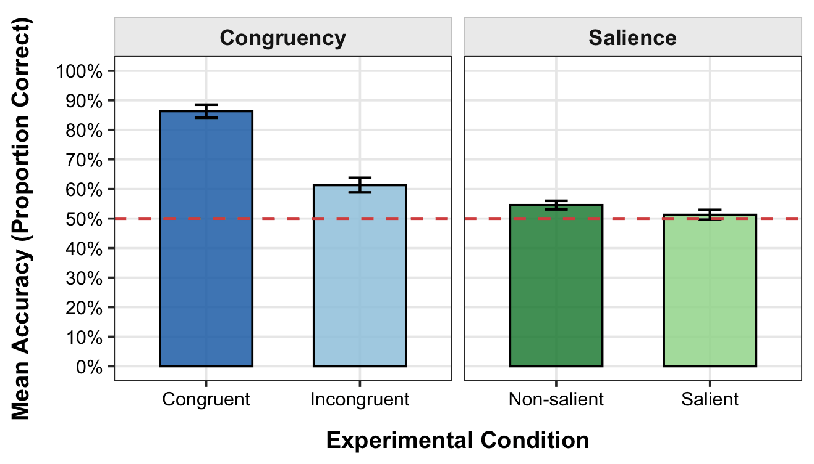
RESULTS
1. Cue recognition
3. Ending recognition
ENDING RECOGNITION
How did the story end?
Performance in each factor as predicted or unpredicted
Have you seen this story before?
1
2
3
4
Yes
No
Although they may have similar effects, these effects are independent.
These could reflect parallel processing across separate cognitive pathways with no mutual modulation or overlap.

Slide 61
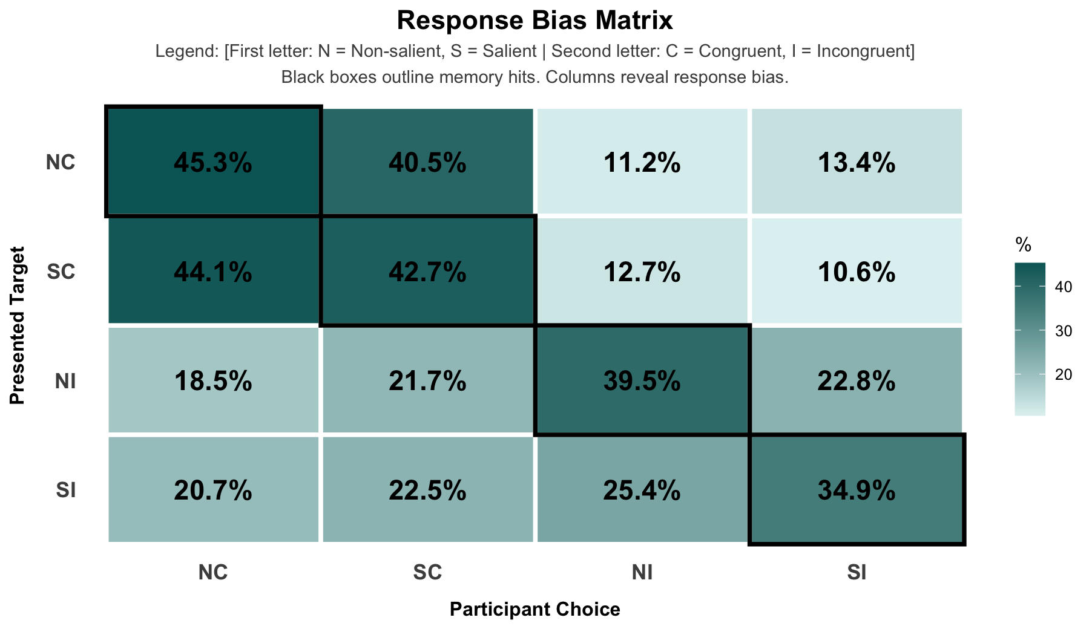
RESULTS
1. Cue recognition
C
I
NS
S
Congruent
Incongruent
Non-Salient
Salient
3. Ending recognition
ENDING RECOGNITION
How did the story end?
Response Bias Matrix
Have you seen this story before?
1
2
3
4
Yes
No
CONGRUENCY EFFECT
Memory hits are significantly higher for congruent endings:
• Congruent: 45.3% and 42.7%
• Incongruent: 39.5% and 34.9%
Within both congruency levels, Non-Salient stimuli are remembered slightly better than Salient stimuli:
• Congruent: NC (45.3%) > SC (42.7%) (+2.6%)
• Incongruent: NI (39.5%) > SI (34.9%) (+4.6%)
Memory performance is highest for congruent, non-salient stimuli and lowest for the salient, incongruent combination.

Slide 62
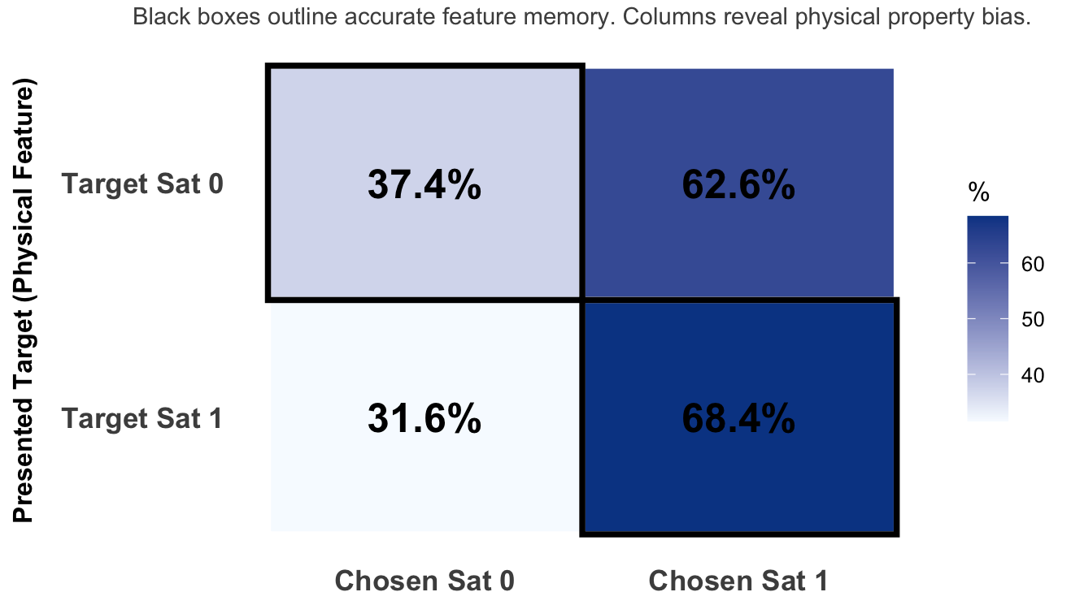
RESULTS
1. Cue recognition
3. Ending recognition
ENDING RECOGNITION
How did the story end?
Response Bias Matrix
Have you seen this story before?
1
2
3
4
Yes
No
SATURATION BIAS
Bias in response:
• Saturation 1 endings is always the most chosen answer regardless the condition

Slide 63
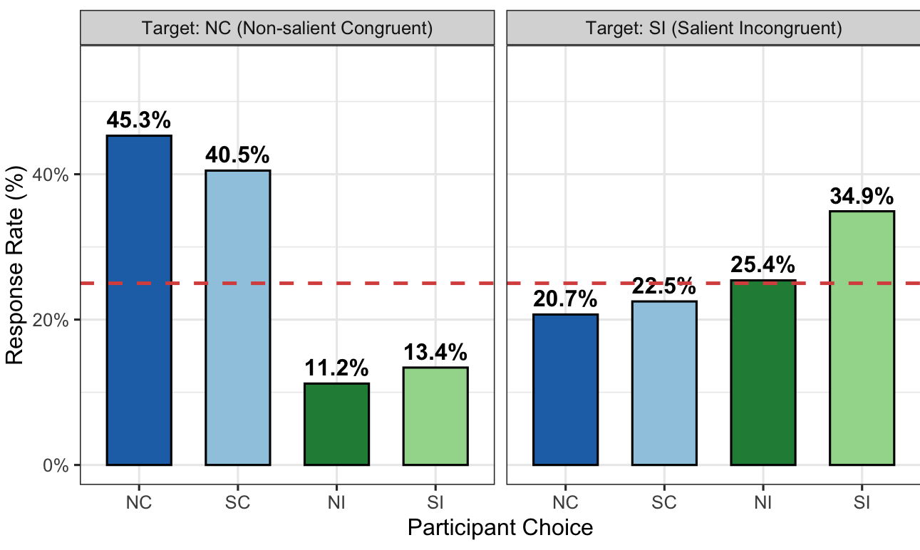
RESULTS
1. Cue recognition
C
I
NS
S
Congruent
Incongruent
Non-Salient
Salient
3. Ending recognition
ENDING RECOGNITION
How did the story end?
Response Bias Matrix
Have you seen this story before?
1
2
3
4
Yes
No
TARGET NC (Non-salient Congruent)
Congruent responses (NC and SC) soar well above chance, while incongruent responses (NI and SI) plummet to below 25%.
TARGET SI (Salient Incongruent)
Responses cluster around the chance level (20.7%, 22.5%, 25.4%), except for the correct answer (34.9%), which stands out slightly.

