Slide 1


Here's your outline to get started
Key facts about your topic
IMDb, also known as Internet Movie Database, is an online database of information related to world films, television programs, home videos and video games, and internet streams, including cast, production crew, personnel and fictional character biographies, plot summaries, trivia, and fan reviews and ratings. An additional fan feature, message boards, was abandoned in February, 2017. The database is owned and operated by IMDb.com, Inc., a subsidiary of Amazon. As of December 2017, IMDb has approximately 4.7 million titles and 8.3 million personalities in its database, as well as 83 m...
Launched: Oct 17, 1990
CEO: Col Needham (1990)
Founder: Col Needham
Parent organization: Amazon
See more: Open the Notes below for more information.
Notes:
QuickStarter has created an outline to help you get started on your presentation. Some slides include information here in the notes to provide additional topics for you to research.
Summary:
IMDb, also known as Internet Movie Database, is an online database of information related to world films, television programs, home videos and video games, and internet streams, including cast, production crew, personnel and fictional character biographies, plot summaries, trivia, and fan reviews and ratings. An additional fan feature, message boards, was abandoned in February, 2017. The database is owned and operated by IMDb.com, Inc., a subsidiary of Amazon. As of December 2017, IMDb has approximately 4.7 million titles and 8.3 million personalities in its database, as well as 83 million registered users. The movie and talent pages of IMDb are accessible to all internet users, but a registration process is necessary to contribute information to the site.

Slide 2
IMDb.com
Web Scraping Project
By Stephen Shafer

Slide 3
Contents
Overview
Web Scraping
Data Cleaning
Analysis/Visualization

Slide 4
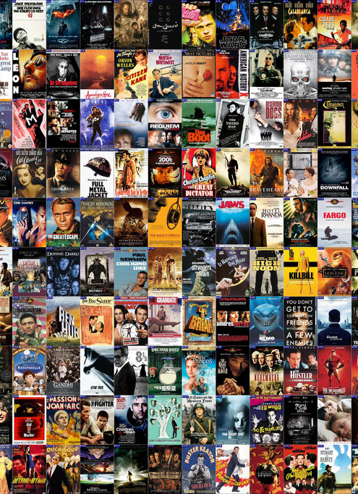
What is IMDB?

Slide 5
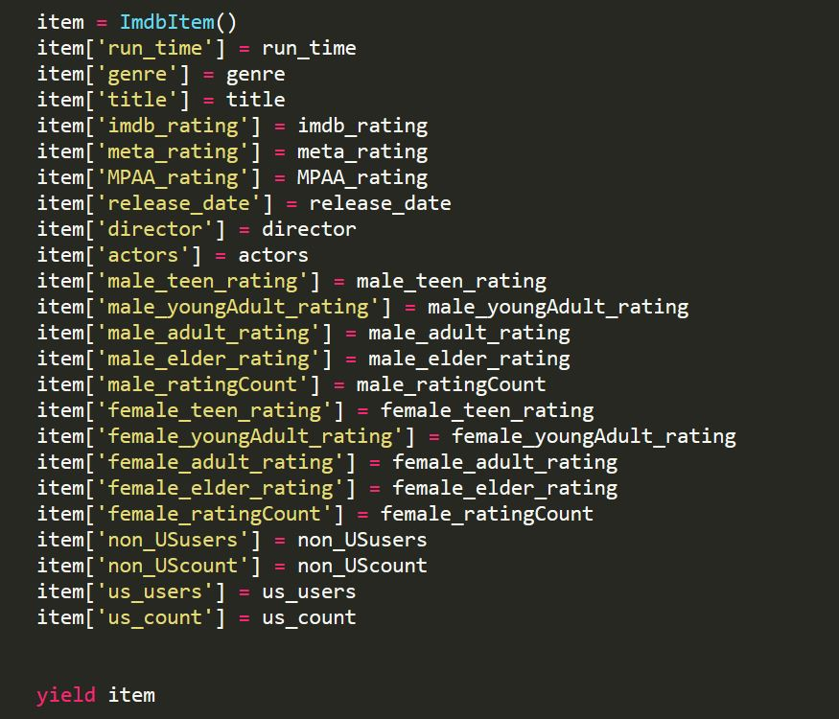
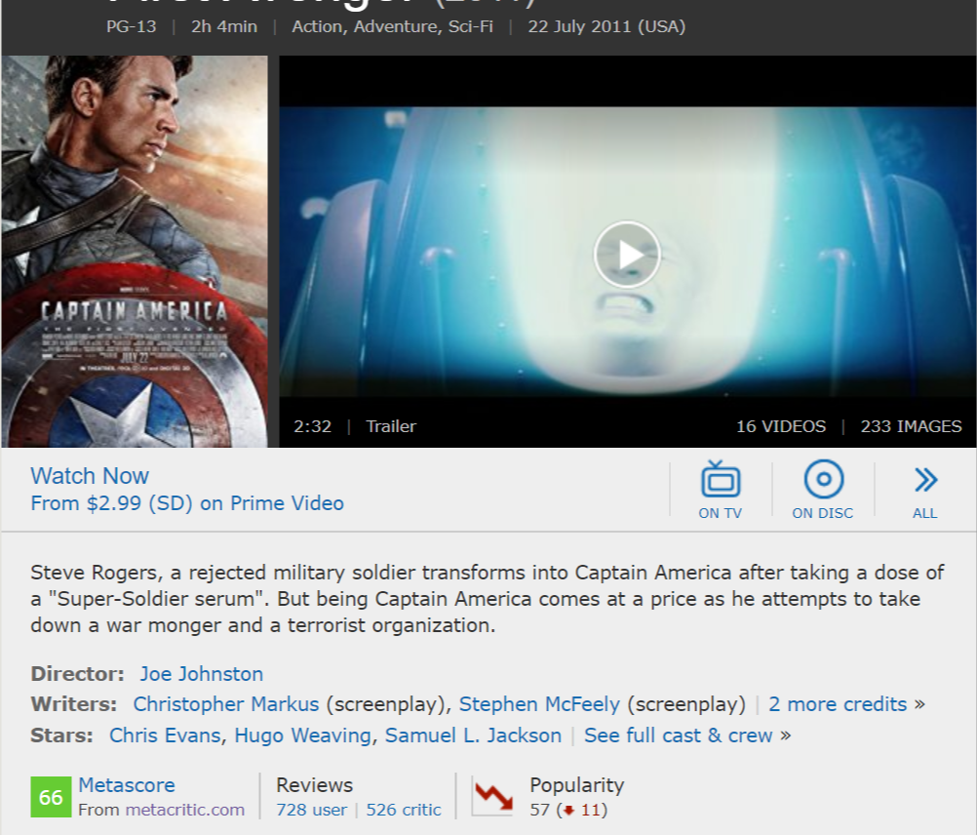
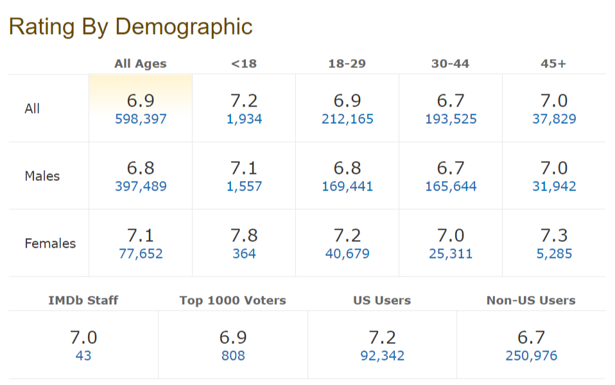
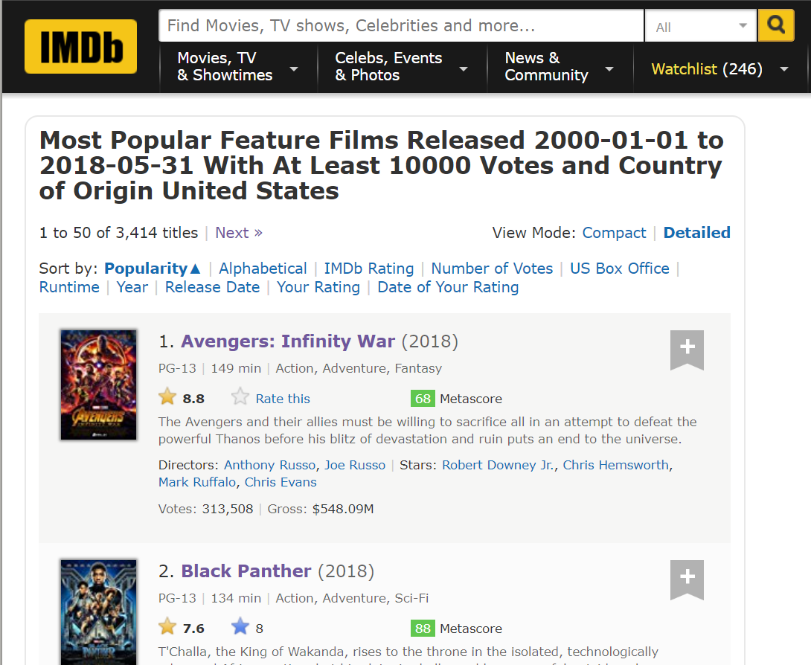
Web Scraping

Slide 6
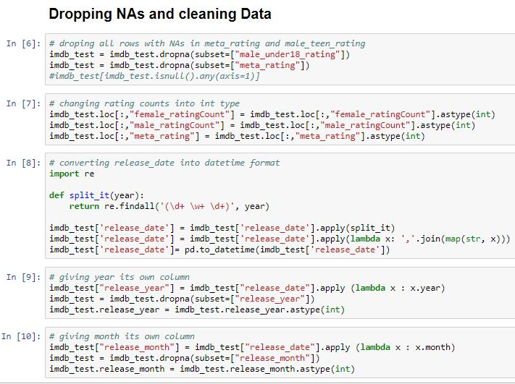
Cleaning

Slide 7
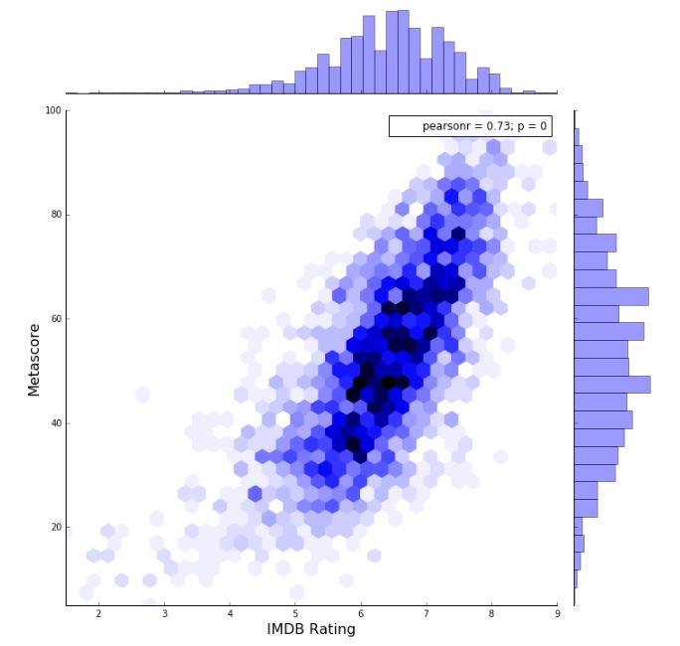
Analysis & Visualization

Slide 8
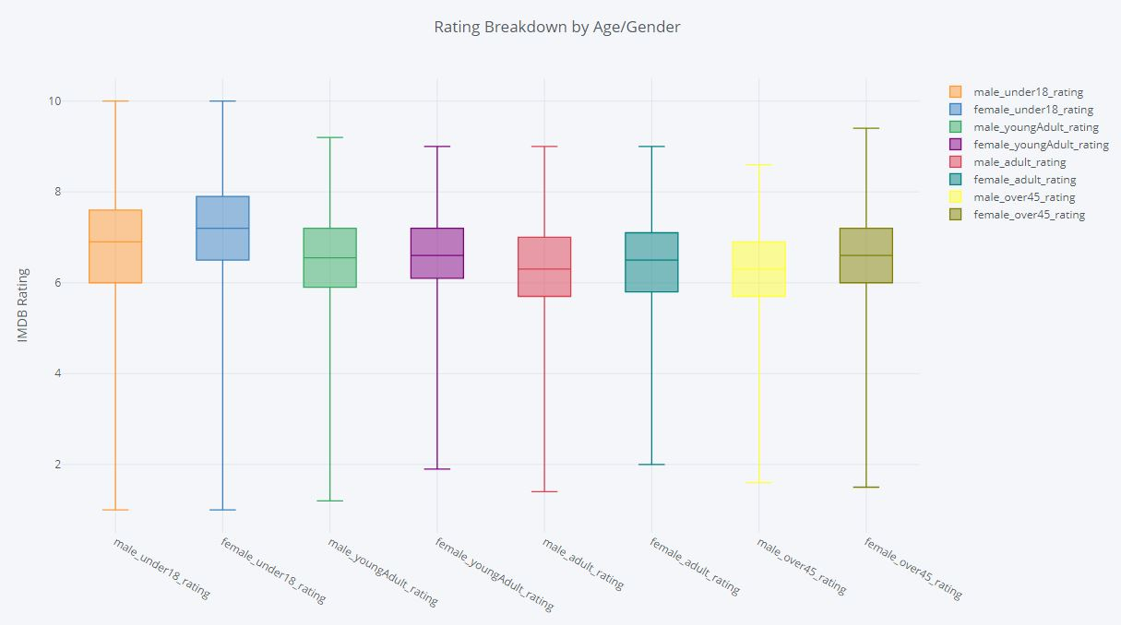

Slide 9
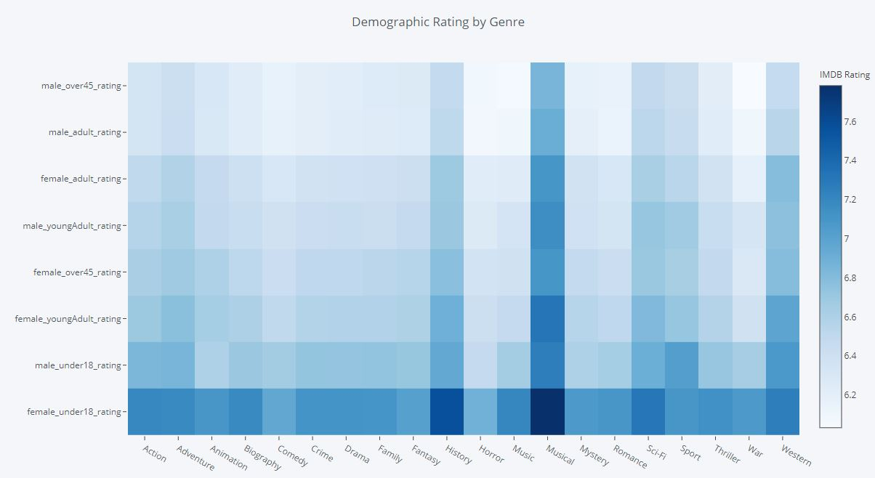

Slide 10
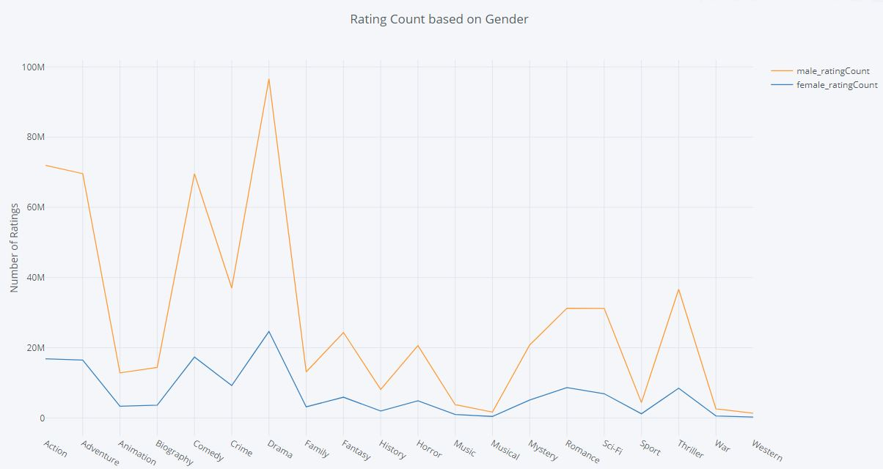

Slide 11
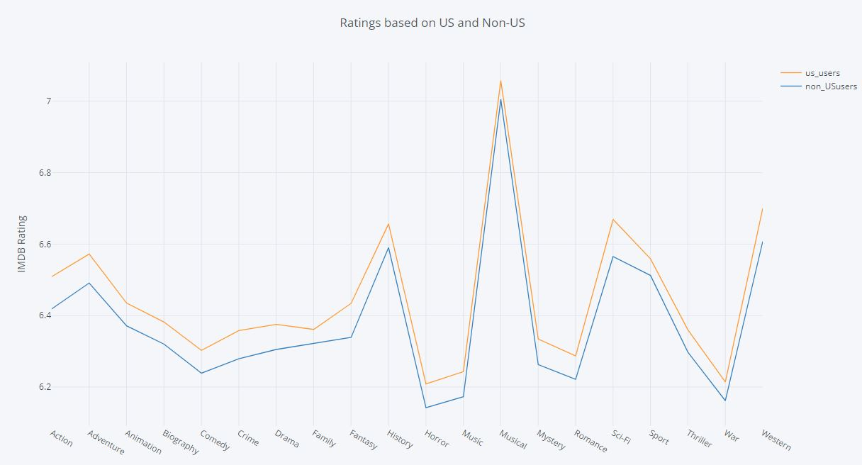

Slide 12
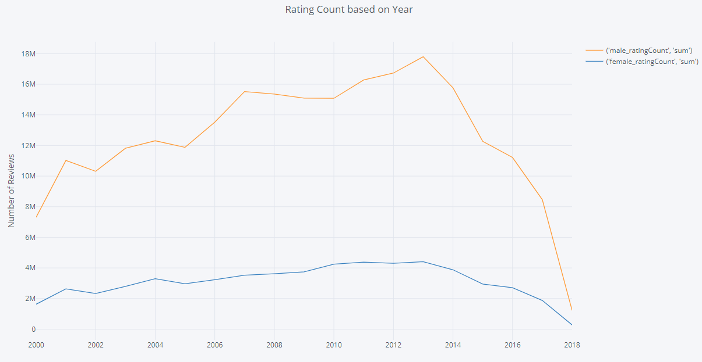

Slide 13
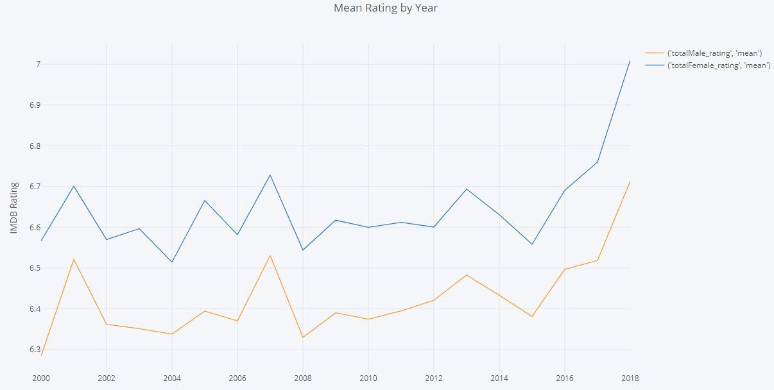

Slide 14
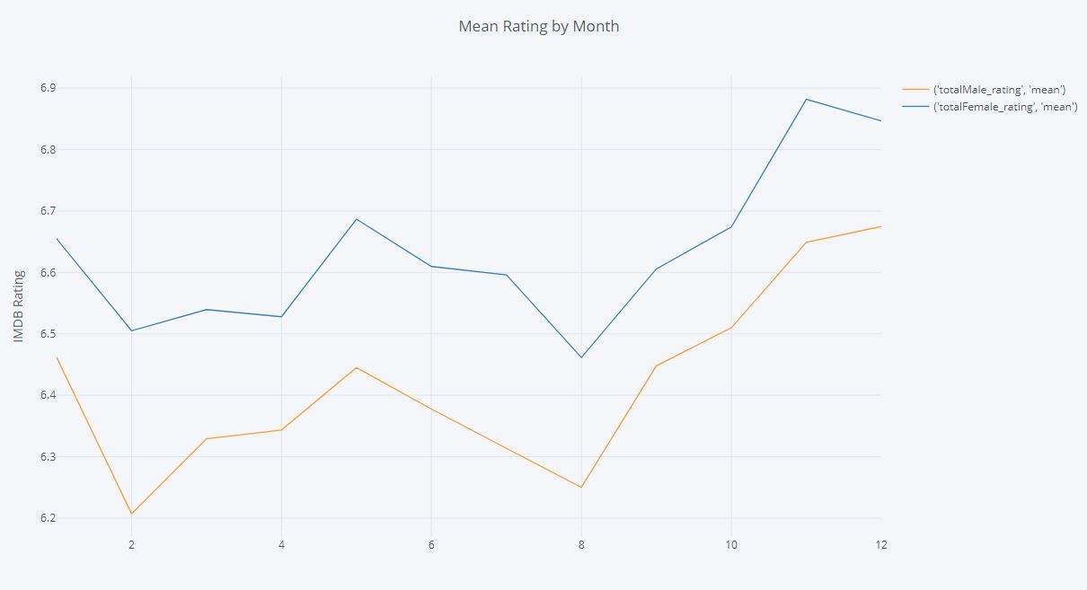

Slide 15
