Slide 1
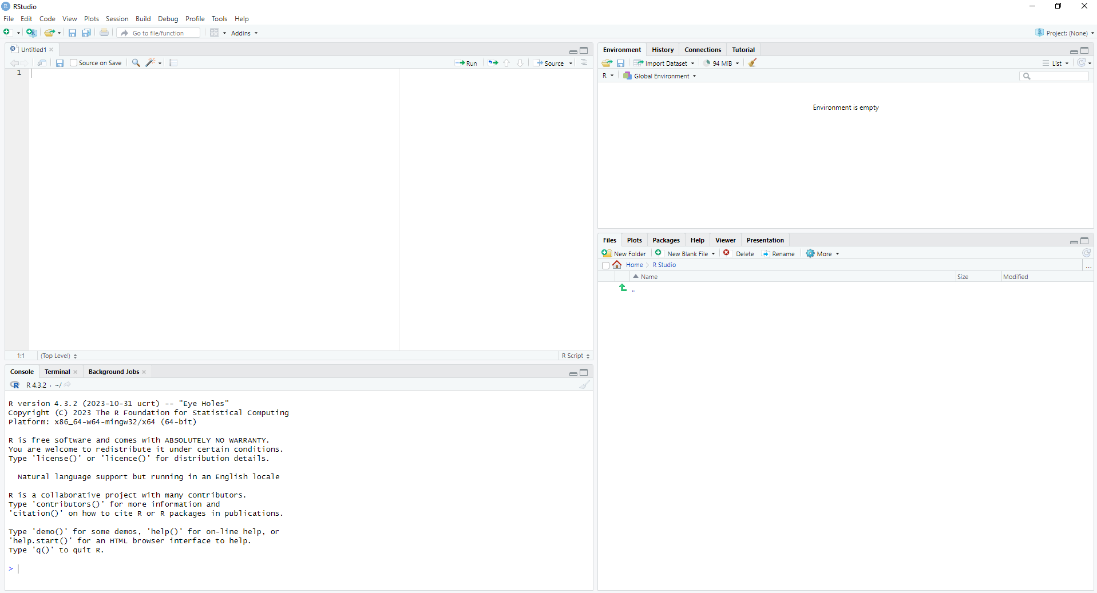
This is your environment.
This is your file.
This is where your files show up and where your plots will appear.
This is the console.

