Slide 1
SSH Honeypot Analysis
A security resource whose value lies in being probed, attacked, or compromised
By Noah Waxman

Slide 2
The Problem
SSH servers are constant targets for automated and manual attacks
Limited understanding of current attack patterns and methodologies
Need for real-world data on attacker behavior
Challenge of studying attacks safely

Slide 3
The Solution
Implemented Cowrie SSH honeypot on Oracle VPS
Key components:
Emulated SSH server
Command logging
Session recording
Geographical tracking
Deliberately limited command set to study attacker reactions

Slide 4
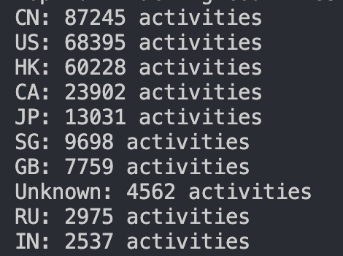
Key Findings
Top attacking countries:

Slide 5
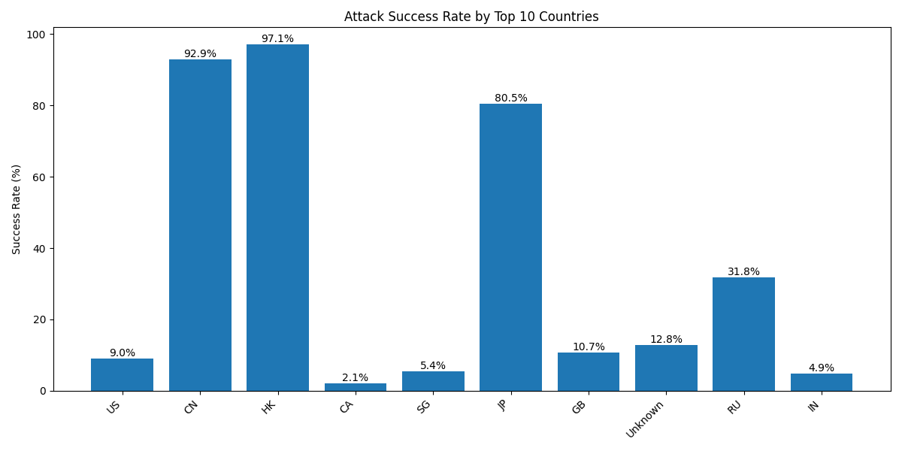
Key Findings
Top attacking countries:

Slide 6
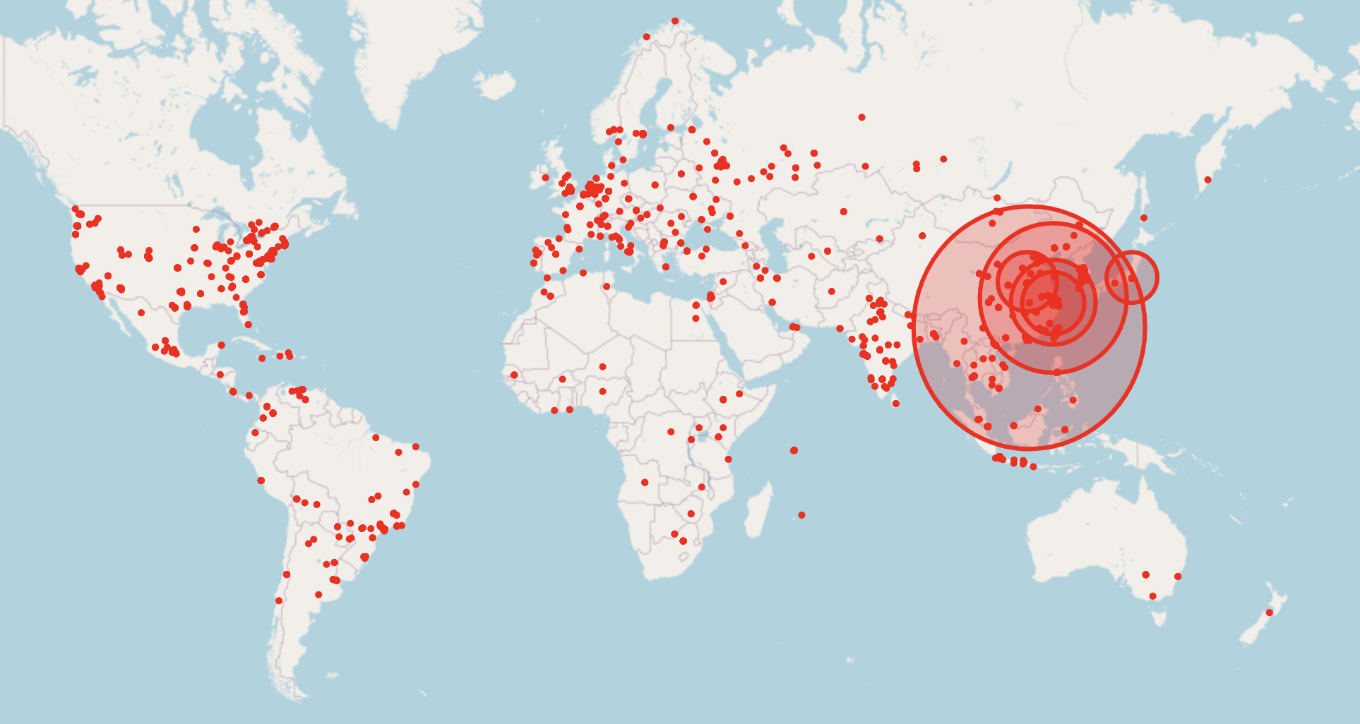

Slide 7
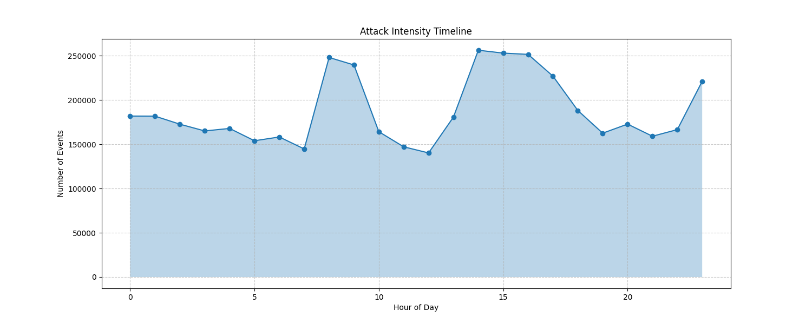
Key Findings

Slide 8
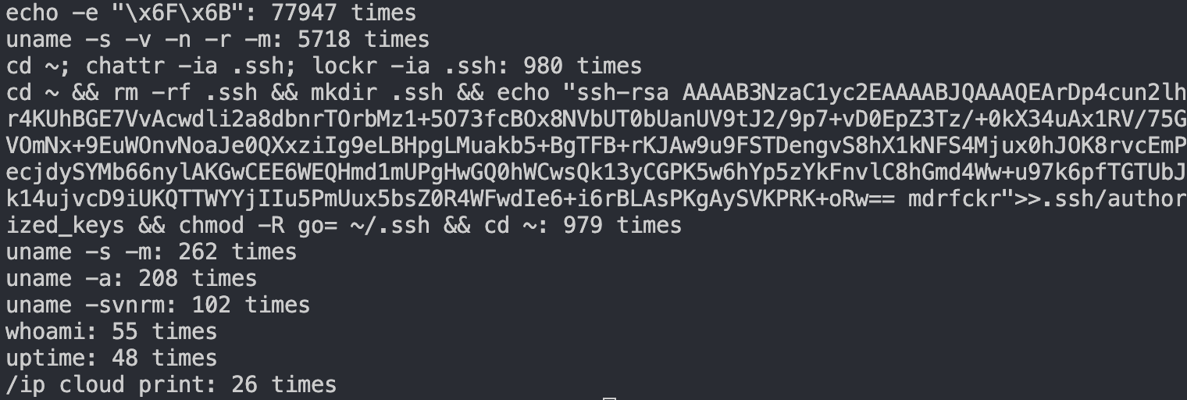
Key Findings
Top commands used:

Slide 9
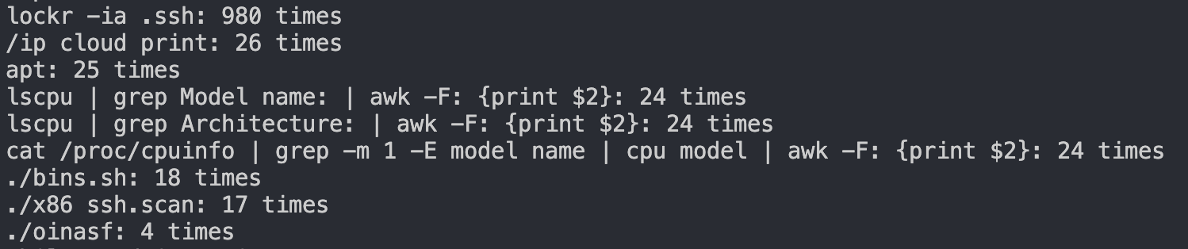
Key Findings
Top failed commands used:

Slide 10
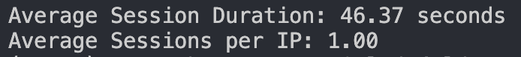
Key Findings
Session statistics:

Slide 11
Why This Matters
Real-world security research experience
Understanding current attack methodologies
Improving defensive strategies
Contributing to the security community's knowledge
Practical application of network security concepts

