Slide 1
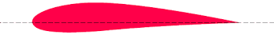










$$c_{n}$$
$$c_{L}$$
$$ϕ$$
$$c_{D}$$
chord line
$$Ωr(1-{ a}^{′})$$
$$ϕ$$
$$c_{t}$$
plane of rotation
$$θ$$
$$ϕ$$
$$α$$
W
$v_{∞}$(1+a)

