Slide 1
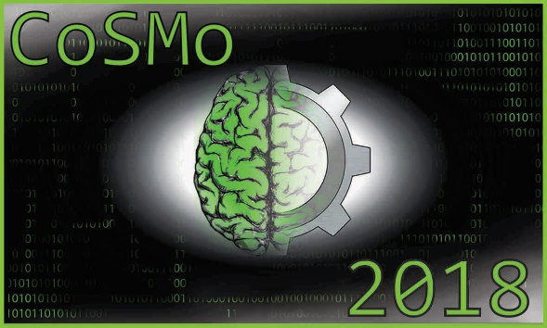
eNtrOPy
Fisher Information Information Fishers
Eva Berlot, Lina, Koronfel, Tyler Manning, Noah Steinberg

Slide 2
Phenomenon
Notes:
Noisey neurons are noisey
NOTE - i think the outline for rest of the slides should be at least partially based off of the outline that we got on one of our first days (http://compneurosci.com/wiki/images/f/fc/HowtoModel_CoSMo2018.pdf - slides 15 on)

Slide 3
Objective / goal / question

Slide 4
Background
What’s known?
Previous models?
Notes:
Neuron populations contain information not just in the signal provided by the population, but also in the variability of the population (often called ‘noise’ correlations) (1)
Correlations can have a large effect at the population level even when they have a small effect at the level of pairs (2)
Specifically, noise correlations can have a strong influence on the information available in large populations (3)

Slide 5
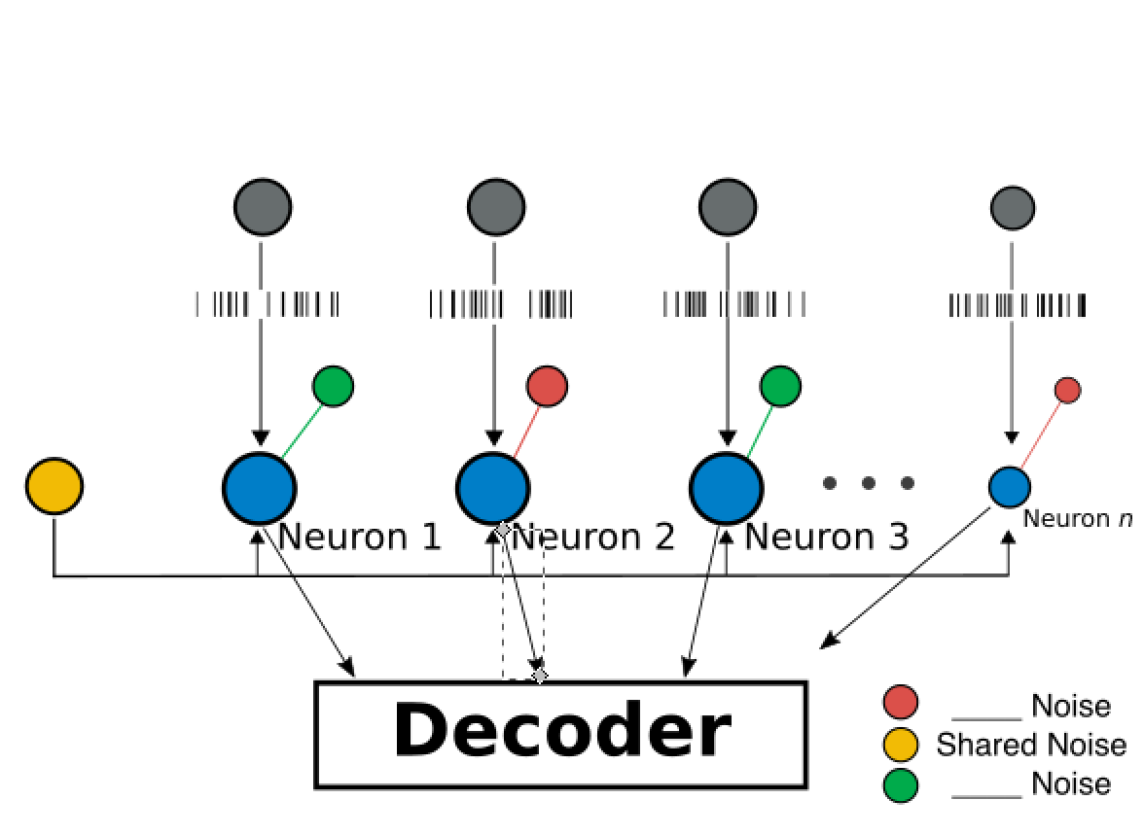
Parameters and variables
Final version of this image

Slide 6
Hypotheses
[reframe the beginning of our abstract w/ less words?]

Slide 7
Selected toolkit
Why is this the appropriate toolkit?
Notes:
LIF

Slide 8
Model schematic / equations
Notes:
LIF

Slide 9
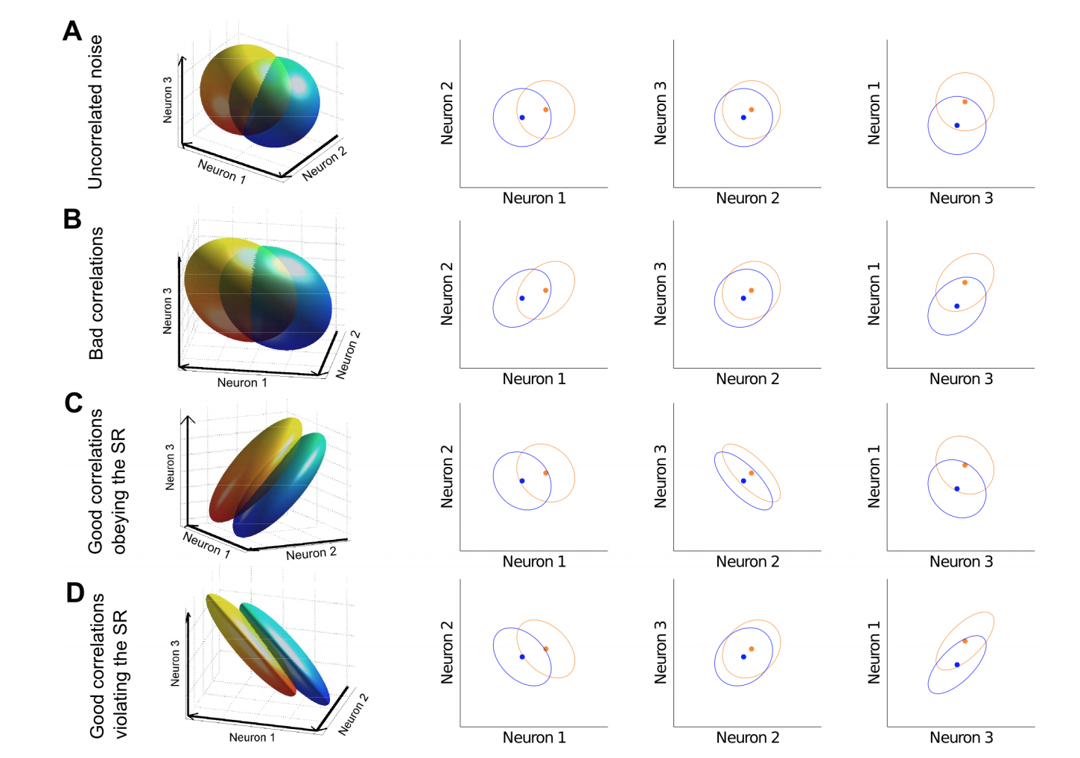
Simulations / results
(4)
We might want to use this figure to explain the trouble we ran into with our initial approach to correlations?

Slide 10
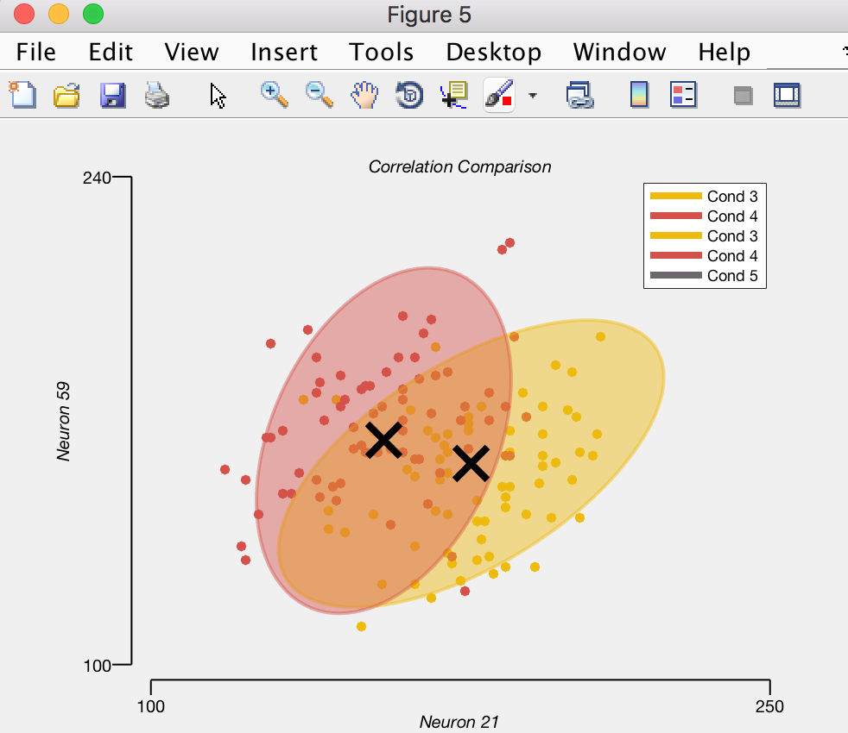
Simulations / results
Analyzing neuron population correlation – final version of this graph

Slide 11
Model testing re. hypotheses
Does your model speak towards your hypothises?

Slide 12
Critical model evaluation
Is this a good model?

Slide 13
Summary & conclusions
What have you learned?

Slide 14
References
‘The mechanics of state-dependent neural correlations’ Dorion et al
https://www.nature.com/articles/nrn1888
Mendels OP and Shamir M (2018) Relating the Structure of Noise Correlations in Macaque Primary Visual Cortex to Decoder Performance. Front. Comput. Neurosci. 12:12. doi: 10.3389/fncom.2018.00012
The sign rule and beyond: boundary effects, flexibility, and noise correlations in neural population codes (Yu Hu, Zylberg, Shea-Brown)

