Slide 1

eNtrOPy
Fisher Information Information Fishers
Eva Berlot, Lina, Koronfel, Tyler Manning, Noah Steinberg

Slide 2
Phenomenon
Noisey neurons are noisey
Information in neuron population is provided by signal (individual level) and variability (population level) ¹
Correlations can have a large affect at the population level even when they have a small effect at the level of pairs ²
Notes:
Noisey neurons are noisey
NOTE - i think the outline for rest of the slides should be at least partially based off of the outline that we got on one of our first days (http://compneurosci.com/wiki/images/f/fc/HowtoModel_CoSMo2018.pdf - slides 15 on)
Neuron populations contain information not just in the signal provided by the population, but also in the variability of the population (often called ‘noise’ correlations) (1)
Correlations can have a large effect at the population level even when they have a small effect at the level of pairs (2)
Specifically, noise correlations can have a strong influence on the information available in large populations (3)

Slide 3
Objective / goal / question
Notes:
Can noise in neuron populations enhance the decidability of the signal?

Slide 4
Background
What’s known?
Correlations can have a large effect at the population level even when they have a small effect at the level of pairs ²
Noise correlations can have a strong influence on the information available in large populations ³
Previous models?
Notes:
Neuron populations contain information not just in the signal provided by the population, but also in the variability of the population (often called ‘noise’ correlations) (1)
Correlations can have a large effect at the population level even when they have a small effect at the level of pairs (2)
Specifically, noise correlations can have a strong influence on the information available in large populations (3)

Slide 5
Parameters and variables
Leaky Integrate and Fire Neurons
Noise Correlations

Slide 6
Hypotheses
[reframe the beginning of our abstract w/ less words?]
Notes:
Our abstract:
A common idea in neuroscience is that neuronal populations should faithfully encode the relevant stimuli. While there has been a lot of attention to the influence of tuning properties and noise on encoding performance individually, we do not know how noise correlations optimally relate to tuning properties. To investigate this, we have simulated a population of leaky integrate-and-fire neurons, and examined the effect of modulating noise and stimulus correlations on decoding accuracy. We find the highest decoding efficiency when neurons with similar tuning have negative noise correlations. It is thus important to consider tuning properties and noise correlation jointly when asking how neurons should encode stimuli.

Slide 7
Selected toolkit
Why is this the appropriate toolkit?
Notes:
LIF

Slide 8
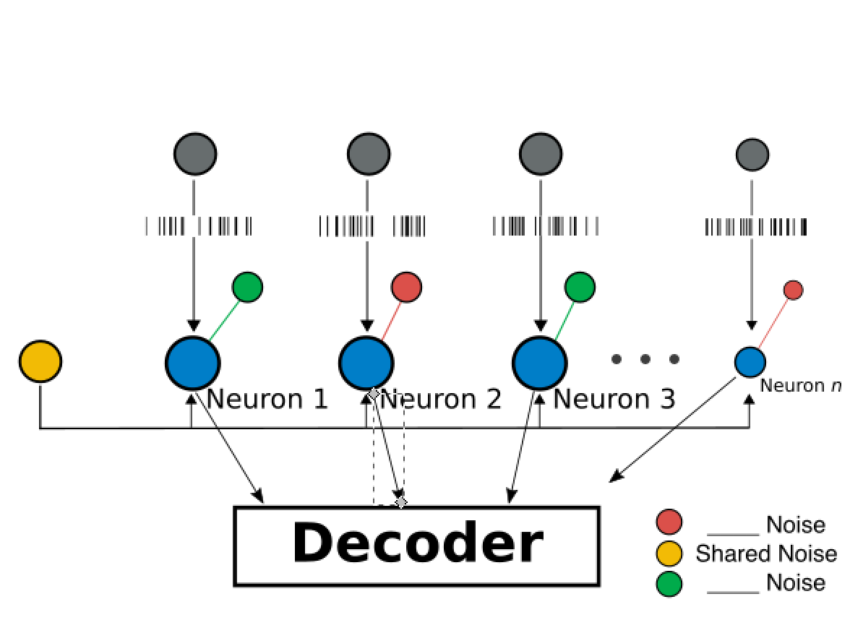
Model schematic / equations
Final version of this image
Notes:
LIF

Slide 9
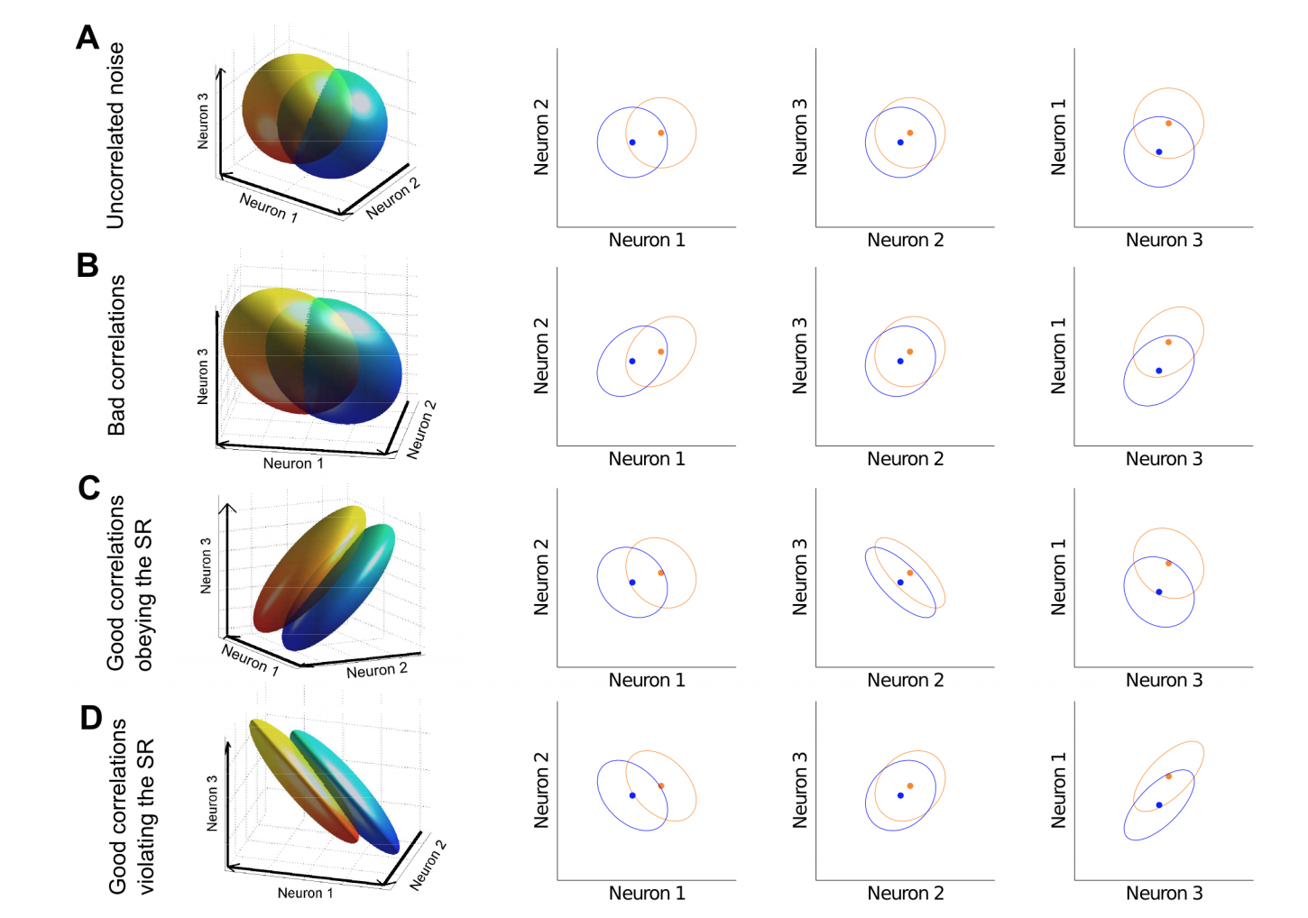
Simulations / results
(4)
We might want to use this figure to explain the trouble we ran into with our initial approach to correlations?

Slide 10
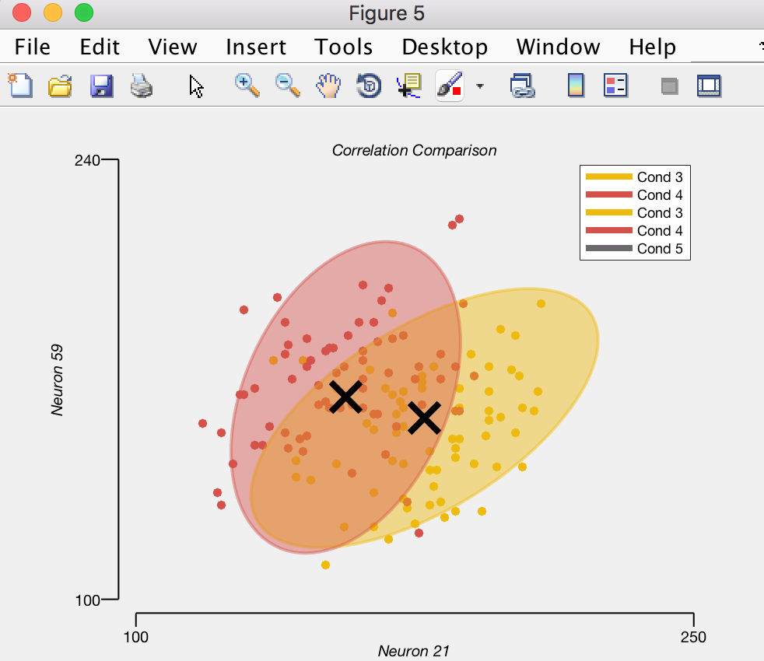
Simulations / results
Input final version of neuron correlation graphs (right)
Input correlation matrix graph

Slide 11
Model testing re. hypotheses
Does your model speak towards your hypothises?
[INPUT DECODABILITY GRAPH]

Slide 12
Critical model evaluation
Is this a good model?
Criteria | Our Model
Explains the data?
✓
Generalizable?
x
Provides new insight?
✓
Usefulness?
✓
Elegance?
✓
4 / 5
😁
Notes:
The criteria of a good model:
Does it/ Has it
Explains the data
Is generalizable
Provides new insight
Usefulness
Elegance
So elegant

Slide 13
Summary & conclusions
What have you learned?

Slide 14
References
Doiron B, Litwin-Kumar A, Rosenbaum R, Ocker GK, Josic K. 2016. The mechanics of state-dependent ´ neural correlations. Nat. Neurosci. 19(3):383–93
Averbeck, B.B. et al. (2006) Neural correlations, population coding and computation. Nat. Rev. Neurosci. 7, 358–366
Mendels OP, Shamir M. 2018. Relating the Structure of Noise Correlations in Macaque Primary Visual Cortex to Decoder Performance. Front. Comput. Neurosci. 12(12):
Hu, Y., Zylberberg, J., and Shea-Brown, E. (2014). The sign rule and beyond: boundary effects, flexibility, and noise correlations in neural population codes. PLoS Comput. Biol. 10, e1003469.

Slide 15
Critical model evaluation
Is this a good model?
Criteria | Our Model
Explains the data? | ✓
Generalizable? | x
Provides new insight? | ✓
Usefulness? | ✓
Elegance? | ✓
4 / 5
😁
Notes:
The criteria of a good model:
Does it/ Has it
Explains the data
Is generalizable
Provides new insight
Usefulness
Elegance
So elegant
Group project notes
Group name (FIIF)
Project title
Group membership all the names
Abstract we wrote for project with 100 word max

