Slide 1
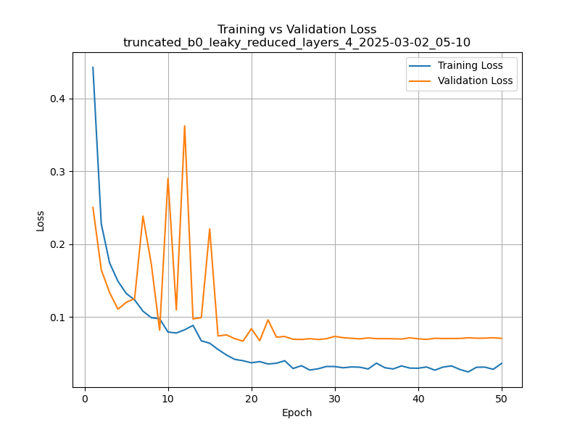
truncated_b0_leaky_reduced_layers_4_2025-03-02_05-10

Slide 2
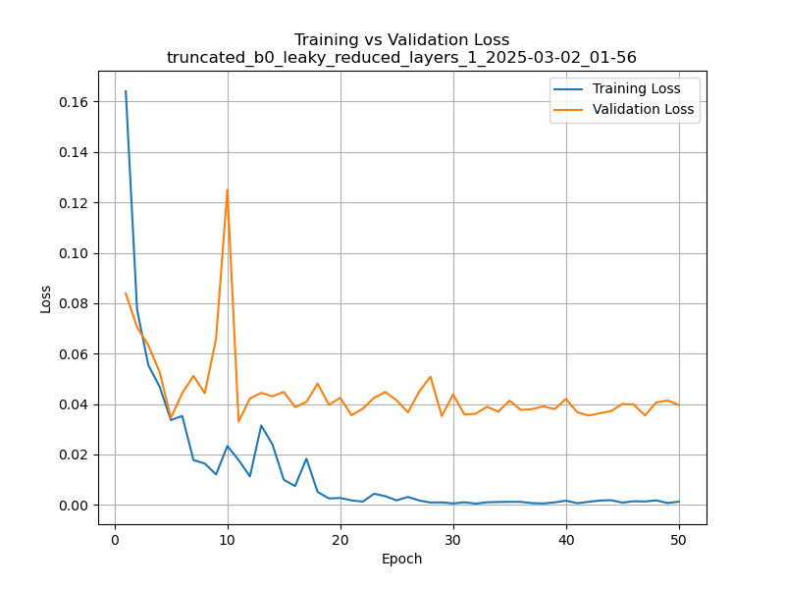
truncated_b0_leaky_reduced_layers_1_2025-03-02_01-56

Slide 3
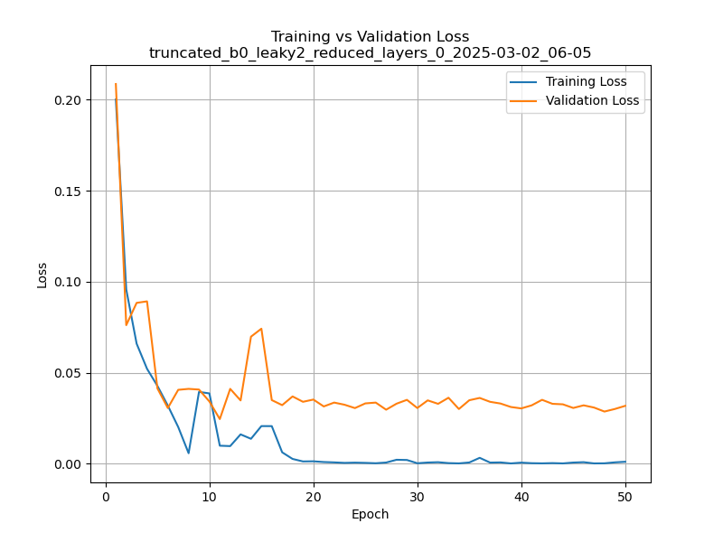
truncated_b0_leaky2_reduced_layers_0_2025-03-02_06-05

Slide 4
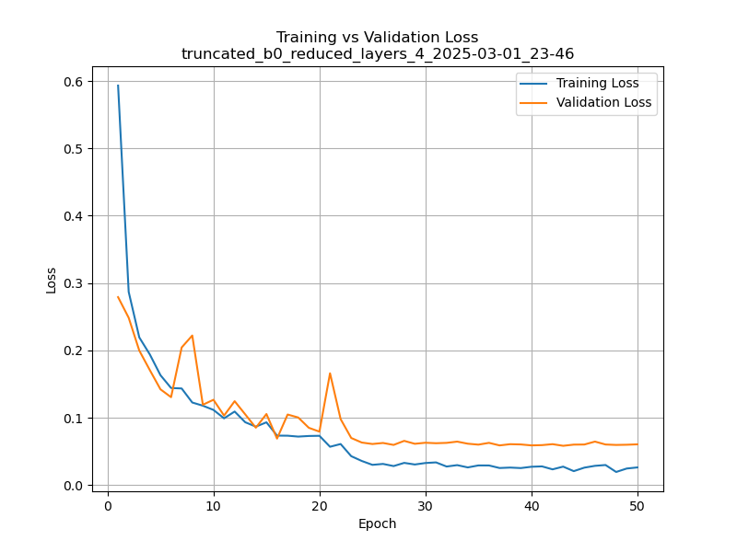
truncated_b0_reduced_layers_4_2025-03-01_23-46

Slide 5
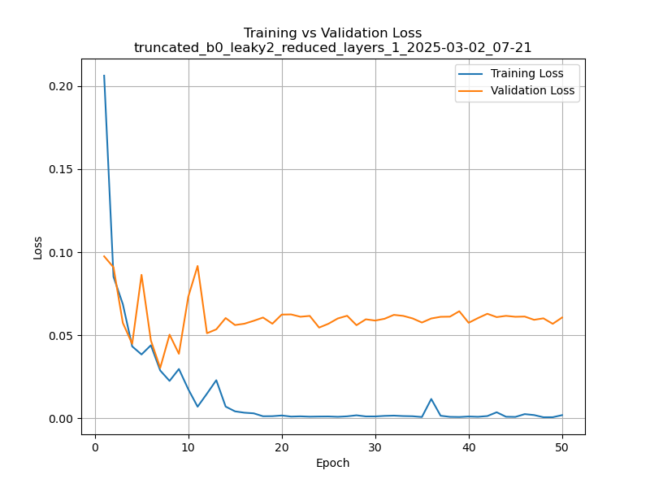
truncated_b0_leaky2_reduced_layers_1_2025-03-02_07-21

Slide 6
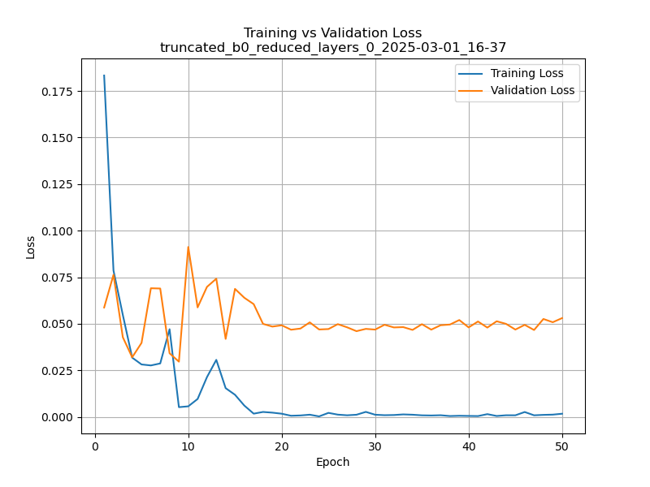
truncated_b0_reduced_layers_0_2025-03-01_16-37

Slide 7
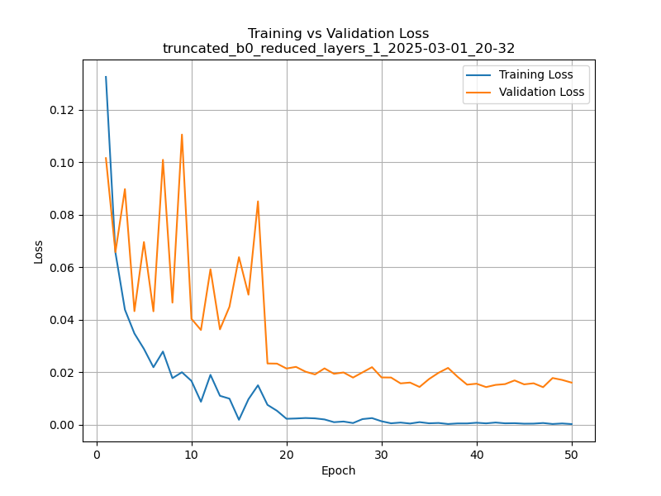
truncated_b0_reduced_layers_1_2025-03-01_20-32

Slide 8
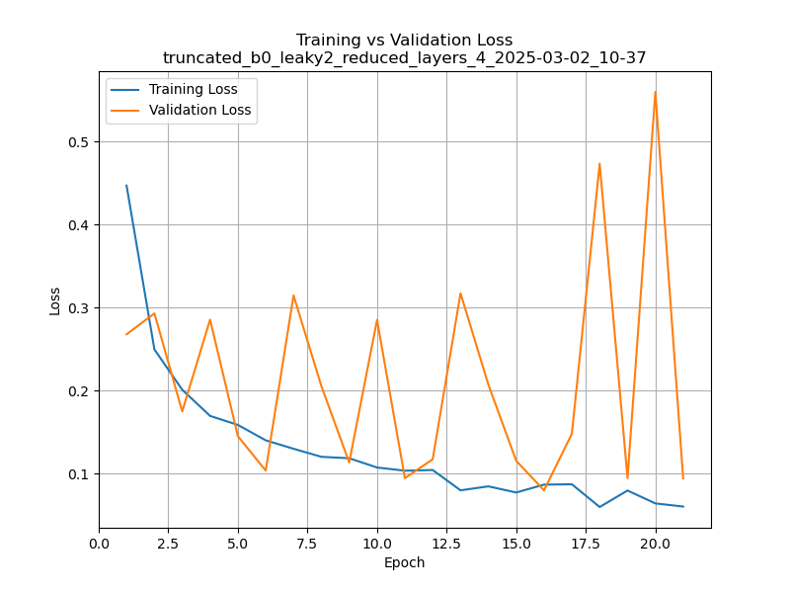
truncated_b0_leaky2_reduced_layers_4_2025-03-02_10-37

Slide 9
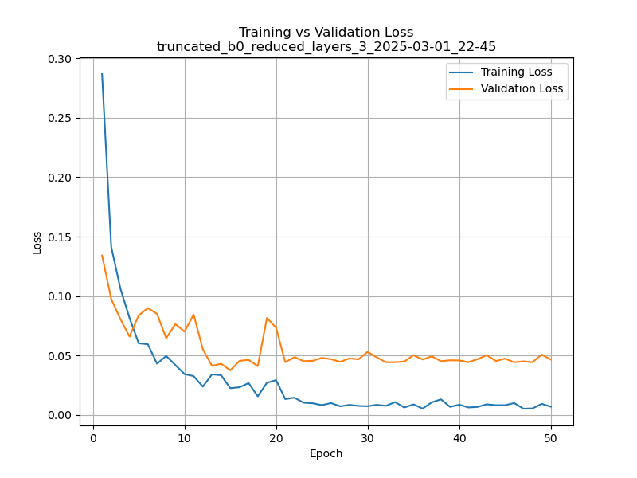
truncated_b0_reduced_layers_3_2025-03-01_22-45

Slide 10
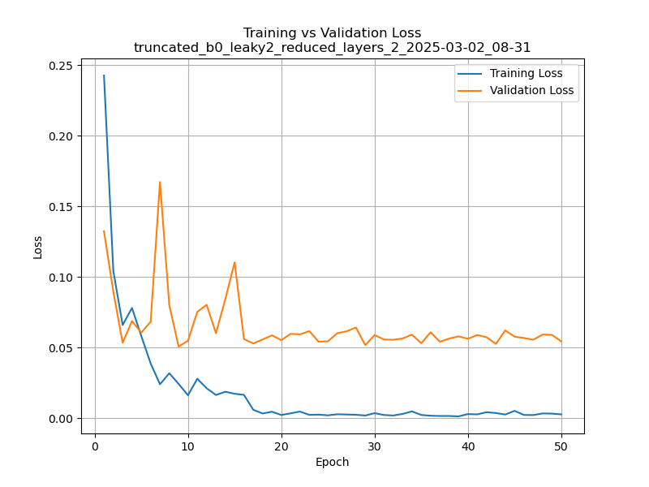
truncated_b0_leaky2_reduced_layers_2_2025-03-02_08-31

Slide 11
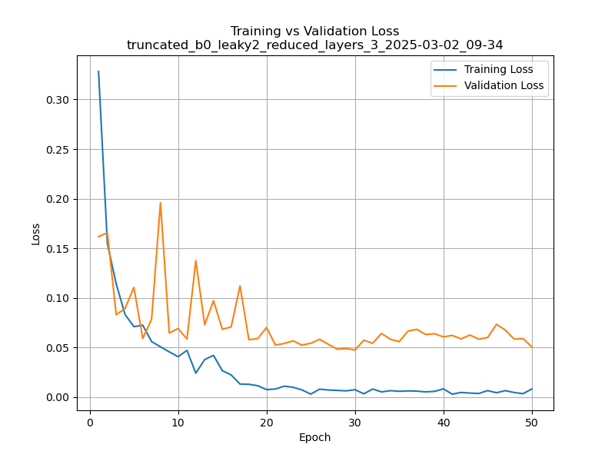
truncated_b0_leaky2_reduced_layers_3_2025-03-02_09-34

Slide 12
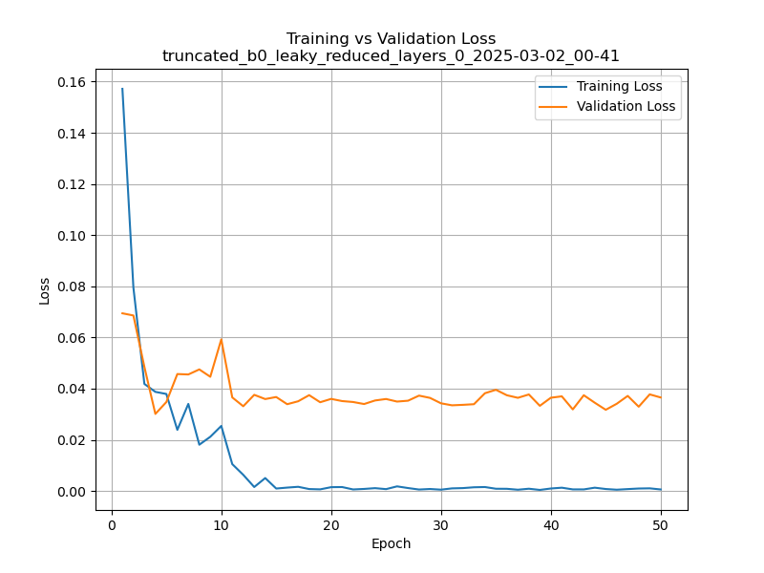
truncated_b0_leaky_reduced_layers_0_2025-03-02_00-41

Slide 13
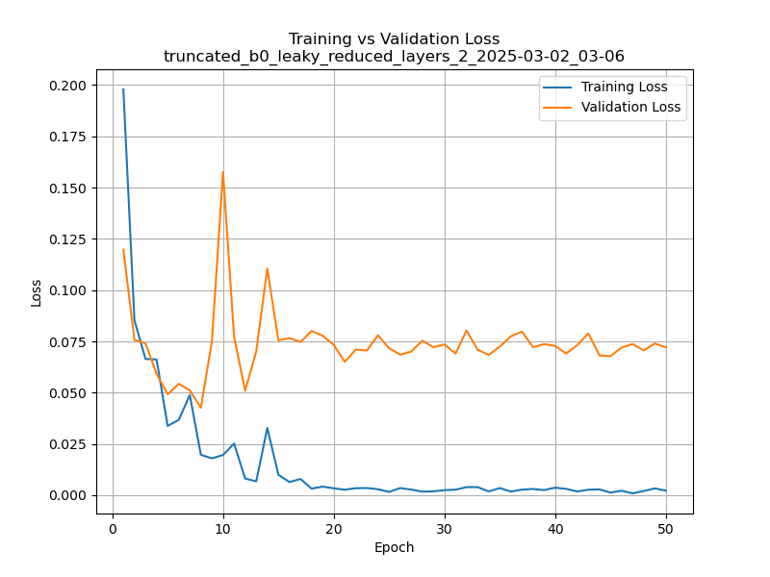
truncated_b0_leaky_reduced_layers_2_2025-03-02_03-06

Slide 14

truncated_b0_reduced_layers_0_2025-03-01_19-17

Slide 15
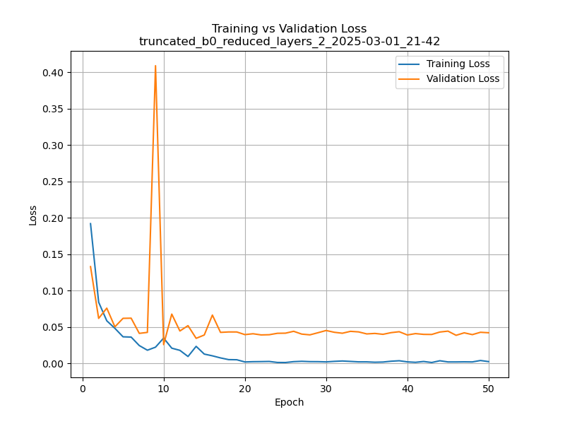
truncated_b0_reduced_layers_2_2025-03-01_21-42

Slide 16
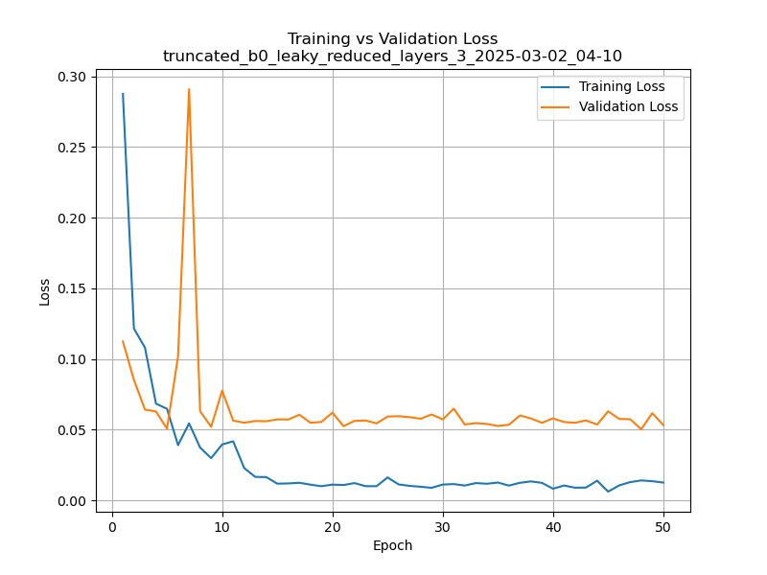
truncated_b0_leaky_reduced_layers_3_2025-03-02_04-10

