Slide 1
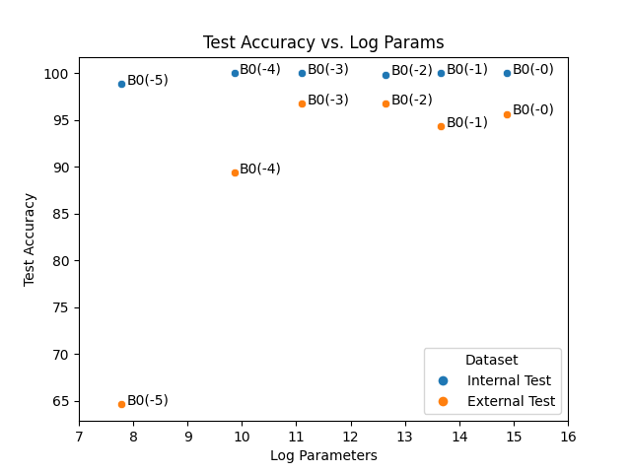

Slide 2
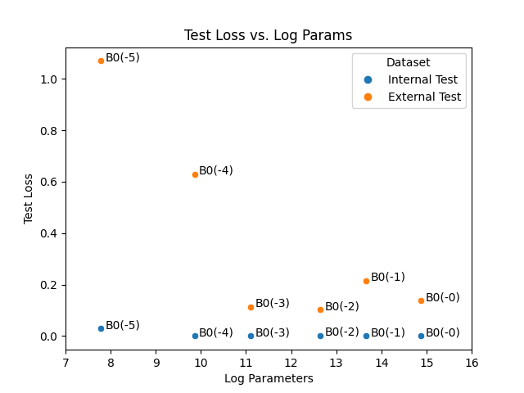

Slide 3
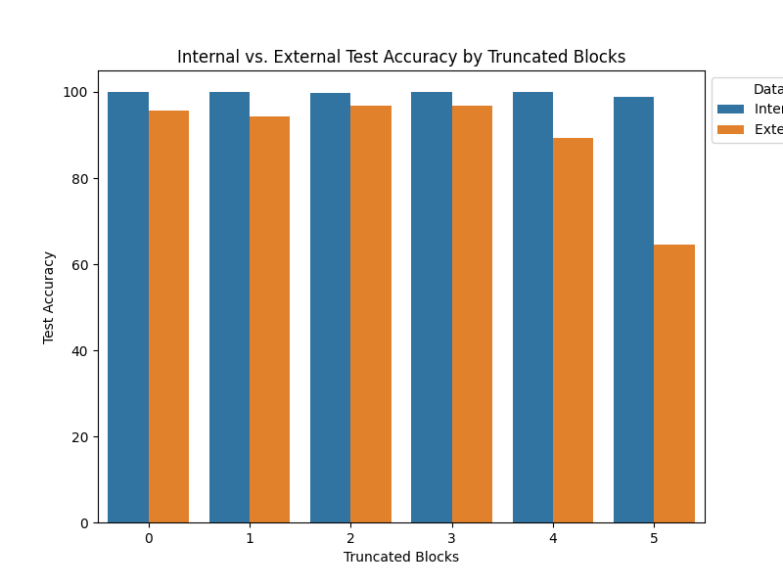


Slide 4
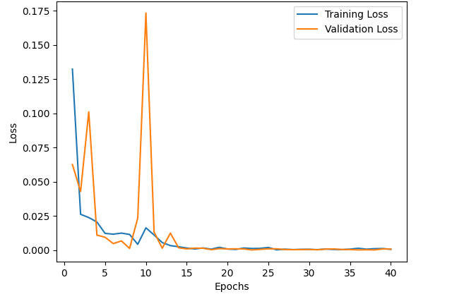
EfficientNet B0 (-3) Training Loss Plot

Slide 5
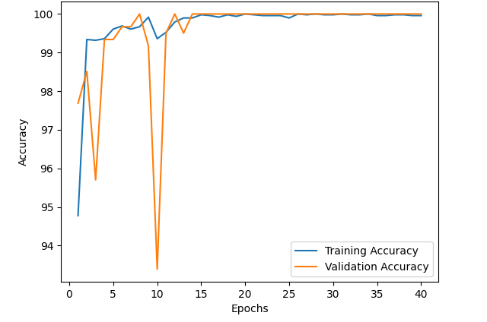
EfficientNet B0 (-3) Training Accuracy Plot

Slide 6
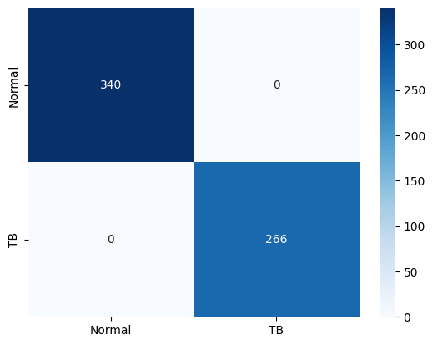
EfficientNet B0 (-3) Internal Confusion Matrix

Slide 7
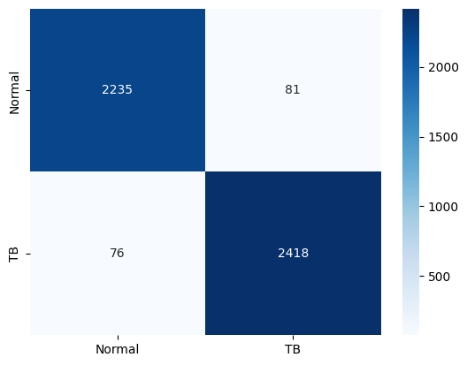
EfficientNet B0 (-3) External Confusion Matrix

Slide 8
