Slide 1

App Lifecycle
Salesforce App Deployment
Key application lifestyle milestones:
Plan, Build, Test, and Deploy
The use of a sandbox org is recommended for changes that affect data like automations.
Apex code must be deployed from a sandbox org.
A simple lifecycle refers to changes made in a production org with no sandbox.
An advanced lifecycle refers to changes tested in multiple sandboxes that can be consolidated in an integration sandbox.
Governance refers to standards for coding, testing, and integration.
Different sandbox types are available depending on the org edition:
Developer:
Production org metadata
200 MB limit
Refresh every day
Developer Pro:
Production org metadata
1 GB limit
Refresh every day
Partial Copy:
Production org data filtered with a template
5 GB limit
Refresh every 5 days
Full Copy:
All production org data
Production org limits
Refresh every 29 days

Slide 2
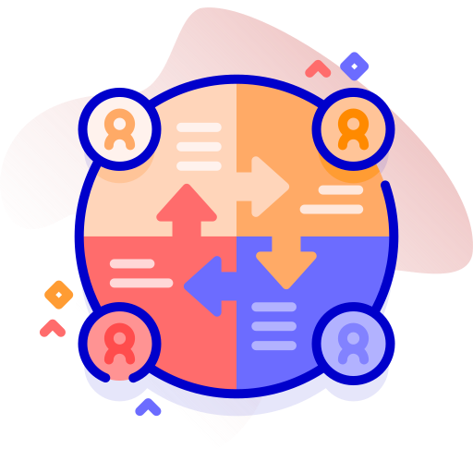
Change Sets
Salesforce App Deployment
Change sets are used for deploying metadata from one org to a related org (sandbox ↔ production).
Not all metadata types are supported and cannot deploy components in a specified order.
Change sets cannot delete or rename metadata components.
Require an authorized deployment connection be configured in Deployment Settings.
Change sets should be created, uploaded, validated, tested, then deployed.
Change sets can be inbound or outbound for an org.
Uploaded change sets are received as inbound change sets and must be deployed.
Uploaded change sets are closed and must be cloned to edit.
Metadata contained in an inbound change sets are overwritten, not merged.
There is no partial deployment, all components are deployed or none.
Change sets are deleted if the source org is deleted or refreshed.
Apex code must pass unit tests and meet 75% code coverage.
Test options:
Default with all local tests for production and none for sandbox
Local tests with no managed package tests
All tests
Specified tests

Slide 3
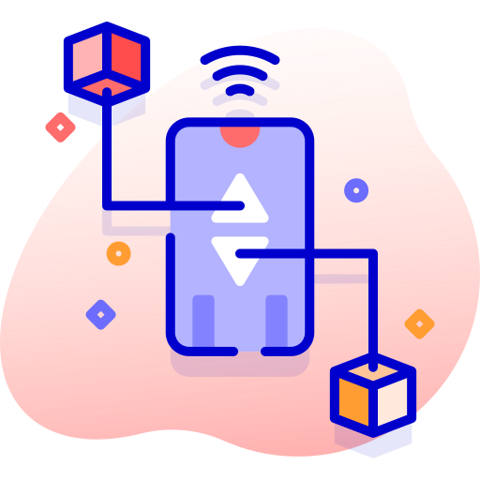
Packages
Salesforce App Deployment
Packages allow for component distribution across unrelated orgs (Setup > Package Manager).
Package components must be tested and production-ready.
Apex code must pass unit tests and meet 75% code coverage.
Dependent metadata is automatically included.
The package version must be specified upon upload.
Can set a password, minimum requirements, and documentation.
Can be shared with an installation URL and can be deprecated to prevent new installations.
Packages are profile, only for Administrators, or for all users.
Unmanaged packages:
Include app templates or other open-source metadata.
Cannot update existing components.
Can supplement Change Sets for unrelated orgs.
Can be edited by the end user.
The author cannot upgrade unmanaged packages remotely.
Managed packages:
Commercial apps published and installed from AppExchange.
Source code is not available to customers. Must be created from a Developer Edition org.
Contain a unique namespace to prevent name conflicts with prefixes on components.
Not all components can be packaged.
Package author can offer upgrades.
Package author cannot uninstall the package remotely.

Slide 4

Deployment
Salesforce App Deployment
A deployment plan refers to a series of steps to manage changes between Salesforce orgs.
Time must be allowed for long testing and verification before implementing in a production org.
Data backup should be considered before deployment for possible rollback.
Example:
Announce the maintenance window in advance
Validate changes with change sets or packages
Lock out users using login hours
Deploy changes
Perform manual changes not supported by change sets or packages
Verify functionality in the new org
Unlock users

