Slide 1

Validation Rules
Salesforce Automation
Ensure a record meets criteria before it is saved.
Criteria:
Field type (numeric, text, … )
Field format (email, year, phone number, regex, … )
Field ranges (e.g. date in current year)
...
Helps maintain data quality.
Throws the error message when the criteria expression returns TRUE.
Can be checked on creation and edit.
Error message can be placed at the top of the page or by the triggering field.
Must be marked ‘Active’ to be used.
All rules are checked, a triggered rule does not stop the checking process.
Validation is checked before other automation.
Validation is applied even if the validated field is not displayed on the page layout.

Slide 2

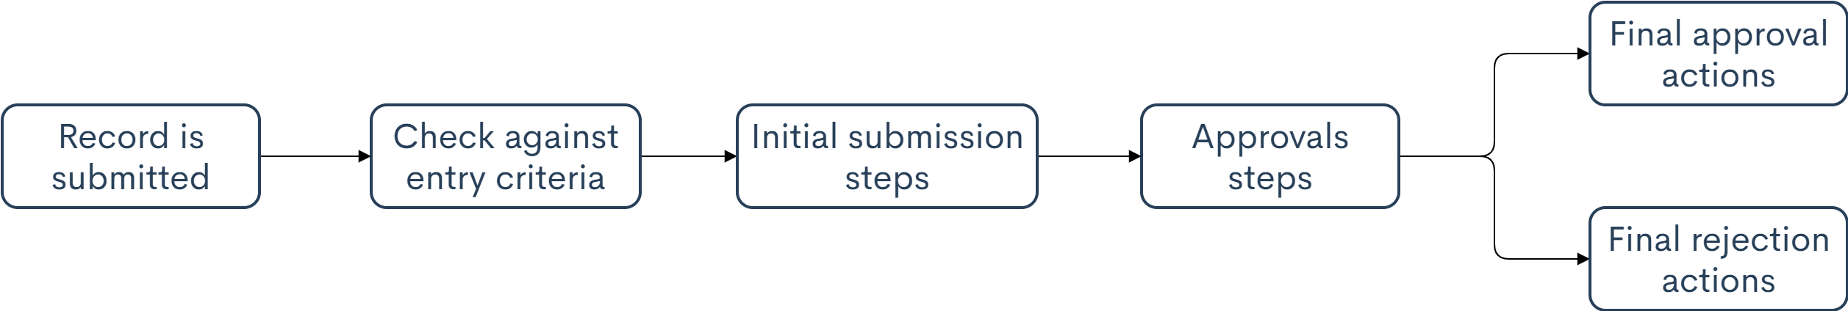
Approvals
Salesforce Automation
Automated process for approving records.
Actions:
Looking for a record
Field changes
Task creation
Email alerts
Outbound messages
Triggers:
Button on the record
Process
Flow
Apex trigger
Approvers:
Manager or another designated approver
Submitter-chosen user or queue
Admin-chosen user(s), related users, or queue
Delegated approver (chosen by the designated approver)
Approval flowchart:
By default, records are locked on submission.
Parallel approval can require unanimous or first response approval.
Approvals are supported (with limited features) with the Salesforce App, Chatter, and Email.

Slide 3
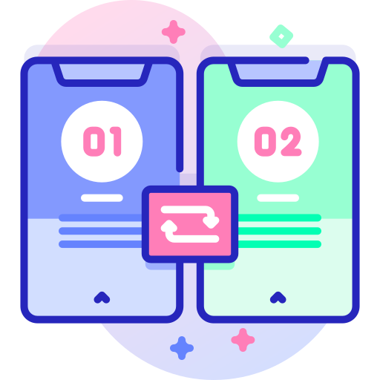
Workflows
Salesforce Automation
Record-based simple background automation.
Actions:
Field updates
Task creation
Email alerts
Outbound messages
Triggers:
Record save
Data import
API
Workflow rules are executed after validation rules and can invalidate previously validated fields.
Actions can be immediate or time-dependent based on date field or trigger date.

Slide 4
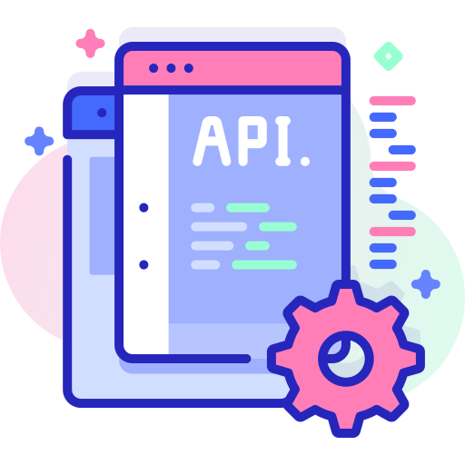
Processes
Salesforce Automation
Background automation.
Actions:
Create record
Call Apex
Launch Flow
Chatter post
Submit Approval
Email alert
Custom notification
Triggers:
Record save
Data import
API
Process
Platform event
Defined with an object, criteria, and condition actions.
Can be immediate or scheduled.
Can cause infinite loops – be careful to avoid.
Actions are executed in the order in which they appear.
Update related record
Quick actions
Launch Process
Send survey

Slide 5

Flows
Salesforce Automation
Guided visual user interfaces, complex automations, or record deletions.
Actions:
Create record
Call Apex
Launch Flow
Chatter post
Submit Approval
Email alert
Custom notification
Triggers:
Record save
Record delete
Schedule
Visualforce
Lightning components
Data import
API
Process
Platform event
Link (can pass parameters)
Types:
Screen flow: user interface with user input.
Autolaunched flow: invoked from a schedule, process, record, Apex, or platform event.
Defined with elements, resources, and connectors.
Supports complex logical branching, loops, and debugging.
Versions allow a pervious version of the flow to be run or reverted.
Fault paths can handle errors for elements that can fail.
A running flow instance is called a flow interview and can be run in parallel with other interviews.
Delete record
Update any record
User Interface (Screen Flow)

Slide 6


