Slide 1
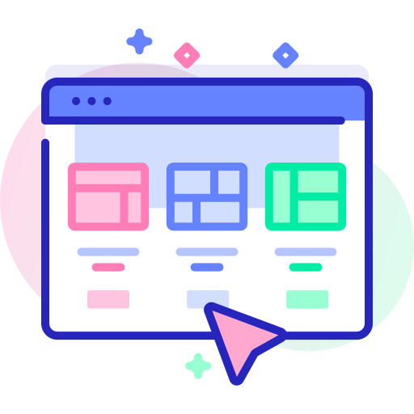
UI Customization
Salesforce User Interface
A page layout is the arrangement of buttons, fields, quick actions, related lists, and other components.
Custom components can be an Aura component (old) or a Lightning web component (new).
Lightning components utilize HTML, CSS, and JavaScript client-side with an APEX backend and require the use of My Domain.
Custom tabs give users to custom object data.
A Visualforce tab can display a Visualforce page and a web tab can display a webpage within Salesforce.
A list view displays records that meet defined criteria and they can be sorted and filtered.
In Lightning, users can pin a list view to make it their default.
List view actions include edit, delete, and follow records.
In Lightning, a list view chart can be added (vertical bar, horizontal bar, or donut).
Filters can utilize logic (OR / AND) and reference dynamic values (TODAY).
The Lightning home page is for the most important components of an app that deserve first visibility.
Can add standard or custom components and is designed in Lightning App Builder.
Lightning record pages that display individual record data can be customized.
Object fields can be added or hidden and templates can be selected based on the form factor.
The accordion component organizes and collapses multiple other components.
Record page view can be grouped, full, or console and can be assigned by app, profile, record type, etc.
Standard themes or a set of custom images and colors can theme and brand an entire org.
In-App Guidance can create interactive tours with step-by-step prompts and images.
Some user interface settings must be enabled for the org in Setup prior to use:
Collapsible sections, hover details, inline editing, enhanced lists, printable lists, etc.

Slide 2

Buttons, Links, Actions
Salesforce User Interface
Custom buttons can link to external apps or Salesforce links with URLs, JavaScript, or Visualforce.
Can be added to record pages, list views, and search but not on user record pages.
In Classic, JavaScript can modify records but not in Lightning.
Not supported on Web-to-Lead, Web-to-Case, or Case Teams related lists.
Standard buttons like New and Edit can be overridden or hidden but not deleted.
Custom links can link to internal or external URLs, JavaScript, or Visualforce.
Can only be added in the custom link section of record page layouts.
Can customize link to open the URL in current or new tab/window.
Use cases include the map of an address field.
Custom actions add functionality by interacting with Salesforce data.
Can be added to the Home page, Chatter tabs, Chatter groups, and record pages.
Global publisher layouts control the layout of global actions and can be assigned to user profiles.
Standard Chatter Lightning actions include Post, Poll, and Question.
Default actions can use predefined fields on accounts, cases, contacts, leads, and opportunities.
Productivity actions include View Website and Send Email.
The action layout editor can add, remove, and rearrange action fields.

