Slide 1

TEAM mARACUJA
Teodora Ljubevska, noah bucher, daniel Pflüger

Slide 2

Lifelong Learning is currently done by only a few people
Motivation
“Our study showed that people who are passionate […] learn
much faster than those who are motivated by fear. That
same research we did revealed that, at most, only 14%
of US workers express this form of passion in relation
to their work.”
Source: Harvard Business School Journal (https://hbr.org/2021/10/what-motivates-lifelong-learners?msclkid=a4dede50abb411ecad0e69af4b7a2253)

Slide 3
The access to education is difficult and challenging
We provide the most urgent solutions
Problems
Educational offers are spread over many platforms
Documentation and validation of education is difficult
People in different educational states are not connected
Solutions
Individualized educational offers from central registry
Institutions issue unique certificates to student/edu.ID
Forum to share experiences
Switch can extend the scope of the edu.id and simplify the access to appropriate education

Slide 4

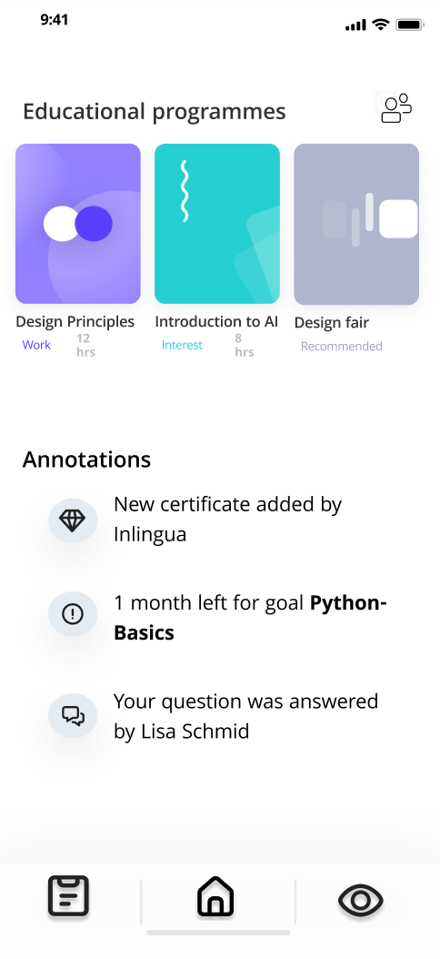

EduMate

Slide 5
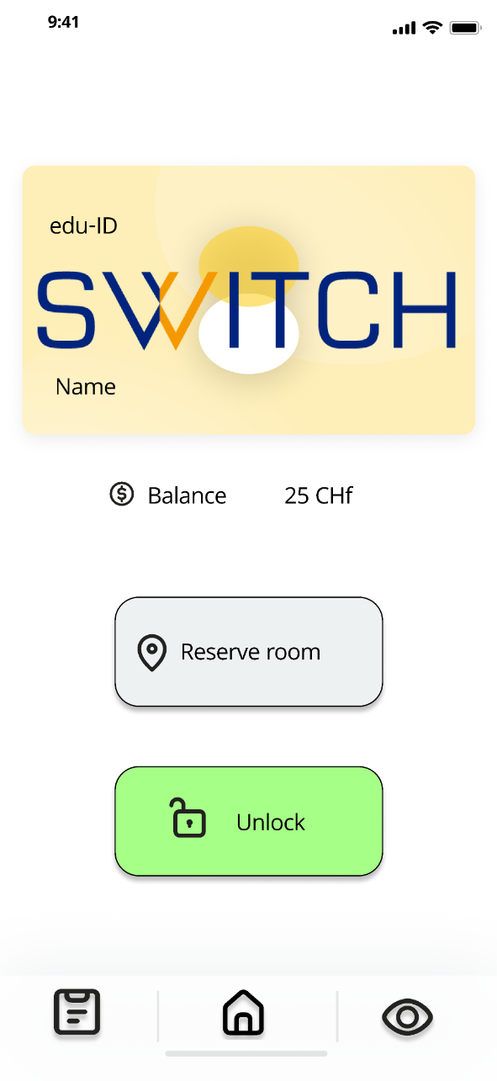
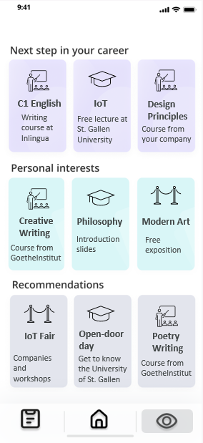
Digital Student Card
Discovery Page

Slide 6
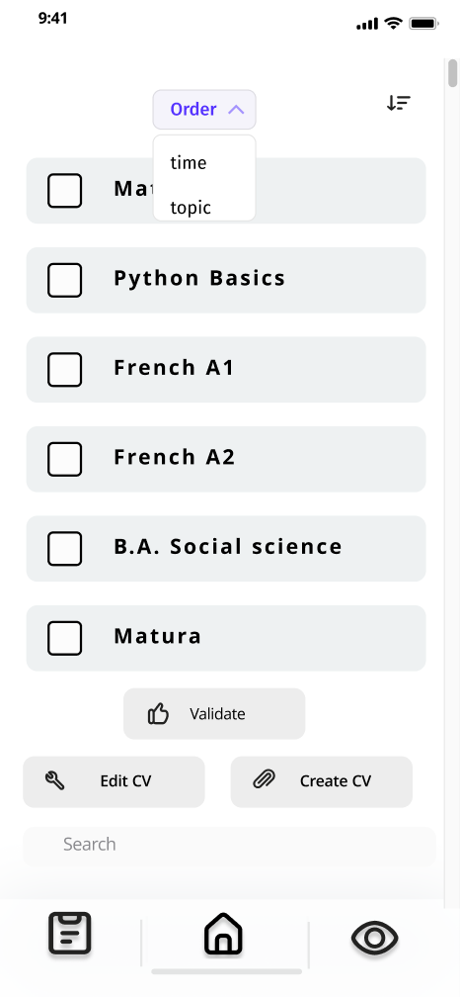
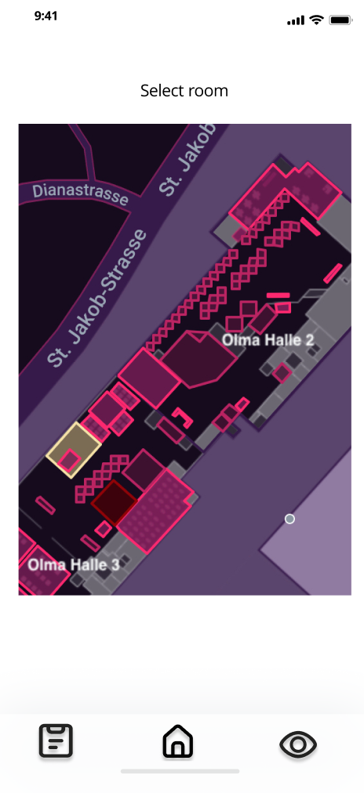
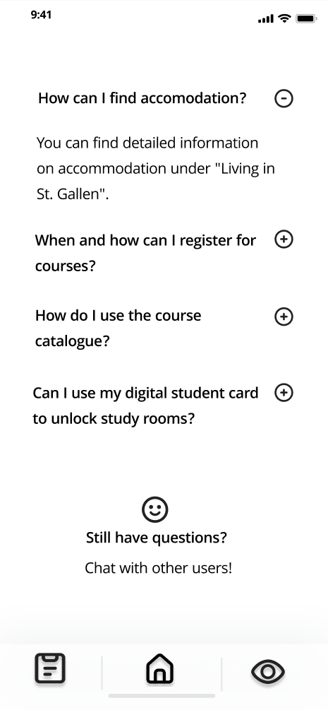
Certifications
Room bookings
FAQ & Chat
Create CVs, decentralized, unforgeable
Simple overview, easy booking
Quick answers, personal chat

Slide 7

Reports are certified by Institution. They can be verified online.
Certification
Blockchain
validation
Digital fingerprint
University
Employer
Report
apply
EduMate
Student
Curriculum Vitae

Slide 8
Business Model
Overview
1 Digital Student Card
1
2
Fee per issued digital student card
2 Affiliate Program
Commission for every booking via affiliate link
3 Transaction fees
Transaction fees for every verification done on the blockchain
3
4
4 Subscription Model for Institutions
Monthly contribution for Universities and Institutions to be featured in the suggestions

Slide 9
Detailed Business model
New Campus Card at Swiss universities cost on average 20-25 CHF
Digital Student Card would be priced at 15 CHF
No loss of card possible, no additional costs
Less administrative burdens
Affiliate Links from recommendations within the app to the booking site of the partner
Revenue share for every successful sale
Offer low revenue shares to guarantee competitive and fair pricing
Digital Student Card
Affiliate Program
Transaction fees
Subscription model to be placed in the recommended courses
Aiming at Universities and Institutions
Companies that use the blockchain pay per verification
Additional subscription model offering a certain number of transactions per quarter
Bulk discounts
Subscription Model

Slide 10
EduMate
TEAM mARACUJA
Teodora Ljubevska, noah bucher, daniel Pflüger

