Slide 1
SMR(State Machine Replication)
Presented by Bocheng Cui
PhD Student in UNH
noahcui.github.io/info

Slide 2
Familiar?
Please sign your name on the sheet, system of the gym is down.
Planned scheduled maintenance upgrades for CS servers. Agate will not be available until we finish the updating. This will take probably 30 ~ 40 mins.
Your favorite online video game is scheduling an system update starts from 8am, and will not be available until 10.
Notes:
Sharding gives developers more flexibility.
Sharded system can scale with #clusters.
One or more shard can be deployed on one server, depending on their needs, so geo-distributed is possible.

Slide 3
Did you ever heard of these?
Google is updating its server, you will not able to use YouTube and Google Search in the next two hours
Planned scheduled maintenance updates for Amazon, please come back 2 weeks later.
Bank of Durham’s system is down, please sign your name and the amount of money you want to withdraw in the sheet.
Notes:
Sharding gives developers more flexibility.
Sharded system can scale with #clusters.
One or more shard can be deployed on one server, depending on their needs, so geo-distributed is possible.

Slide 4
What is SMR?
State Machine Replication (SMR) or state machine approach is a general method for implementing a fault-tolerant service by replicating servers and coordinating client interactions with server replicas. The approach also provides a framework for understanding and designing replication management protocols.
Notes:
Sharding gives developers more flexibility.
Sharded system can scale with #clusters.
One or more shard can be deployed on one server, depending on their needs, so geo-distributed is possible.

Slide 5
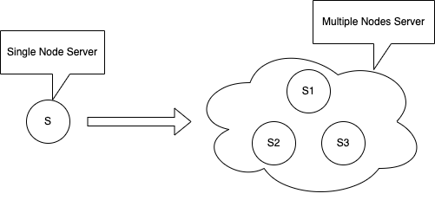
Notes:
Sharding gives developers more flexibility.
Sharded system can scale with #clusters.
One or more shard can be deployed on one server, depending on their needs, so geo-distributed is possible.

Slide 6
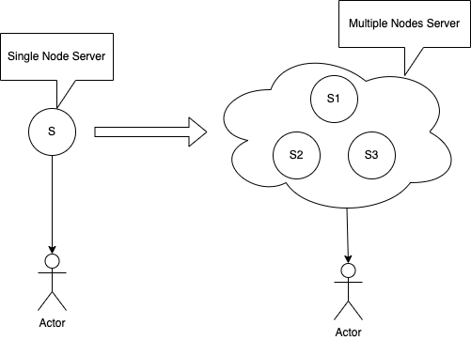
Notes:
Sharding gives developers more flexibility.
Sharded system can scale with #clusters.
One or more shard can be deployed on one server, depending on their needs, so geo-distributed is possible.

Slide 7
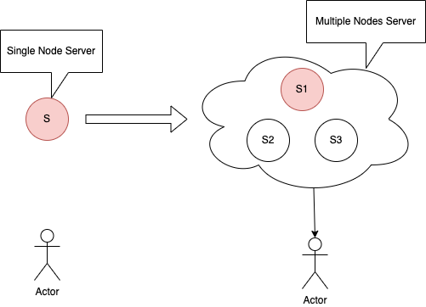
Notes:
Sharding gives developers more flexibility.
Sharded system can scale with #clusters.
One or more shard can be deployed on one server, depending on their needs, so geo-distributed is possible.

Slide 8
Solutions
Paxos
Multi-Paxos
Raft
Mencius
Simplified Mencius
…
Notes:
Planned stops are 1000x more frequent than unplanned failures.
Existing sharding frameworks cannot perform shard migration without impacting in-flight client requests.
Existing sharding frameworks do not provide sufficient support for geo-distributed applications.
Lack of support for geo-distributed applications and inability to maintain application availability during planned events.
Geo-distributed applications are ubiquitous in large-scale internet services.
100% of facebook’s sharded applicathons are deployed to multiple regions.

Slide 9
Requirements
All replicas in SMR must operate as deterministic state machines.
Can only commit and execute an request after they made an agreement of Majority
Need to guarantee the order of requests.
Reliable.
Handling of node failure and re-join(Dynamic number of nodes).
Notes:
Placement & load-balancing
Most sharding frameworks use hand-crafted PLB heuristics, which are easy to start with but become brittle and hard to extend over time.
Small applications prefer simplicity, whereas mega application often employ high customized features. Attempting to implement all custom features in a single sharding framework makes it unwiedly and over complex.
System stability :Cap the number of concurrent shard moves per server and per application to limit churns that may threaten system stability.
Server capacity: The aggregate consumption of all shards on a server should not exceed the server’s capacity
Region preference: SM allows a fine-grained control of placing individual shards at different regions.
Spread of replicas: It’s preferred to place a shard’s replicas across fault domains at all levels, including regions, data centers, and racks.
Planned maintenance: depending on an application’s configuration, SM may proactively drain shards out of a server with pending maintendance or software upgrades.
Utilization threshold: an application may prefer its server utilization to not exceed a threshold, e.g. 90%
Global load balancing: balance load across servers in different regions.
Regional load balancing: balance load across servers within a region
Parallel shard failover: evenly distribute shards on a failed server to multiple other servers for faster recovery.

Slide 10
Cost
Performance(Throughput and Latency)
Resources per request
Better Coders
Reliable communication between nodes
Better algorithms reduce the cost of one or some of them.
Notes:
Placement & load-balancing
Most sharding frameworks use hand-crafted PLB heuristics, which are easy to start with but become brittle and hard to extend over time.
Small applications prefer simplicity, whereas mega application often employ high customized features. Attempting to implement all custom features in a single sharding framework makes it unwiedly and over complex.
System stability :Cap the number of concurrent shard moves per server and per application to limit churns that may threaten system stability.
Server capacity: The aggregate consumption of all shards on a server should not exceed the server’s capacity
Region preference: SM allows a fine-grained control of placing individual shards at different regions.
Spread of replicas: It’s preferred to place a shard’s replicas across fault domains at all levels, including regions, data centers, and racks.
Planned maintenance: depending on an application’s configuration, SM may proactively drain shards out of a server with pending maintendance or software upgrades.
Utilization threshold: an application may prefer its server utilization to not exceed a threshold, e.g. 90%
Global load balancing: balance load across servers in different regions.
Regional load balancing: balance load across servers within a region
Parallel shard failover: evenly distribute shards on a failed server to multiple other servers for faster recovery.

Slide 11

Thank you
Presented by Bocheng Cui
PhD student in UNH
noahcui.github.io/info

