Slide 1



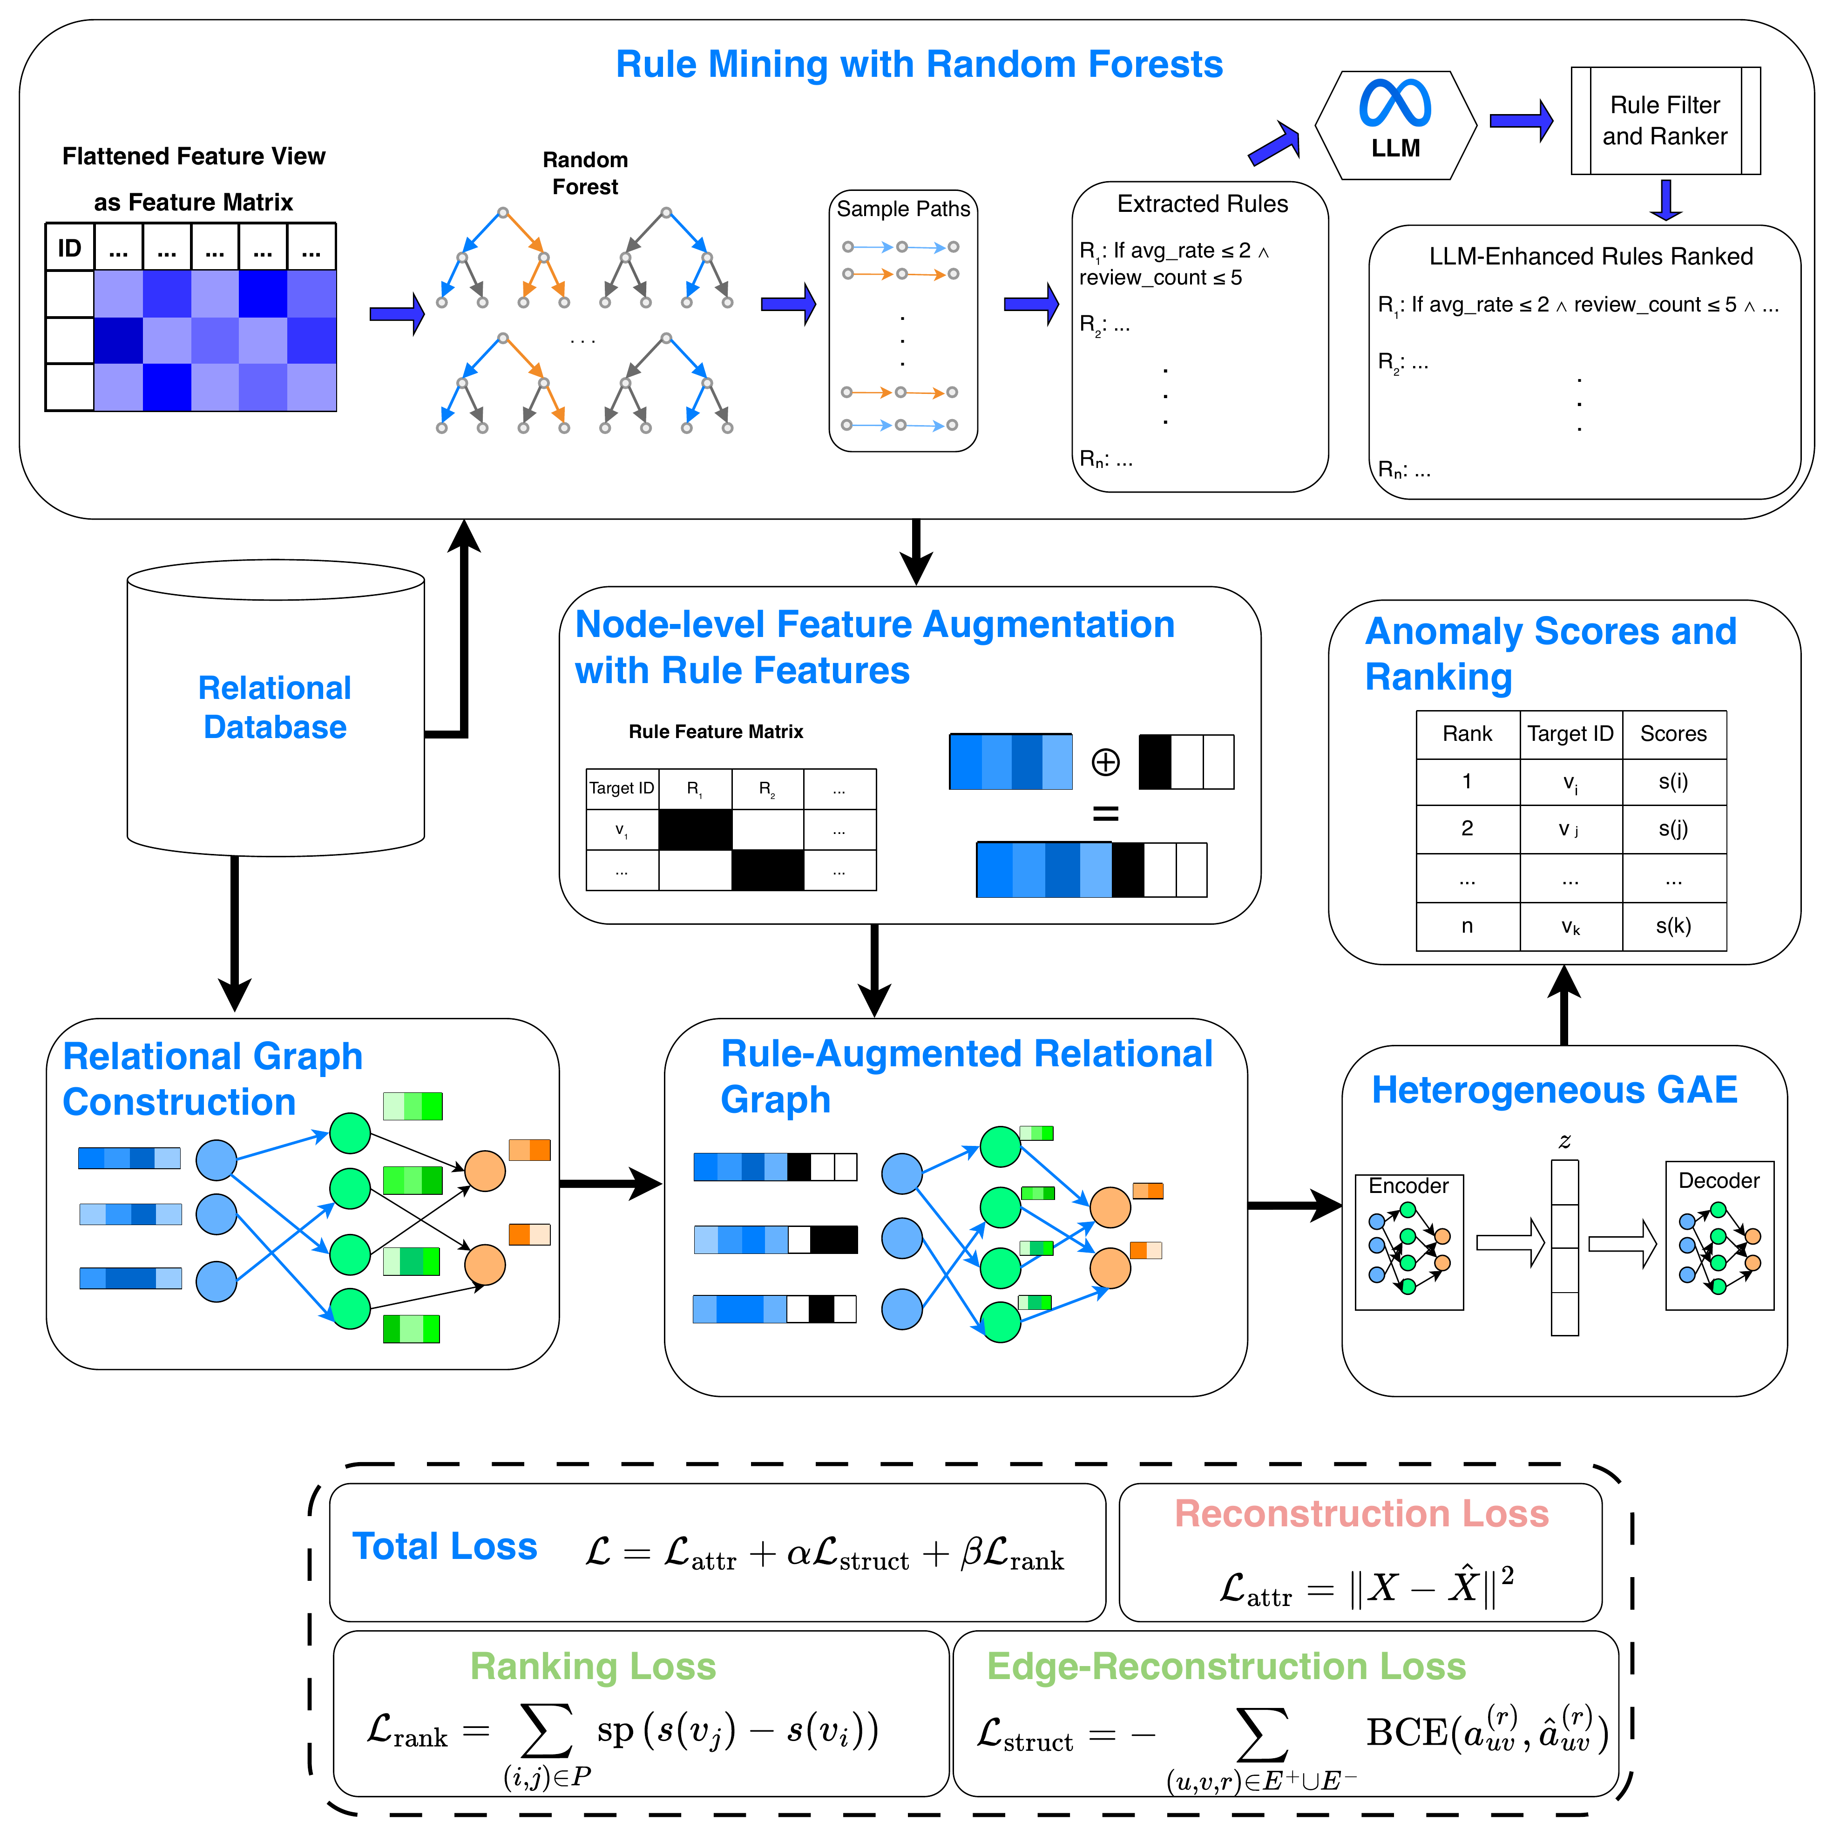
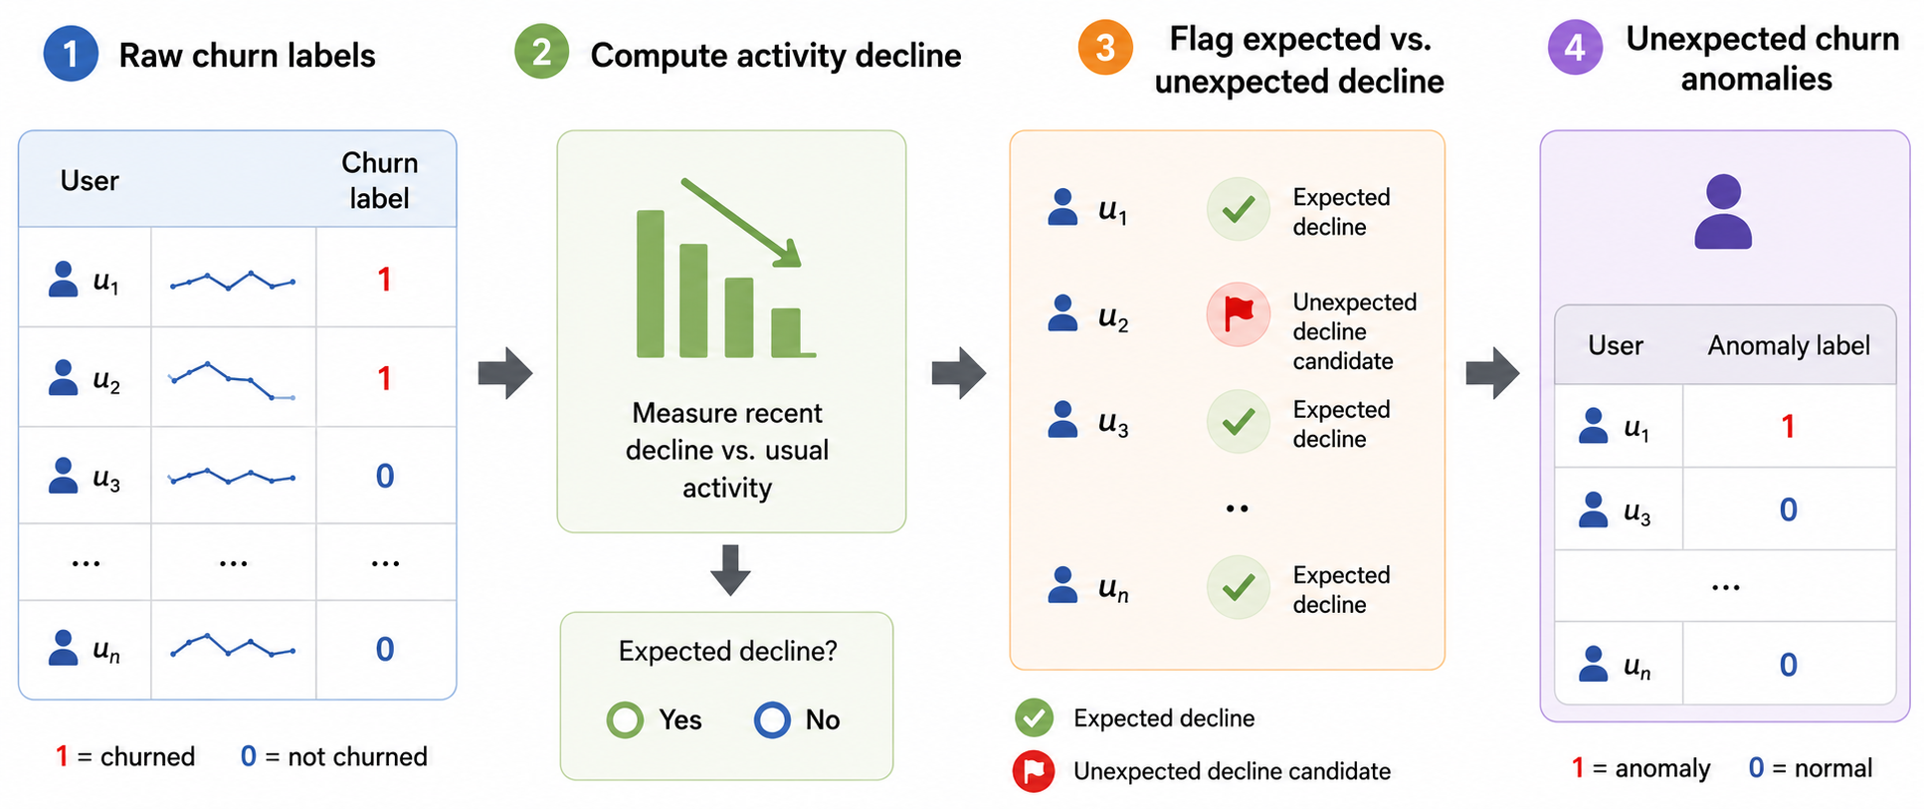
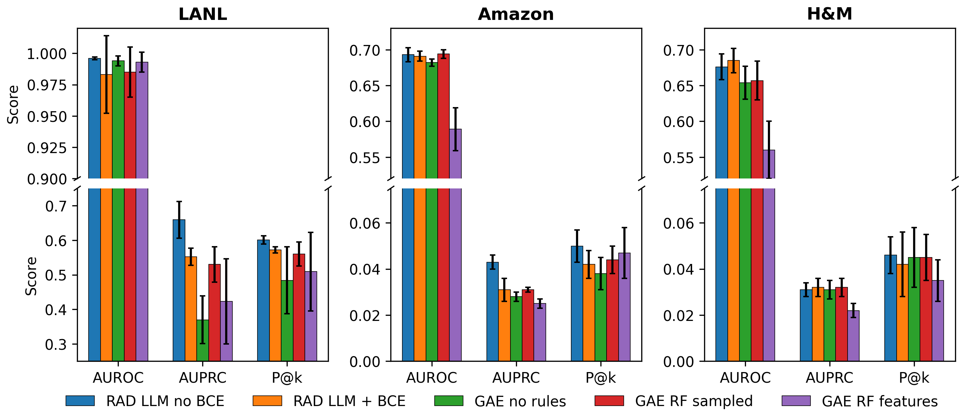
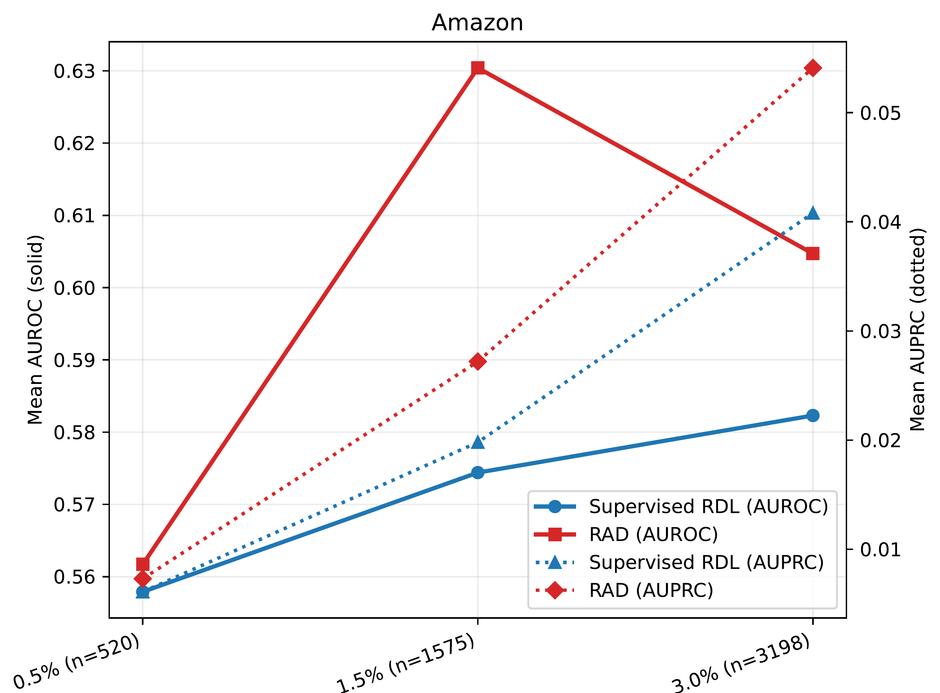
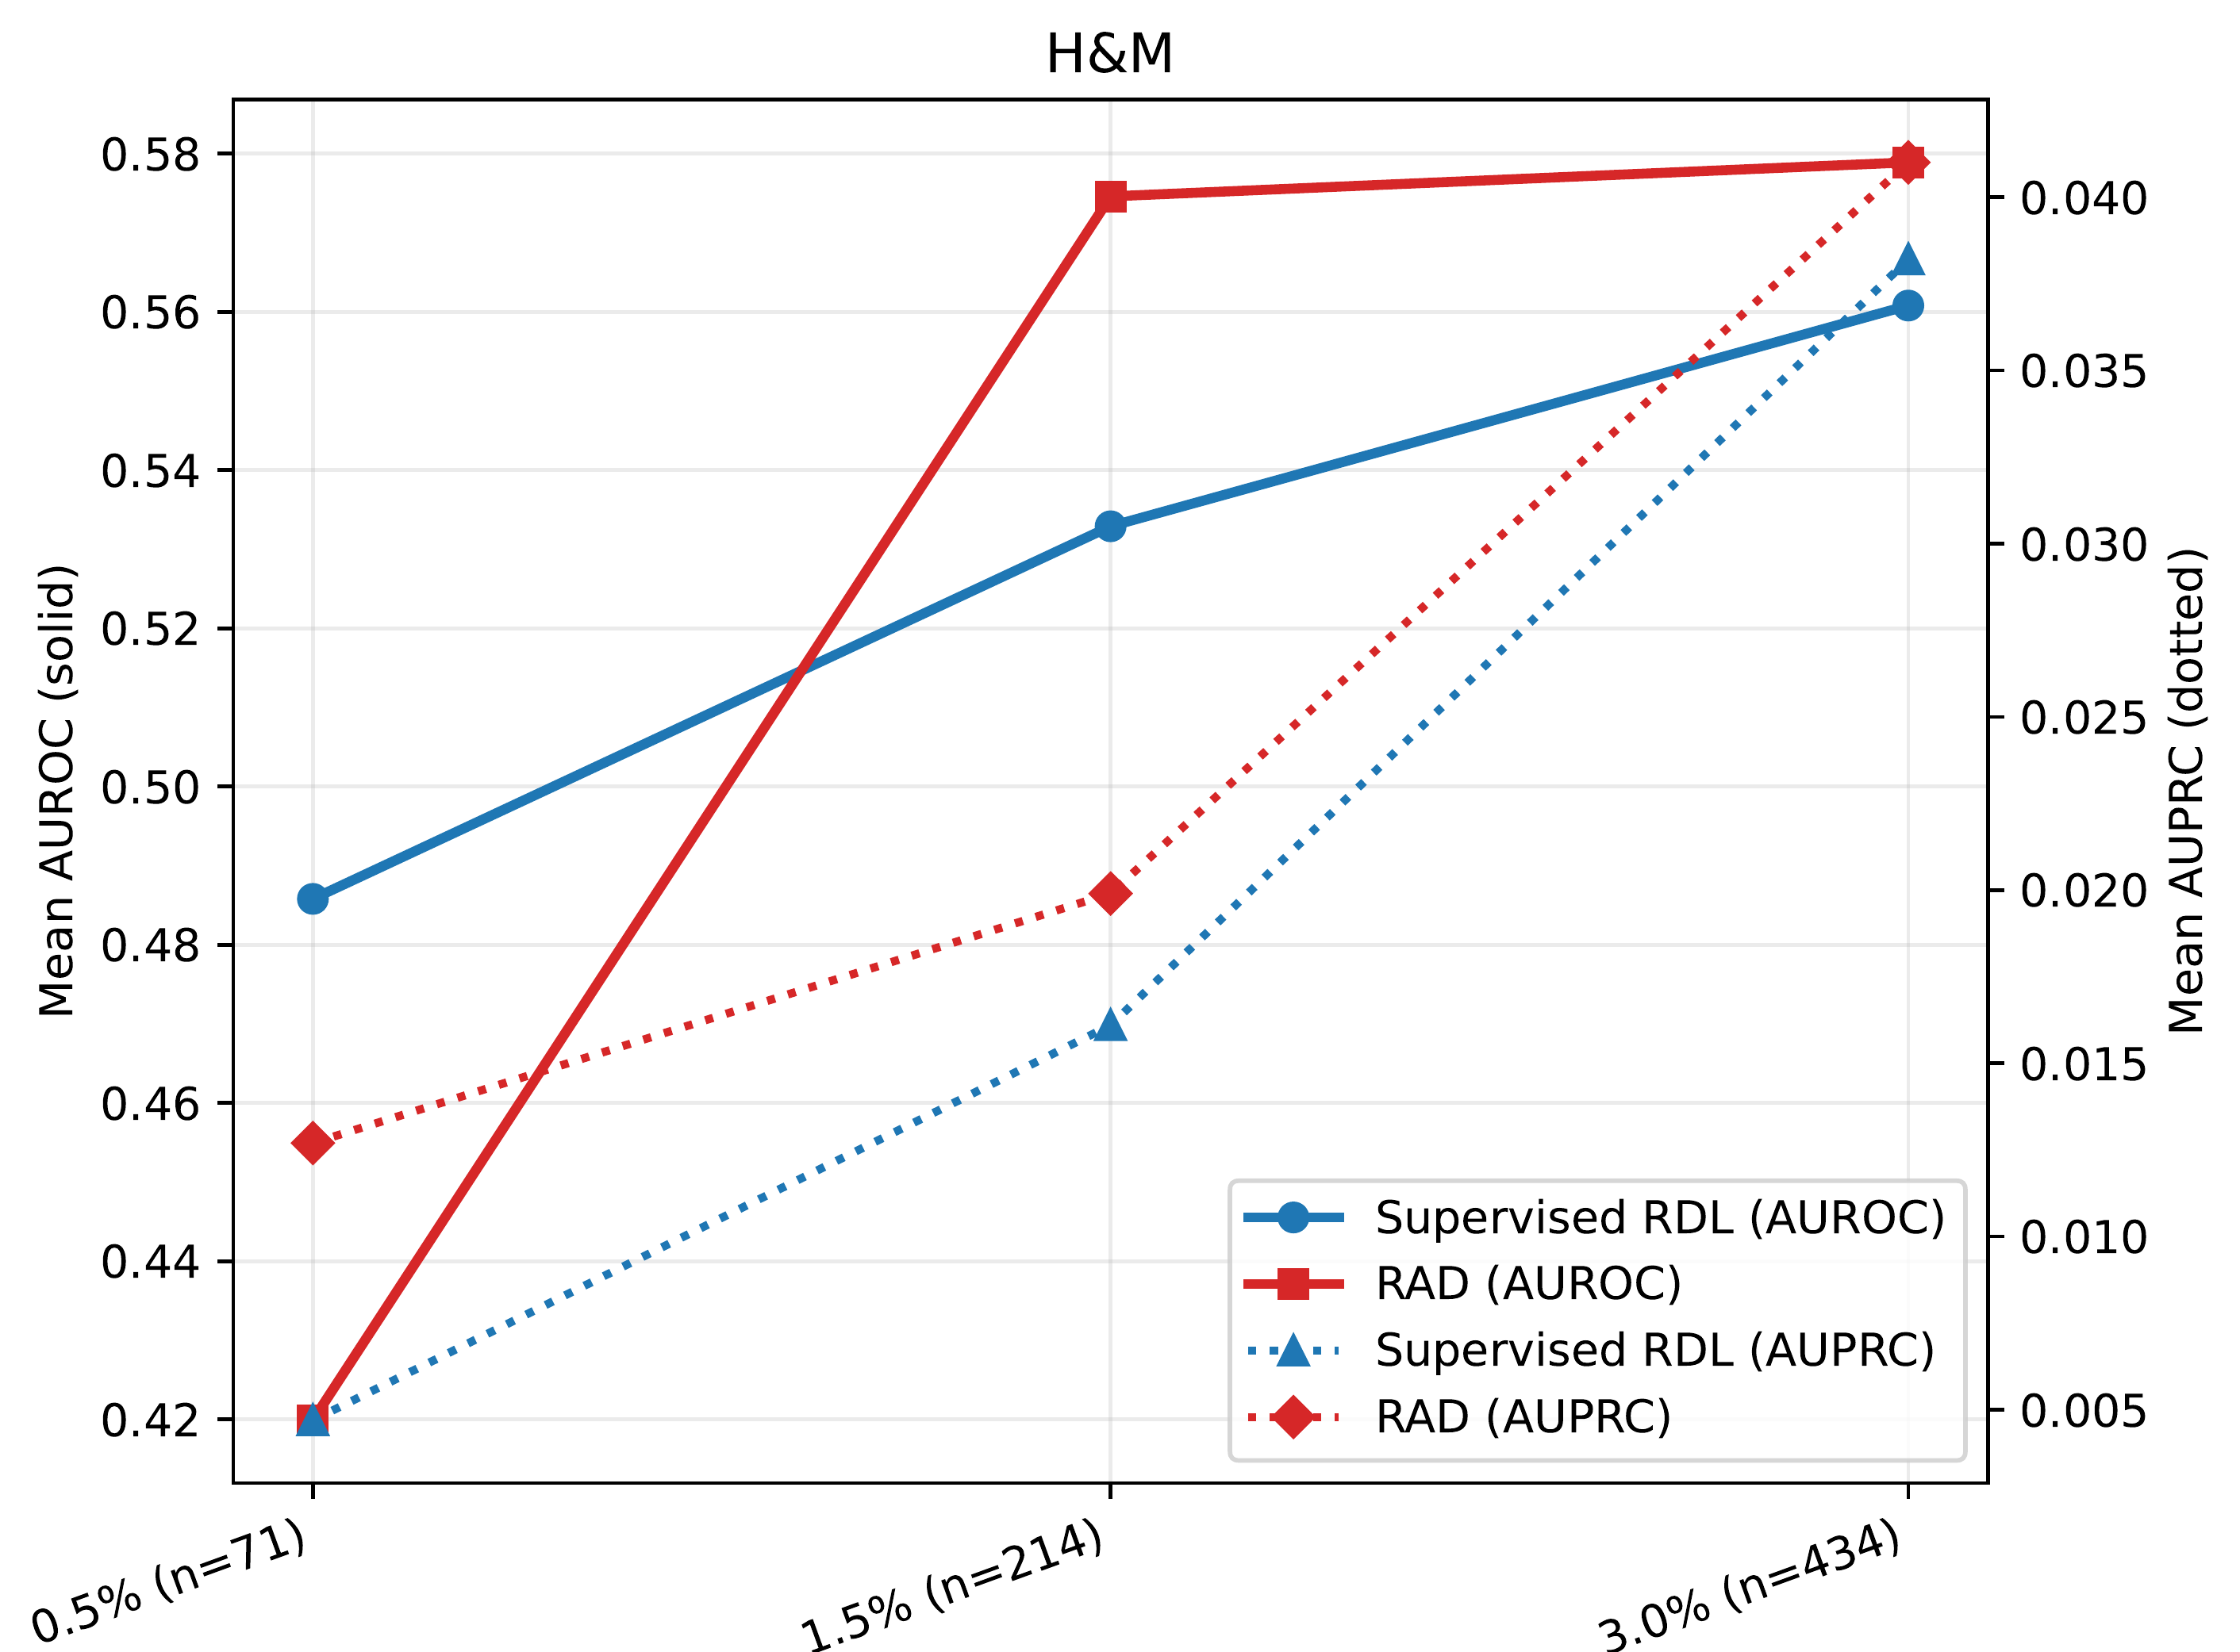
RAD: Rule-Augmented
Relational Anomaly Detection
Noah Dahle, Anne Tumlin, Ngoc Tran, Xenofon Koutsoukos, Tyler Derr
Vanderbilt University, Nashville, TN, USA
CIKM ’26 · Rome, Italy
Code & data
Key idea Mine symbolic rules from the data, inject them into target nodes before graph message passing, and train a heterogeneous graph autoencoder with a ranking loss — better anomaly retrieval in multi-table databases.
1.2
0.659
0.601
best average AUPRC rank of 10 methods across 3 benchmarks
AUPRC on LANL cyber events vs 0.525 for the best baseline
LANL precision@k: 60% of top alerts are real red-team logins (best baseline 0.540)
1
The Problem
3
RAD: Rule-Augmented Relational Anomaly Detection
A login can look normal as a single row yet be suspicious given who logged in, where, and what happened just before. Such anomalies live across tables.
1
Relational graph
Rows become typed nodes, primary–foreign keys become typed edges; only data available at time t is used.
Flattening into one feature matrix loses entity identity, schema roles and multi-hop context
Relational deep learning keeps structure but has no anomaly objective
Symbolic rules capture behavior, but usually sit outside representation learning
2
Rule mining
Random-forest paths become conjunctive predicates, ranked by support, confidence and lift. An LLM prunes, tightens and merges them.
2
A New Benchmark
3
Rule injection
Each target node gets a binary rule vector r(v), concatenated to its features before message passing.
Task | Target | Records | Anomaly
LANL | Auth event | 1.65B | Red-team login
Amazon | Customer | 15.0M | Unexpected review churn
H&M | Customer | 16.7M | Unexpected purchase churn
4
Rule-aware scoring
2-layer heterogeneous GraphSAGE autoencoder trained with reconstruction + pairwise ranking loss.
No label leakage. The LLM only proposes predicates, which are re-validated on train/validation data. It never assigns labels or scores.
4
Main Results (10 seeds)
5
Ranking at a Glance
Model | LANL |  |  | Amazon |  |  | H&M |  |  | Avg. rank ↓
 | AUROC | AUPRC | P@k | AUROC | AUPRC | P@k | AUROC | AUPRC | P@k | AUROC | AUPRC | P@k
RAD (rules, no BCE) | 0.996 | 0.659 | 0.601 | 0.693 | 0.043 | 0.050 | 0.828 | 0.143 | 0.129 | 2.0 | 1.2 | 2.0
RAD (rules, BCE) | 0.860 | 0.557 | 0.572 | 0.695 | 0.043 | 0.051 | 0.787 | 0.110 | 0.125 | 3.3 | 1.8 | 2.3
RDL weighted | 0.553 | 0.007 | 0.021 | 0.720 | 0.037 | 0.062 | 0.700 | 0.035 | 0.064 | 4.7 | 4.8 | 3.7
RDL unweighted | 0.685 | 0.015 | 0.026 | 0.713 | 0.037 | 0.062 | 0.693 | 0.039 | 0.064 | 4.3 | 3.8 | 3.3
AE+Rank | 0.943 | 0.525 | 0.540 | 0.518 | 0.016 | 0.015 | 0.456 | 0.013 | 0.005 | 5.2 | 5.2 | 5.7
DRL | 0.673 | 0.004 | 0.005 | 0.463 | 0.013 | 0.003 | 0.456 | 0.013 | 0.009 | 7.5 | 8.2 | 7.2
AE | 0.888 | 0.009 | 0.000 | 0.474 | 0.014 | 0.014 | 0.408 | 0.012 | 0.007 | 6.7 | 7.3 | 7.8
Deep SVDD | 0.736 | 0.005 | 0.001 | 0.458 | 0.013 | 0.003 | 0.412 | 0.012 | 0.002 | 7.7 | 8.7 | 8.8
Isolation Forest | 0.644 | 0.003 | 0.000 | 0.450 | 0.013 | 0.001 | 0.402 | 0.012 | 0.004 | 9.7 | 9.3 | 9.5
Supervised MLP | 0.965 | 0.050 | 0.093 | 0.659 | 0.027 | 0.041 | 0.642 | 0.027 | 0.039 | 4.0 | 4.7 | 4.7
Means over 10 seeds (std. dev. in the paper). Bold = best per column. AUPRC and P@k matter most under heavy class imbalance.
Average AUPRC rank across LANL, Amazon and H&M (lower is better). Both RAD variants rank ahead of every baseline, including the supervised MLP.
6
What Matters? Ablations
7
Robust to the Anomaly Definition
Rules help: rule-augmented variants beat the no-rules GAE, most clearly on AUPRC
Compact predicates beat raw random-forest decision features
Edge reconstruction (BCE) is optional: the no-BCE variant ranks best overall
Varying the unexpected-churn prevalence (0.5%, 1.5%, 3.0%) leaves the RAD-vs-RDL comparison stable: the 1.5% default is not a cherry-picked threshold. Solid lines = AUROC, dotted = AUPRC.
Paper: doi.org/10.1145/3799682.3841086 Code: github.com/noahd15/RAD_RelationalAnomalyDetection Supported by NSA (H98230-23-C-0279) and NSF (IIS-2239881, ECCS-2325417, IIS-2524380, DGE-2622415).
Notes:
Two-minute pitch. 1) Problem: in relational databases, anomalies often depend on context across tables; flattening loses that, and relational deep learning has no anomaly objective. 2) Idea: RAD mines random-forest rules, refines them with an LLM into compact predicates, and injects them as binary features into target nodes before message passing. A heterogeneous graph autoencoder is trained with reconstruction plus a pairwise ranking loss. 3) Benchmark: LANL red-team logins plus unexpected churn on Amazon and H&M. 4) Results: best average AUPRC rank (1.2 of 10 methods); LANL AUPRC 0.659 vs 0.525 and P@k 0.601 vs 0.540. Amazon: RDL wins AUROC and P@k, RAD wins AUPRC. 5) Ablations: rules help, compact predicates beat raw RF features, edge reconstruction is optional. Results are stable across 0.5 to 3 percent prevalence.

