Slide 1
Bitcoin and Blockchain Technology

Slide 2
Fundamental Challenges of a Digital Currency
Can I trust that the money is authentic and not counterfeit?
Can I trust that the digital money can only be spent once (known as “double spend problem”)?
Can I be sure that no one else can claim this money belongs to them and not me?
Notes:
Emergence of viable digital money is closely linked to the development in cryptography.
When comparing these questions for physical/ paper money, or fiat:
The counterfeiting problem is solved by using increasingly sophisticated papers and printing technology.
Double spending problem is easy since a physical dollar cannot be in two places at once
Digital US dollar, like our debit cards, the double spend issue is resolved by clearing all electronic payments through a central authority
With physical money, of course its in your hands, and with digital fiat, you have a central authority, so if someone spends your money you can dispute it
For a Digital Currency:
Cryptographic digital signatures enable a user to sign a digital asset or transaction proving ownership of that asset
All cryptocurrencies use this approach for the third question, and the other two are answered differently for each cryptocurrency

Slide 3
History of Digital Currencies Leading up To Bitcoin
Began in Late 1980s:
A currency that could be sent untraceably
Did not require central authorities (Banks)
Bit Gold (1998): Could never solve the double spending problem
DigiCash (1990s) : Advanced use of public and private key cryptography as a way to send electronic transactions
Notes:
Main idea here is that there were systems that had slowly built the basis for Bitcoin, which was released about a decade later
Bitcoin represents the culmination of decades of research in cryptography and distributed systems from the 80s to the early 2000s

Slide 4
Bitcoin (2008)
A set of rules for independent transaction validation and currency issuance (consensus rules)
A decentralized peer-to-peer network (the bitcoin network)
A public transaction ledger (the blockchain)
A mechanism for reaching global decentralized consensus on the valid blockchain (Proof-of-Work Algorithm)
Notes:
About a decade after Bitgold was released, Satoshi nakatomoto released the whitepaper for bitcoin in 2008
Bitcoin became so popular because it brought together these four key points in a unique and powerful combination

Slide 5
Transactions
Private/ Public Keys
Wallets
Notes:
Transactions are the most important part of the bitcoin ecosystem
Everything in bitcoin is designed to ensure that transactions can be created, propagated on the network, validated, and finally added to the global ledger of transactions
In order to understand how a transaction is sent, I’m going to quickly go over how a wallet works

Slide 6
Private/ Public Key
Ownership of bitcoin is established through:
Digital Keys
Bitcoin Addresses
Digital Signatures
Digital Keys, or private keys, are not stored on the network, but in a file, or wallet
Notes:
In essence a wallet is really just a place that stores you’re keys
There isn’t actually bitcoin in you’re wallet, but instead its just keys that are correlated to a certain amount of bitcoin in the network

Slide 7
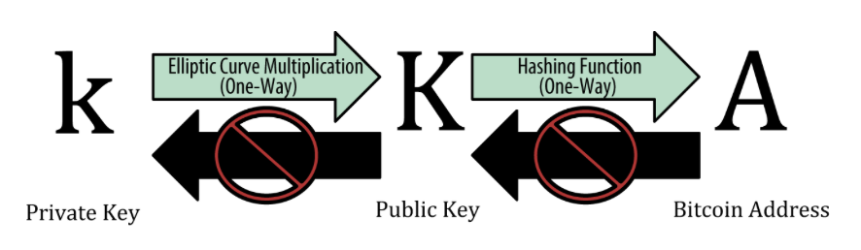
Notes:
Private key is simply a number that can be picked at random of 256 bits, and is the root of all user control over their funds
Giving away your private key is like handing over your SSN, Passport, everything
Now from the private key, elliptic curve multiplication is used to generate a public key
And finally you can use a SHA 256 hash function to generate your bitcoin address, which is like you’re home address

Slide 8
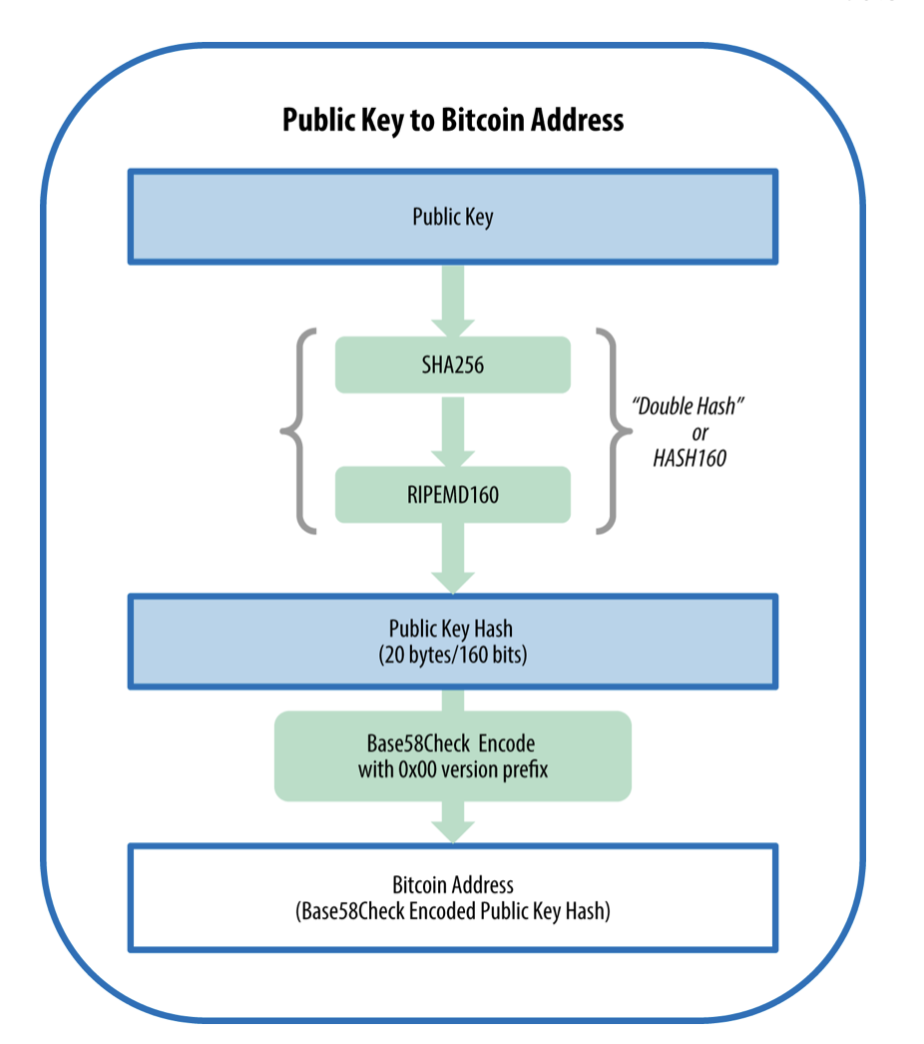
Notes:
From the public key, the Bitcoin address is then created
So, the public key is double hashed, using the HASH 160
Finally, in order to compress the length of the address, the address in encoded in base58
Base 58 is just a base65 encoded without the values 0, O, l, L

Slide 9
Digital Signatures
Signature proves that the owner of the private key, who is is the owner of the funds has authorized the spending of those funds
Proof of Authorization is undeniable (nonrepudiation)
Signature Proves that the transaction has not and cannot be modified by anyone else

Slide 10
Wallets
Application that serves as a primary user interface
Bitcoin wallets do not contain coins, they contain keys
Keychain containing private/public keys
Users Control the coins on the network by signing transactions with the keys in their wallet

Slide 11
Transaction
Transaction Output - indivisible chunks of bitcoin currency, recorded on the blockchain
UTXO - unspent transaction outputs
Available and spendable outputs
Notes:
Transactions are the most important part of the bitcoin ecosystem
Everything in bitcoin is designed to ensure that transactions can be created, propagated on the network, validated, and finally added to the global ledger of transactions
Fundamental building block of a bitcoin transaction is a transaction output
Bitcoin is built on a UTXO model,

Slide 12
UTXO Model
Example: Bob wants to buy a soda for $1.50
$5 Bill
6 Quarters
Bitcoin payment must be Created with whatever denominations the user has available
If Alice wants to send Bob 1 BTC
0.25 BTC * 4
0.95 + 0.05 BTC
Transaction consumes previous unspent transactions
These are linked to previous transactions incurred
Wallet application takes care of this abstraction
Notes:
6 quarters also works, it’s whatever that alice has in her wallet

Slide 13
Transaction Outputs
Bitcoin transactions create an output
If Bob sends Alice 0.2 BTC, but only has a full 1 BTC
Bob will be given ~0.8 BTC in return in unspent transactions in the output transaction

Slide 14
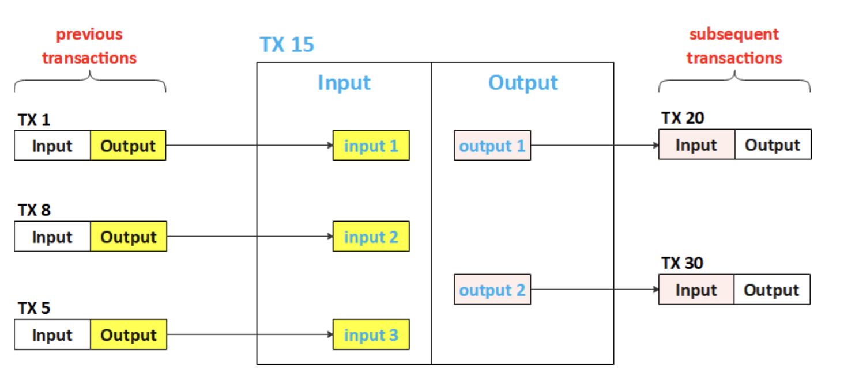
Notes:
Say Bob wants to send some BTC to Alice, he uses values that are in the output of other transactions, to accumulate enough to send

Slide 15
Locking and Unlocking Scripts:
Unlocking: Transaction consumes existing UTXO (at the input) by unlocking it with the current owner’s signature
Condition: Prove she/he is the holder of the designated public key by showing signature
Locking: The newly generated UTXO (at the output) is locked to the new owners public key/bitcoin address
Only holder of the designated public key can claim this bitcoin
Notes:
This is where the digital signatures come into play, when one wants to use their unspent transaction
So each transaction along with those values also contains a locking and unlocking script

Slide 16
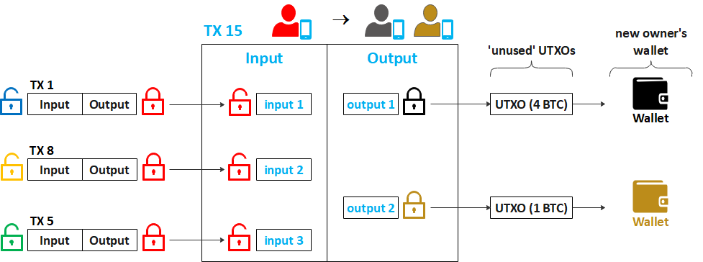

Slide 17
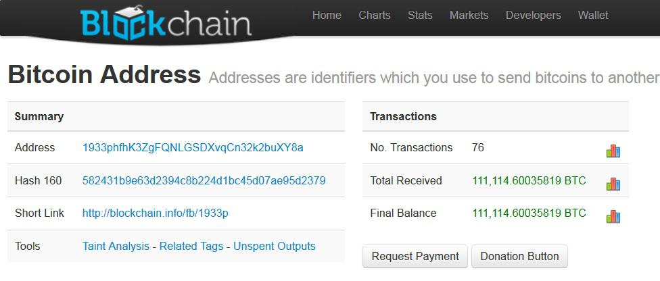
Notes:
Example of how a wallet is aggregating all values in blockchain to show final amount

Slide 18
The Bitcoin Network
P2P: Computers that participate in the network are “peers” to each other
They are all equal, and there are no special nodes
Decentralization
Example: Limewire
Data is propagated to the nearest peer, etc
Bitcoin network is a group of “peers” running the Bitcoin P2P Protocol
All nodes are equal, they may take on different roles
All peers have a copy of the blockchain

Slide 19
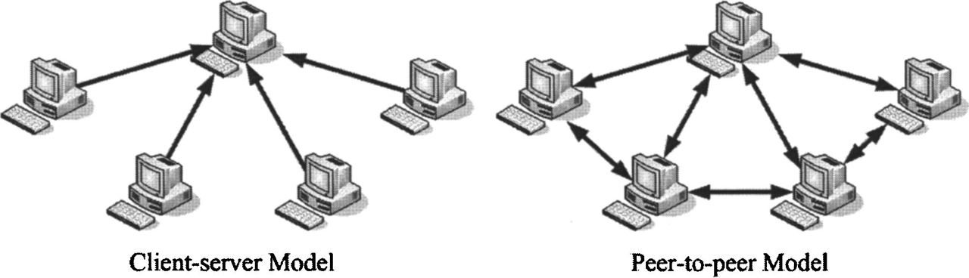
Centralized Decentralized Networks

Slide 20
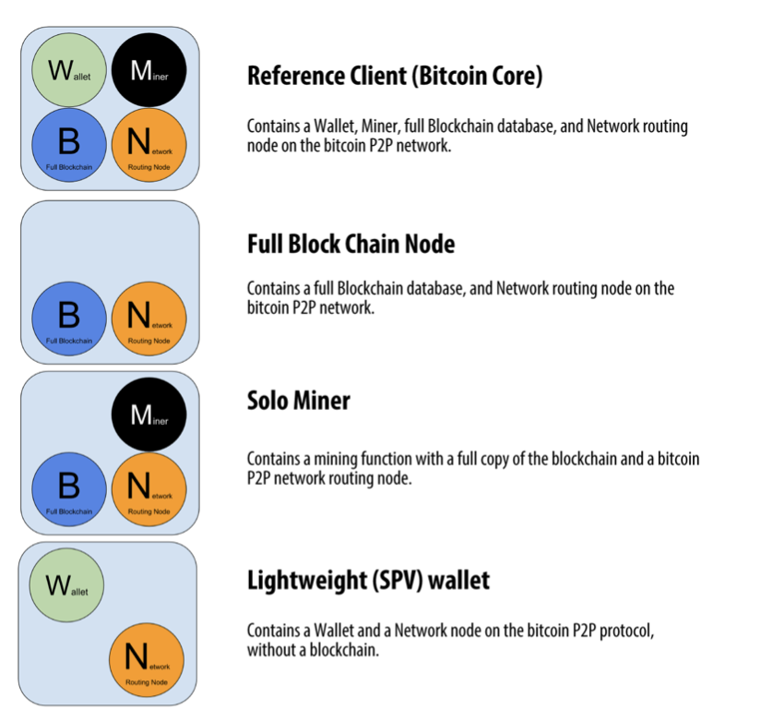
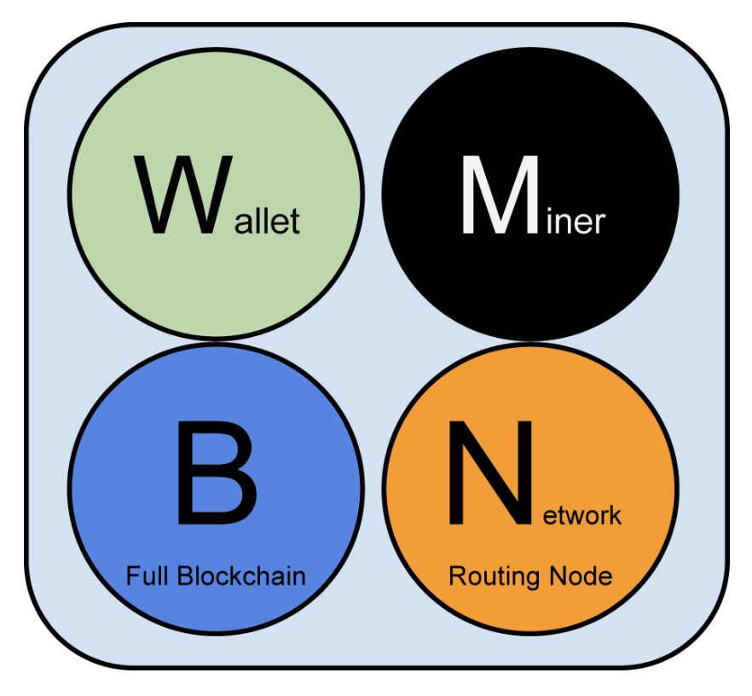
Types of Nodes in Bitcoin P2P Network

Slide 21
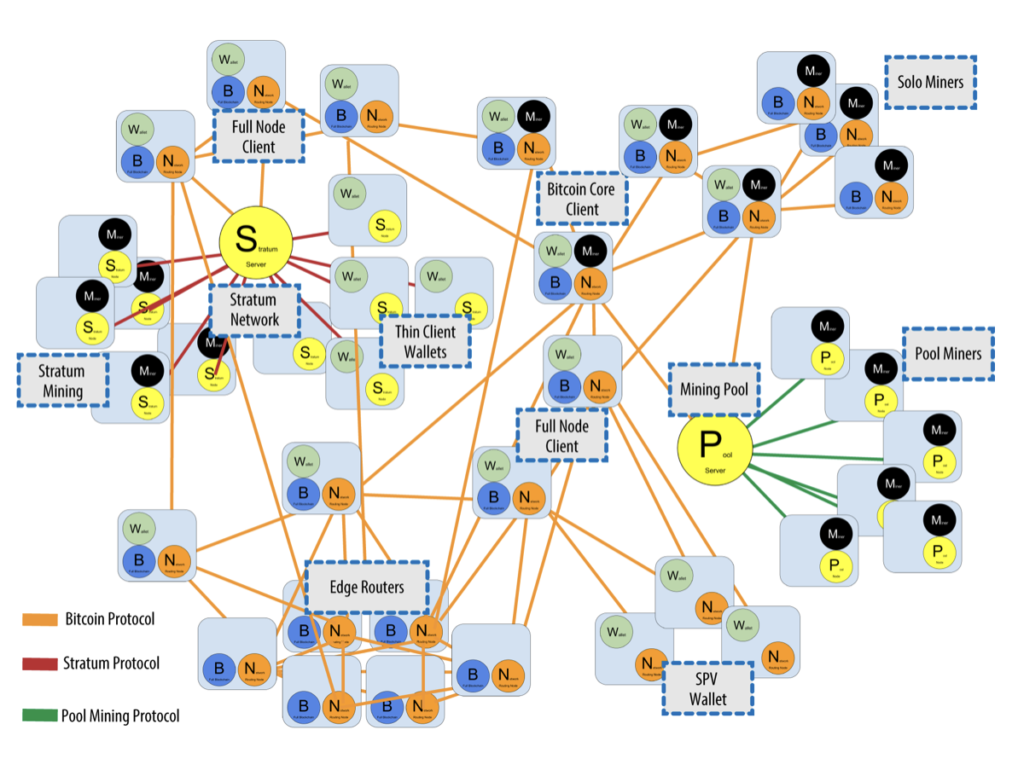
Notes:
Overview of the Entire Bitcoin Network:

Slide 22
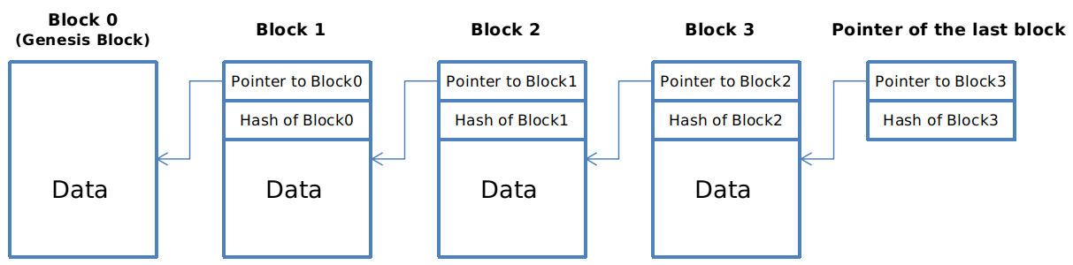
Public Transaction Ledger (The Blockchain)
Blockchain Data Structure: Back Linked List of Blocks of Transactions
Each block within blockchain is identified by hash of its header
Each block also references its parent block, through previous hash block

Slide 23
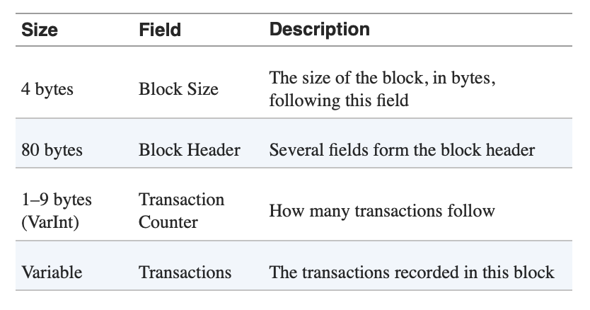
Structure of a Block
Notes:
Block consists of a header, containing metadata,
Followed by a list of transactions
The amount of transactions can vary, and an average transaction is 250 bytes and blocks can contain on average about 500 transactions

Slide 24
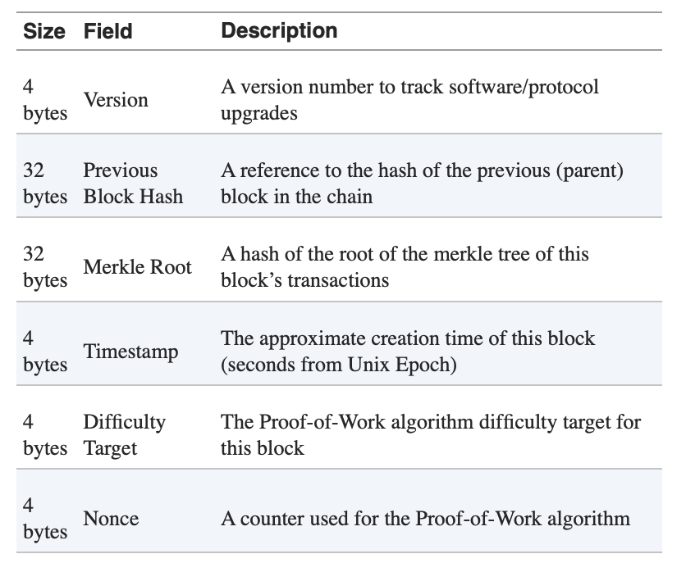
Block Header
Notes:
Version - is used to for other miners to acknowledge
Previous block hash
Difficulty, Timestamp, and Nonce all relate to the mining protocol, which I’ll talk about in the next section
They’re there so they can be easily verified by other peers
The header is hashed for the parent block, and the longer the chain becomes, the more difficult it becomes to change a block as more are built ontop of it

Slide 25
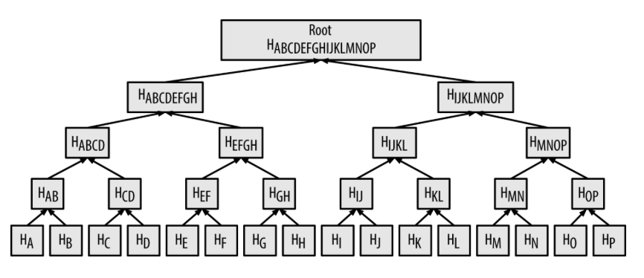
Merkle Trees
Each header contains a merkle root of all block’s transactions
Notes:
Merkle trees make it easy to verify that a transaction is included in a dataset,

Slide 26
Decentralized Consensus
How can we get everyone in the network to agree on a single universal “truth” about who owns what, without having to trust anyone?
Emergent Consensus
No fixed moment when consensus occurs, instead it emerges from thousands of independent nodes following the same set of rules
Notes:
Traditional payment systems depend on a trust model that has a central authority that provides the clearing house
Bitcoin has no central authority, but every node has a copy of a public ledger that it can trust

Slide 27
Independent Verification of Transactions (Network Nodes)
Each node verifies every transaction against a long list of criteria (protocol)
Syntax and Data Structure is Correct
Reject if sum of input values is less than sum of output values
For each input, the referenced output must exist and cannot already be spent
Double Spending Problem
Etc
If a transaction is valid, every node builds a pool of valid (but unconfirmed) transactions
Notes:
On a transactional level,
So every node that receives a transaction tests this set of rules to confirm that the transaction is legitimate

Slide 28
Mining Nodes (Proof-Of-Work Algorithm)
Mining validates new transactions and records them on the blockchain
Incentive: New Bitcoin
Mining is the mechanism by which the bitcoin network is decentralized
A New Block is “mined” roughly every 10 minutes
Notes:
Mining secures the bitcoin system, and enables the emergence of network-wide consensus

Slide 29
Building a Block
Mining node will aggregate these valid transaction from the transaction pool, and create a candidate block
Candidate is not valid yet, and only becomes valid if the miner succeeds in finding a solution to the proof of work algorithm
Coinbase transaction - Transaction input is different than a traditional transaction
This is the reward for the miner
BTC reward
Fees from each transaction
Payment (or output) of this transaction goes to the miner’s wallet
First transaction in a block
Notes:
Candidate block is a combination of all of the data we saw in the previous block structure

Slide 30
Building the Block
Aggregate transactions from transaction pool
Add Previous Block Hash
Summarize all transactions in the block in the merkle root
Add timestamp
Fill in the target (Difficulty of PoW)
Nonce, initialized to zero

Slide 31
Proof of Work Algorithm
Mining- the process of hashing (SHA256) the block header repeatedly, while changing one parameter (nonce), until the resulting hash is less than a specific target
Target - determines the difficulty of getting a hash correct
The lower the target value is, the more difficult it is to find a correct hash
The goal of mining is to find a hexadecimal value (hashed header) that is less than the target
By incrementing the nonce, and rehashing a new value is found

Slide 32
Example:
Find a hash that is lower than : “I am Satoshi Nakamoto”
Hash: 5d7c7ba21cbbcd75d14800b100252d5b428e5b1213d27c385bc141ca6b47989e

Slide 33
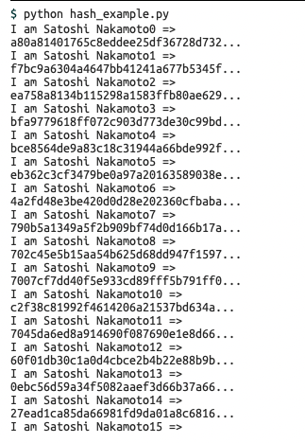
Example:
“I am Satoshi Nakamoto13” generates a hash that is less than the target

Slide 34
Proof of Work
Work cannot be cheated:
Brute force is the only way to get a valid hash
Easily Verifiable:
Nonce is a part of the block header
Any node in the network can hash using that nonce and verify that the value is less than the target
Increasing the difficulty by 1 bit, you decrease the search space by half
Effectively, doubles the amount of time it takes to find a solution

Slide 35
Proof of Work
As more mining nodes compete, the more difficult it gets to mine BTC
Current Rates:
206 EH/s
206 Exahashes (1 quintillion) per second is being computed in the bitcoin network

Slide 36
Adjusting the Target
Blocks should be generated every 10 minutes
Target is a dynamic parameter to maintain those 10 minutes per block
Every 2,106 blocks
How do you do that in a decentralized network?
Time it took to find the last 2,016 blocks and compare that to the expected 20,160 minutes
The ratio between actual and adjusted timespan if proportionately adjusted

Slide 37
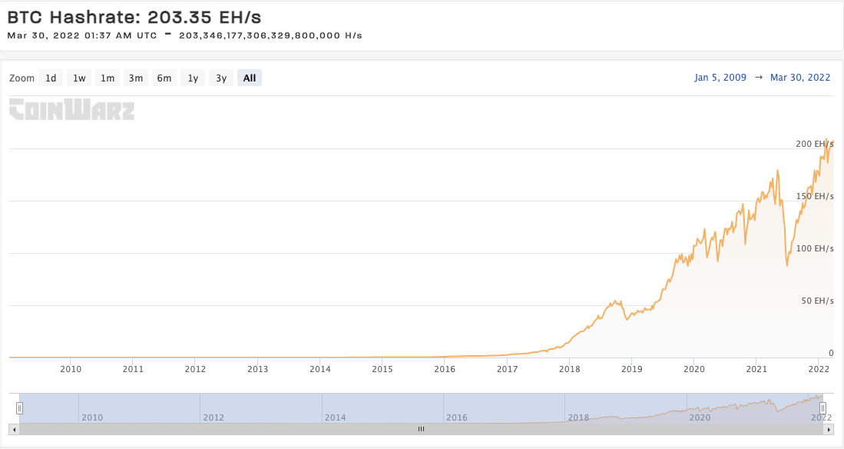

Slide 38
Current Statistics on Mining
6.25 BTC per Block
Miners were paid $42.3 Million in the last 24 hours to secure the bitcoin network
Amount of Bitcoin Reward is halved every 210,000 blocks
Roughly every 4 years
Expected to Run out of Bitcoin by 2140
Lowest Denomination: 0.00000001 BTC
1 satoshi, which is the smallest unit in Bitcoin network

Slide 39
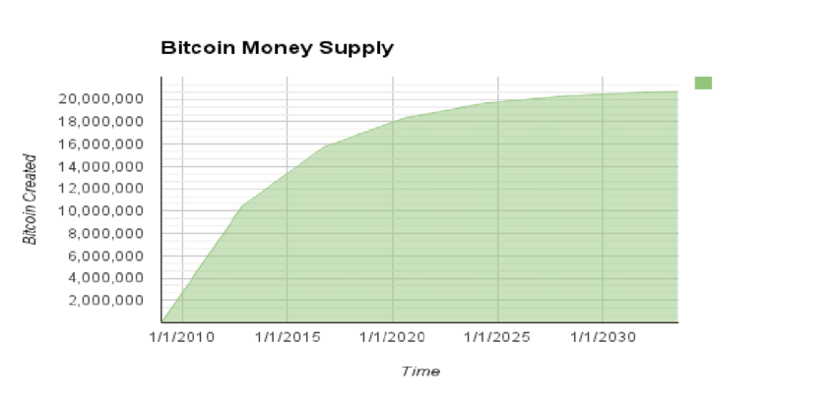

Slide 40
Successful Mining of a Block
Mining node transmits the block to all of its peers
The peers validate the block, and then propagate the block
Each node adds the block to its local blockchain
Notes:
As they validate the block, they immediately abandon their efforts on that block, create a new block, and the process begins again

Slide 41
Thoughts on the future of digital currencies
Money: Medium of Exchange
Digital Currencies:
Lower latency
Lower fees
Moving to a Digital Economy
Apple Pay, Google Pay, Venmo

