Slide 1
Interview with Dan Ackerman
Noah Edward Hall
Notes:
This presentation demonstrates the new capabilities of PowerPoint and it is best viewed in Slide Show. These slides are designed to give you great ideas for the presentations you’ll create in PowerPoint 2010!
For more sample templates, click the File tab, and then on the New tab, click Sample Templates.

Slide 2
Who is Dan “Dackerman” Ackerman?
1
2
3
All Star
Sales Star
Super Star
Philadelphia Eagles
CBS Corporation
Adap.TV Programmatic
TV Sports. TV Sales. TV Innovation.

Slide 3

How did I do it
Lunch
My Lucky Shirt
Firm Hand Shake
15 Minute Deadline 20 Minute Meeting
Everyone feels good after lunch.

Slide 4



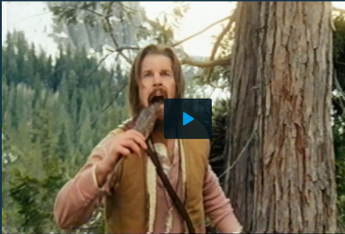

The Dackerman TV Takeover
Adap.TV Senior Vice President
Linear TV Leader
World Domination Goal: Create a programmatic TV advertising platform that brings the precision and fluidity of online Video and allows buyers to plan, execute and report across any device.
Major Success
TV’s first programmatic Ad… EVER!
The Manliest Low-Calorie Soda in the History of Mankind or…. Dr. Pepper TEN

Slide 5




Dackerman Has no Competitor.
Dackerman Has Lunch.
Programmatic TV. BOOM!
AT&T AdWorks
Placemedia
Videology

Slide 6

Traditional TV Advertising
Advertiser | Publisher
Age Gender Time Placement | Massive Demand Massive Control 80% Upfront 0% Innovation

Slide 7





Programmatic.
Huh?
Bid Data
Optimization
Psychographics
Near-Time Customization.
All-The-Time Efficiency.
Pay for the Audience
Not for the
Box

Slide 8

Noah Edward Hall Making things go boom.
!
March 2014

