Slide 1
Chapter 1
What Is Strategy, and Why Is It Important?
Notes:
Be sure to see experienced and newer versions of the Instructor’s Manual at http://www.mhhe.com/ftrStrategy2e.com

Slide 2
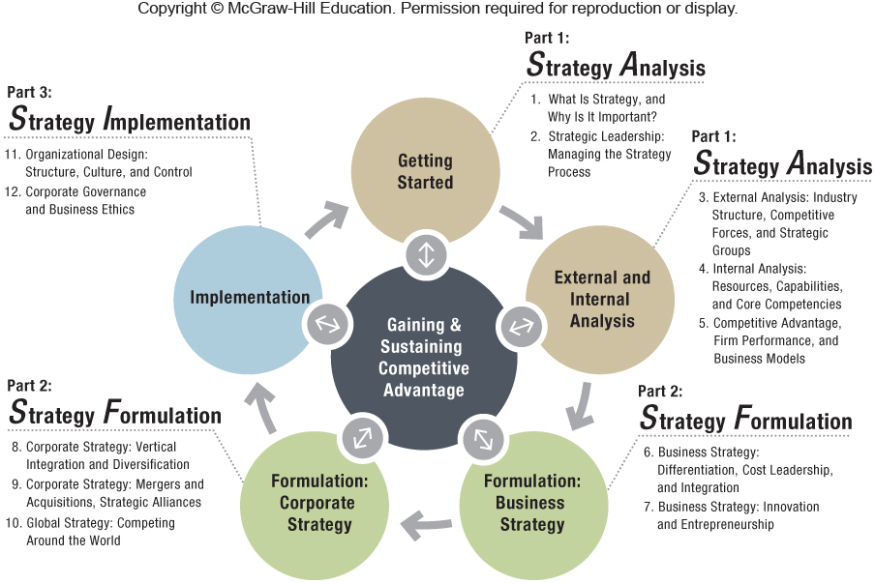

Slide 3
Chapter Outline
1.1 What Strategy Is: Gaining and Sustaining Competitive Advantage
What Is Competitive Advantage?
Industry vs. Firm Effects in Determining Firm Performance
1.2 Stakeholders and Competitive Advantage
Stakeholder Strategy
Stakeholder Impact Analysis
1.3 The AFI Strategy Framework
1.4 Implications for the Strategist
Notes:
Instructors:
Important concepts throughout this chapter are introduced here.
- The role of competitive advantage
- The importance of stakeholders
- The integrative AFI framework

Slide 4
Strategy Smart Exercise
Break out into small groups of 3-4.
Make sure someone in the group has a laptop.
Create a league if you like.
Craft a collaborative strategy for throwing the paper airplane the greatest distance.
Competitive Advantage:
Throw the plane through the window.
Sustained Competitive Advantage:
Repeatedly throw the plane through the window.
Take into account external and internal factors for maximum performance.
Watch the video http://flightsimx.archive.amnesia.com.au/index.html
Notes:
Instructors:
If you are interested in a light-hearted yet competitive start to your course this activity is offered as a complement to the text. Below is some information about the game…..
Game History: Amnesia Razorfish built this mini game for a FlightSim X promo/competition in Dec 06. In April 07 we stuck it up on our archive server, and we put a link to it here in our blog. We have no idea how the game spread given that we did nothing to promote it, but we do really appreciate everyone (now counted in millions) giving up their valuable minutes to play.
Who Are We?
Amnesia Razorfish is the Australian arm of one of the largest digital agencies in the world, Razorfish. It’s very informal and our staff are free to say absolutely anything they like. Their blog isn’t censored but they do try to behave, just don’t take them too seriously… “we like to have fun, that includes in here too”.
http://blog.amnesiarazorfish.com.au/who-we-are/

Slide 5
Strategy Smart Videos
What Is Good Corporate Strategy?
http://www.youtube.com/watch?v=43kZDnyDXOc
4:47 Minutes
A conversation with Richard Rumelt; relevant for:
What Strategy Is: Gaining and Sustaining Competitive Advantage and the elements of a good strategy
Notes:
Instructors:
“Strategy Smart” videos or exercises are additional material provided here to instructors to help you customize the course.
In this video of Dr. Richard Rumelt from UCLA Anderson School of Management, he discusses some concrete examples of hindrances to good business strategy.

Slide 6
Strategy Smart Videos
What Is Strategy?
http://www.youtube.com/watch?v=ibrxIP0H84M
1:47 Minutes
Michael Porter
Notes:
Instructors:
“Strategy Smart” videos or exercises are additional material provided here to instructors to help you customize the course.
In this video of Dr. Michael Porter of Harvard Business School, he discusses some misconceptions about strategy. This lecture is from the Leaders in London Summit in 2008

Slide 7
Strategy Smart Videos
Harvard Business School: Inside the Case Method
Part 1
http://www.youtube.com/watch?v=Y4j25Pj4JyQ
7:57 Minutes
Part 2
http://www.youtube.com/watch?v=JJ7aVrtTbg0
5:40 Minutes
Notes:
Instructors:
“Strategy Smart” videos or exercises are additional material provided here to instructors to help you customize the course.
This is a two part video of a variety of professors and students at Harvard Business School, discussing the case method in the Harvard MBA program.

Slide 8

ChapterCase 1
©Kim Hong-JI/Reuters/Corbis
Apple: Once the World’s Most Valuable Company
August 20, 2012
Most valuable public company of all time
Apple’s stock valuation reached $623 billion
15 years earlier, arch-rival Microsoft invested $150 million in Apple, which likely prevented Apple’s bankruptcy.
Notes:
Instructors:
Students will largely be familiar the smart phone business and the battle between Apple and Android operating systems. Some students may have switched between systems and could be a topic of discussion about competitive advantage.
The instructor’s manual notes you could extend this discussion into computers with a discussion of Dell, Lenovo and HP if you want to discuss similar ideas in a different industry.
Below is an article from Wall Street Journal with some questions about the future of Apple.
Apple Has an Identity Crisis: Is It a Hardware Company or a Software Firm?
The Wall Street Journal
Monday, April 22, 2013
http://online.wsj.com/article/SB10001424127887323551004578439162453339122.html?mod=wsj_share_tweet

Slide 9
ChapterCase 1
Founder Steve Jobs
Business Model Innovation – powerful strategy
1997 – near bankruptcy
2001 – iPod launched revitalization
2001 – iTunes
2007 – iPhone
2010 – iPad
Notes:
Instructors:
Here is a timeline of some of the major products and events for Apple since the return of Steve Jobs.
Apple became the world’s most successful company due to a powerful competitive strategy. That strategy, conceptualized by co-founder Steve Jobs, combines innovation in products, services, and business models.
In 2012 investors were excited about Apple’s stock. In 2013 the tide shifted towards Google. See the economist article below as an example report to bring this out in class.
The Economist: Mar 9th 2013
http://www.economist.com/news/business/21573160-web-giant-wants-be-known-beauty-well-brains-dont-be-ugly?fsrc=scn/tw_ec/don_t_be_ugly

Slide 10
ChapterCase 1
Growth potential industries
Mobile Internet, TV, etc.
Can Apple become the first $1 trillion company on earth?
Must find new industries to revolutionize
Penetration of huge markets
China and India
Notes:
Instructors:
The end of the chaptercase1 could lead to a discussion of where Apple’s future may lie. They have already disrupted computers, music, phone and created a tablet industry. Where should Apple strategically go next?
A number of analysts have cut their expectations for Apple's results following signs of weakening demand for its devices.
2014 Forecasts for both the iPhone and iPad have been reduced.
The Wall Street Journal Wednesday, April 17, 2013
http://online.wsj.com/article/SB10001424127887323809304578428631511414580.html

Slide 11
1.1 What Strategy Is: Gaining and Sustaining Competitive Advantage
A GOOD STRATEGY CONSISTS OF:
ANALYSIS:
Diagnosis of the competitive advantage
Set of coherent actions to implement the firm’s guiding policy
IMPLEMENTATION:
Guiding policy to address the competitive challenge
FORMULATION:
Notes:
Instructors:
The digital companion to this book McGraw-Hill Connect has an interactive exercise on this section of the textbook. It builds provides more background with a short Nvidia case and builds student confidence on how strategy helps build competitive advantage. (LO 1-1).

Slide 12
ANALYSIS:
Diagnosis of the competitive advantage
Competitive Challenge for Steve Jobs
2001 – Recognized that with less than 5% market share, Apple could not compete with Microsoft, Intel, and Dell in the PC industry, thus Jobs needed to create the next big thing

Slide 13
Guiding policy to address the competitive challenge
FORMULATION:
Guiding Policy – Business Model Innovation
Seamless integration across music/photo/mobile devices
iPods, iTunes, iMacs disrupted the existing PC market
Shifted competitive focus to mobile devices

Slide 14
Set of coherent actions to implement the firm’s guiding policy
IMPLEMENTATION:
Effectively Implemented Overarching Approach
Simple Rules:
Focused only on two computer models (laptop and desktop) in two market segments (professional and consumer)
Disrupted Industry Status Quo:
Business model innovation through product innovations executed at planned intervals
Notes:
Instructors:
Apple under Steve Jobs created a series of temporary competitive advantages. He began by dramatically cutting down the size of the product portfolio which helped Apple avoid bankruptcy.
This streamlining of its product lineup enhanced Apple’s strategic focus.

Slide 15
What Is Competitive Advantage?
Competitive Advantage:
Superior performance relative to other competitors in the same industry or the industry average
Key terms here – Superior and Relative
Sustainable Competitive Advantage:
Outperforming over a prolonged period
Strategic Positioning
Trade-offs are required
Walmart versus Nordstrom
Notes:
Instructors:
The concept of competitive advantage is crucial for students to understand here. But it is also important to discuss that having an advantage today does NOT mean the firm will have it tomorrow. Microsoft to Apple to Google could be a discussion on this point.
● Value creation with distinctive strategies illustrates strategic positioning within the same industry:
● Walmart creates value through low prices.
● Nordstrom creates value through exceptional service.

Slide 16
Strategy Highlight 1.1
JetBlue: “Stuck in the Middle”?
JetBlue ran into trouble by trying to combine two different strategies simultaneously.
There were a cost-leadership strategy, focused on low prices, and a differentiation strategy, focused on delivering unique features.
Despite enjoying some early years of competitive advantage, Jet Blue is struggling to maintain that edge.
Notes:
Instructors:
JetBlue’s founder learned from inside SWA and started a new airline striving for even lower costs than SWA but with better service and additional amenities. This integration of both cost-leadership AND differentiation is difficult but properly implemented it can yield a competitive advantage for a substantial period of time.

Slide 17
Strategy Highlight 1.1
Stuck in the middle
No clear strategy or strategic position
Many firms attempting both low-cost and differentiated products end up being stuck in the middle.
This type of failure contributed to JetBlue’s recent competitive disadvantage.

Slide 18
WHAT STRATEGY IS NOT
Grandiose statements
Failure to face competitive challenges
Operational effectiveness, competitive benchmarking, or other tactical tools
Notes:
Instructors:
● Grandiose statements “Our strategy is to win” or “We will be #1.” Such statements of desire, on their own, are not strategy. They provide little managerial guidance and frequently fail to address the economic fundamentals.
● A failure to face a competitive challenge. Managers at the now-defunct video rental chain Blockbuster, for example, failed to address the competitive challenges posed by new players such as Netflix, Redbox, Amazon Prime, and Hulu.
● Operational effectiveness, competitive benchmarking, or other tactical tools are not strategy. People casually refer to a host of different policies and initiatives as some sort of strategy: pricing strategy, Internet strategy, alliance strategy, operations strategy, IT strategy, brand strategy, marketing strategy, HR strategy, China strategy, and so on. All these elements may be part of a firm’s functional and global initiatives to support its competitive strategy.

Slide 19
Industry vs. Firm Effects in Determining Performance
Firm performance
Determined primarily by two factors: industry effects and firm effects
Industry effects
Firm performance attributed to the industry structure in which a firm competes
Firm effects
Firm performance attributed to the actions managers take
Notes:
Instructors:
While these two factors are INTERDEPENDENT, a key point which is evident in the exhibit following
is that managers’ actions tend to be more important in determining
firm performance than the forces exerted on the firm by its external environment.
As strategy instructors we can all be glad for this as it provides empirical evidence that our course can help managers improve the performance of their firms!

Slide 20
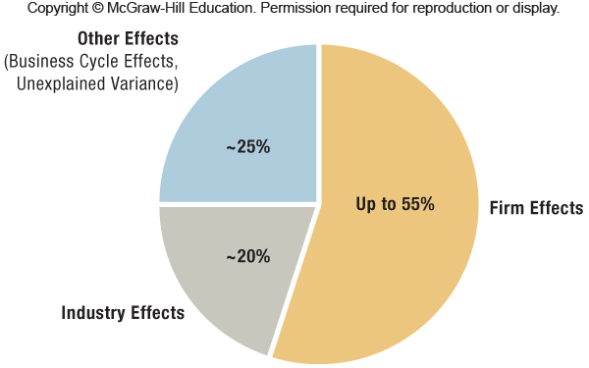
Exhibit 1.1 Effects Determining Superior Firm Performance

Slide 21
1.2 Stakeholders and Competitive Advantage
There is an important relationship between:
Strategic management
Role of business in society
Superior performance drives reinvestments
Fulfilling careers
Shareholder value
Value for society
Notes:
Instructors:
The lessons of Apple & HP in the text are strikingly different over the past 20 years. Of course we don’t know what the next 20 years will hold for these two technology stalwarts.
The digital companion to this book McGraw-Hill Connect has an interactive exercise on this section of the textbook. It builds student confidence on stakeholders (LO 1-4).

Slide 22
Black Swan Events
Profound impact of a highly improbable and unexpected event:
Most swans are white. The metaphor of a black swan represents something unanticipated.
Erosion of the public’s trust in business and free-market capitalism:
Early 2000s – Accounting scandals at Enron, Arthur Andersen, WorldCom, Tyco, Adelphia led to destruction of shareholder value.
2008 – Global Financial Crisis
2011 – Occupy Wall Street protest movement
Notes:
Instructors:
At the end of the chapter Small-Group exercise 1 may be used to further student involvement in this topic. In particular, students in New Jersey, Louisiana, Texas, Japan and other areas that have recently experienced natural disasters will be able to relate to this topic.
This exercise can be used to push students to address this problem from the different perspectives. The instruction manual also has some ideas for a class exercise around this topic.

Slide 23
Black Swan Events: Two Key Points
Managers
Managerial actions can affect the economic well-being of countless global citizens.
Stakeholders
Effective stakeholder management is necessary to ensure continued survival and sustainable competitive advantage.

Slide 24
Stakeholder Strategy
An integrative approach to managing a diverse set of stakeholders effectively in order to gain and sustain competitive advantage
Concerned with how the firm exchanges with various stakeholders to create and trade value

Slide 25
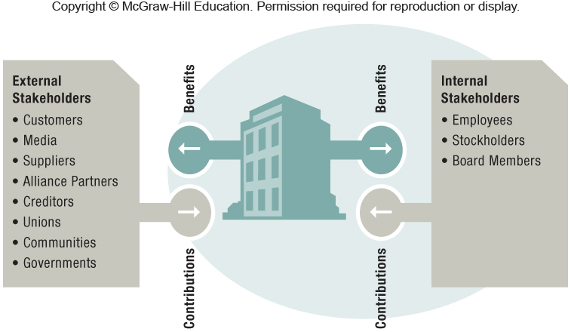
Exhibit 1.2 Internal and External Stakeholders in an Exchange Relationship with the Firm

Slide 26
Stakeholder Strategy
Effective stakeholder management can benefit firm performance:
Satisfied stakeholders are more cooperative
Increased trust lowers transaction costs
Effective management leads to greater adaptability and flexibility
Avoidance of negative outcomes
Reduction of risk exposure
Strong reputations rewarded in the marketplace
Notes:
Instructors:
Target Corporation is used as an example in the book. The class may be able to bring in other examples. Be sure to have the students identify the stakeholder group affected by their example.

Slide 27
Stakeholder Impact Analysis
A decision tool with which managers can recognize, assess, and address the needs of different stakeholders, allowing the firm to achieve competitive advantage while acting as a good corporate citizen.
Power
Legitimacy
Urgency
Notes:
Instructors:
Managers must go through a five-step process when recognizing and addressing stakeholders’ claims. In each step, managers must pay particular attention to three important stakeholder attributes: power, legitimacy, and urgency.
The BP strategy highlight (1.2) can be used to enliven a discussion of the five step process here and the following slide of exhibit 1.3.

Slide 28
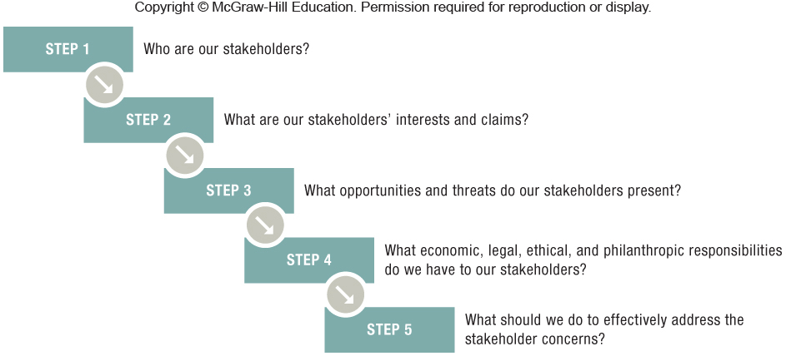
Exhibit 1.3 Stakeholder Impact Analysis

Slide 29
Corporate Social Responsibility (CSR)
A framework that helps firms recognize and address the economic, legal, social, and philanthropic expectations that society has toward business.
CSR has four components of responsibility:
Economic
Legal
Ethical
Philanthropic
Notes:
Instructors:
The digital companion to this book McGraw-Hill Connect has an interactive exercise on this section of the textbook. It builds student confidence on stakeholders (LO 1-5).

Slide 30
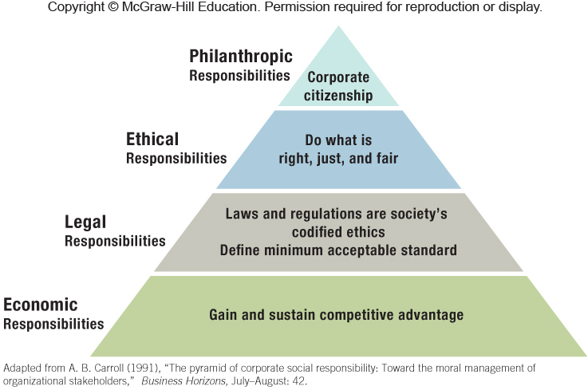
Exhibit 1.4 Pyramid of Corporate Social Responsibility

Slide 31
Strategy Highlight 1.2
BP: “Lack of Business Integrity”?
BP’s strategic focus on cost reductions compromised the implementation of an adequate safety culture resulting in the 2010 drilling rig explosion off the Louisiana coastline:
Killing 11 workers
Releasing an estimated 5 million barrels of crude oil into the Gulf of Mexico over the next three months
Causing the largest environmental disaster in U.S. history
Costing BP $14 billion for the cleanup alone
Claiming a “lack of business integrity,” the EPA has banned BP from any new contracts with the U.S. government.

Slide 32
1.3 The AFI Framework
STRATEGIC ANALYSIS (A)
Chapter 2
What roles do strategic leaders play?
How does strategy come about?
Chapter 3
How do external environmental forces impact sustainable competitive advantage?
Chapter 4
What effects do internal resources, capabilities, and core competencies have on sustainable competitive advantage?
Chapter 5
How do we make money?
How can we assess and measure competitive advantage?
What is the relationship between competitive advantage and firm performance?

Slide 33
STRATEGY FORMULATION (F)
Chapters 6 and 7
How should we compete (cost leadership, differentiation, or integration)?
Chapters 8 and 9
Where should we compete (industry, markets, and geography)?
Chapter 10
Where (local, regional, national, and international) and how should we compete around the world?

Slide 34
STRATEGY IMPLEMENTATION (I)
Chapter 11
How should we organize to put the formulated strategy into practice?
Chapter 12
What type of corporate governance is most effective?
How do we anchor strategic decisions in business ethics?

Slide 35
1.4 Implications for the Strategist
STRATEGY is the SCIENCE of SUCCESS and FAILURE.
Strategists are challenged by competition, complexity, uncertainty and volatility.
The strategist is empowered by:
The universality of strategic management principles.
Knowledge that the actions they create have more influence on firm performance than does the external environment.
Following the 3-step AFI framework.
Notes:
Instructors:
The instructor’s manual has the following link to a 1 minutes and 43 second video by a strategy consultant at BCG Australia
A nice video to illustrate the implications for strategists is this one by James Goth, Partner and Managing Director of BCG,
Competitive Advantage . He discusses the meaning of competitive advantage and strategy. http://vimeo.com/16644996
Copy and paste the URL into a browser to view the video.

Slide 36
ChapterCase 1
©Kim Hong-JI/Reuters/Corbis
Consider This…
2012
Despite Apple’s $1 billion courtroom victory against Samsung, Samsung sold more smartphones than Apple.
2013
Samsung introduced the new Galaxy S4 model, intensifying competition with Apple.
Apple uncharacteristically botched the launch of the iPhone 5.
The embedded Apple map app was far inferior to Google maps, used in earlier versions of the iPhone.

Slide 37
ChapterCase 1
Consider This…
Samsung sold more smartphones than Apple in 2012.
Apple’s top management team experienced turnover and some executives were forced out.
A few months after reaching $623 billion, Apple’s share price dropped 30%, eliminating $200 billion in market valuation.
This case underscores the challenges of creating and sustaining a competitive advantage.
Notes:
Instructors:
The following questions can serve as good discussions of the position that Apple has in the smartphone industry.
● Explain Apple’s success over the last decade. Think about which industries it has disrupted and how. Also take a look at Apple’s main competitors.
● Is Apple’s success attributable to industry effects or firm effects, or a combination of both? Explain.
● What recommendations would you have for Apple to outperform its competitors in the future?
● Why do you think it is so hard to not only gain but also to sustain a competitive advantage?

Slide 38
Take-Away Concepts
LO 1-1
Explain the role of strategy in a firm’s quest for competitive advantage.
Strategy is the set of goal-directed actions a firm takes to gain and sustain superior performance relative to competitors.
A good strategy enables a firm to achieve superior performance; it consists of three elements:
Diagnosis of the competitive challenge.
Guiding policy to address the competitive challenge.
A set of coherent actions to implement the firm’s guiding policy.
Successful strategy requires three integrative management tasks—analysis, formulation, and implementation.

Slide 39
Take-Away Concepts
LO 1-2
Define competitive advantage, sustainable competitive advantage, competitive disadvantage, and competitive parity.
Competitive advantage is always judged relative to other competitors or the industry average.
To obtain a competitive advantage, a firm must either create more value for customers while keeping its cost comparable to competitors.
A firm able to outperform competitors for prolonged periods of time has a sustained competitive advantage.
A firm that continuously underperforms its rivals or the industry average has a competitive disadvantage.
Two or more firms that perform at the same level have competitive parity.
An effective strategy requires that strategic trade-offs be recognized and addressed—e.g., between value creation and the costs to create the value.

Slide 40
Take-Away Concepts
LO 1-3 Differentiate the role of firm effects and industry effects in determining firm performance.
A firm’s performance is more closely related to its managers’ actions (firm effects) than to the external circumstances surrounding it (industry effects).
Firm and industry effects, however, are interdependent. Both are relevant in determining firm performance.

Slide 41
Take-Away Concepts
Stakeholders are individuals or groups that have a claim or interest in the performance and continued survival of the firm.
Internal stakeholders include stockholders, employees, and board members.
External stakeholders include customers, suppliers, alliance partners, creditors, unions, communities, and governments.
Several recent black swan events eroded the public’s trust in business as an institution and free-market capitalism as an economic system.
Effective management of stakeholders is necessary to ensure the continued survival of the firm and to sustain any competitive advantage.
LO 1-4
Evaluate the relationship between stakeholder strategy and sustainable competitive advantage.

Slide 42
Take-Away Concepts
LO 1-5
Conduct a stakeholder analysis.
Stakeholder impact analysis considers the needs of different stakeholders.
In a stakeholder impact analysis, managers pay particular attention to three important stakeholder attributes: power, legitimacy, and urgency.
Stakeholder impact analysis is a five-step process that answers the following questions for the firm:
Who are our stakeholders?
What are our stakeholders’ interests and claims?
What opportunities and threats do our stakeholders present?
What economic, legal, and ethical responsibilities do we have to our stakeholders?
What should we do to effectively address the stakeholder concerns?

