Slide 1
Chapter 4
Internal Analysis:
Resources, Capabilities, and Core Competencies
Notes:
Be sure to see experienced and newer versions of the Instructor’s Manual at http://www.mhhe.com/ftrStrategy2e.com

Slide 2
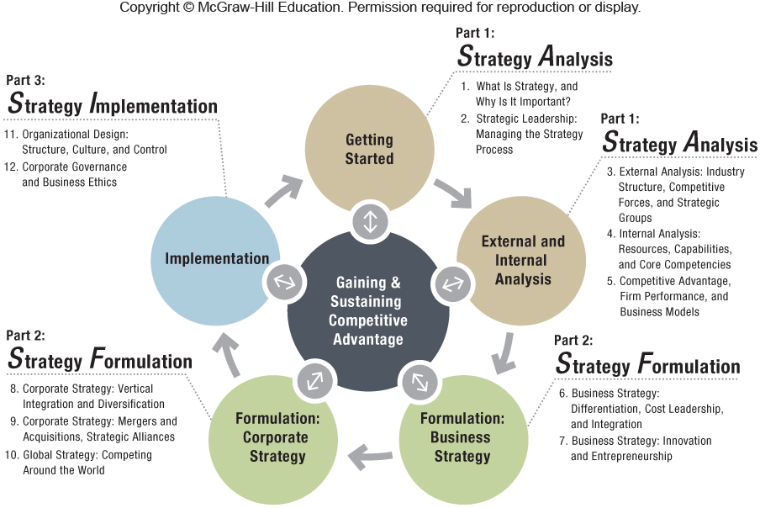

Slide 3
Chapter Outline
4.1 Looking Inside the Firm for Core Competencies
4.2 The Resource-Based View
Two Critical Assumptions
The VRIO Framework
How to Sustain a Competitive Advantage
4.3 The Dynamic Capabilities Perspective
4.4 The Value Chain Analysis
4.5 Implications for the Strategist
Using SWOT Analysis to Combine External and Internal Analysis

Slide 4
Strategy Smart Videos
Failure: The Secret to Success – Honda – The Power of Dreams
http://www.youtube.com/watch?v=1bPzCZCmMfQ
8:23 Minutes
Topics: Building Core Competencies; Competencies are honed over long periods of time through learning from failure

Slide 5
Strategy Smart Videos
D 2007 - All Things Digital: The Wall Street Journal Executive Conference
Steve Jobs and Bill Gates Historic Interview
http://www.youtube.com/watch?v=85PMSYAguZ8
15:06 Minutes
Topics: Core Competencies; Resource-Based View; SWOT

Slide 6
Strategy Smart Videos
Steve Jobs rare footage conducting a presentation on 1980
http://www.youtube.com/watch?v=0lvMgMrNDlg
22:54 Minutes
Topics: Capabilities; Core Competencies; Competitive Advantage; Innovation; Isolating Mechanisms
A bit long, but well worth it. Perhaps best watched before class or in specific segments.

Slide 7
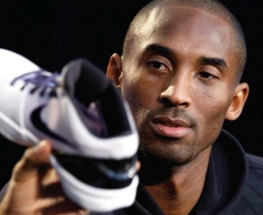
ChapterCase 4
Kobe Bryant
©Lucy Nicholson/Reuters/Landov
Nike’s Core Competency: The Risky Business of Fairy Tales
Nike, a company created by Bill Bowerman and Phil Knight in 1964, today has 60% − 90% market share (depending on the sport) and $25 billion in annual revenues.
These are sponsored celebrities epitomizing Nike’s core competence of creating heroes, i.e., selecting athletes who succeed against all odds.
This Core Competency does have its risks, as heroes do sometimes fall, resulting in public relations disasters.
Notes:
Instructors:
This brief case is designed to provide material for an internal analysis of Nike’s core competencies that led it to a commanding market share in both basketball and running shoes.

Slide 8
CORE COMPETENCIES
CAPABILITIES
Strategically Integrated Resources
Embedded Strengths Enabling Value-Creation
RESOURCES
Assets Leveraged for Strategy Formulation/ Implementation
Competitive Advantage
Gaining & Sustaining

Slide 9
4.1 Looking Inside the Firm for Core Competencies
Competitive advantage derives from core competencies, which enable:
Differentiation of products/services creating perceived value, or
Cost leadership – offering products/services of comparable value at lower cost
NIKE – Core Competence – Just Do It
Unlocking human potential
Anyone can be a hero
Notes:
Instructors:
The digital companion to this book McGraw-Hill Connect has an interactive video case exercise on this section of the textbook. It builds student confidence on internal analysis and covers human capital in particular (LO 4-1).
Exhibit 4.3 has a number of examples of firms with their core competencies and applications.
The IM notes the Starbucks min-case (MiniCase6 at the end of the core chapters in the text) would be a good example to use in discussing resources, capabilities and core competencies.
Encourage students to work in small group to develop a list of resources for a simple case, then a list of capabilities. When they have spent a few moments on this, call on various groups to allow you to create a list of resources and capabilities on the board.
As an example using the Starbucks mini-case, you might discuss how Starbucks’ resource of exclusive supply contracts with superior coffee growers, combined with Starbucks’ capabilities to roast coffee and to train highly skilled baristas, enables them to create a core competence of superior tasting coffee. In a capstone course, you might use this exercise to illustrate the interaction of business level strategy and marketing functional strategy.

Slide 10
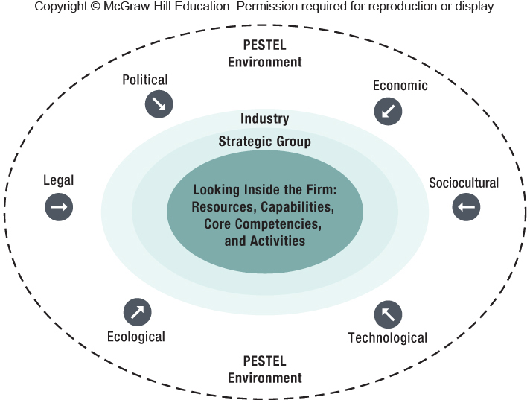
Exhibit 4.2 Looking Inside the Firm for Competitive Advantage, Resources, Capabilities, Core Competencies, and Activities
Notes:
Instructors:
This figure can be used to transition from the external view of Chapter 3 to the internal view here in Chapter 4.
From the IM:
You might want to begin your lecture by returning to the illustration of peeling back layers of an onion to show students the
strategic analysis process of beginning in the broad macro-environment, closing in to the industry environment, and then
finally reaching the firm environment. Refer here to Exhibit 4.2 to help students put external and internal analysis in context.
Core competencies allow a firm to differentiate its products and services from those of its rivals, creating higher value for
the customer or offering products and services of comparable value at lower cost. The important point here is that
competitive advantage can be driven by core competencies.

Slide 11
CORE COMPETENCIES
CAPABILITIES
Strategically Integrated Resources
Embedded Strengths Enabling Value-Creation
RESOURCES
Assets Leveraged for Strategy Formulation/ Implementation
Competitive Advantage
Gaining & Sustaining

Slide 12
KEY CONCEPTS
Developing the product /service markets [visible side] is just as important as leveraging core competencies [invisible side].
Honda has developed a distinct competency in engines with a business model of locating places to place these engines – from cars, SUVs, vans, trucks, motorcycles, ATVs, boats, airplanes, generators, snow blowers, lawn mowers, other yard equipment, etc.
Notes:
Instructors:
We like to spend a few minutes discussing Honda here. Most students are familiar with them for cars or lawnmowers but very few have considered what it is that ties their businesses together. Highly reliable engines which started small and have now expanded to a broad array of products and categories.

Slide 13
CORE COMPETENCIES DERIVE FROM:
Competitive Advantage
CABABILITIES
RESOURCES
Tangible Assets
Strategically Orchestrating Diverse Resources
ACTIVITIES
Add Incremental Value by Transforming Inputs
Intangible Assets
Gaining & Sustaining

Slide 14
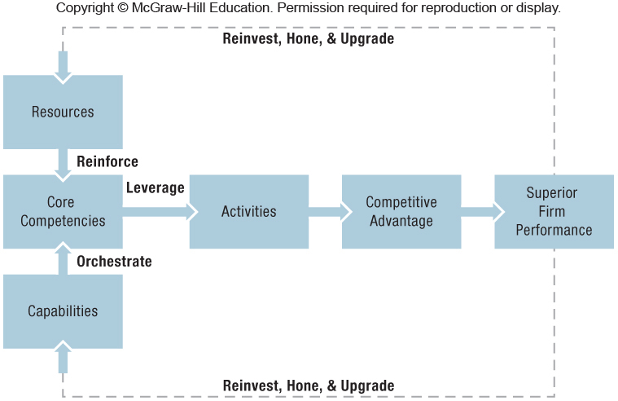
Exhibit 4.4 Linking Resources, Capabilities, Core Competencies, and Activities to Competitive Advantage and Superior Firm Performance
Notes:
Instructors:
The digital companion to this book McGraw-Hill Connect has an interactive exercise on this section of the textbook. It builds student confidence on the internal analysis and tangible and intangible resources (LO 4-1 and 4-2).

Slide 15
4.2 The Resource-Based View
Competitive advantage is more likely to develop from intangible rather than tangible resources..
Tangible and Intangible Resources – Examples:
Apple
Tangible Resource Value: $15 Billion
Intangible Resource Value: $180 Billion
Google
Tangible Resource Value: $8 Billion
Intangible Resource Value: $110 Billion
Notes:
Instructors:
The IM suggests the following simple class exercise to engage the students further in these concepts of tangible and intangible resources.
Assign some of the examples in Exhibit 4.3 to a different team and ask them to develop a list of the tangible resources,
intangible resources, and capabilities that are needed to deliver the core competency of the firm.

Slide 16
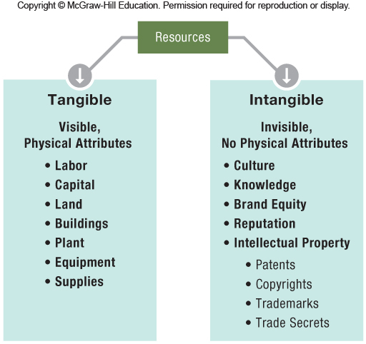
Exhibit 4.5 Tangible and Intangible Resources
Notes:
Instructors:
The digital companion to this book McGraw-Hill Connect has an interactive exercise on this section of the textbook. It builds student confidence on the internal analysis and tangible and intangible resources (LO 4-1 and 4-2).

Slide 17
4.2 The Resource-Based View
Resources are key to superior firm performance.
If resources and capabilities exhibit VRIO attributes, they become the building blocks for gaining and sustaining competitive advantage.
VRIO
(V) Valuable
(R) Rare
(I) Costly to imitate
(O) Organized to capture the value of the resource/capability

Slide 18
Two Critical Assumptions
The two assumptions – that firms may control – are critical in explaining superior firm performance for the resource-based model:
Resource Heterogeneity
Model assumption that a firm is a bundle of resources and capabilities differ across firms
Resource Immobility
Model assumption that a firm has resources that tend to be “sticky” and that do not move easily from firm to firm
Notes:
Instructors:
We suggest spending a few minutes on these assumptions as though they may seem “common sense” we find they are often not commonly thought about.
The IM has a couple of suggestions for classroom discussion starters.
Invite students to identify examples of resource heterogeneity within an industry: For example, compare the search algorithm capability of Microsoft (Bing) versus Google or the economies of scale of Wal-Mart versus Target, or the app store content for Android, Apple, Microsoft, and Blackberry.
Invite students to identify examples of resource immobility within an industry: For example, long patent lives for proprietary drugs, long-term licenses for access to petroleum reserves (usually 20 years or more), trademark protection for valuable Disney characters, or copyright protection for the Harry Potter books and licensing.

Slide 19
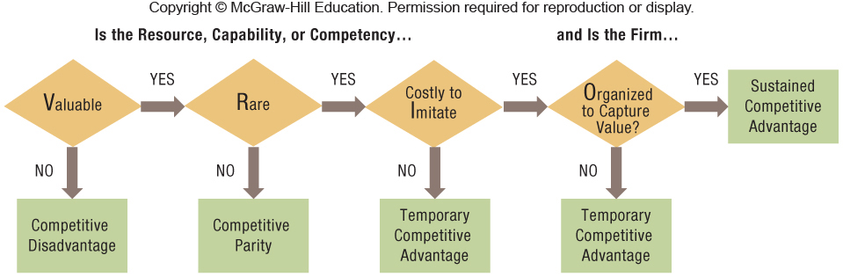
Exhibit 4.6 Applying the Resource-Based View: A Decision Tree Revealing Competitive Implications
Notes:
Instructors:
The digital companion to this book McGraw-Hill Connect has an interactive case exercise on this section of the textbook. It builds student confidence on the VRIO framework by looking at a short case on Nintendo (LO 4-4).
We recommend describing each of the four characteristics of the VRIO analysis separately in your lecture. Of particular note is that the fourth characteristic is actually about the organization or firm itself rather than its resources. This point is often difficult for students to grasp, as they are often not used to ordering their thoughts into levels of analysis, so it is worth emphasizing.

Slide 20

The VRIO Framework
Valuable
Attractive features
Lower costs (& price)
Higher profits
Honda – design & build engines
Rare
Only a few firms possess
Toyota – lean manufacturing
Temporary competitive advantage
Costly to Imitate
Unable to develop or buy at a reasonable price
Nike – Yes
Crocs – No
Organized to Capture
Exploit competitive potential
Structure
Coordinating systems
Xerox PARC – No
Notes:
Instructors:
The digital companion to this book McGraw-Hill Connect has an interactive case exercise on this section of the textbook. It builds student confidence on the VRIO framework by looking at a short case on Nintendo (LO 4-4).
An example of VRIO analysis from the IM is below.
The commercialization of the CAT scanner provides a classic example for a VRIO analysis, in which direct imitation through a work around allowed a second mover not only to mitigate the innovator’s advantage but also to gain and even sustain a competitive advantage. Based on internal research, the British conglomerate EMI developed and launched the computed axial tomography (CAT) scanner. This technology, for which EMI received several patents, can take threedimensional pictures of the human body and is considered to be the most important breakthrough in radiology since the discovery of X-rays. The invention of the CAT scanner also paved the way for follow-up innovations like nuclear magnetic resonance imaging (MRI). Despite its initial success, EMI lost out quickly to GE Medical Systems (GEMS). How can the innovator with a patent-protected technology lose out to a follower? GEMS was able to reverse-engineer EMI’s CAT scanner to produce a model that worked around EMI’s patents. Moreover, GEMS was able to leverage important complementary resources such as financing, large-scale manufacturing, and a wide distribution and marketing network. While EMI clearly possessed a valuable and rare resource, it was not able to protect itself from GE’s substitution attempt.

Slide 21
Strategy Highlight 4.1
Applying VRIO: The Rise and Fall of Groupon
Mason’s Strategic Vision for Groupon Was
To Be the Global Leader in Local Commerce:
2008 – 27-year-old Andrew Mason founded Groupon
Groupon creates marketplaces, i.e., a group-coupon
Internal Analysis – VRIO framework application would have predicted Groupon’s first-mover competitive advantage as temporary at best.
External Analysis – The five forces model would have predicted low industry profit potential.
Notes:
Instructors:
Small Group Exercise #2 (page 124) extends the ideas from this strategy highlight into some thoughtful questions for the students to discuss in small break out sessions.
You may want to update Groupon info before your class to have information on where the firm has gone since the press time of the text. http://www.groupon.com/
For year 2013, the stock market responded positively to a new strategy to develop a network of warehouses to support the sale of goods, growth in business
through their mobile app, rapid growth in North American revenue, a shift away from pushing deals through email to a marketplace for deals that users that users can pull when they want them, and firing of CEO Andrew Mason.

Slide 22
HOW TO SUSTAIN A COMPETITIVE ADVANTAGE
Isolating Mechanisms
Better Expectations of Future Values
Buy Resources at a low cost.
Nike signing future mega-athletes early in their career (i.e., Michael Jordan)
Real estate development- Highway expansion
Path Dependence
Current alternatives are limited by past decisions.
Geographic concentration of the U.S. carpet industry
GM’s problems competing with Toyota Prius was decades in the making.
Notes:
Instructors:
There are four conditions above and beyond core competencies that can help a firm protect and sustain a competitive advantage. If one of any of these four is present, the firm can strengthen its basis for competitive advantage, increasing its chance to be sustainable over a longer period of time.
Students typically have a good feel for these two mechanisms however the two on the next slide seem to take more explanation and examples.

Slide 23
HOW TO SUSTAIN A COMPETITIVE ADVANTAGE (cont’d)
3. Causal Ambiguity
Cause of success or failure is not apparent.
Why has Apple had such a string of successful products?
Role of Steve Job’s vision?
Unique talents of the Apple design team?
Timing of product introductions?
4. Social Complexity
Two or more systems interact creating many possibilities.
A group of 3 people has 3 relationships.
A group of 5 people has 10 relationships.
Notes:
Instructors:
Some students may need some additional explanation of the differences between causal ambiguity and social complexity. In some sense, this is natural because there is a relationship between these two items. Social complexity can be one reason for causal ambiguity.
Causal ambiguity is pointing to the fact that we can’t identify within the firm specifically how the firm has been able to be successful. Social complexity relates to interactions of multiple elements in the business model.

Slide 24
Strategy Highlight 4.2
Bill “Lucky” Gates
Bill Gates is one of the richest people in the world
He is also “rich” in LUCK.
In 8th grade, his school got a computer and software programs.
In 1975, founded Microsoft with long-time friend Paul Allen.
In 1980, his mother heard IBM was looking for an operating system…
Bill Gates didn’t have one, but he knew where to get one.
He then sold copies of MS-DOS to IBM (through a non-exclusive license), and thus kept the copyright.

Slide 25
SUMMARY
Taken together, a firm may be able to protect its competitive advantage – even for long periods of time – when its managers have consistently:
Better expectations about the future value of resources.
Have accumulated a resource advantage that can be imitated only over long periods of time.
When the source of their competitive advantage is causally ambiguous or socially complex.

Slide 26
4.3 The Dynamic Capabilities Perspective
A firm’s ability to create, deploy, modify, reconfigure, upgrade, or leverage its resources in its quest for competitive advantage
Essential to create a sustained competitive advantage
A dynamic fit between internal strengths and external opportunities
Resource stocks – current level of intangible resources
Resource flows – investments to maintain or build a resource
Notes:
Instructors:
The second discussion question on ethical and social issues (page 123) relates to resource loss of key personnel. Below are some thoughts on this discussion point from the IM.
The chapter mentions that one type of resource flow is the loss of key personnel who move to another firm. Assume that the human resources department of your firm has started running ads and billboards for open positions near the office of your top competitor. Your firm is also running Google ads on a keyword search for this same competitor. Is there anything unethical about this activity? Would your view change if this key competitor had just announced a major layoff?
Students will have a variety of viewpoints on this matter. As a matter of practice, the other firm can also run ads outside “my firm” as well. Effective managers recognize many of their best employees will have headhunters call them with jobs at competitors, for example. The best counter to this situation is keeping an open dialogue with the associates at the firm so you know why they come to work every morning. If they are fairly satisfied with their current assignments and job situation, they will not answer the competitor ads, nor the headhunter phone calls. We find this does often change the student’s perspective on the situation. Some of the most ardent in favor of an ethical violation in the first question now see it has a bridge to a fresh employment option for employees who did, or may be about to, lose their jobs.

Slide 27
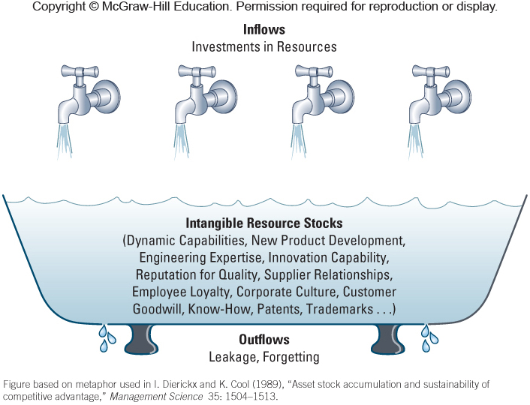
Exhibit 4.7 The Bathtub Metaphor: The Role of Inflows and Outflows in Building Stocks of Intangible Resources
Notes:
Instructors:
The following is a further discussion of this exhibit from the IM. There is also an extensive discussion of Circuit City in the IM.
The investments can be several different types. It could be money, but it could also be people or time invested in building intangible resource stocks. The outflow can be key employees that leave the organization or the lack of organizational memory, causing the same lesson to be learned several times.
A useful example of dynamic capabilities in action is IBM’s success at transforming itself from a hardware company to a services company. IBM—nicknamed Big Blue—helped kick-start the PC revolution in 1981 by setting an open standard in the computer industry with the introduction of the IBM PC running on an Intel 8088 chip and a Microsoft operating system (MS-DOS). Ironically, in the years following, IBM nearly vanished after experiencing the full force of that revolution, because its executives believed that the future of computing lay in mainframe and mini-computers that would be produced by fully integrated companies. However, with an open standard in personal computing, the entire industry value chain disintegrated, and many new firms entered into its different stages .This in turn led to a strategic misfit for IBM, which
resulted in a competitive disadvantage. Rather than breaking up IBM into independent businesses, Gerstner refocused the company on satisfying market needs, which demanded sophisticated IT services. Keeping IBM together as one entity allowed Gerstner to integrate hardware, software, and services to provide sophisticated solutions to customers’ IT challenges. IBM was also quick to capitalize on the emergence of the Internet to add further value to its business solutions. They also moved quickly to sell their PC business when substitution from tablet computers were just beginning to impact demand.
The IBM of today is an agile and nimble global IT-services company. You might want to show the NY Times video “How does Watson Work?” to accompany this discussion.

Slide 28
4.4 The Value Chain Analysis
The internal activities a firm engages in when transforming inputs into outputs
Each activity adds incremental value and associated costs.
This concept can be applied to any firm – goods or service.
The value chain helps to assess which parts add value and which do not.
Notes:
Instructors:
The Value Chain describes the internal activities a firm engages in when transforming inputs into outputs. The concept is general enough to be applied to basically any firm, from those in old-line manufacturing industries to those in high-tech ones or even service firms.
We find that fewer students today have actually seen something “made.” This can create some confusion regarding the differences between primary and support activities. You may ask if any of the students have worked in any sort of manufacturing or process-related business. Using an example of a product or service will help the students frame the differences between primary and support functions.
Students may be interested in watching this 4 minute video showing the manufacturing of a Tesla Motors Model S in California. http://www.youtube.com/watch?v=8_lfxPI5ObM

Slide 29
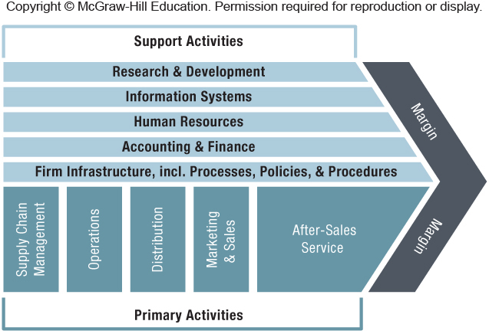
Exhibit 4.8 A Generic Value Chain: Primary and Support Activities
Notes:
Instructors:
The IM has a suggested activity to solidify student understanding of this firm level value chain tool building from discussion question 2 on McDonald’s.
Draw the students’ attention to Exhibit 4.8. Ask them to identify at least one activity in each category. Taking the consumers’ perspective should be easy for them and they are likely to identify research and development of new menu items and sourcing high quality ingredients at good prices as generating the most value for them. They are likely to identify supply chain management as critical to cost control. Some of them may have experience working for McDonalds or another fast food restaurant. If so, they should be able to identify the major cost structure drivers as: store labor, food wastage, and foot traffic per store. They may also note the importance of getting the maximum impact and reach from advertising and sales promotion programs. If your course is a capstone that focuses on integrating theory across functional areas, you might also ask the students to download the spreadsheet of McDonalds financial highlights. By analyzing these statements they should be able to see the high level of SG&A (mainly marketing) and the high operating costs for company-owned stores. They also should identify the importance of franchise operations to market share, cash flow, and margins, showing that service to franchisees is critically important.
In the last few years, McDonald’s has made a lot of changes to its menu, adding more healthy choices and more higher-priced items, such as those offered in McCafé (e.g., premium roast coffee, frappé, and fruit smoothies), and has also enhanced its in-restaurant services (e.g., free, unlimited Wi-Fi, newer interiors). Did McDonald’s new priorities—in terms of a broader, healthier menu and an improved in-restaurant experience—require changes to its traditional value chain activities? If so, how? Try to be as specific as possible in comparing the McDonald’s from the recent past (focusing on low-cost burgers) to the McDonald’s today.
Invite students to check out McDonalds corporate blog to get a real-time update and an international perspective. The students should be able to identify differences in R&D, marketing, and design & engineering, but most importantly, they should identify the impact on the supply chain processees of incorporating more fresh, less frozen food ingredients.

Slide 30
PRIMARY AND SUPPORT ACTIVITIES
The value chain is divided into primary and support activities.
Primary activities – Firm activities that add value directly by transforming inputs into outputs as the firm moves a product or service horizontally along the internal value chain
Support activities – Firm activities that add value indirectly, but are necessary to sustain primary activities
Notes:
Instructors:
We find that fewer students today have actually seen something “made.” This can create some confusion regarding the differences between primary and support activities. You may ask if any of the students have worked in any sort of manufacturing or process-related business. Using an example of a product or service will help the students frame the differences between primary and support functions.
Students may be interested in watching this 4 minute video showing the manufacturing of a Tesla Motors Model S in California. http://www.youtube.com/watch?v=8_lfxPI5ObM

Slide 31
IMPLICATIONS FOR THE STRATEGIST
EXTERNAL ANALYSIS
Exploit Opportunities
MATCHING
Vision, Mission & Strategy
INTERNAL ANALYSIS
Leverage Strengths
Mitigate Threats
Minimize Weaknesses
MACRO
PESTEL
PORTER
MICRO
VRIO

Slide 32
4.5 Implications for the Strategist
USING SWOT ANALYSIS TO COMBINE EXTERNAL
AND INTERNAL ANALYSIS
Synthesizes internal analysis of the company’s strengths and weaknesses (S and W) with those from an analysis of external opportunities and threats (O and T)
SWOT =
VRIO framework plus
PESTEL plus
Porter’s five forces analyses
Notes:
Instructors:
A SWOT analysis is still one of the most widely used tools of strategy in industry.
We bring together the concepts of this chapter’s internal analysis with those of Chapter 3 about outside the firm in the SWOT analysis. In addition to simply using the SWOT analysis appropriately, an additional step is required to make it a truly useful tool in the strategic management process: making decisions about how to create competitive advantage from the elements listed in the SWOT categories. It is for this reason we bring in the SWOT matrix tool here. The matrix adds alternatives, which are developed from the SWOT elements. This is a critically important step that helps to drive strategy out of the analysis phase and toward the implementation stage, because as we have already learned (from Mintzberg in Chapter 2), a strategy that has no action behind it is not really a strategy at all! Alternatives build plans that match the organization’s strengths to its opportunities, minimize or address its weaknesses, and compete in the face of its threats.
You may want to use one of the mini-cases in the text as a basis for inviting students to brainstorm alternatives for each box in the diagram in Exhibit 4.9.

Slide 33
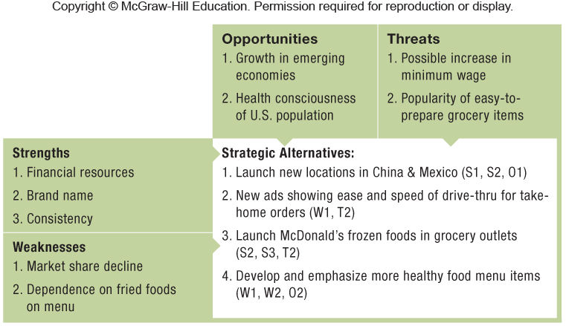
Exhibit 4.10 Strategic Questions within the SWOT Matrix

Slide 34
Using SWOT Analysis to Combine External and Internal Analysis
SWOT Limitations
SWOT analysis – widely used management tool
However, a strength can also be a weakness, and an opportunity can also be a threat.
The answer is – it depends…
To be an effective management tool, the strategist must conduct thorough external and internal analyses, grounding these analyses in rigorous theoretical frameworks, in order to derive a set of strategic options.

Slide 35
ChapterCase 4
Kobe Bryant
©Lucy Nicholson/Reuters/Landov
Consider This…
Nike’s strategy of building its core competency by creating heroes is not without risks.
Time and time again Nike’s heroes have fallen from grace.
Although Nike’s co-founder and chairman Phil Knight declared that scandals surrounding its superstar endorsement athletes are “part of the game,” too many of these public relations disasters could damage the company’s brand and lead to a loss of competitive advantage.
Notes:
Instructors:
The IM has some thoughts on the discussion questions provided here (page 120 of the text). Below is a synopsis of the IM.
What would it take for Nike’s approach to turn from a strength into a
weakness? Did this tipping point already occur? Why or why not?
Students are likely to point out that Nike’s competence in creating heroes by focusing on athletes from disadvantaged backgrounds can lead and has led to public relations nightmares. It is risky. The key to this discussion is to draw in the students’ knowledge from their marketing courses on how closely brand image is tied to celebrity endorsers public image.
What recommendations would you have for Phil Knight and Nike? Can you identify a way to “reframe” the
competency of creating heroes? Or a new way to think of heroes that would continue to build the brand?
An obvious way of diversifying risk is to spread endorsement funds across multiple athletes, this reduces the positive impact of each association on the brand, but it also reduces the negative impacts of a “failed hero”. Students may come up with many new ideas on how to build heroes. One such concept that would lower the firms risk is to reduce the emphasis on heroes that have risen from disadvantaged circumstances to heroes who serve the community through charitable activities.
If you are a competitor of Nike (such as Adidas, Under Armour, New Balance, or Li Ning), how could you exploit
Nike’s apparent vulnerability? Provide a set of concrete recommendations.
Students should find this a rich topic for creative thinking. Encourage them to identify both offensive and defensive tactics. Ideas might include: keeping disgraced endorsers in the limelight, developing endorsement deals with other athletes, creating campaigns based on the idea that everyone is a hero to someone, or creating endorsement deals with child athletes. AACSB 2013 Standard 9 Thinking creatively

Slide 36
Take-Away Concepts
LO 4-1 Differentiate among a firm’s resources, capabilities, core competencies, and activities.
Core competencies are unique, deeply embedded, firm-specific strengths that allow companies to differentiate their products and services and thus create more value for customers than their rivals, or offer products and services of acceptable value at lower cost.
Resources are any assets that a company can draw on when crafting and executing strategy.
Capabilities are the organizational and managerial skills necessary to orchestrate a diverse set of resources to deploy them strategically.
Activities are distinct and fine-grained business processes that enable firms to add incremental value by transforming input into goods and services.

Slide 37
Take-Away Concepts
LO 4-2
Compare and contrast tangible and intangible resources.
Tangible resources have physical attributes and are visible.
Intangible resources have no physical attributes and are invisible.
Competitive advantage is more likely to be based on intangible resources. A firm can shape an industry’s structure in its favor through its strategy.

Slide 38
Take-Away Concepts
RESOURCE HETEROGENEITY
RESOURCE IMMOBILITY
Resources tend to be “sticky” and don’t move easily from firm to firm.
Bundles of resources, capabilities, & competencies differ across firms.
The resource bundles of firms competing in the same industry are unique and thus differ from one another.
Because of this stickiness, the resource differences are difficult to replicate and, can be long-lasting.
LO 4-3 Evaluate the two critical assumptions behind the resource-based view.

Slide 39
Take-Away Concepts
For a firm’s resource to be the basis of a competitive advantage, it must have VRIO attributes: valuable (V), rare (R), and costly to imitate (I). The firm must also be able to organize (O) in order to capture the value of the resource.
A resource is valuable (V) if it allows the firm to take advantage of an external opportunity and/or neutralize an external threat.
A resource is rare (R) if the number of firms that possess it is less than the number of firms it would require to reach a state of perfect competition.
A resource is costly to imitate (I) if firms that do not possess the resource are unable to develop or buy the resource at a comparable cost.
The firm is organized (O) to capture the value of the resource if it has an effective organizational structure, processes, and systems in place to fully exploit the competitive potential.
LO 4-4
Apply the VRIO framework to assess the competitive implications of a firm’s resources.

Slide 40
Take-Away Concepts
LO 4-5
Evaluate different conditions that allow firms to sustain their competitive advantage.
Several conditions make it costly for competitors to imitate the resources, capabilities, or competencies that underlie a firm’s competitive advantage: (1) better expectations of future resource value (or simply luck), (2) path dependence, (3) causal ambiguity, and (4) social complexity.
These barriers to imitation are isolating mechanisms because they prevent rivals from competing away the advantage a firm may enjoy.

Slide 41
Take-Away Concepts
LO 4-6
Outline how dynamic capabilities can help a firm sustain competitive advantage.
To sustain a competitive advantage, any fit between a firm’s internal strengths and the external
Dynamic capabilities allow a firm to create, deploy, modify, reconfigure, or upgrade its resource base to gain and sustain competitive advantage in a constantly changing environment.

Slide 42
Take-Away Concepts
LO 4-7
Apply a value chain analysis to understand which of the firm’s activities in the process of transforming inputs into outputs generate differentiation and which drive costs.
The value chain describes the internal activities a firm engages in when transforming inputs into outputs.
Each activity the firm performs along the horizontal chain adds incremental value and incremental costs.
A careful analysis of the value chain allows managers to obtain a more detailed and fine-grained understanding of how the firm’s economic value created breaks down into a distinct set of activities that help determine perceived value and the costs to create it.
When a firm’s set of distinct activities is able to generate value greater than the costs to create it, the firm obtains a profit margin (assuming the market price the firm is able to command exceeds the costs of value creation).

Slide 43
Take-Away Concepts
LO 4-8
Conduct a SWOT analysis to combine external and internal analysis and derive strategic implications.
Formulating a strategy that increases the chances of gaining and sustaining a competitive advantage is based on synthesizing insights obtained from an internal analysis of the company’s strengths (S) and weaknesses (W) with those from an analysis of external opportunities (O) and threats (T).
The strategic implications of a SWOT analysis should help the firm to leverage its internal strengths to exploit external opportunities, while mitigating internal weaknesses and external threats.

