Slide 1
Chapter 2
Strategic Leadership:
Managing the Strategy Process
Notes:
Be sure to see experienced and newer versions of the Instructor’s Manual at http://www.mhhe.com/ftrStrategy2e.com

Slide 2
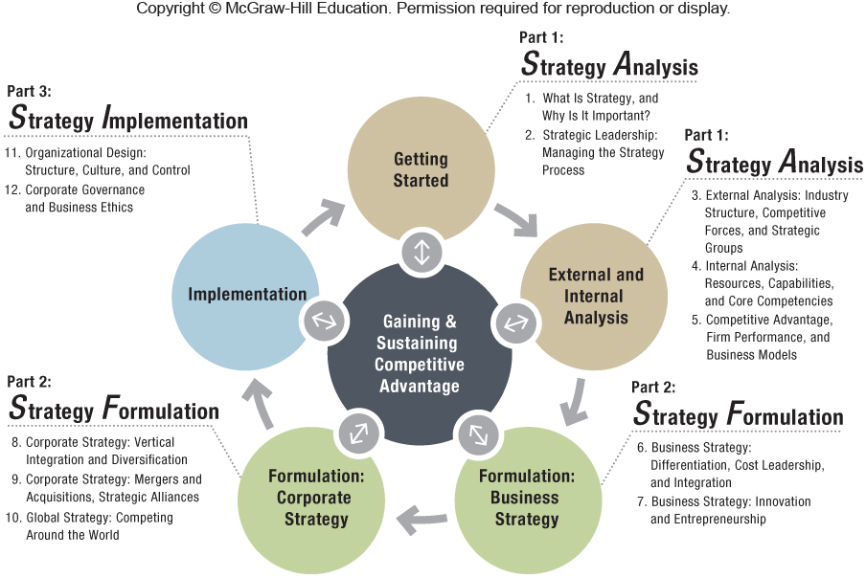

Slide 3
Chapter Outline
2.1 Vision, Mission, and Values
Vision and Mission
Living the Values
2.2 Strategic Leadership
How Do You Become an Effective and Ethical Strategic Leader?
Formulating Strategy Across Levels: Corporate, Business, and Functional Managers
2.3 The Strategic Management Process
Top-Down Strategic Planning
Scenario Planning
Strategy as Planned Emergence: Top-Down and Bottom-up
2.4 Implications for the Strategist
Notes:
Instructors: Below is a brief chapter summary from the IM
Chapter 2 begins with a discussion of the role of vision, mission, and values in strategic management.Vision statements are covered in more detail with a particular emphasis on customer- versus product-oriented visions. Next, we expand upon the topic of corporate social responsibility from Chapter 1 with a discussion on firm ethical values. Not only do firms need to make a profit, but they also need to do so by doing good. This topic is reinforced in the Chapter Case (PepsiCo) and in Strategy Highlight 2.1 (Merck). The
chapter addresses the roles of a strategic leader must fulfill successfully lead the company and achieve its strategic objectives to discusses Level 5 leadership theory. Finally, the chapter includes a description of three different processes used to “make”
strategy. A top-down focused strategic planning process, a future-oriented scenario planning process and a participative planned emergence process are all compared and contrasted. Strategy Highlight 2.2 (Starbucks) illustrates planned emergence.

Slide 4
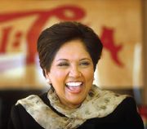
ChapterCase 2
© Neville Elder/Corbis
PepsiCo’s Indra Nooyi: “Performance with a Purpose”
$70 billion in annual revenues
300,000 worldwide employees
CEO Indra Nooyi had a leadership role in:
1997 – Divestiture of Taco Bell, Pizza Hut, & KFC
1998 – Acquisition of Tropicana
2001 – Acquisition of Quaker Oats (including Gatorade)
Notes:
Instructors:
The “Consider This” discussion at the end of the chapter has several discussion questions that you may think about asking to kick off a dialogue on Indra Nooyi’s leadership at PepsiCo.
- What “grade” would you give Ms. Nooyi for her job performance as a strategic leader?
- What should a strategic leader like Ms. Nooyi do if his or her vision does not seem to lead to an immediate (financial) competitive advantage?

Slide 5
ChapterCase 2
Ms. Nooyi declared PepsiCo’s vision to be “Performance with a Purpose,” defined by three dimensions:
Human sustainability
Environmental sustainability
The whole person at work
This triple-bottom-line competitive advantage approach considers economic, social, and environmental performance, underscoring CSR and stakeholder strategy.
Notes:
Instructors:
You may want to tell the students that “triple-bottom-line” is explored more fully in Chapter 5 of this text.
One example of the Pepsico commitment to “Performance with a Purpose” is given in the IM and summarized below.
In the last few years, PepsiCo has been contracting directly with small farmers in impoverished areas (for example, in Mexico). What started as a pilot project in PepsiCo’s Sabritas snack food division has now spread to over 1,000 farmers providing potatoes, corn, and sunflower oil to the firm. Pepsi provides a price guarantee for farmers’ crops that is higher and much more consistent than the previous system of using intermediaries.
The farmers report that since they have a firm market, they are planting more crops. Output is up about 160 %, and the
farm incomes have tripled in the last three years.
The program also has benefits for Pepsi as well. A shift to sunflower oil for its Mexican products will replace the 80,000 tons of palm oil it currently imports from Asia and Africa, thus slashing transportation and storage costs.
Some questions you could use to engage the students here might be….(thoughts on answers are given in the IM)
What are the benefits of this program for PepsiCo? What are its drawbacks?
What other societal benefits could such a program have in Mexico?

Slide 6
2.1 Vision, Mission, and Values
Strategic management process
Process employed by strategic leaders to conceive and implement a strategy, which leads to sustainable competitive advantage
Strategic leadership
Executives’ use of power and influence to direct assets in the pursuit of an organization’s goals
Notes:
Instructors:
■ What is our vision?
What do we want to accomplish ultimately?
■ What is our mission?
How do we accomplish our goals?
■ What are our values?
What guardrails do we put in place to act ethically and legally as we pursue our vision and mission?

Slide 7
Vision and Mission
VISION
Aspiration of the firm that lays the foundation for its mission – “to” is a common word
MISSION
What an organization does, including products, services, and which markets – “by” is a common word
Notes:
Instructors:
The digital companion to this book McGraw-Hill Connect has an interactive video exercise on this section of the textbook. It builds student confidence on vision and mission (LO 2-1 and 2-2).
The following is a discussion starter suggestion from the IM. (the referenced video is 2 minutes long).
Building a great company has some similarities to building a great house. Using this analogy to start the chapter should
resonate for many students. It is a helpful way to introduce the idea of vision and yet still tie it to something tangible that
must be implemented (building that great new home). You may want to open the discussion of vision with this humorous
video: https://www.youtube.com/watch?v=gqVGjR0JDQw&feature=player_embedded#t=0
TEACH FOR AMERICA (TFA)
Vision: To attain an excellent education for all children.
Mission: By enlisting our nation’s most promising future leaders in the effort.

Slide 8
FOR-PROFIT VS. NOT-FOR-PROFIT VISIONS
Main difference is the metric by which the firm assesses successful performance
TFA – success measured by the impact its teachers have on student performance
For-Profit firms – success measured by financial performance
Competitive Advantage – vision is aspirational, not exclusively financial
Notes:
Instructors:
● Not-for-Profit: Teach For America (TFA): One day, all children in this nation will have the opportunity to attain an excellent education.
● For-Profit examples- visionary companies, including 3M, General Electric, Merck, Nordstrom, Proctor & Gamble (P&G), and Walmart, provide more aspirational ideas that are not exclusively financial.
● Tracking the stock market performance of companies over many decades, researchers found that these visionary companies outperformed their peers by a wide margin.
● Thus highly motivating visions can improve financial performance.

Slide 9
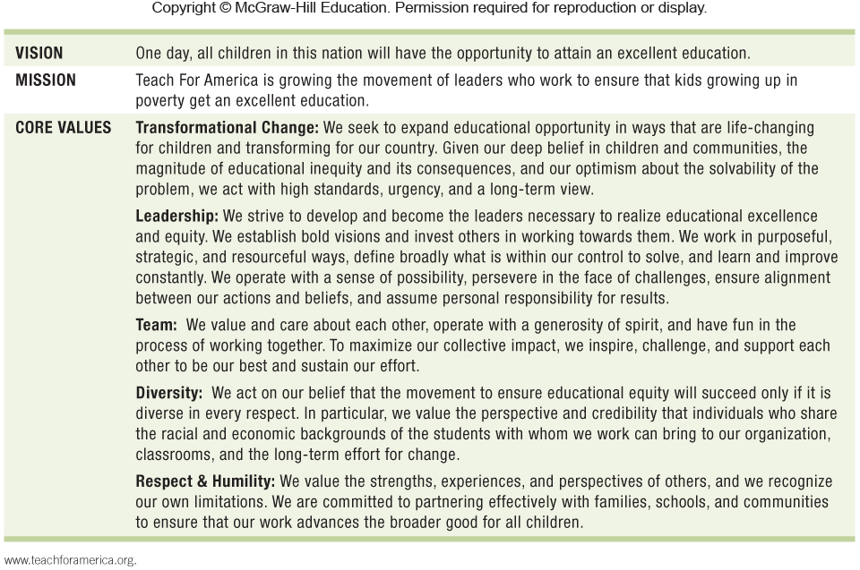
Exhibit 2.1 Teach For America

Slide 10
CUSTOMER-ORIENTED VS. PRODUCT-ORIENTED
Customer-oriented vision statements allow firms to adapt to changing environments.
Product-oriented vision statements are less flexible.
Strategic flexibility is a necessary condition to achieve competitive advantage.

Slide 11
PRODUCT-ORIENTED VISION STATEMENTS
A product-oriented vision defines a business in terms of a good or service.
Product-oriented visions tend to force managers to take a myopic view of the business landscape.

Slide 12
CUSTOMER-ORIENTED VISION STATEMENTS
A customer-oriented vision defines a business in terms of providing solutions to customer needs and are more flexible.
Example: We are in the business of providing solutions to professional communication needs.
However the company needs to be careful to differentiate between a customer-oriented vision and following customer sentiments.
Notes:
Instructors:
The IM has a couple of additional examples of companies using inspiring vision statements. Below is the summary of one.
When Facebook acquired Instagram, they sent Emily White to act as the new COO, charged with converting it from a
revenue-less business into a profit center. One of her first steps was to target the CEO toward creating a vision for the firm
to create an inspiring focus for advertisers, users, and employees. He came up with “to capture and share the world’s
moments”. Ask students to evaluate this vision in terms of whether it will attract customers (advertisers) or users. How
might it serve as a guide to employees about what they should or should not work on? See Instagram pictures itself making
money Wall Street Journal 9/8/13 and video link is here:
http://live.wsj.com/video/instagram-pictures-itself-making-money/59582BCE-0949-4E8D-A13F-25FF6C2FA2DD.html?KEYWORDS=instagram%23!59582BCE-0949-4E8D-A13F-25FF6C2FA2DD#!59582BCE-0949-4E8D-A13F-25FF6C2FA2DD

Slide 13
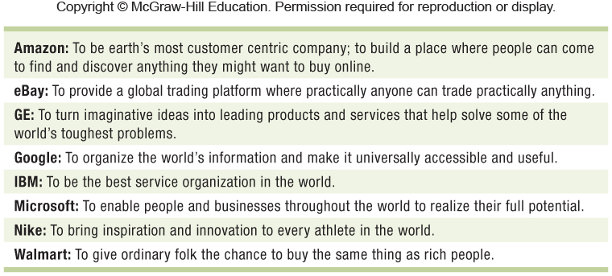
Exhibit 2.2 Companies with Customer-Oriented Vision Statements

Slide 14
EVOLUTION OF INTEL CORPORATION VISION STATEMENT
Early – to be the preeminent building-block supplier of the PC industry
1999 – to be the preeminent building-block supplier to the Internet economy
2008 – to delight our customers, employees, and shareholders by relentlessly delivering the platform and technology advancements that become essential to the way we work and live
Notes:
Instructors:
Intel Corporation illustrates a changing vision statement from product to customer-oriented, as evolving customer needs require adaption.
Part of this shift was reflected by the hugely successful “Intel Inside” advertising campaign in the 1990s that made Intel a household name worldwide.
Intel accomplished superior firm performance over decades through continuous adaptations to changing market realities. Its formal vision statement lagged behind the firm’s strategic transformations.
Intel regularly changed its vision statement after it had accomplished each successful transformation. In such a case, vision statements and firm performance are clearly not related to one another.

Slide 15
Living the Values
Values are ethical standards/norms that govern the behavior of individuals within a firm.
Two Important Functions:
Values form a foundation for a firm’s vision and mission.
Values serve as the guardrails to keep the company on track.
Notes:
Instructors:
The following discussion points are a summary of items brought out in the IM.
One example to show that firms with lax ethical values hurt more than their shareholders would be Bernie Madoff. Using a
giant Ponzi scheme, he and several employees in his investment securities firm, defrauded high-profile institutional and individual investors such as bank HSBC, Banco Santander, Human Rights First, the International Olympic Committee, film producer and CEO of DreamWorks Animation Jeffrey Katzenberg, actor Kevin Bacon, and Nobel Peace Prize winner Elie Wiesel. Madoff’s fraud totaled an estimated $65 billion. He was sentenced to 150 years imprisonment and fines of more than $170 billion.(“Q&A on Madoff case,” The Wall Street Journal, March 12, 2009.)
Another example:
What responsibility do lower-level executives at Enron bear for not reporting questionable practices by the firms’
leadership?
With over 20,000 employees at Enron, and another 30,000 at Arthur Anderson, it is clear some people knew and did nothing about it

Slide 16
Strategy Highlight 2.1
Merck: Reconfirming Its Core Values
Founder George W. Merck’s words form the basis of the company’s values even today.
Merck ended River Blindness in Africa, Latin America & the Middle East by donating its recently discovered drug Mectizan.
However, these values were challenged with the Vioxx Case. The firm did voluntarily pull the drug off the market when evidence linking heart attacks and strokes to Vioxx was revealed,
Resulting in Merck shares falling 27%.
Notes:
Instructors:
This strategy highlight offers the opportunity to illustrate that a firm’s strategy is--and should be--constrained by its core values. These values guide a firm on strategies on which it should embark and strategies that it should avoid or abandon. It also does a nice job of illustrating that strategic planning involves many decisions that are legal but may not confirm to the firm’s ethical values.

Slide 17
2.2 Strategic Leadership
ORGANIZATIONAL COMMITMENT
Strategic leadership – the behaviors and styles of executives that influence others to achieve the organization’s vision and mission
Strategic leaders impact firm performance as do leaders whose decisions lead to huge destruction of shareholder wealth and jobs.
Notes:
Instructors:
The text provides a number of examples of leaders at both the positive and negative end of the performance scale. In the IM there a couple of more detailed examples. One of these is summarized below.
Consider the situation at JCPenney in 2011-2013 (see Investor William Ackmann targets JCPenney CEO Wall Street
Journal 8/8/13; Penney wounded by deep staff cuts Wall Street Journal 4/14/13; and a video). Ron Johnson was brought in
to save JCP from sharply declining competitiveness. He completely re-envisioned the firm’s strategy, customer
experience, store layout, and pricing position. He closed underperforming stores and retrained/replaced staff. Sadly, he lost
even more customers in the process. The board of directors fired him and brought back the previous CEO (who had been
replaced due to under-performance).
How did Ron Johnson’s previous experience and perspectives gained as head of Apple’s retail operations shape his strategic thinking at JCP?

Slide 18
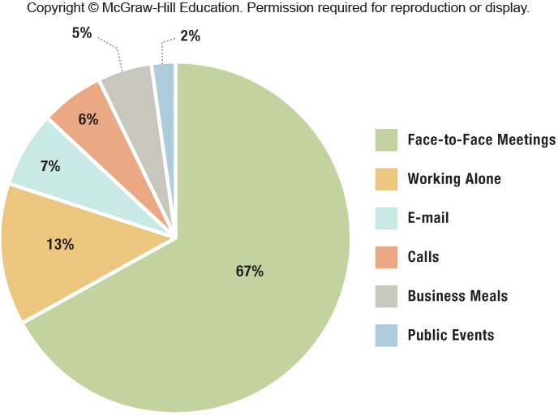
Exhibit 2.3 How CEOs Spend Their Days
SOURCE: Author’s depiction of data from O. Bandiera, A. Prat, and R. Sadun (2012), “Managerial capital at the top: Evidence from the time use of CEOs,” London School of Economics and Harvard Business School Working Paper.

Slide 19
How Do You Become an Effective and Ethical Strategic Leader?
Upper-echelons theory – Framework that views organizational outcomes – strategic choices and performance levels – as reflections of top management values, who interpret situations through their unique perspective lens
Strong leadership is the result of both innate abilities and learning.

Slide 20
GOOD TO GREAT
Jim Collins identified great companies as those that transitioned from average performance to sustained competitive advantage.
He measured that transition as “cumulative stock returns of 6.9 times the general market in the 15 years following their transition points.”
Notes:
Instructors:
Jim Collins found consistent patterns of leadership among the companies he studied, as pictured in the Level-5 leadership pyramid in Exhibit 2.4.
The pyramid is a conceptual framework that shows leadership progression through five distinct, sequential levels. Collins found that all the companies he identified as great were led by Level-5 executives.

Slide 21
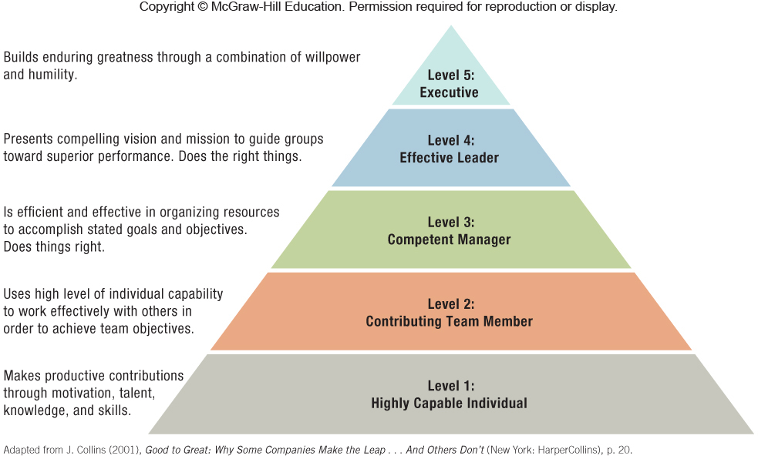
Exhibit 2.4 Strategic Leaders: The Level 5 Pyramid

Slide 22
Formulating Strategy Across Levels: Corporate, Business, and Functional Managers
CORPORATE STRATEGY
BUSINESS STRATEGY
FUNCTIONAL STRATEGY
How to compete (cost leadership, differentiation, or integration)
How to implement a business strategy
Where to compete (industry, markets, and geography)
Notes:
Instructors:
The digital companion to this book McGraw-Hill Connect has an interactive exercise on this section of the textbook. It builds student confidence on strategy across levels (LO 2-5).

Slide 23
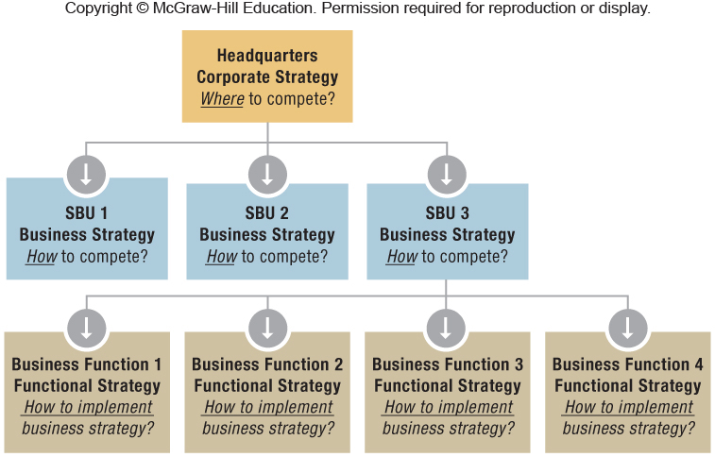
Exhibit 2.5 Strategy Formulation & Implementation Across Levels: Corporate, Business, and Functional Strategy

Slide 24
2.3 The Strategic Management Process
When strategizing for competitive advantage, managers rely on three different approaches. This order represents how these approaches were developed over time.
STRATEGIC PLANNING
STRATEGY AS PLANNED EMERGENCE
SCENARIO PLANNING

Slide 25
Top-Down Strategic Planning
Top-down strategic planning – Rational, top-down process aiding in programming for future success
Information flows only one way: top-down.
Centralized strategic intelligence and decision-making
Exhibit 2.6 illustrates the three steps of analysis, formulation, and implementation in a traditional top-down strategic planning process.
Notes:
Instructors:
As the text notes, Apple's Steve Jobs was one of the few successful tech companies using a top-down strategic-planning process. He felt that he knew best what the next big thing should be. Under his top-down, autocratic leadership, Apple did not engage in market research, because Jobs firmly believed that “people don't know what they want until you show it to them.”
However since Jobs’ death, Apple’s strategy process has become more flexible under its new CEO Tim Cook; the company is now trying to incorporate the possibilities of different future scenarios and bottom-up strategic initiatives.

Slide 26
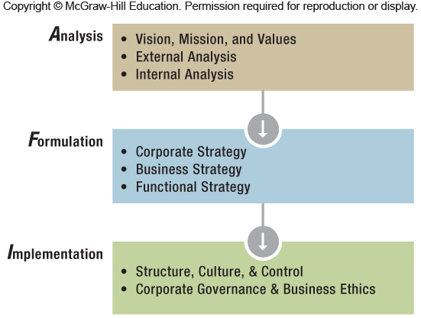
Exhibit 2.6 Top-Down Strategic Planning in the AFI Framework

Slide 27
Scenario Planning
Managers envision different what-if scenarios to anticipate plausible futures.
Scenario planning takes place at both the corporate and business levels of strategy.
Addresses both optimistic and pessimistic futures
Exhibit 2.7 illustrates the use of scenario planning with the AFI strategy framework.
Notes:
Instructors:
The following is a discussion question from the end of chapter material relevant to this subject of the chapter. It is important for students to give some thought to the appropriate context for the three different ways to formulate strategy.
Identify an industry that is undergoing intense competition or is being featured in the business press. Discuss how
scenario planning might be used by competitors to prepare for future events. Can some industries benefit more than
others from this type of process? Explain why.
Industries that by their nature need to make “big bets” are often users of scenario planning. This would include the oil
industries. It would also include other major extraction companies (Alcoa, for example) and capital intensive industries
such as semiconductors (Intel). These firms must make major investments around the globe to be successful in their
industries. Scenario planning can help them with boundary conditions on their choices.

Slide 28
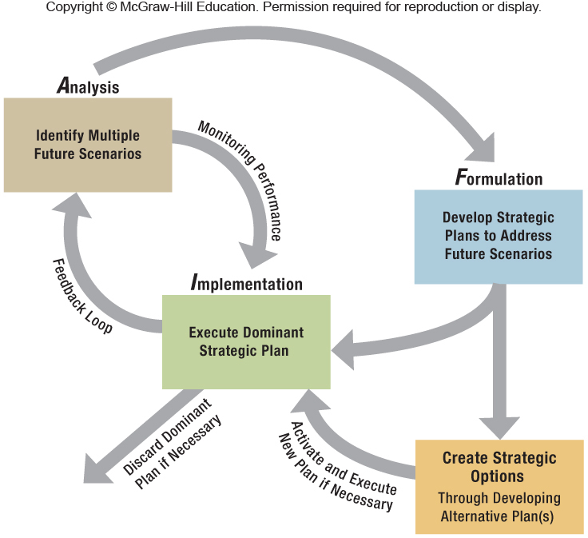
Exhibit 2.7 Scenario Planning Within the AFI Strategy Network

Slide 29
SCENARIO PLANNING: ANALYSIS
Analysis stage
Managers brainstorm to identify possible future scenarios, with critical inputs from different hierarchies and different functional areas (e.g., R&D, manufacturing, and marketing & sales).
Examples of external forces to be considered:
Exchange rate fluctuations
Currency appreciation/depreciation
Financial crises impacting credit/equity/liquidity
Black Swan events (impactful & unpredictable)

Slide 30
SCENARIO PLANNING: FORMULATION
Formulation stage
Management teams develop different strategic plans to address possible future scenarios.
These capture the firm’s internal and external environments and answer key questions.
From the portfolio of options, managers transform the most viable options into full-fledged, detailed strategic plans that can be activated and executed as needed.

Slide 31
SCENARIO PLANNING: IMPLEMENTATION
Implementation stage
Executives decide which option most closely matches the current reality and managers implement the dominant strategic plan.
The iterative, interdependent relationship among analysis, formulation, and implementation enhances organizational learning and strategic flexibility.

Slide 32
Strategy as Planned Emergence: Top-Down and Bottom-Up
Critics of top-down and scenario planning argue that strategic planning is not the same as strategic thinking.
Most notable of these critics, Henry Mintzberg, proposed a third approach to the strategic management process.
From this viewpoint, managers must synthesize all available input from different internal/external sources into an overall strategic vision.
Notes:
Instructors:
The digital companion to this book McGraw-Hill Connect has an interactive case exercise on this section of the textbook. It builds student confidence on emergent strategy using a short case about 3M (LO 2-6).

Slide 33
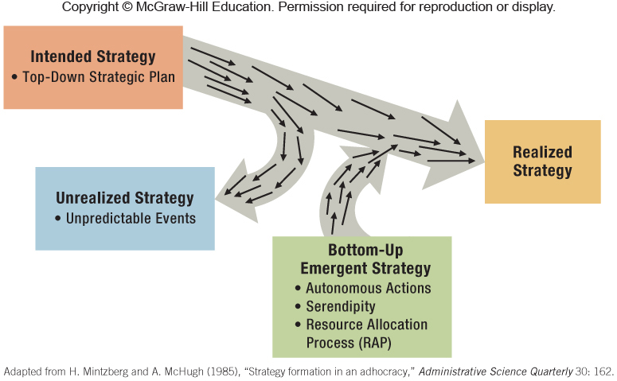
Exhibit 2.8: Realized Strategy Combines Top-Down and Bottom-Up

Slide 34
Strategic initiative
Activity a firm pursues to explore and develop new products and processes, new markets, or new ventures
Strategic initiatives may develop through:
Autonomous actions by lower-level employee
Serendipity (random events, pleasant surprises, accidental happenstances)
The Resource Allocation Process (RAP)

Slide 35
Strategy Highlight 2.2
Starbucks’s CEO: “It’s Not What We Do”
The story of Frappuccino® is chronicled in this Strategy Highlight, including:
The strong resistance by top executives
The tenacious determination of one store manager, Diana
The importance of a product champion for autonomous innovation
The culmination of Frappuccino being a billion-dollar business for Starbucks
Notes:
Instructors:
This Strategy Highlight illustrates that successful emergent strategies are sometimes the result of serendipity combined with autonomous actions of mid and lower-level employees.

Slide 36
STRATEGIC INITIATIVES VIA AUTONOMOUS ACTIONS
Google employs a 70-20-10 rule when organizing the work of its engineers:
70% is focused on its main business (search and ads)
20% is spent on ideas of their own choosing
10% is devoted to total wild cards (e.g., driverless car)
Google reports that half of its new products came from the 20 percent rule.
Notes:
Instructors:
Below is an end of chapter suggested small group activity if you would like the students to work through some of the issues associated with this bottom-up approach.
End of Chapter Small Group Exercise 2
In many situations, promising ideas emerge from the lower levels of an organization, only to be discarded before
they can be implemented. It was only extraordinary tenacity (and indeed, disregard) for the policy of selling only
corporate-approved drinks that permitted the Frappuccino to “bloom” within Starbucks (see Strategy Highlight
2.2). What would be some problems that would need to be addressed to introduce an angel-network idea into a
firm? Use a firm someone in your group has worked for or knows well to discuss possible issues of widely
distributing small funding level approvals across the firm.
This exercise builds on some of the ideas applied in the Starbucks Strategy Highlight, combined with thoughts from Gary
Hamel’s book The Future of Management (Harvard 2007). It also integrates some of the real options concepts, because
these “seeds” of funding spread throughout the organization will enable limited funding of many different ideas and give
each project some time to get traction without it being a “bet the business” decision.

Slide 37
STRATEGIC INITIATIVES VIA AUTONOMOUS ACTIONS
Championed by a mid-level engineer, GE’s leadership relented and bought Enron Wind for $200 million.
A huge success, generating revenues over $10 billion in 2012, this acquisition opened up significant alternative-energy opportunities, including GE’s ecomagination.
From product-oriented to consumer-oriented, from Welch to Immelt, GE transitions are underscored.
Notes:
Instructors:
This is a second example from the text of strategic initiatives which emerged from lower in the organization.
The IM has several short examples of products such as Superglue, Scotchgard and Velcro that were developed from often serendipitous events by front line employees rather than due to some high level corporate planning.

Slide 38
2.4 Implications for the Strategist
THREE STRATEGIC PROCESSES
The three strategy processes discussed in this chapter, each have strengths and weaknesses.
Important variables to consider:
Rate of environmental change (internal/external)
Firm size
Employee commitment to vision, mission, and organizational values
Notes:
Instructors:
● RATE OF CHANGE- The effectiveness of the chosen strategy process is contingent upon the rate of change in the internal and external environments of the firm. In a slow-moving environment, top-down strategic planning might be the most effective approach.
● FIRM SIZE- A second dimension is firm size. Larger firms tend to use either a top-down strategic planning process or scenario planning. For a nuclear power provider such as Areva in France that provides over 75% of the country’s energy and has the long-term backing of the state, for instance, using a top-down strategy approach might work well. Given that nuclear accidents are rare but when they occur have a tremendous impact (such in Chernobyl, Russia, and Fukushima, Japan), Areva might use scenario planning to prepare for black swan events. In fast-moving environments, by contrast, Internet companies such as Alibaba, eBay, Facebook, Google, Dropbox, Pinterest, or Twitter tend to use the strategy as planned emergence process.
● EMPLOYEE COMMITMENT- All employees should be involved in setting an inspiring vision and mission to create more meaningful work. Belief in a company’s vision and mission motivates its employees. Moreover, every employee plays a strategic role. Lower-level employees focus mainly on strategy implementation when a firm is using top-down or scenario planning. However, any employee (even at the entry level) can have great ideas that might become strategic initiatives with the potential to transform companies.

Slide 39
ChapterCase 2
© Neville Elder/Corbis
Consider This…
The stakeholder strategy approach adopted by Indra Nooyi is applauded by some, yet performance under PepsiCo’s “Performance with a Purpose” vision is lagging behind Coke and Diet Coke.
Should Ms. Nooyi be replaced?
Should PepsiCo be split into a beverage and snack foods company in order to leverage unbundled profit potential?

Slide 40
Take-Away Concepts
LO 2-1
Describe the roles of vision, mission, and values in the strategic management process.
A vision captures an organization’s aspirations. An effective vision inspires and motivates members of the organization.
A mission statement describes what an organization actually does—what its business is—and why and how it does it.
Values define the ethical standards and norms that should govern the behavior of individuals within the firm.

Slide 41
Take-Away Concepts
LO 2-2
Evaluate the strategic implications of product-oriented and customer-oriented vision statements.
Product-oriented vision statements define a business in terms of a good or service provided.
Customer-oriented vision statements define business in terms of providing solutions to customer needs.
Customer-oriented vision statements provide managers with more strategic flexibility than product-oriented missions.
To be effective, visions and missions need to be backed up by hard-to-reverse strategic commitments.

Slide 42
Take-Away Concepts
LO 2-3
Explain why anchoring a firm in ethical values is essential for long-term success.
Employees tend to follow values practiced by strategic leaders. Without commitment from top managers, statements of values remain merely public relations exercises.
Ethical values are the guardrails that help keep the company on track when pursuing its mission and its quest for competitive advantage.

Slide 43
Take-Away Concepts
To become an effective strategic leader, a manager needs to develop skills to move sequentially through five different leadership levels: highly capable individual, contributing team member, competent manager, effective leader, and executive.
LO 2-4
Outline how managers become strategic leaders.

Slide 44
Take-Away Concepts
LO 2-5
Describe the roles of corporate, business, and functional managers in strategy formulation and implementation.
Corporate executives must provide answers to the question of where to compete (in industries, markets, and geographies), and how to create synergies among different business units.
General managers in strategic business units must answer the strategic question of how to compete in order to achieve superior performance. They must manage and align the firm’s different functional areas for competitive advantage.
Functional managers are responsible for implementing business strategy within a single functional area.

Slide 45
Take-Away Concepts
LO 2-6
Evaluate top-down strategic planning, scenario planning, and strategy as planned emergence.
Top-down strategic planning is a sequential, linear process that works reasonably well when the environment does not change much.
In scenario planning, managers envision what-if scenarios and prepare contingency plans that can be called upon when necessary.
Strategic initiatives can be the result of top-down planning or can emerge through a bottom-up process from deep within the organization. They have the potential to shape a firm’s strategy.
A firm’s realized strategy is generally a combination of its top-down intended strategy and bottom-up emergent strategy, resulting in planned emergence.

