Slide 1
Chapter 5
Competitive Advantage, Firm Performance,
and Business Models
Notes:
Be sure to see experienced and newer versions of the Instructor’s Manual at http://www.mhhe.com/ftrStrategy2e.com

Slide 2
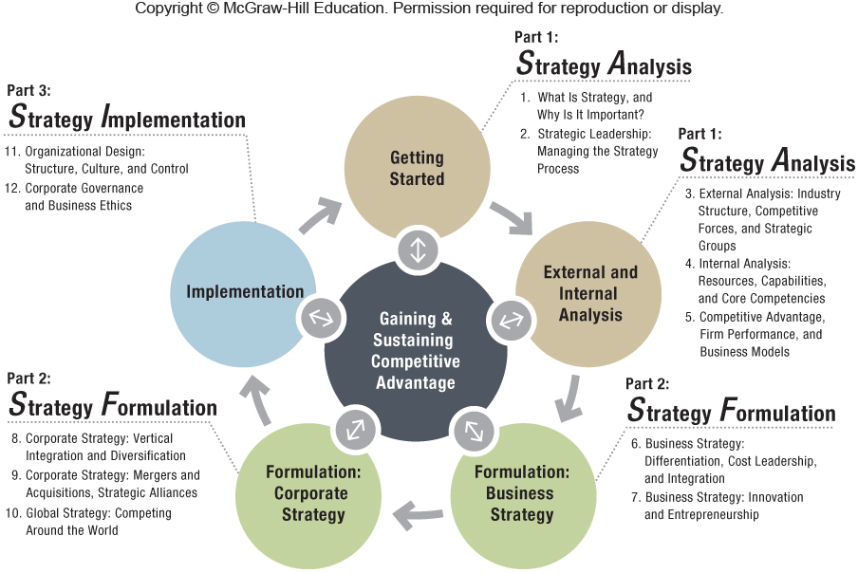

Slide 3
Chapter Outline
5.1 Competitive Advantage and Firm Performance
Accounting Profitability
Shareholder Value Creation
Economic Value Creation
The Balanced Scorecard
The Triple Bottom Line
5.2 Business Models: Putting Strategy into Action
5.3 Implications for the Strategist

Slide 4
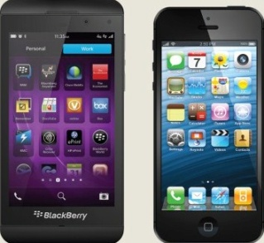
ChapterCase 5
©STANCA SANDA/Alamy
Assessing Competitive Advantage: Apple vs. BlackBerry
2012 – A comparison of Apple vs. BlackBerry on return on invested capital (ROIC), where ROIC = (Net profits / Invested capital) reveals:
Apple’s ROIC was 35.0%.
BlackBerry’s ROIC was 14.1%.
Apple was 2.5 times more efficient than BlackBerry at generating a return on invested capital, so Apple had a clear competitive advantage over BlackBerry.
Notes:
Instructors:
This case is designed to provide material enabling students to measure and compare firm performance and competitive advantage between Apple and Blackberry. The case builds on and extends the Chapter 1 Case on Apple by specifically measuring Apple’s competitive advantage relative to Blackberry as of the end of 2012.

Slide 5
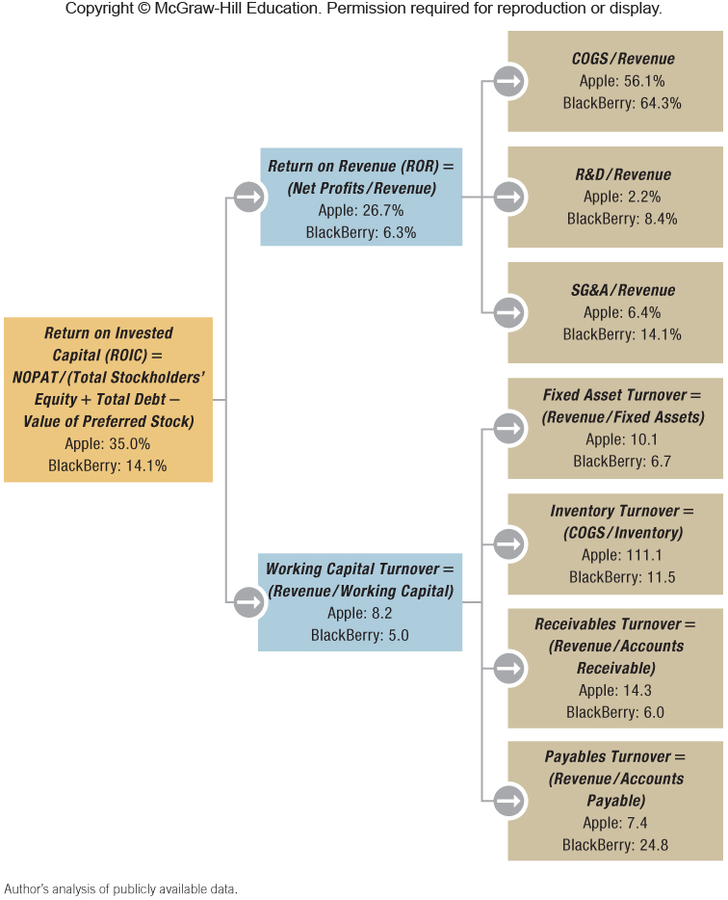
Exhibit 5.1 Comparing Apple and BlackBerry: Drivers of Firm Profitability
Notes:
Instructors:
You may want to point out to your students that toward the end of the textbook, a section called “How to Conduct a Case Analysis” includes a table with a complete presentation of accounting measures (profitability, activity, leverage, liquidity, and market measures), how they are calculated, and their benefits and shortcomings. The students should find these useful when working through the strategy term project or analyzing different case studies and business situations.

Slide 6
THREE TRADITIONAL FRAMEWORKS TO ASSESS FIRM PERFORMANCE
ACCOUNTING PROFITABILITY
What is the firm’s accounting profitability?
SHAREHOLDER VALUE CREATION
How much shareholder value does the firm create?
ECONOMIC VALUE CREATION
How much economic value does the firm generate?

Slide 7
5.1 Competitive Advantage and Firm Performance
To measure competitive advantage, we must:
Assess firm performance and
Benchmark to the industry average / other competitors
Three performance dimensions:
What is the firm’s accounting profitability?
How much shareholder value does the firm create?
How much economic value does the firm generate?

Slide 8
Accounting Profitability
Examining one of these – Return on invested capital (ROIC), constituent parts are return on revenue and working capital turnover.
2012 – Apple had a distinct competitive advantage over BlackBerry because Apple’s ROIC was much higher than BlackBerry’s.
Why is the ROIC for these two companies so different?
Apple vs. BlackBerry financial ratios are in Figure 5.1.
Notes:
Instructors:
The IM brings in another example of firm comparison for class discussion which you may find useful.
Consider Google vs. Microsoft, which are becoming more direct competitors. Which of the two has competitive advantage in terms of accounting profitability? Microsoft is larger than Google and thus records a higher net income ($21.9 B vs. $10.8 B in 2012). In 2012 Microsoft had a higher ROA (16.5 v. 13.0) and ROE (30.1 v. 16.6). Thus, we can conclude that Microsoft held a competitive advantage over Google by this measure. Note, though, that high-tech companies like Google and Microsoft have relatively few tangible assets. This in turn limits the usefulness of accounting profitability when assessing competitive advantage. Refer students to Exhibit 5.2. The price to book ratio of both firms is quite high (3.64 for Microsoft and 3.25 for Google on 10/8/13). Key to their performance are intangible assets such as Google’s ability to invent proprietary search and data-management algorithms and Microsoft’s ability to develop proprietary software code for its Windows operating system.

Slide 9
Accounting Profitability
LIMITATIONS
All accounting data are historical data and thus backward-looking.
Accounting data do not consider off–balance sheet items.
Accounting data focus mainly on tangible assets, which are no longer the most important.
They do measure relative profitability, which is useful when comparing firms of different size over time.
Notes:
Instructors:
All three performance measures have advantages and disadvantages. We like to spend a few minutes working with the students to identify these through examples.
For example, Hyundai’s reputation for quality, Honda’s core competency in designing highly reliable engines, and Zappos’s superior customer experience are not balance sheet items.

Slide 10
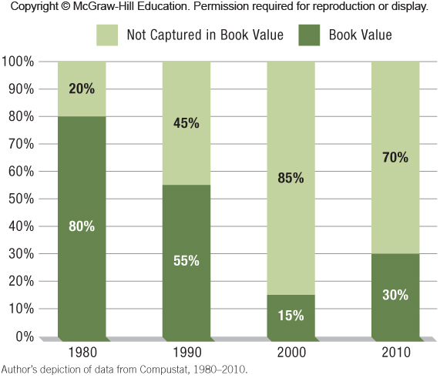
Exhibit 5.2 The Declining Importance of Book Value in a Firm’s Stock Market Valuation, 1980−2010
Notes:
Instructors:
You may want to note the similarity here to the discussion of tangible and intangible assets in the resource-based view of competitive advantage in Chapter 4.

Slide 11
THREE TRADITIONAL FRAMEWORKS TO ASSESS FIRM PERFORMANCE
ACCOUNTING PROFITABILITY
What is the firm’s accounting profitability?
SHAREHOLDER VALUE CREATION
How much shareholder value does the firm create?
ECONOMIC VALUE CREATION
How much economic value does the firm generate?

Slide 12
Shareholder Value Creation
Shareholders
Individuals or organizations who own one or more shares of stock in a public company
The legal owners of public companies
Effective strategies to grow the business can increase a firm’s profitability and its stock price.
Risk capital
The money provided by shareholders in exchange for an equity share in a company.
Cannot be recovered if the firm goes bankrupt
Notes:
Instructors:
We find that students are most comfortable with this perspective of measuring competitive advantage. Whether they have invested their own money or not, they are largely familiar with buying and selling publicly traded stocks. We try to point out the highly volatile and short-term nature of stock prices, whereas generally we think about competitive advantage lasting more than one quarter or one year.

Slide 13
Total return to shareholders
Return on risk capital, including stock price appreciation plus dividends received over a specific period
This is what investors are interested in.
It is an external performance metric, unlike accounting data.
Efficient-market hypothesis
All available information about a firm’s past, current state, and expected future performance is embedded in the firm’s stock price.
Notes:
Instructors:
The video “We’re All Predictably Irrational” is 20 minutes of a speech by Professor Dan Ariely, the author of The New York Times bestseller Predictably Irrational and also a newer book The Upside of Irrationality. The video is too long for most class presentations, but we ask for student volunteers to view the video before class and let them select a two- or three-minute section to show to the class.
Alternatively, each student could be assigned to view different brief videos on Professor Ariely’s website (most are less than one minute) http://danariely.com/videos/
Students can summarize for the class in one sentence the learning message from that video and how it might affect the purchase of stocks. Professor Ariely’s work focuses on behavioral economics and explains why people are not rational in their purchase decisions.

Slide 14
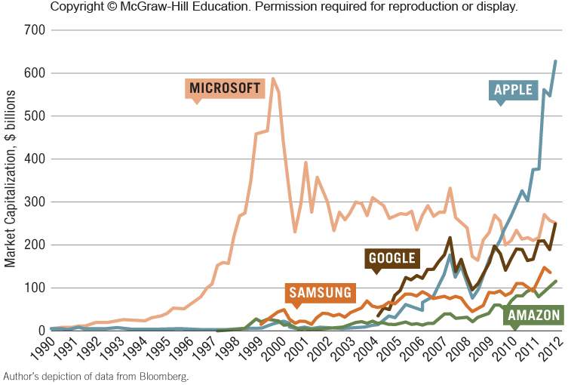
Exhibit 5.3 Stock Market Valuations of Amazon, Apple, Google, Microsoft, and Samsung

Slide 15
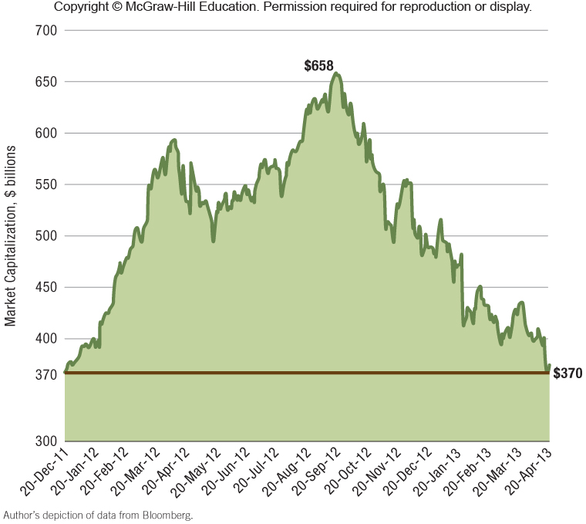
Exhibit 5.4 Apple’s Market Cap (December 2011− April 2013)
Notes:
Instructors:
Here is an alternative discussion from the IM that you may find interesting to do in class.
Pull up a five-year stock price chart for HP. Use it to illustrate the impact that stock market impressions of the CEO’s vision and leadership capabilities can have on the stock price. In the first 10 months of 2011, the firm’s stock price dropped by 48%, primarily due to lack of confidence in CEO Leo Apotheker’s ability to articulate a consistent strategic direction for the firm (see Wall Street Journal video). He was replaced with Meg Whitman. Again the firm lost half its market value in the next 14 months primarily as a result of frequent highly pessimistic comments by Ms. Whitman as to the firm’s financial outlook for the coming five years. All of this occurred during a time when the overall market indices, and HP competitors’ stock prices, were rising.
Link back to the material in chapter 4 to discuss how important a CEO’s leadership skills are to a firm’s competitive advantage. For this particular measure of competitive advantage, this one item in the firm’s slate of resources and capabilities can have an outsized impact.

Slide 16
Shareholder Value Creation
LIMITATIONS
Stock prices can be highly volatile, making it difficult to assess firm performance, particularly in the short term.
Overall macroeconomic factors such as the unemployment rate, economic growth or contraction, and interest and exchange rates all have a direct bearing on stock prices.
Stock prices frequently reflect the psychological mood of investors, which can at times be irrational.
Notes:
Instructors:
Coverage of the drawbacks of this perspective is useful to help students understand when this approach may be appropriate and when it may NOT be.

Slide 17
THREE TRADITIONAL FRAMEWORKS TO ASSESS FIRM PERFORMANCE
ACCOUNTING PROFITABILITY
What is the firm’s accounting profitability?
SHAREHOLDER VALUE CREATION
How much shareholder value does the firm create?
ECONOMIC VALUE CREATION
How much economic value does the firm generate?
Notes:
Instructors:
If a number of your students have internet access in the classroom we like to use Discussion question #1 on Dominos pizza to discuss the differences between the 3 major perspectives.
Below is the discussion question and some comments on it from the IM.
Domino’s Pizza has been in business for over 50 years old and claimed #1 Worldwide in Pizza Delivery in 2013. Visit the company’s business-related website (www.dominosbiz.com) and read the company profile under the “Investors”
tab. Does the firm focus on the economic, accounting, or shareholder perspective in describing its competitive advantage in the profile?
On the Domino’s Pizza company profile page, most of the focus is on economic value creation for the company and its customers. The site talks about all the products the company offers— from thin crust, deep dish, hand-tossed pizzas to bread sticks, cheesy bread, buffalo wings, sandwiches, pasta, and boneless chicken. The website mentions the 2009 reconfiguration of its hand-tossed pizza, which now has new sauce, cheese, and garlic-seasoned crust. This reinvention combined with the extensive menu drives the creation of economic value: profit for Domino’s and consumer surplus for the customer. Moreover, the company profile discusses the ways in which it has innovated within the pizza business: the heatwave hot bag, a better box, the spoodle, and pizza tracking and building tools through its online ordering. Domino’s is
the only company that allows the customers to monitor their order through the Pizza Tracker. This tool is another example of Domino’s effort to increase its competitive advantage through the creation of economic value.

Slide 18
Economic Value Creation
A firm has a competitive advantage when it creates more economic value than rival firms.
Economic value creation is the difference between a buyer’s willingness to pay for a product/service and the firm’s total cost to produce it:
(V – C), where (V) = Value and (C) = Cost, also called economic contribution
The amount of total perceived consumer benefits equals the maximum willingness to pay.
Notes:
Instructors:
The digital companion to this book McGraw-Hill Connect has an interactive exercise on this section of the textbook. It builds student confidence on the economic value perspective of competitive advantage (LO 5-3).
The PC example in the text should resonate well with students, since it represents a significant purchase for them in which they likely consider competing brands with different positioning. We use some of the class time to highlight the differences between consumer surplus and producer surplus. Also, in a foreshadowing of Chapter 6 (business-level strategies), we note
firms have the ability to adjust the price within the economic value created space (V-C).

Slide 19
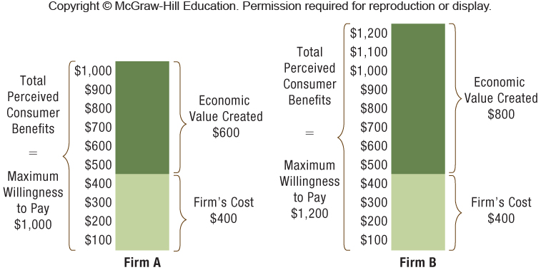
Exhibit 5.5 Competitive Advantage: Same Cost as Firm A but Firm B Creates More Economic Value

Slide 20
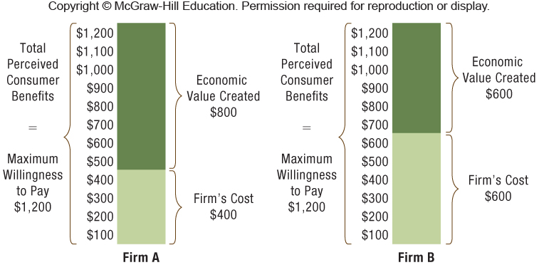
Exhibit 5.6 Firm A’s Competitive Advantage: Same Total Perceived Consumer Benefits as Firm B But Firm A Creates More Economic Value

Slide 21
Total Perceived Consumer Benefits and Economic Value Created
VALUE
(V)
Consumer’s willingness to pay maximum price; sometimes called the reservation price
COST
(C)
Cost to produce the good/service directly impacts the profit margin
PROFIT
(P)
Difference between the price (P) charged and the cost (C) to produce or (P – C)
Notes:
Instructors:
In discussing economic value creation, we sometimes refer to these as the “VPCs” to highlight the key components in a way to help students remember the material.

Slide 22
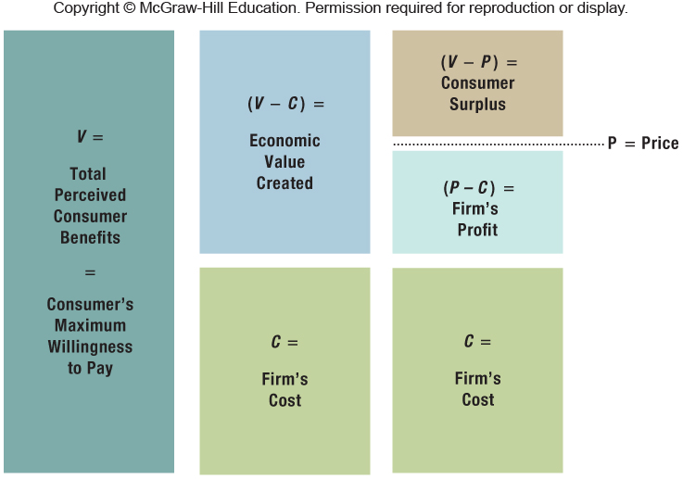
Exhibit 5.7 Competitive Advantage and Economic Value Created: The Role of Value, Cost, and Price
Notes:
Instructors:
In discussing economic value creation, we sometimes refer to these as the “VPCs” to highlight the key components in a way to help students remember the material.

Slide 23
From an economic context, strategy is about:
Creating economic value and
Capturing as much of it as possible
A large difference between V and C gives the firm two distinct pricing options:
Charge higher prices to reflect the higher product value and increase profitability, or
Charge the same price as rivals and gain market share
The strategic objective is to maximize (V – C), which is the economic value created.
Notes:
Instructors:
This foreshadows Chapter 6 (business-level strategies), as we note firms have the ability to adjust the price within the economic value created space (V-C).

Slide 24
OPPORTUNITY COST
Opportunity costs – The value of the best forgone alternative use of the resources employed
Accounting profitability – Relies on historical costs
Economic value creation – All costs are considered, including opportunity costs
Notes:
Instructors:
We find students often don’t really understand the opportunity costs logic until they have worked through an example.
The bistro entrepreneur faces two types of opportunity costs: (1) forgone wages she could be earning if she was employed elsewhere and (2) the cost of capital she invested in her bistro, which could instead be invested in, say, the stock market or U.S Treasury bonds. At the end of the year, the bistro entrepreneur considers her business over the last 12 months. She
made an accounting profit of $60,000, calculated as total revenues minus expenses (which include all historical costs but not opportunity costs). But she also realizes she has forgone $40,000 in salary she could have earned at another firm. In addition, she knows she could have earned $25,000 in interest if she had bought U.S. Treasury bills with a 5 percent return instead of investing $500,000 in her business. The opportunity cost of operating the bistro was $65,000 ($40,000 + $25,000). Therefore, when considering all costs, including opportunity costs, she actually experienced an economic loss of $5,000 ($60,000 – $65,000).
She should stay in business only if she values her independence more than $5,000 or thinks
business will be better next year.

Slide 25
Economic Value Creation
LIMITATIONS
Determining the value of a good in the eyes of consumers is not a simple task.
The value of a good in the eyes of consumers changes based on income, preferences, time, etc.
To measure firm-level competitive advantage, the economic value created for all products/services offered by the firm must be assessed.

Slide 26
The Balanced Scorecard
HOLISTIC PERSPECTIVE OF FIRM PERFORMANCE
Balanced scorecard – Strategy implementation tool that harnesses multiple internal and external performance metrics in order to balance financial and strategic goals
The four key questions are:
How do customers view us?
How do we create value?
What core competencies do we need?
How do shareholders view us?
Notes:
Instructors:
Now we move to the first of two frameworks that strive for a more complete picture of firm performance and thus competitive advantage. The balanced scorecard brings together internal and external measures in attempts to balance financial and strategic goals.
As discussed in the chapter, a balanced scorecard views the performance of an organization through four lenses: customer, innovation and learning, internal business, and financial. According to surveys from Bain & Company (a consulting firm), in recent years about 60 percent of firms in both public and private sectors have used a balanced scorecard for performance measures. (See http://www.thepalladiumgroup.com for examples.)

Slide 27
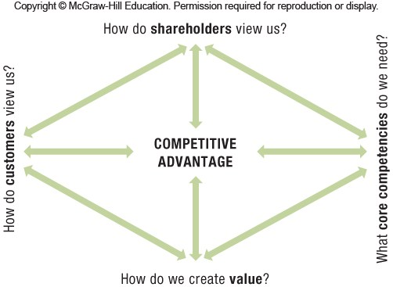
Exhibit 5.8 A Balanced-Scorecard Approach to Creating and Sustaining Competitive Advantage

Slide 28
ADVANTAGES OF THE BALANCED SCORECARD
Communicate and link the strategic vision to responsible parties within the organization
Translate the vision into measureable operational goals
Design and plan business processes
Implement feedback and organizational learning in order to modify and adapt strategic goals when indicated
Notes:
Instructors:
At the end of the chapter is a small group exercise that we have found engages the students because it makes the perspectives here more personal.
With your group, create a balanced scorecard for the business school at your university. You might start by looking at your school’s web page for a mission or vision statement. Then divide up the four perspectives among the team members to develop some key elements for each one. It may be helpful to remember the four key balanced-scorecard questions from the chapter (see Exhibit 5.8):

Slide 29
DISADVANTAGES OF THE BALANCED SCORECARD
It is a tool for strategy implementation, not for strategy formulation.
It provides only limited guidance about which metrics to choose−different situations call for different metrics.
Failure to achieve competitive advantage is not indicative of a poor framework but of strategic failure− i.e., managers must have crafted a strategy that builds competitive advantage.
Managers must accurately translate their strategy into objectives that can be measured within this model.
Notes:
Instructors:
We devote substantial space to the benefits and drawbacks of this approach since it is widely used, at least in part, in many business settings.

Slide 30
The Triple Bottom Line
STAKEHOLDER PERSPECTIVE
Economic, social and ecological dimensions make up the triple bottom line.
Noneconomic factors can have a significant impact on a firm’s financial performance, as well as its reputation and goodwill.
Extended producer responsibility – In anticipation of government regulation – proactively addressing social or ecological issues
Notes:
Instructors:
The second integrative framework is the triple bottom line. This approach does not have the widespread appeal of the balanced scorecard, but there are signs that organizations are increasingly asked to address these “triple concerns.”
Students will sometimes have strong views for or against a triple-bottom-line approach. Some will think the firm should stick to the financials, while others will want the firms to push for more progress in the social and ecological areas.

Slide 31
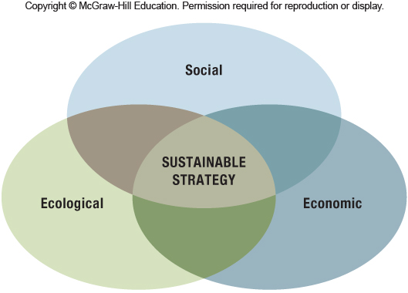
Exhibit 5.9 The Triple Bottom Line:
The Simultaneous Pursuit of Performance along Social, Economic, and Ecological Dimensions Provides a Basis for a Sustainable Strategy
Notes:
Instructors:
The digital companion to this book McGraw-Hill Connect has an interactive video exercise on this section of the textbook. It builds student confidence on the triple bottom line perspective (LO 5-5).

Slide 32
Strategy Highlight 5.1
Interface: The World’s First Sustainable Company
1994 – Founder Ray Anderson set the visionary goal for the company to be entirely “off oil” by 2020.
Interface’s business model has revolutionized the carpet industry.
Their BHAG— big hairy audacious goal—has catapulted Interface into being the world’s first fully sustainable company.
Notes:
Instructors:
This highlight discusses how a business-to-business firm in the carpet industry has made dramatic changes in the way it approaches the consumption of petroleum-based materials and energy.
One comment we hear from students a fair amount is that firms are only moving to consider social and ecological matters due to consumer pressures. While it is undeniable that some firms will have major press announcements around relatively small accomplishments in this area, other firms are really dramatically changing their business practices. We selected Interface, Inc. as the firm to highlight here for several reasons. One was that, as a business-to business firm (that most students have never heard of), it is not incentivized to produce big corporate events to build an ecologically sound reputation in the mind of the consumer.

Slide 33
CORPORATE SOCIAL RESPONSIBILITY
Historically, economic performance has been the focus of firm performance.
More recently, society and investors require companies to also address social and ecological concerns.
Millennials – born between 1980 and 1991 – expect firms to be socially responsible and have a strong interest in working for companies that match their values.
Research studies – CSR and firm performance relationship:
Some find CSR improves financial performance.
Others conclude superior financial performance makes CSR possible.
Notes:
Instructors:
Ask students to share how a firm’s sustainability practices influence their behaviors as consumers. In other words, based on a sample size of one, how closely overlapped are environmental sustainability, societal impacts, and profits in fast-moving consumer goods industries?
Referring back to Chapter Case 2, in deciding whether to buy Coke beverages or Pepsi beverages at the grocery store, how much do they consider the amount of recycled materials used in the packaging for each firm or the extent to which the firm donates money to social causes?
If you have a Starbucks near campus, did any students begin buying more coffee there when the firm switched to recyclable cups?

Slide 34
5.2 Business Models: Putting Strategy into Action
Business model – Plan that details the firm’s competitive tactics and initiatives
A business model explains how the firm intends to make money, and how the firm conducts its business with buyers, suppliers, and partners.
Business model innovation may be more important in achieving superior performance than product or process innovation.
Notes:
Instructors:
The digital companion to this book McGraw-Hill Connect has a brief case analysis exercise on this section of the textbook. It builds student confidence on the use of different types of business models (LO 5-6).

Slide 35
Strategy Highlight 5.2
Threadless: Leveraging Crowdsourcing to Design Cool T-Shirts
2000 – Founded by Jake Nickell & Jacob DeHart, their business model leverages prosumers, a hybrid between producers and consumers.
Through Internet-enabled technology, crowdsourcing–using a group of people who voluntarily perform tasks traditionally completed by firm employees–translates real-time market research and design contests into actual sales.
Notes:
Instructors:
This highlight illustrates business model innovation: How the online startup Threadless uses the Internet to craft a new business model.
Discussion Question 4 from the end of chapter material discusses an interesting partnership for Threadless.
In the spring of 2013, Disney and Pixar Animation announced an expansion of its partnership with Threadless. Previous successes have been shirts for Disney villains, Toy Story, and the Muppets, made from designs based on winning submissions of an art contest. The current launch is for T-shirts designed to coincide with the summer 2013 sequel of Monsters University by Disney and Pixar Animation. The designs were chosen from 487 submissions by artists around the world. With Disney’s long history of expertise in designing clothing to coincide with movie launches, why do you think the company has decided to partner with Threadless? How does this help Disney build competitive advantage? What other firms use this crowdsourcing technique? Where else might this type of business model show up in the future?
Suggestions from the IM:
Disney has skills in both licensing and in creatively promoting movies to their target audiences. Crowdsourcing with Threadless enables them to leverage both competencies and engage a young demographic with their movies and characters. Crowdsourcing is becoming more and more popular and widely accepted. A well known example is Wikipedia, which has become a giant crowdsourced encyclopedia. Threadless specifically has partnered with Thermos for lunch box designs and Griffin for smartphone cases.
One area where it would not be surprise to see this type of crowdsourcing is in video games. An enterprising company could ask for ideas, perhaps from many fans, to create a new game that would fit the desires of many of their customers. Students may cite Lego as a firm that is letting customers submit their own designs and then produces them as the demand is generated, or they may just provide the parts for the custom design back to the client.

Slide 36
Effective Business Model – Two Steps
Formulate
Managers transform their strategy of how to compete into a blueprint of actions and initiatives that support the overarching goals.
Implement
Managers implement this blueprint through structures, processes, culture, and procedures.
If translation into a profitable business model fails, the firm will most likely fail.

Slide 37
Different Business Models
Razor–Razor-Blade
Developed by Gillette – The initial product is often sold at a loss or given away for free in order to drive demand for complementary goods.
Subscription-Based
Users pay for access to a product /service during the payment term.
Examples: cable television, cellular service providers, satellite radio, Internet service providers, and health clubs
See Dollar Shave Club subscription-based example in notes and video link on next slide.
Notes:
Instructors:
The IM has an interesting example from a major movie theater which is considering changing it’s business model.
Bundling: Cineplex is experimenting with bundling a ticket to see a movie in the theater with a future electronic download of the movie shortly before it goes to market as a DVD. If you use this example, you might ask the students to describe how this bundling business model benefits the competitive advantage of the movie distributor by both increasing revenues and reducing expenses. The increased revenue may come about by capturing more money from the movie patron than the distributor’s share of revenues from streaming the movie through either legitimate means or piracy. The reduced expenses may come about from leveraging the benefit of the advertising done at the time of the movie’s theatrical release. (See “One
ticket to rule them all” Wall Street Journal 10/8/13

Slide 38
DIFFERENT BUSINESS MODELS
Pay-As-You-Go
The user pays for only the services he or she consumes.
Freemium = free + premium
The basic features of a product/service are provided free of charge, but the user must pay for premium services such as advanced features or add-ons.
Notes:
Instructors:
Low-cost model (similar to Freemium): A model in which basic service is provided at a low cost and extra items are sold at a premium. The business pursuing this model has the goal of driving down costs. An example is Ryanair which provides very minimal flight service, but allows customers to pay exorbitant prices for upgrades. See “Examples of Well--‐Known Business Models.” BPlans.co.uk. Apr 3, 2013.
Pay-As-You-Go Example: FlightCar- Princeton, Harvard, and MIT drop-outs Kevin Petrovic, Rujul Zaparde, and Shri Ganeshram, launched FlightCar, where the business model links those spending money on long-term airport parking and those paying to rent a car. Your car is rented while it is parked at an airport, in exchange for free airport parking, a free gas card, VIP cleaning and insurance covers theft, damage and liability. For now, there is five times as much demand as supply. http://www.wired.com/business/2013/02/flightcar/

Slide 39
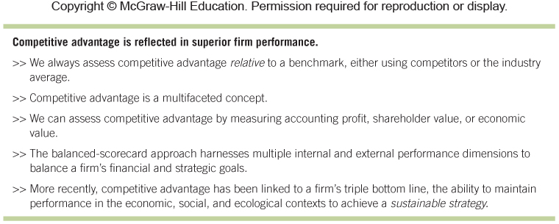
Exhibit 5.11 How Do We Measure and Assess Competitive Advantage?

Slide 40
5.3 Implications for the Strategist
COMPETITIVE ADVANTAGE AND FIRM PERFORMANCE
No One Best Strategy
Goal of Strategic Management
Quantitative and Qualitative
Business Model
Integrate and align each business function and activity to obtain overall superior performance.
Holistic perspective is required for performance assessment, measuring different dimensions over different times.
How a firm does business is more critical to its competitive advantage, than what it does.
Only better strategies – Relative to competitors or industry average
Notes:
Instructors:
The IM has a good exercise in critical reasoning skills that focuses particularly on the student’s skills in triangulation, sensemaking, evaluative judgements, and logical argument.
Ask the student to choose a publicly traded firm. If they are doing the strategic management term project in the textbook, then that firm would be the ideal choice. Otherwise, they could choose a firm for which they might like to work or that they are researching for another class. Then I ask them to watch the firm’s most recent earnings presentation or other presentation to Wall Street analysts and read an article in the business press on the earnings results published after the presentation. Then I ask them to write a paper addressing these questions:
• What was one area that one or more analysts seemed most concerned about? In what way did his/their view differ from that of the company? Why do you think that was?
• How did the company portray its performance in this area? What did it identify as logical arguments and evidence to support its view of performance or future prospects?
• What was the perspective of the business press reporter? Was he/she more or less positive than the company? Why?
• After reviewing all three different perspectives how would you evaluate the firm's performance? Which evidence did you find most persuasive in reaching this conclusion? Why?

Slide 41
ChapterCase 5
©STANCA SANDA/Alamy
Consider This…
Firm profitability for Apple and BlackBerry are presented in ChapterCase 5.
The focus of the analysis is fiscal year 2012, which means that this is a snapshot, a static analysis.
Although the two key questions are answered:
Assess firm performance.
Compare this to competitors.
Managers need to engage in a dynamic analysis, repeating this over a number of years.
This will help identify when and where things went wrong (for BlackBerry) and how to get back on track.
Notes:
Instructors:
The “Consider This” discussion at the end of the case provides an opportunity to work with the students further on some of the key financial ratios. It is particularly important for students to understand when the ratios are indicating problems such as those faces by BlackBerry.
Calculate some key profitability, activity, leverage, liquidity, and market ratios for Apple and BlackBerry over time.
You may want to use the most current financial reports, but some illustrative data
available in fall 2013 are shown in the table below.
Conduct a dynamic firm profitability analysis over time (fiscal years 2008–2012) as shown in Exhibit 5.1. Can you find signs of performance differentials between these two firms that may have indicated problems at BlackBerry? When did BlackBerry’s performance problems become apparent?
The handwriting was on the wall for Blackberry when their FY 2012 (March 2011-February 2012) results showed a decline in sales during a rapid rise in market demand. Furthermore, despite the decline in revenue, COGS and SG&A expense had risen over the prior year--an untenable situation.

Slide 42
Take-Away Concepts
To measure competitive advantage, we must be able to (1) accurately assess firm performance, and (2) compare and benchmark the focal firm’s performance to other competitors in the same industry or the industry average.
To measure accounting profitability, we use standard metrics derived from publicly available accounting data.
Commonly used profitability metrics in strategic management are return on assets (ROA), return on equity (ROE), return on invested capital (ROIC), and return on revenue (ROR).
All accounting data are historical and thus backward-looking. They focus mainly on tangible assets, and do not consider intangibles that are hard or impossible to measure and quantify, such as an innovation competency.
LO 5-1
Conduct a firm profitability analysis using accounting data.

Slide 43
Take-Away Concepts
LO 5-2
Apply shareholder value creation to assess and evaluate competitive advantage.
Investors are primarily interested in total return to shareholders, which includes stock price appreciation plus dividends received over a specific period.
Total return to shareholders is an external performance metric; it indicates how the market views all publicly available information about a firm’s past, current state, and expected future performance.
Applying a shareholders’ perspective, key metrics to measure and assess competitive advantage are the return on (risk) capital and market capitalization.
Stock prices can be highly volatile, which makes it difficult to assess firm performance. Overall macroeconomic factors have a direct bearing on stock prices. Also, stock prices frequently reflect the psychological mood of the investors, which can at times be irrational.
Shareholder value creation is a better measure of competitive advantage over the long term due to the “noise” introduced by market volatility, external factors, and investor sentiment.

Slide 44
Take-Away Concepts
LO 5-3
Explain economic value creation and different sources of competitive advantage.
The relationship between economic value creation and competitive advantage is fundamental in strategic management. It provides the foundation upon which to formulate a firm’s competitive strategy of cost leadership or differentiation.
Three components are critical to evaluating any good or service: value (V), price (P), and cost (C). In this perspective, cost includes opportunity costs.
Economic value created is the difference between a buyer’s willingness to pay for a good or service and the firm’s cost to produce it (V 2 C).
A firm has a competitive advantage when it is able to create more economic value than its rivals. The source of competitive advantage can stem from higher perceived value creation (assuming equal cost) or lower cost (assuming equal value creation).

Slide 45
Take-Away Concepts
LO 5-4
Apply a balanced scorecard to assess and evaluate competitive advantage.
The balanced-scorecard approach attempts to provide a more integrative view of competitive advantage.
Its goal is to harness multiple internal and external performance dimensions to balance financial and strategic goals.
Managers develop strategic objectives for the balanced scorecard by answering four key questions: (1) How do customers view us? (2) How do we create value? (3) What core competencies do we need? (4) How do shareholders view us?

Slide 46
Take-Away Concepts
LO 5-5
Apply a triple bottom line to assess and evaluate competitive advantage.
Noneconomic factors can have a significant impact on a firm’s financial performance, not to mention its reputation and customer goodwill.
Managers are frequently asked to maintain and improve not only the firm’s economic performance but also its social and ecological performance.
Three dimensions—economic, social, and ecological—make up the triple bottom line. Achieving positive results in all three areas can lead to a sustainable strategy—a strategy that can endure over time.
A sustainable strategy produces not only positive financial results, but also positive results along the social and ecological dimensions.
Using a triple-bottom-line approach, managers audit their company’s fulfillment of its social and ecological obligations to stakeholders such as employees, customers, suppliers, and communities in as serious a way as they track its financial performance.
The triple-bottom-line framework is related to stakeholder theory, an approach to understanding a firm as embedded in a network of internal and external constituencies that each make contributions and expect consideration in return.

Slide 47
Take-Away Concepts
The translation of a firm’s strategy (where and how to compete for competitive advantage) into action takes place in the firm’s business model (how to make money).
A business model details how the firm conducts its business with its buyers, suppliers, and partners.
How companies do business is as important to gaining and sustaining competitive advantage as what they do.
Some important business models include razor– razor-blade, subscription-based, pay-as-you-go, and freemium.
LO 5-6
Outline how business models put strategy into action.

