Slide 1
Chapter 6
Business Strategy:
Differentiation, Cost Leadership, and Integration
Notes:
Be sure to see experienced and newer versions of the Instructor’s Manual at http://www.mhhe.com/ftrStrategy2e.com

Slide 2
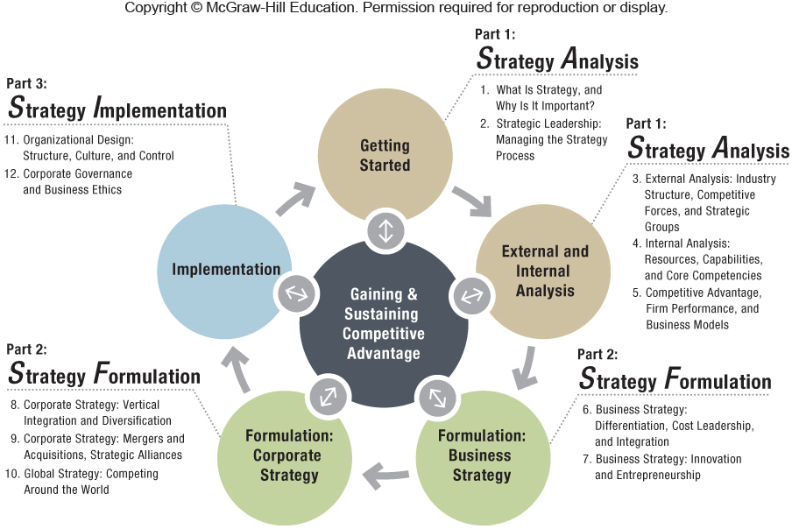

Slide 3
Chapter Outline
6.1 Business-Level Strategy: How to Compete for Advantage
Strategic Position
Generic Business Strategies
6.2 Differentiation Strategy: Understanding Value Drivers
6.3 Cost-Leadership Strategy: Understanding Cost Drivers
6.4 Business-Level Strategy and the Five Forces: Benefits and Risks
Cost-Leadership Strategy: Benefits and Risks
Differentiation Strategy: Benefits and Risks
6.5 Integration Strategy: Combining Cost Leadership and Differentiation
Value and Cost Drivers of Integration Strategy
Integration Strategy Gone Bad: “Stuck in the Middle”
6.6 The Dynamics of Competitive Positioning
6.7 Implications for the Strategist

Slide 4

ChapterCase 6
©Diego Giudice/Corbis
P&G’s Strategic Position Weakens
Procter & Gamble (P&G), a differentiated firm, with 22 iconic brands, and $85 B Revenues
Current problems stem from strategic decisions made by former CEO, A. G. Lafley:
P&G’s $57 billion acquisition of Gillette
U.S.-centric focus – emerging markets to competitors
2009 – CEO Robert McDonald installed
2013 – Directors brought back A. G. Lafley as CEO
Differentiation Strategy = Perceived Value & Premium Pricing
Notes:
Instructors:
This brief case is designed to engage the student’s attention on business strategy formulation.
It illustrates both dynamic conditions in an industry structure and changes in a firm’s strategy in response to both competition and prior strategic missteps.
The ‘consider this’ questions at the end of the chapter bring out some of the complexities of the history and diversified markets that affect P&G. From the IM….
Positioning these questions for the class will give you an opportunity to draw the distinction that diversified firms can set a unique business-level strategy for each industry in which they participate. It might help the students grasp the concepts better if you ask them to focus on a particular product-market business, for example U.S. laundry detergent. In this market, P&G dominates the high end of the market with a proliferation of incrementally different Tide products. They have a very strong position in the mid-tier of the market with Gain, Cheer, and Era. As described in the ChapterCase, consumers have been moving from the top- and mid-tier to the lowest tier of the market, causing a loss of market share and profitability for P&G. P&G’s high marketing intensity and R&D intensity make it difficult for them to compete on price with the cost leaders.

Slide 5
6.1 Business-Level Strategy: How to Compete for Advantage
BUSINESS-LEVEL STRATEGY
The goal-directed actions managers take in their quest for competitive advantage when competing in a single product market
Who – which customer segments – will we serve?
What customer needs, wishes, and desires will we satisfy?
Why do we want to satisfy them?
How will we satisfy our customers’ needs?
Notes:
Instructors:
The digital companion to this book McGraw-Hill Connect has an interactive exercise on this section of the textbook. It builds student confidence on business level strategies of competitive advantage (LO 6-1).

Slide 6
HOW TO COMPETE FOR ADVANTAGE
DIFFERENTIATION
COST LEADERSHIP
Create higher value by delivering products/services with unique features
Create similar value by delivering products/services at a lower cost and lower prices than competitors
INTEGRATION
Combination of differentiation and cost-leadership strategies

Slide 7
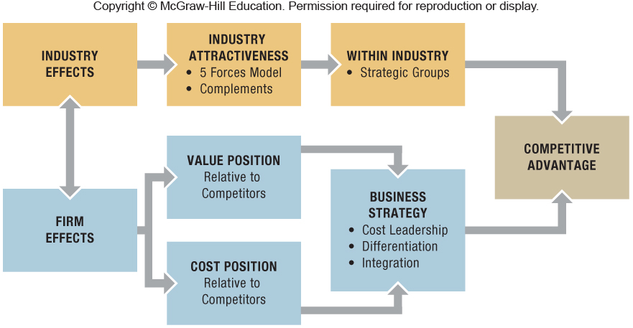
Exhibit 6.1 Industry and Firm Effects Jointly Determine Competitive Advantage
Notes:
Instructors:
The digital companion to this book McGraw-Hill Connect has an interactive exercise on this section of the textbook. It builds student confidence on business level strategies of competitive advantage (LO 6-1).
This diagram can be used to bring together material from chapter 3 around the industry effects (gold part of the diagram) and some elements from chapter 4 which are extended here in chapter 6 to cover more thoroughly the business level strategies. Additionally the whole diagram is an extension of firm and industry level effects introduced in chapter 1.

Slide 8
Strategic Position
The greater the economic value created (V – C), the greater the firm’s competitive advantage.
A firm’s business-level strategy determines its strategic position.
A business strategy is more likely to lead to a competitive advantage if it allows firms to either perform similar activities differently, or perform different activities than their rivals.
Notes:
Instructors:
It is useful here to remind the students of the (V-C) value creation introduced in Chapter 5.
● Competitive advantage is based on the difference between the perceived value a firm is able to create for consumers (V), captured by how much consumers are willing to pay for a product or service, and the total cost (C) the firm incurs to create that value.

Slide 9
Generic Business Strategies
Generic strategies (i.e., universal) – independent of industry – can be used by any organization – manufacturing or service, large or small, for-profit or non-profit, public or private, U.S. or non-U.S. – in the quest for competitive advantage.
Value creation and cost tend to be positively correlated. Thus, there exist important trade-offs between value creation and low cost.
Notes:
Instructors:
Different generic strategies can lead to competitive advantage, even in the same industry.
● Example- Rolex and Timex both compete in the market for wristwatches, yet they follow different business strategies.
Rolex follows a differentiation strategy: It creates a higher value for its watches by making higher-quality timepieces with unique features that last a lifetime and that bestow a perception of prestige and status upon their owners.
Timex, in contrast, follows a cost-leadership strategy: It uses lower-cost inputs and efficiently produces a wristwatch of acceptable quality, highlights reliability and accuracy, and prices its timepieces at the low end of the market.
The issue is not to compare Rolex and Timex directly—they compete in different market segments of the wristwatch industry.
Both can achieve a competitive advantage using diametrically opposed business strategies- this is because both have clear strategic profiles. The idea is to compare Rolex’s strategic position with the next-best differentiator (e.g., Ebel), and Timex’s strategic position with the next-best, low-cost producer (e.g., Swatch).

Slide 10
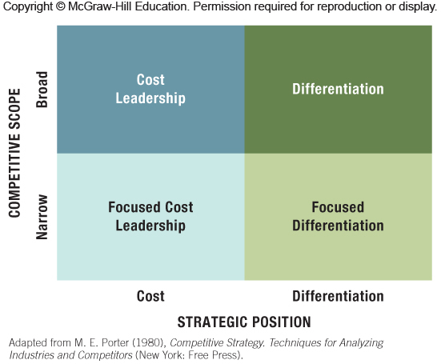
Exhibit 6.2 Strategic Position and Competitive Scope: Generic Business Strategies
Notes:
Instructors:
We have enjoyed working with our students on small group exercise 2 here. The concept of this 2X2 seems simple but can yield interesting discussions when different groups of students place the same firm in a different quadrant. The IM has a suggested placement for the firms given in the end of chapter small group exercise.
We find it helpful to remind the students of the strategic groups discussion (in Chapter 3) as this tool identifies business strategies that would be similar or different from one firm to the next. If used within a large industry (such as airlines), the results should yield a list of firms that make up strategic groups and are direct competitors with each other within the groups. You could, for example, ask students to analysis the airline industry. Make sure that they do not limit themselves to one firm in each box of the rubric.

Slide 11
6.2 Differentiation Strategy: Understanding Value Drivers
Product Features
Most important & clearest drivers
Unique product features >> higher price
BMW M3
Customer Service
ID unmet customer needs & satisfy them
Zappos online retailer
Ritz-Carlton
Complements
Add value when consumed as a bundle
AT&T U-verse with a DVR add-on
Notes:
Instructors:
The digital companion to this book McGraw-Hill Connect has a brief case exercise on this section of the textbook. It builds student confidence on value drivers for differentiation based business level strategies using an example of Toyota values based competitive advantage (LO 6-2).

Slide 12
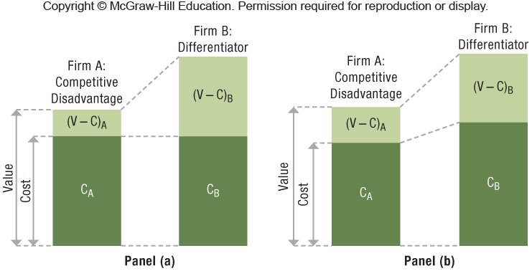
Exhibit 6.3 Differentiation Strategy: Achieving Competitive Advantage
Notes:
Instructors:
The digital companion to this book McGraw-Hill Connect has a brief case exercise on this section of the textbook. It builds student confidence on value drivers for differentiation based business level strategies (LO 6-2).

Slide 13
Strategy Highlight 6.1
Trimming Fat at Whole Foods Market
Whole Foods had lost its competitive advantage due to a failure to control costs effectively.
Trim the fat:
Champion healthy living by offering natural and organic food choices, while also educating consumers
Increase private label by 5% to include over 2,300 products
A clearly formulated business strategy enables Whole Foods to increase the differentiation value gap and command premium prices, while keeping its cost structure in check.
Notes:
Instructors:
WHOLE FOODS: TIMELINE-
● 1980- Four young entrepreneurs opened a small natural-foods store in Austin, Texas.
● Today it is an international supermarket chain with stores in the U.S., Canada, and the United Kingdom. With the acquisition of competitor, Wild Oats, Whole Foods now has 350 stores, employs more than 72,000 people, and earned $12 billion in revenue in 2012.
The IM notes there is a a WSJ video from Feb. 2013 about Whole Foods broadening their target market. It is here:
http://live.wsj.com/video/at-whole-foods-low-prices-mean-trouble-in-aisle-2/3C28C16F-248C-41EC-9582-17A2AAB35857.html?KEYWORDS=Whole+Foods%23!3C28C16F-248C-41EC-9582-17A2AAB35857#!3C28C16F-248C-41EC-9582-17A2AAB35857

Slide 14
6.3 Cost-Leadership Strategy: Understanding Cost Drivers
A Cost-Leadership Strategy With Adequate Value
Cost Drivers
Managers can manipulate cost drivers to keep their costs low.
Cost of input factors
Economies of scale
Learning-curve effects
Experience-curve effects

Slide 15
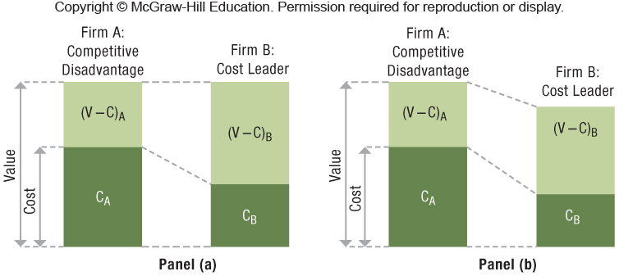
Exhibit 6.4 Cost-Leadership Strategy: Achieving Competitive Advantage

Slide 16
Strategy Highlight 6.2
Ryanair: Lower Cost than the Low-Cost Leader!
Ryanair has unbundled air travel to its extreme.
More than 20% of Ryanair’s revenues flow from ancillary services: premium-rate phone line to contact them, checked bags, checking in, pillows, blankets, water.
Ryanair offers the basic service (air travel only) for a low price, but charges a steep premium for all other items and upgrades.
Notes:
Instructors:
Headquartered in Dublin, Ireland, Ryanair proudly calls itself “the nastiest airline in the world” because of its relentless effort to drive down costs in order to offer rock-bottom air fares. In fact, Ryanair is the lowest-cost airline in the world.
There is a small group exercise at the end of this chapter that builds on this strategy highlight. The exercise asks the student to take the perspective of a competitor and how you would counter the low cost leadership Ryanair has successfully implemented.
We chose Ryanair as an example of low-cost leadership to use a firm that many U.S. students have not heard of but is still in an industry with which they are quite familiar. Our students tell us that by their senior year or MBA level courses, they are tired of talking about Southwest Airlines! Yet the airline industry has many facets that are a challenge for formulating and implementing strategy.

Slide 17
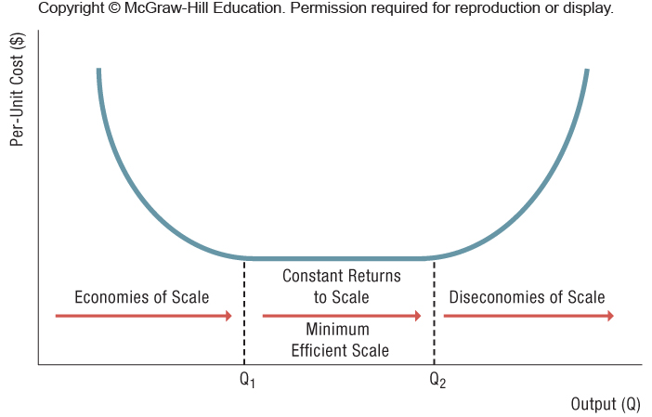
Exhibit 6.5 Economies of Scale, Minimum Efficient Scale, and Diseconomies of Scale
Notes:
Instructors:
The IM has the following unusual example of thinking about this diagram.
Economies of scale are illustrated in Exhibit 6.5, which visually shows the range of scale impacts. Royal Caribbean Cruises is betting on economies of scale. It recently launched its new Oasis class $1.4 billion luxury cruise ships, the Allure of the Seas and Oasis of the Seas—the world’s largest at 20 stories above the sea and stretching more than four football fields. The Oasis of the Seas can accommodate more than 5,400 passengers. Will it allow Royal Caribbean to capture economies of scale, or will it prove too large, leading to diseconomies of scale?

Slide 18
Economies and Diseconomies of Scale
Economies of Scale – output up, cost per unit down
Spread fixed costs over large output
Microsoft upfront R&D for Windows upgrades
Specialized systems
ERP software or robots
Physical properties
Cube-square rule for "big box" stores
Minimum Efficient Scale (MES)
Lowest cost position constant returns to scale
Diseconomies of Scale
Complexity of management or physical limits
Gore Associates and aircraft aeronautics
Notes:
Instructors:
Some extensions on the Gore example from the text are in the IM.
The example of W. L. Gore for diseconomies of scale comes from the very readable book The Tipping Point by Malcolm Gladwell. In the book, Gladwell goes on to discuss a Dunbar Number, which is named after a UK scholar (Robin Dunbar). He argues that humans have cognitive limits at around 150 friends. Gore has expanded the idea into effective work group size limits due to excess bureaucracy and management that slows down decision making as the group size grows.

Slide 19
Cost Drivers: Learning & Experience Curves
Learning Curves
Steeper curve = more learning
Aircraft manufacturing
Cardiac surgeons
Experience Curves
Combine economy of scale & learning curves.
Scale comes down a given learning curve.
Technology allows movement to steeper curve.
Combination can leapfrog in competitive advantage.
Walmart high volumes & technology leadership
Notes:
Instructors:
End of Chapter discussion question 4 uses the Intel example here to bring in some of the HR issues surrounding experience curves. The IM has some good thoughts on how this could unfold in a discussion particularly in an MBA class or environment where several students have professional work experience.
From the IM here is a new example firm the students may enjoy researching for class discussion.
By its third year of operation (2013), Xiaomi (www.xiaomiworld.com) had captured 5% of the Chinese smart phone market. It expects to almost triple its sales in 2014. It sells its handset for approximately half the price of an iPhone 5C. They sell the phone at near cost and seek supplemental revenue from sales of accessories and branded merchandise. In a process somewhat akin to that of Threadless, they seek user suggestions on tweaks to its version of the Android OS and send users weekly updates. (See “How Upstart Xiaomi rattled China’s Smart Phone Industry” Wall Street Journal 10/8/13). Use this example to reinforce the idea that cost leaders do not have to be price leaders, they just have the capability to do so. Remind students that Chapter 5 emphasized the importance of profit to competitive advantage; thus, growing market share does not imply a competitive advantage, if there is no operating profit. Then lead a discussion on whether students think that Xiaomi’s business strategy is sustainable for the long term. If not, how might they tweak the strategy to increase profitability without alienating customers? Would this strategy be effective outside of China?

Slide 20
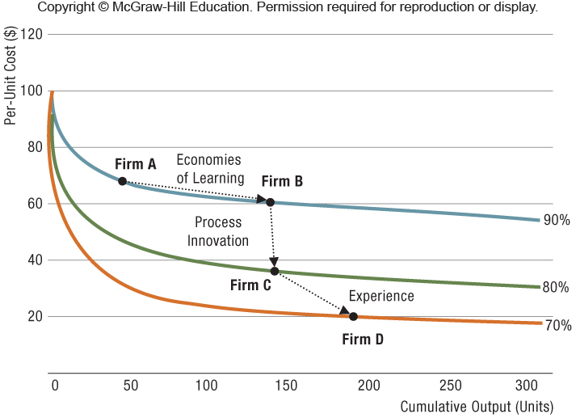
Exhibit 6.6 Gaining Competitive Advantage Through Leveraging Learning & Experience Curve Effects

Slide 21
6.4 Business-Level Strategy and the Five Forces: Benefits and Risks
Cost-Leadership
Benefit: protected from competitors if price war
Risk: new entrant arrives and new capabilities needed
Differentiation
Benefit: reduced rivalry & high cost of imitation
Risk: might overshoot features needed & vulnerable to price-sensitive customers
Notes:
Instructors:
This is a good point to remind students of the discussions on the five forces back in Chapter 3. Here and the next slides we suggest the students integrate the five forces with the generic business strategies for some new insights on the trade-offs of the different positions in different industry conditions.

Slide 22
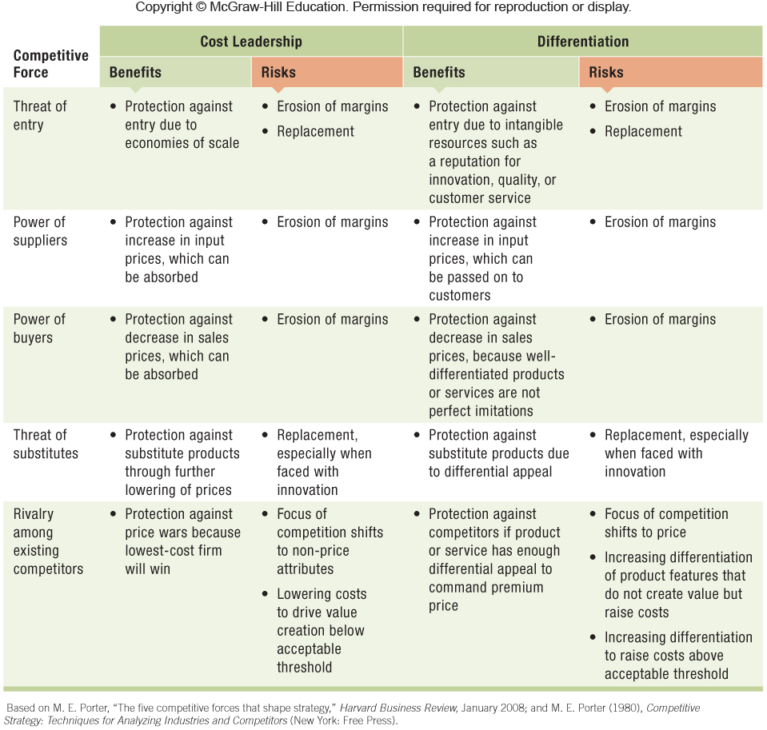
Exhibit 6.7 Competitive Positioning and the Five Forces: Benefits and Risks of Cost-Leadership and Differentiation Business Strategies

Slide 23
6.5 Integration Strategy: Combining Cost Leadership and Differentiation
Firms skilled in both lowering costs and uniqueness
Difficult because the firm manages internal value chain activities that are fundamentally different from one another
Integration can work if investments are not substitutes but rather complements.
Providing important spill-over effects
The goal of an integration strategy is a larger economic value (V − C) than that of rivals.
Notes:
Instructors:
The digital companion to this book McGraw-Hill Connect has an interactive exercise on this section of the textbook. It builds student confidence on the integration based business level strategies (LO 6-5 and 6-6).
The bad news is that an integration strategy is difficult to attain due to required trade-off decisions. But because of this, those firms that do attain it will tend to hold a competitive advantage for a longer period of time.

Slide 24
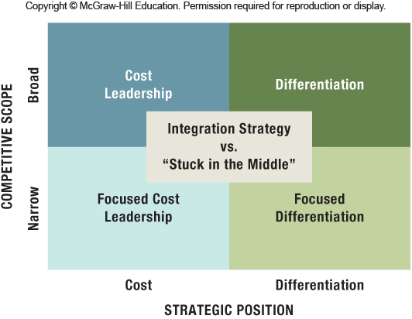
Exhibit 6.8 Integration Strategy vs. “Stuck in the Middle”
Notes:
Instructors:
The digital companion to this book McGraw-Hill Connect has an interactive exercise on this section of the textbook. It builds student confidence on the integration based business level strategies (LO 6-5 and 6-6).

Slide 25
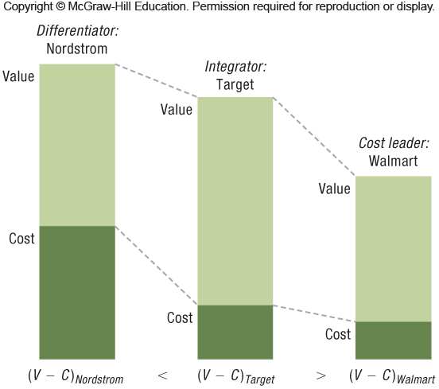
Exhibit 6.9 Target’s Attempt at Achieving Competitive Advantage by Pursuing an Integration Strategy

Slide 26
Value and Cost Drivers of Integration Strategy
Quality
Can increase perceived value & lower cost (V − C)
Economies of Scope
Starbucks adding hot tea to its menu
Customization
BMW, Threadless.com, Toyota all mass customization
Innovation
IKEA - stylist furniture in flat pack delivery
Structure, Culture, & Routines
Ambidextrous organization – Intel
Notes:
Instructors:
These value and cost drivers are interdependent.
For example, process innovations like lean manufacturing contribute to better quality and customer service, which reinforce one another and enhance the brand of a product or service.

Slide 27
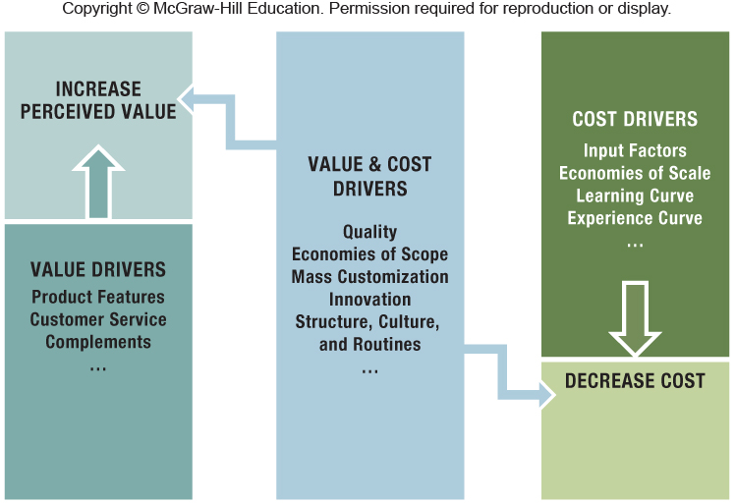
Exhibit 6.10 Value and Cost Drivers
Notes:
Instructors:
We have found Exhibit 6.10 to be one of the most useful in bringing out the context of the different generic business strategies. By understanding how the drivers are different or
similar (complementarity) between the three different strategies, students will gain a deeper understanding of the nature of competitive strategy.

Slide 28
6.6 The Dynamics of Competitive Positioning
Strategic Positions Need to Change over Time
PC assemblers need to move to tablets or smartphones
Productivity Frontier
Value-cost relationship
Captures the best practices at a point in time
PC Industry
2010 – Apple was a differentiator; HP & Lenovo were “stuck in middle.”
2013 – Lenovo was a differentiator in laptops and desktops, HP still has problems with software transformation, Apple seems to be moving into lower-end products and toward an integration strategy.
Notes:
Instructors:
Firms that exhibit effectiveness and efficiency reach the productivity frontier; others are left behind.
The productivity frontier represents a set of best-in-class strategic positions the firm can take relating to value creation and low cost at a given point in time.

Slide 29
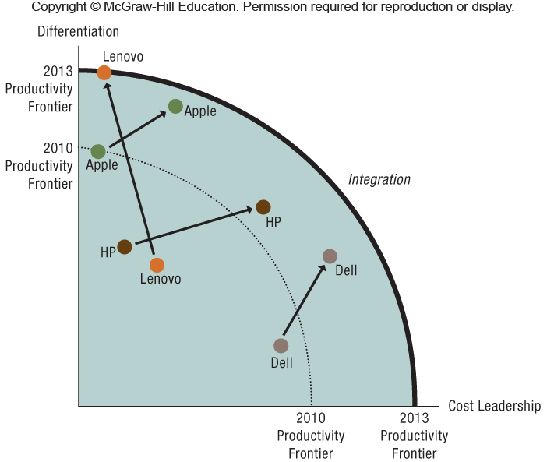
Exhibit 6.11 The Dynamics of Competitive Positioning in the PC Industry: Apple, Lenovo, HP, & Dell
Notes:
Instructors:
From the IM:
An important element in positioning is time. This final tool gives us a way to study how businesses within an industry can change over time. By combining the idea of a productivity frontier from economics with best practices across firms, we can chart the relative competitive positions, as shown here in Exhibit 6.11. HP, Apple, Lenovo, and Dell look to be good examples about the importance of the changing business strategies.

Slide 30
6.7 Implications for the Strategist
Well-formulated and implemented strategies = Enhanced chances of superior performance
Integration strategies successful only if:
An innovation that reconciles the trade-offs, such as Toyota lean-manufacturing approach in ‘80s & ‘90s
Goal is to stay on the productivity frontier.
Notes:
Instructors:
The IM has several good examples and exercises to wrap up this chapter. Below is one example but we encourage you to go to the IM to look at the others if you are interested in additional classroom or student-centered activities.
Hispanics are a growing segment of the audience for Hollywood movies. How might you implement a focused differentiation strategy as a movie studio or movie theater chain targeted toward the Hispanic segment? The Wall Street Journal article “Hollywood Takes Spanish Lessons as Latinos Stream to the Movies” 8/9/13 offers some obvious ideas, such as Hispanic cast members and Spanish speaking parts. It also points to targeting the action/adventure genre that has strongest appeal in the Hispanic segment and promoting the films on Univision. However, students are likely to come up with more ideas, such as serving some Hispanic foods in the theaters and promotional tie-ins with popular telenovelas or Latino literature.

Slide 31
ChapterCase 6
©Diego Giudice/Corbis
Consider This…
P&G generally charges a 20–40% premium for its products, reflecting higher value creation, consistent with its differentiation strategy.
Recently, P&G lost market share because of its higher prices, and its profit margins have also been squeezed by the rising costs of input factors.
P&G has slashed its R&D spending in recent years by as much as 50% in an attempt to bring in more innovation from the outside through its Connect+Develop initiative.

Slide 32
Take-Away Concepts
Business-level strategy determines a firm’s strategic position in its quest for competitive advantage when competing in a single industry or product market.
Strategic positioning requires that managers address strategic trade-offs that arise between value and cost, because higher value tends to go along with higher cost.
Differentiation and cost leadership are distinct strategic positions.
Besides selecting an appropriate strategic position, managers must also define the scope of competition − whether to pursue a specific market niche or go after the broader market.
LO 6-1
Define business-level strategy and describe how it determines a firm’s strategic position.

Slide 33
Take-Away Concepts
The goal of a differentiation strategy is to increase the perceived value of goods and services so that customers will pay a higher price for additional features.
In a differentiation strategy, the focus of competition is on value-enhancing attributes and features, while controlling costs.
Some of the unique value drivers managers can manipulate are product features, customer service, customization, and complements.
Value drivers contribute to competitive advantage only if their increase in value creation (ΔV) exceeds the increase in costs (ΔC).
LO 6-2
Examine the relationship between value drivers and differentiation strategy.

Slide 34
Take-Away Concepts
LO 6-3
Examine the relationship between cost drivers and the cost-leadership strategy.
The goal of a cost-leadership strategy is to reduce the firm’s cost below that of its competitors.
In a cost-leadership strategy, the focus of competition is achieving the lowest possible cost position, which allows the firm to offer the lowest price while maintaining acceptable value.
Some of the unique cost drivers that managers can manipulate are the cost of input factors, economies of scale, and learning- and experience-curve effects.
No matter how low the price, if there is no acceptable value proposition, the product or service will not sell.

Slide 35
Take-Away Concepts
The five forces model helps managers use generic business strategies to protect themselves against the industry forces that drive down profitability.
Differentiation and cost-leadership strategies allow firms to carve out strong strategic positions, not only to protect themselves against the five forces, but also to benefit from them in their quest for competitive advantage.
Exhibit 6.7 details the benefits and risks of each business strategy.
LO 6-4
Assess the benefits and risks of cost-leadership and differentiation business strategies vis-à-vis the five forces that shape competition.

Slide 36
Take-Away Concepts
To address the trade-offs between differentiation and cost leadership at the business level, managers may leverage quality, economies of scope, innovation, and the firm’s structure, culture, and routines.
The trade-offs between differentiation and low cost can either be addressed at the business level or at the corporate level.
LO 6-5
Evaluate value and cost drivers that may allow a firm to pursue an integration strategy.

Slide 37
Take-Away Concepts
A successful integration strategy requires that trade-offs between differentiation and low cost be reconciled.
Integration strategy often is difficult because the two distinct strategic positions require internal value chain activities that are fundamentally different from one another.
When firms fail to resolve strategic trade-offs between differentiation and cost, they end up being “stuck in the middle.” They then succeed at neither strategy, leading to a competitive disadvantage.
LO 6-6 Explain why it is difficult to succeed at an integration strategy.

Slide 38
Take-Away Concepts
The productivity frontier represents a set of best in-class strategic positions the firm can take relating to value creation and low cost at a given point in time.
Reaching the productivity frontier enhances the likelihood of obtaining a competitive advantage.
Not reaching the productivity frontier implies competitive disadvantage if other firms are positioned at the productivity frontier.
Strategic positions need to change over time as the environment changes.
LO 6-7 Describe and evaluate the dynamics of competitive positioning.

