Slide 1

Legislating Artificial Intelligence
Big Data in Public Policy
From Econometrics to AI
Investigating the contextual and content-related factors behind AI bill survival
Emil Fahrig, Noah Fehr, David Hollenstein

Slide 2
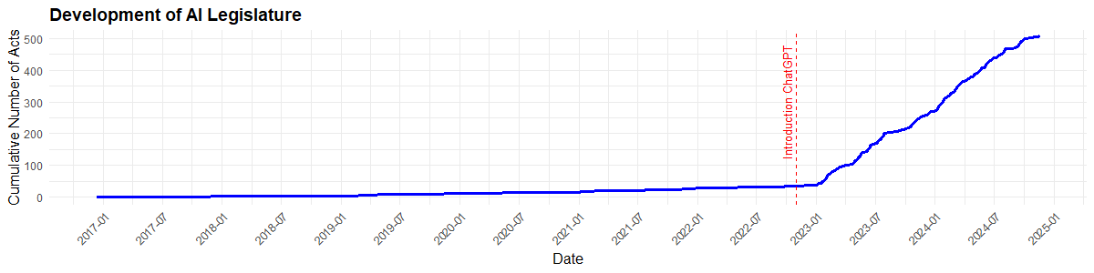
Background & Relevance
AI as new emerging Topic
Legislative regulation lacks behind implementation
Approach of AI legislation reveals underlying views of legislators
Expected use cases of technology
Acceptance of emerging technologies
Leeway for future investments

Slide 3
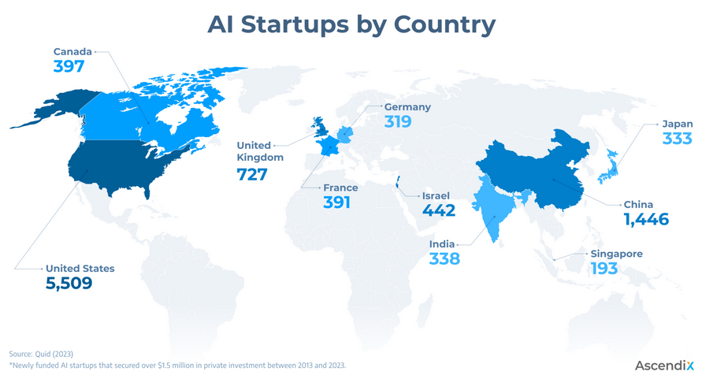
Background & Relevance
RQ: Which legislature passes, and which legislature fails?
RQ is rooted in Literature on bill survival Chalkidis et al.(2020); Eidelman et al. (2018); Yano et al. (2012)
US is an interesting case Al-Marzouqi & Arabi (2024)
AI is highly debated topic
Significant research effort on AI
Active AI startup culture
Sponsor Characteristics | Majority party, seniority, cosponsors
Committee Dynamics | Sponsor alignment
Textual Features | Topics, length of document
Institutional Variables | Bill type, session timing
Political Context | Salience, election proximity

Slide 4
Methodology
Data
AGORA (AI GOvernance and Regulatory Archive)
Collected by the Emerging Technology Observatory
AI-related laws, regulations, standards, and governance documents including full text documents
Dimensions
650 Observations / 101 Variables
Main variable of interest: Status of Document
Geographic and Spacial Focus:
US Legislature
From 2016-2024
Strategy
Pre-Processing of Corpus and Data Frame:
Summarising most important topics and themes
Assign each document a score for each topic
NLP Processing:
Pre-processing
(Lower case / N-Grams/Compound Words / Capitalisation blablabla)
Tokenisation with NLTK (Bigrams phraser module from genism)
BERT
8 Models using BertTopic
Assign topic shares to each doc
Amend to DF
Regression:
Logistic Regression
Dependent Variable: Bill survival (Binary)
Includes Authority-fixed-effects and interactions between Authorities and Topics

Slide 5
(preliminary) Results
What are you trying to do and why is it relevant?
How are you doing it (methods)?
What are your preliminary results?
What are your pain points?

Slide 6
Open Questions
What are you trying to do and why is it relevant?
How are you doing it (methods)?
What are your preliminary results?
What are your pain points?

Slide 7
References
Al-Marzouqi, A. H., & Arabi, A. A. (2024). A Comparative Analysis of the Performance of Leading Countries in Conducting Artificial Intelligence Research. Human Behavior and Emerging Technologies, 2024(1), 1689353. https://doi.org/10.1155/2024/1689353
Chalkidis, I., Fergadiotis, M., Malakasiotis, P., Aletras, N., & Androutsopoulos, I. (2020). LEGAL-BERT: The Muppets straight out of Law School. In T. Cohn, Y. He, & Y. Liu (Eds.), Findings of the Association for Computational Linguistics: EMNLP 2020 (pp. 2898–2904). Association for Computational Linguistics. https://doi.org/10.18653/v1/2020.findings-emnlp.261
Eidelman, V., Kornilova, A., & Argyle, D. (2018). How Predictable is Your State? Leveraging Lexical and Contextual Information for Predicting Legislative Floor Action at the State Level. In E. M. Bender, L. Derczynski, & P. Isabelle (Eds.), Proceedings of the 27th International Conference on Computational Linguistics (pp. 145–160). Association for Computational Linguistics. https://aclanthology.org/C18-1013/
Yano, T., Smith, N. A., & Wilkerson, J. D. (2012). Textual Predictors of Bill Survival in Congressional Committees. In E. Fosler-Lussier, E. Riloff, & S. Bangalore (Eds.), Proceedings of the 2012 Conference of the North American Chapter of the Association for Computational Linguistics: Human Language Technologies (pp. 793–802). Association for Computational Linguistics. https://aclanthology.org/N12-1097/

