Slide 1
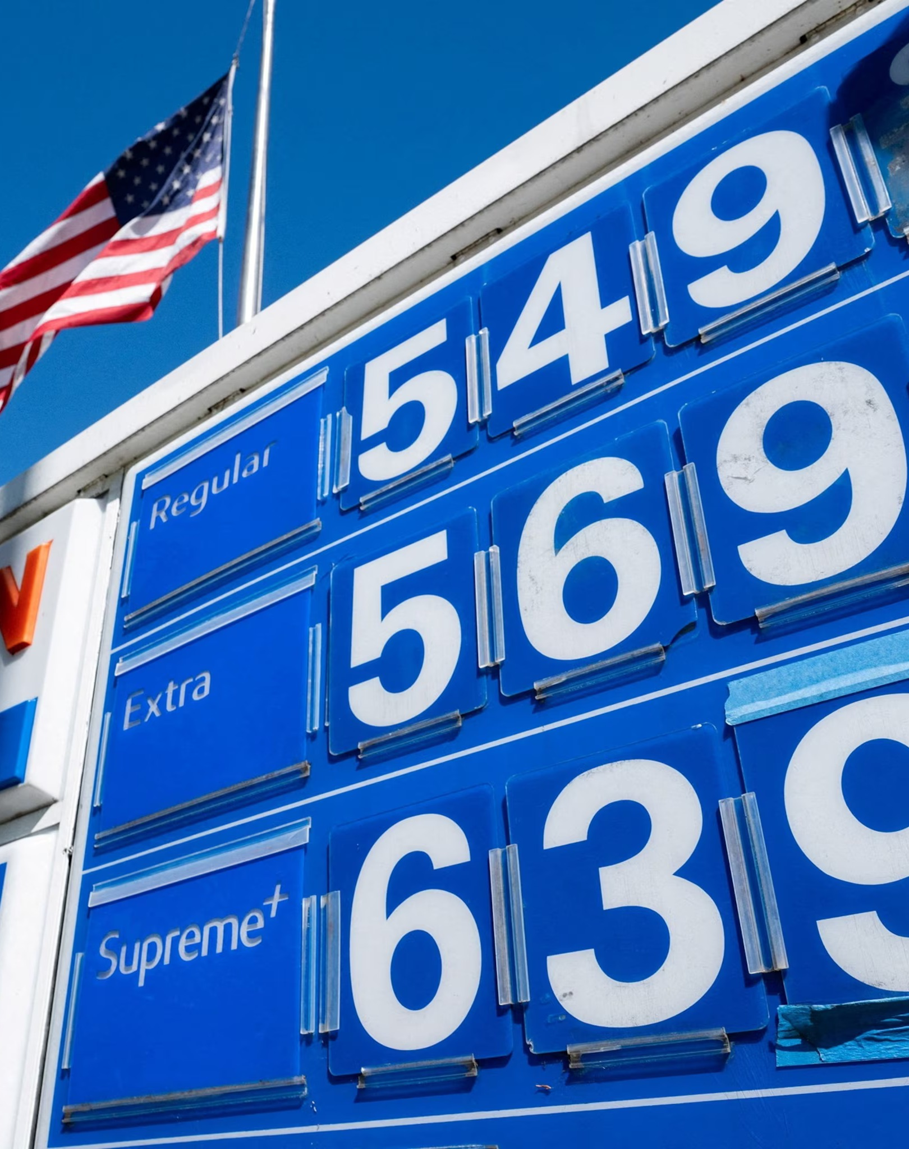
Pain at the Pump
 | Oct 2024 | Oct 2026
Regular | $3.17 / gal ≈ €0.77 / L | $4.33 / gal ≈ €1.02 / L
Diesel | $3.63 / gal ≈ €0.88 / L | $6.18 / gal ≈ €1.46 / L
Gas +37%, diesel +70% in two years
Warm-up: How would you feel about this?
EIA weekly US averages (14 Oct 2024; 12 Oct 2026) · 1 gallon = 3.785 L · €1 = $1.0915 (Oct 2024), $1.1195 (Oct 2026)
Notes:
Prices: US Energy Information Administration weekly national averages. Conversion: $/gal ÷ 3.785 ÷ EUR/USD rate (ECB reference rates, 14 Oct 2024 and 14 Oct 2026). Diesel hit a record $6.53 on Sept 22, 2026 (AAA). Driver: the war with Iran and the closure of the Strait of Hormuz.
Why are European prices still higher? Mostly taxes: Austria adds mineral oil tax (MÖSt), CO2 pricing and 20% VAT; US federal + state fuel taxes are far lower. Austrian prices topped €2/L this summer (ÖAMTC). Americans also drive much more and have fewer public transport options, so price rises hit harder.
Follow-up: Who do you think voters blame when gas prices go up?

Slide 2
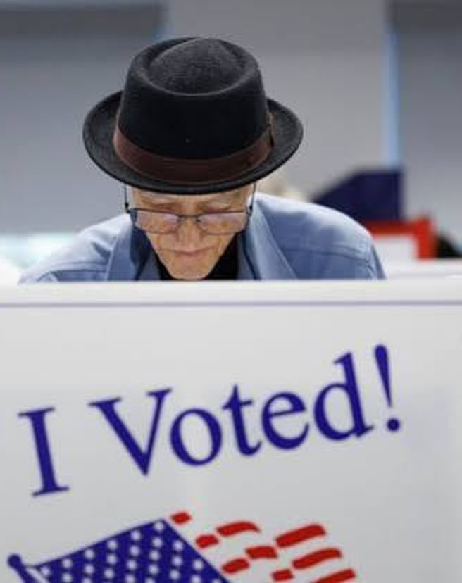
What Is a Midterm?
The President serves four-year terms
Members of Congress serve either two- or six-year terms
Midterms are the congressional elections that happen halfway through the President’s term
Notes:
Election Day: Tuesday, November 3, 2026. All 435 House seats and about a third of the Senate are on the ballot.

Slide 3

Representatives
“The House” is the lower chamber of the US Congress
435 members serve two-year terms
Current Speaker: Mike Johnson
Notes:
Mike Johnson (Republican, Louisiana) has been Speaker since October 2023.

Slide 4
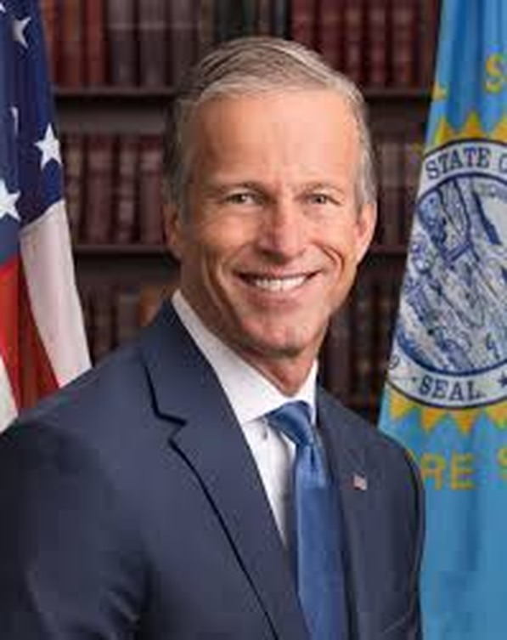
Senators
The Senate is the upper chamber of the US Congress
100 members, two per state
Senators serve six-year terms
Current Majority Leader: John Thune
Filibuster: major legislation needs 60 votes
Notes:
John Thune (Republican, South Dakota) became Majority Leader in January 2025. Republicans hold 53 of 100 seats. The filibuster: 60 votes are needed to end debate (cloture) on most bills.

Slide 5
What Usually Happens in a Midterm?
Public opinion is “thermostatic”: it shifts against the party in power
Wave elections:
  1994 – “Republican Revolution”
  2010 – Tea Party wave
  2018 – “Blue wave” against Trump
Rare exceptions: 1998, 2002
Source: American Presidency Project (UCSB)
Notes:
Thermostatic: like a thermostat, voters push back against whatever direction the government is moving. The president’s party has lost House seats in almost every midterm since the Civil War.
1994: Republicans won the House for the first time in 40 years (Newt Gingrich). 2010: backlash against Obama and the Affordable Care Act. 2018: Democrats won the House back in Trump’s first term.
Exceptions: 1998 (backlash against Clinton’s impeachment) and 2002 (rally-around-the-flag after 9/11).

Slide 6

What Will Happen This Year?
Trump is very unpopular this term (~37%)
Democrats very likely to retake the House
Democrats favored, but less likely, to take the Senate
Gallup (1994–2022); 2026: polling averages, mid-Oct · Odds: Kalshi, 1 Oct 2026
Notes:
Approval: Gallup’s last readings before each midterm (Clinton 46, Bush 38, Obama 45, Trump 40, Biden 40). Trump 2026 ≈ 37% in polling averages (Silver Bulletin net approval −22.4 on Oct 14); Pew has him at just 30%, his second-term low.
Odds (Kalshi prediction market, Oct 1): about 91% Democrats win the House; about 63% Democrats win the Senate. Republicans hold the Senate 53–47, so Democrats need a net gain of 4 seats — key races: Maine, North Carolina, Michigan, Alaska, Ohio, Texas.

Slide 7
Issues This Cycle
War with Iran and the Strait of Hormuz
Economy and cost of living
Gas prices
Immigration
Health care
Source: NYT/Siena poll of likely voters, 8–13 Sept 2026
Notes:
Context: the US and Israel began strikes on Iran in February 2026; Iran closed the Strait of Hormuz, a key oil route, which drove up gas prices. Pew (early Oct): only about a third of Americans approve of Trump’s handling of the conflict.
NYT/Siena (Sept 2026): Democrats lead on every issue polled except AI (Republicans 42, Democrats 40). Immigration used to be one of the Republicans’ strongest issues.
Discussion: Which issue would matter most to you as a voter?

Slide 8
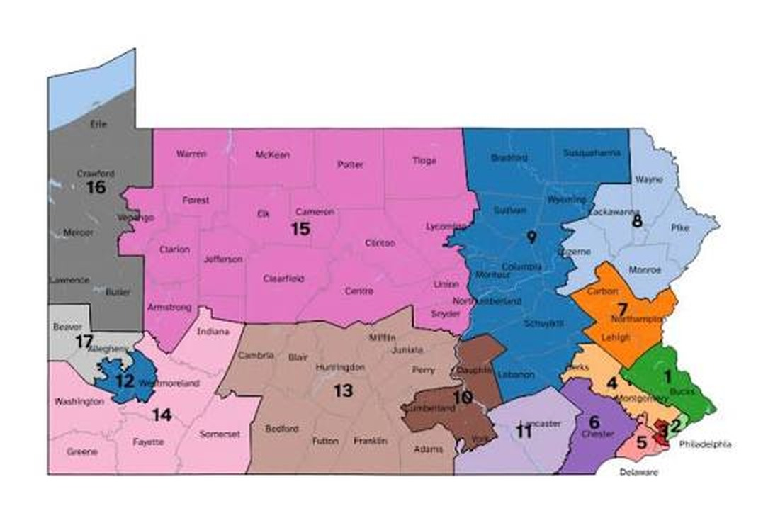
Redistricting
Redistricting: redrawing House district lines, normally once a decade after the census
Gerrymandering: drawing the lines to help one party
2025–26: unprecedented mid-decade redraws
  Texas (+5 R), urged by Trump
  California fights back (+5 D)
  A dozen states join in: net ≈ +10 R on paper
Each colour = one House district (Pennsylvania)
Sources: Wikipedia; Voting Rights Lab (Aug 2026)
Notes:
The word comes from Governor Elbridge Gerry (1812), whose district looked like a salamander.
Texas redrew its map in August 2025 at Trump’s urging to gain about five seats. California voters answered with Proposition 50 (Nov 2025), targeting five Republican seats. Others followed: Missouri, North Carolina, Ohio, Florida (+R); Utah (court-ordered, +D). After the Supreme Court’s Louisiana v. Callais ruling (April 2026) weakened the Voting Rights Act, Southern states such as Tennessee, Alabama and Louisiana redrew too. Virginia’s Democratic redraw was struck down by its Supreme Court; Indiana’s Republicans refused to redraw.
Estimated net effect: roughly +10 seats for Republicans on paper — but in a strong Democratic year, gerrymanders can backfire ("dummymander").

Slide 9
Political Ads: Maine
Sen. Susan Collins (R, in office since 1997) vs. Troy Jackson (D, former Maine Senate President)
TV ads
Social media
“Fifth”
Jackson · the “fifth-generation logger” intro
“I’m running”
Collins · launch video with new running shoes (X)
“Grocery Store”
Jackson · his mother tells his story
Boba tea video
Jackson mocks GOP ad spending (X; Fox News clip)
“Frustrating Times”
Collins · sportscaster Bill Green vouches for her
“Family Got Paid, We Got Played”
Super PAC attack ad on Jackson
Blue = Democratic side Red = Republican side · Click a title to open the ad
Notes:
Maine is one of the most expensive Senate races ever: more than $137 million in TV ads since late July (AdImpact, via Bangor Daily News). Collins is the last Republican senator from New England; Democrats need this seat to win the Senate.
Fun fact: a pro-Collins super PAC accidentally bought attack ads in Portland, Oregon instead of Portland, Maine (Oct 2026).
Activity questions: Who is the ad for? Is it positive or negative? What emotions does it use? What image of the candidate does it create?

Slide 10
Political Ads: Texas
Ken Paxton (R, Texas Attorney General) vs. James Talarico (D, state representative)
TV ads
Social media
“Waking Up”
Talarico · positive bio ad in a pickup truck
“Meet Ken Paxton”
Talarico · online ad on Paxton’s scandals
“Most Corrupt”
Talarico · his first negative TV ad
“The People vs. Ken Paxton”
Talarico · posted on X
“King James”
Paxton · uses an AI-generated Talarico
Paxton’s first general-election ad
Paxton · attacks Talarico’s views (X)
Blue = Democratic side Red = Republican side · Click a title to open the ad
Notes:
Paxton beat incumbent Senator John Cornyn in the Republican primary runoff in May 2026. Talarico is a former teacher and seminary student who became famous through viral videos about faith and politics.
“Waking Up” went viral partly because critics noticed Talarico was driving a rented Dodge Ram, not his own truck. “King James” shows an AI-generated Talarico; the disclaimer appears in small print about 20 seconds in (FactCheck.org) — a good discussion point about AI in political ads.
Activity questions: Who is the ad for? Is it positive or negative? What emotions does it use? What image of the candidate does it create?

