Slide 1
Warmup
What form of greeting do you use?

Slide 2

Key & Peele
WATCH FIRST
How many different greetings can you spot?
Click to open on YouTube
Notes:
Click the yellow button during the slideshow to open the sketch in your browser: https://www.youtube.com/watch?v=nopWOC4SRm4
Before playing: ask students to count or note the different greetings they see. After: How did the greeting change depending on who was being greeted?

Slide 3

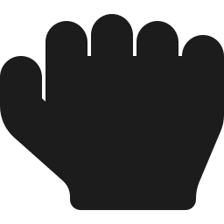

American & NYC Greetings
Handshakes, fist bumps, daps, and what they say about you
Notes:
Introduce the theme: greetings change with the setting and the relationship, and choosing the wrong one says something about you.

Slide 4
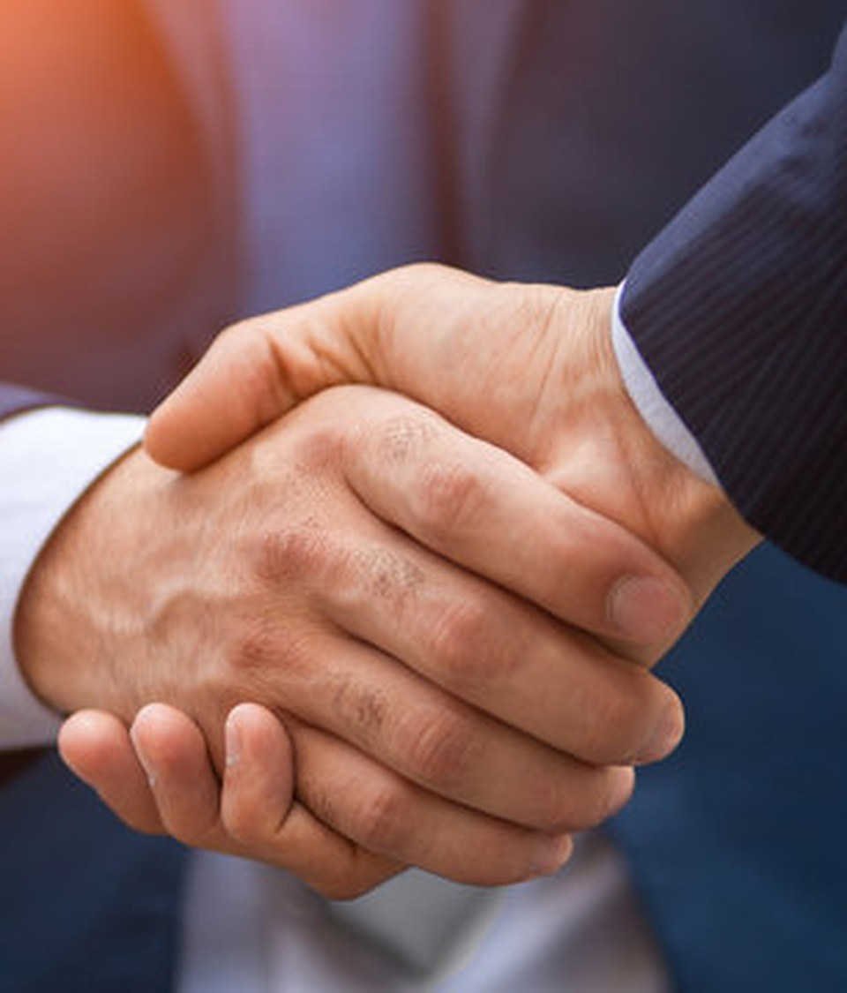
The Handshake
Appropriate for nearly all settings (can be too formal)
Conveys formality
Notes:
Prompt: When would an Austrian shake hands where an American wouldn't, and vice versa?

Slide 5
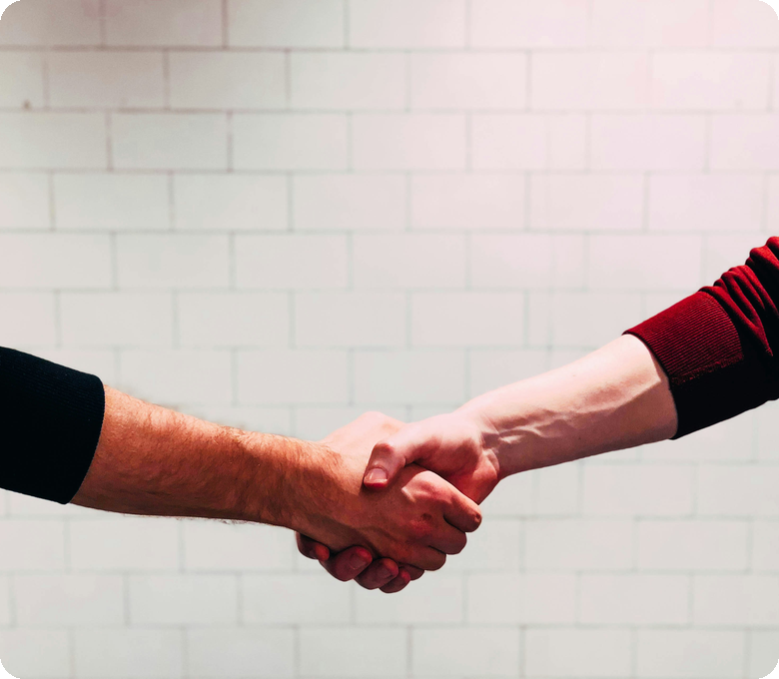

Do's and Don'ts of the Handshake
DO
Make eye contact
DO
Utilize a firm grip
Notes:
Practice: pair up and shake hands; partner gives feedback on grip and eye contact.

Slide 6
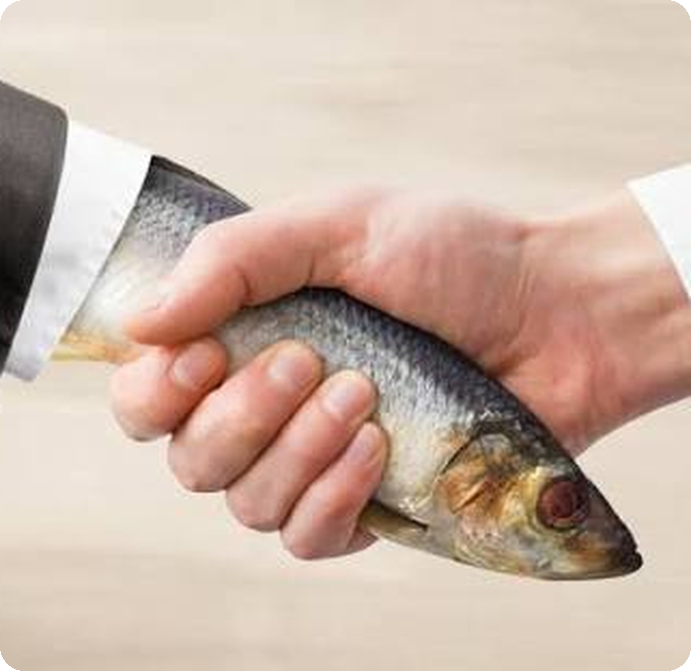

Don'ts of the Handshake
DON'T
DON'T
Leave your hand limp
Squeeze too hard (conveys insecurity)
DON'T
DON'T
Pull the person too hard towards you
Have sweaty palms
Notes:
The photo shows the "dead fish" handshake, the English idiom for a limp grip.
Prompt: Which of these would bother you most? Why might over-squeezing read as insecurity?

Slide 7
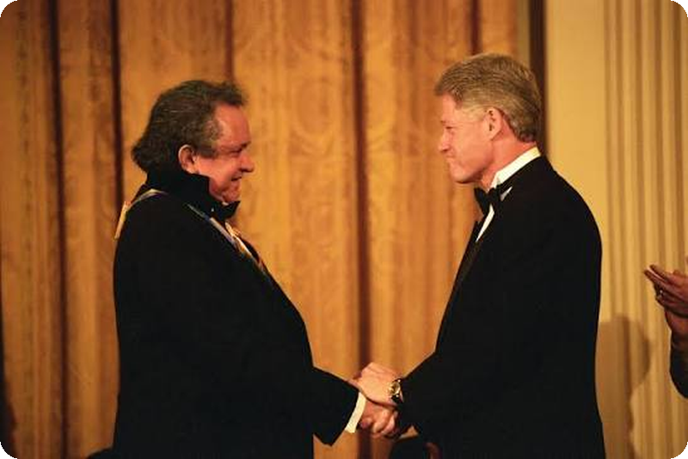
The
Two-Handed
Shake
POSSIBLE VARIANT
Can convey a greater sense of personability when executed properly, but also carries greater risk
Notes:
Another well-known example: Justin Trudeau placing his left hand on Donald Trump's arm at the White House in February 2017; VOA Learning English covered this in an article on presidential handshakes: https://learningenglish.voanews.com/a/trump-handshakes-analysis/3903689.html
Prompt: Warm or overbearing? What changes the reading (relationship, status, length of the shake)?

Slide 8
Phrases for the Handshake
“Nice to meet you.”
“It's a pleasure to meet you.”
“How are you?”
Reply: “Nice to meet you too.”
A notch more formal: interviews, important people
Not a real question. Reply: “Good, thanks. And you?”
“Good to see you again.”
“Please, call me ___.”
“Thanks for having me.”
For someone you've already met
Invites first names; very American
When you're the guest or visitor
Notes:
Practice: students pair up, shake hands and use two phrases each. Point out that Americans move to first names quickly, unlike Herr/Frau in Austria.

Slide 9
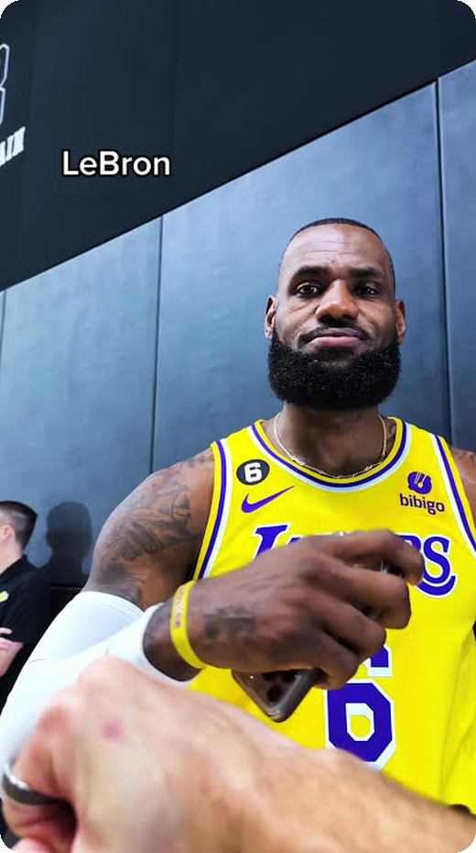
The Fist Bump
Very informal, usually used in sports contexts
Generally only comes after an achievement
Can make you seem out of touch (millennialism)
DON'T
Let it linger afterwards
Notes:
Prompt: Your boss fist-bumps you after a meeting. How does that land? Note "millennialism": slang for a habit that marks someone as a millennial trying a bit too hard.

Slide 10
Phrases for the Fist Bump
“Let's go!”
“Nice one!”
“Good game.”
Celebrating a win or a big moment
Quick praise right after something good
After a match, often to the other team too
“Way to go!”
“Pound it.”
“That's what I'm talking about!”
Praise for someone's achievement
Invites a fist bump (also “Bump it”)
Excited approval
Notes:
Quick drill: call out a situation ("I passed my driving test!") and a student responds with a fist bump and a phrase.

Slide 11
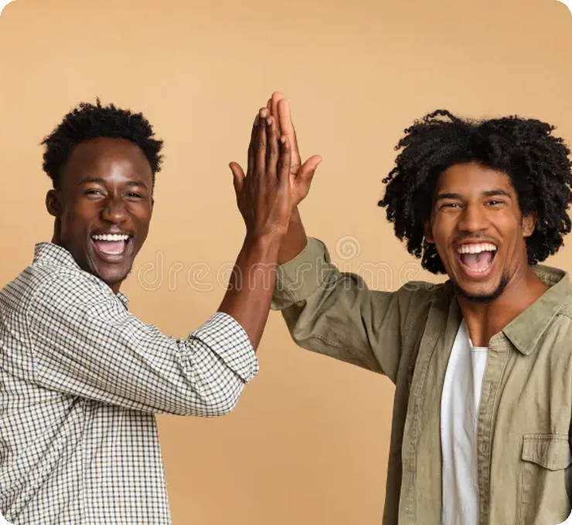
The High Five
Similar to the fist bump
“Give me five,” “up top,” etc.
Magic Johnson claimed to have invented it
1977
First used by two professional baseball players
Notes:
The usual story: on October 2, 1977, at Dodger Stadium, Glenn Burke greeted his Los Angeles Dodgers teammate Dusty Baker with a raised hand after Baker's 30th home run of the season. A competing claim puts it at University of Louisville basketball practice in 1978-79 (Derek Smith telling Wiley Brown "Up high"). Magic Johnson has said he and Greg Kelser invented it at Michigan State, though he gave no date and didn't claim the name.
Sources: https://sabr.org/gamesproj/game/october-2-1977-dusty-baker-hits-30th-homer-receives-first-ever-high-five-from-glenn-burke-in-dodgers-loss-to-astros/ ; https://en.wikipedia.org/wiki/High_five
Prompt: Who would you high-five, and who would you never high-five?

Slide 12
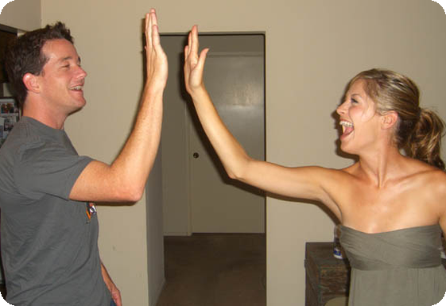
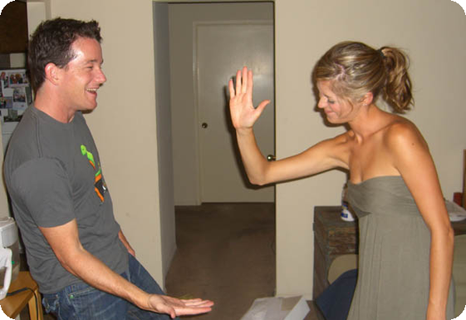
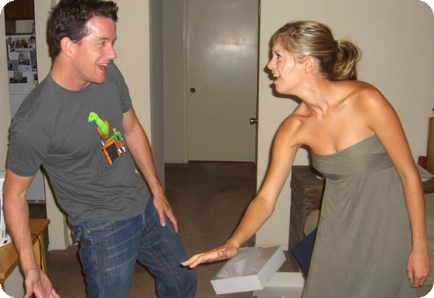
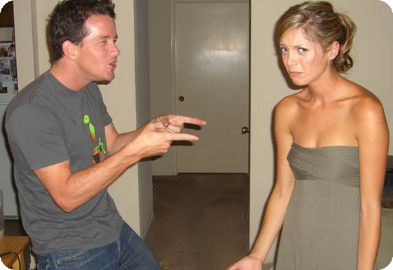
Up High, Down Low, Too Slow
Up high!
A normal high five
1
Down low…
Offer a low five
2
1
2
Too slow!
Pull your hand away at the last second
3
Gotcha!
Enjoy their reaction
4
3
4
Notes:
A classic playground prank that almost every American knows, from kids to adults. Demonstrate it on a student, then let pairs try it.
Language note: "too slow" is said with a teasing, sing-song tone; the person who falls for it usually rolls their eyes (photo 4).

Slide 13
Phrases for the High Five
“Up top!”
“Gimme five!”
“Don't leave me hanging!”
Invites a high five, hand raised
Short for “Give me five”; same invitation
When someone ignores your raised hand
“Down low… too slow!”
“High five!”
“Nailed it!”
Kids' joke: pull your hand away at the last second
Said while doing it, often after good news
Someone just succeeded; a high five follows
Notes:
Act it out: "Don't leave me hanging" and "Down low... too slow" are fun to demonstrate with a student.

Slide 14
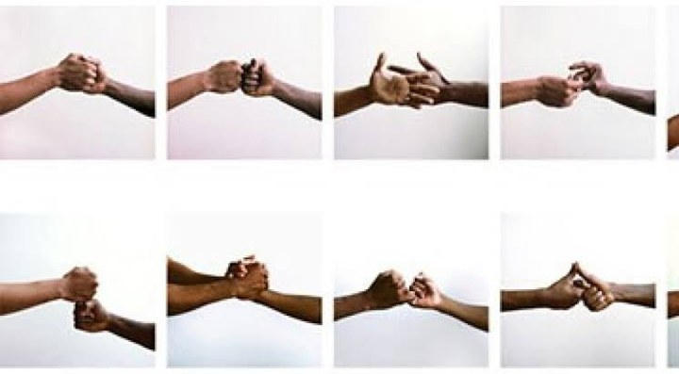
The Dap
?
First, “dap”: what does it mean?
Originated among Black soldiers during the Vietnam War
Now: most common form of greeting (amongst teenagers)
Not used in professional contexts
If you don't know how to do it properly, can make you seem like a loser
Notes:
The photo series shows how many variations a dap can have; ask students to describe each move.
What "dap" means: a handshake-style greeting, typically some mix of slapping palms, clasping hands, bumping fists or snapping fingers. To "give dap" / "dap someone up" is to greet them this way.
Background: it spread among Black GIs in Vietnam as a sign of unity and solidarity; it first appeared in print in 1971. The word's origin is uncertain: soldiers said it came from Vietnamese "dep" (beautiful); dictionaries suggest "tap" or "dab". The popular "Dignity And Pride" acronym is a later explanation (backronym), a nice discussion point.
Source: https://grammarphobia.com/blog/2020/12/dap.html

Slide 15
Phrases for the Dap
“What's up?”
“What's good?”
“Yo!”
Not a real question. Reply: “Not much, you?”
Same as “What's up?” Reply: “Chillin'.”
Casual hello, often across a room or street
“How you doin'?”
“Dap me up.”
“Aight, I'm out.”
Classic New York; quick, no real answer needed
“Give me dap,” an invitation to the greeting
Leaving; usually comes with one more dap
Notes:
Point out the pronunciation: "What's up" often becomes "Wassup" or just "Sup"; "Aight" = "all right". Ask: which of these would sound strange coming from a teacher?

Slide 16
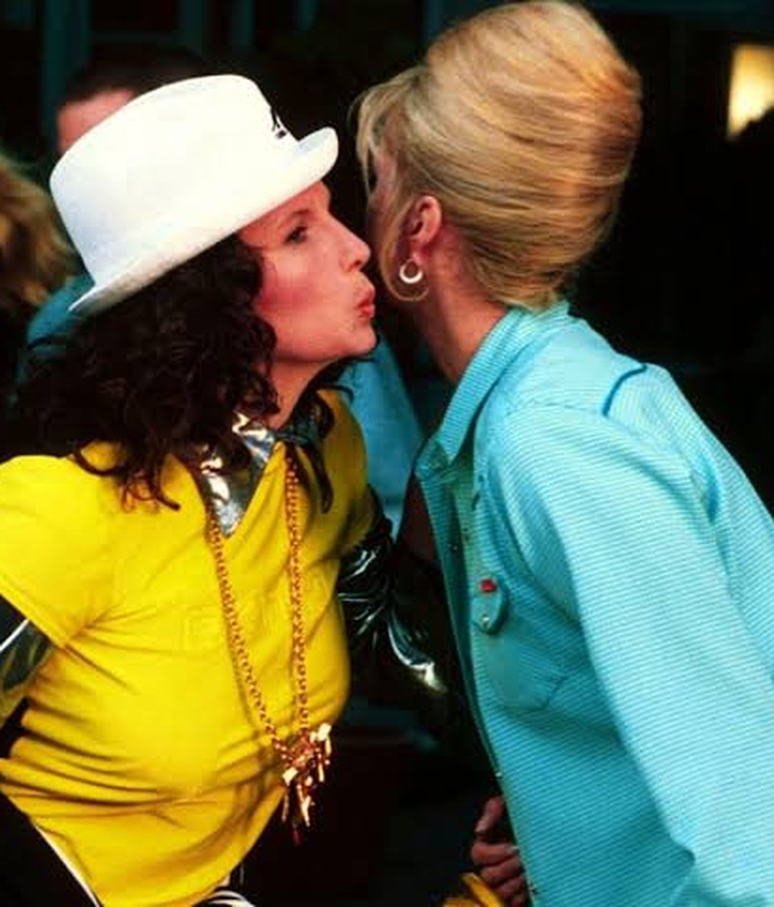

Greetings I Would Avoid in the U.S.
Air-kissing
Bowing
Hugging
Notes:
Prompt: Austrians often greet friends with a Bussi on each cheek. How might an American react, and why?

Slide 17
APA Article
WASHINGTON - A new study backs up what the etiquette books have been saying all along, that a firm handshake helps makes a good first impression for both males and females. The study, reported in this month's issue of the Journal of Personality and Social Psychology, a journal published by the American Psychological Association (APA), finds that consistent with the etiquette and business literature, there is a substantial relation between the features that characterize a firm handshake (strength, vigor, duration, eye contact and completeness of grip) and a favorable first impression.

Slide 18
The University of Alabama study involved 112 male and female college students whose handshakes were evaluated by four handshake coders who received one month of training and practice in shaking hands and evaluating handshakes before the study began. The students, who didn't know their handshakes were being evaluated, had their hands shaken eight times (twice with all four experimenters) and they also completed four personality questionnaires.

Slide 19
Results of the study, according to lead author William F. Chaplin, PhD, show that a person's handshake is consistent over time and is related to some aspects of his or her personality. Those with a firm handshake were more extraverted and open to experience and less neurotic and shy than those with a less firm or limp handshake. The researchers say these results demonstrate that personality traits, assessed through the self-report, can predict specific behaviors assessed by trained observers.

Slide 20
The study did identify some sex differences. Males were generally found to have firmer handshakes than women. Also, women who are more liberal, intellectual and open to new experiences were found to have a firmer handshake and made a more favorable impression than women who were less open and had a less firm handshake. For men, the opposite was found; more open men had a slightly less firm handshake and made a somewhat poorer impression than less open men.

Slide 21
Dr. Chaplin says the implications of the study may be important for self-promotion strategies used by women. "The result of this study differs from the typical finding that women who exhibit confident behavior that is similar to the behavior of men often make a more negative impression than the men," said Dr. Chaplin. He says the current study was similar to real-world situations of business contacts and employment interviews where "giving a firm handshake may provide an effective initial form of self-promotion for women that does not have the costs associated with other less subtle forms of assertive self-promotion."

Slide 22
Reflect: Why might this be true?

Slide 23

Activity
Greeting Roulette: act out the greeting, keep the small talk going for 30 seconds, then the class votes: did it fit?
Notes:
How it runs: a pair gets a scenario slide, acts out the greeting plus ~30 seconds of small talk, then the class votes whether the greeting fit, and one student explains why.
Twist: now and then, secretly tell a pair to use the WRONG greeting; the class spots it and suggests a fix. Each scenario slide's notes have a suggested right greeting and a wrong-greeting twist.
Short on time: do only a few scenarios, or run the wrong-greeting rounds as a whole class.

Slide 24

SCENARIO 1
Meeting your new boss on your first day
Notes:
Fits: firm handshake + “Nice to meet you.” Twist: a fist bump, or “Yo, what's up?”

Slide 25

SCENARIO 2
Your teammate just scored the winning goal
Notes:
Fits: fist bump (or a hug, between close teammates) + “Let's go!” Twist: a formal handshake + “It's a pleasure to meet you.”

Slide 26

SCENARIO 3
Running into your teacher at the supermarket
Notes:
Fits: a wave or a quick handshake + “Oh, hi! How are you?” Twist: a dap + “What's good?”

Slide 27
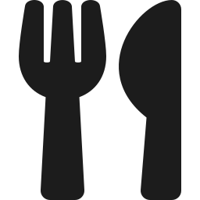
SCENARIO 4
Meeting your American friend's parents for dinner
Notes:
Fits: handshake + “Thanks for having me.” Twist: an air-kiss on both cheeks.

Slide 28

SCENARIO 5
A job interview in Manhattan
Notes:
Fits: firm handshake, eye contact + “It's a pleasure to meet you.” Twist: a limp or bone-crushing handshake, or the two-handed shake.

Slide 29

SCENARIO 6
Seeing your best friend at a party
Notes:
Fits: a dap or a hug + “Yo, what's up?” Twist: a stiff formal handshake + “Good evening.”

Slide 30

SCENARIO 7
A Japanese business partner arrives at the office
Notes:
Fits: a handshake, perhaps with a slight nod. Discussion: should you bow? Twist: a deep bow, or a fist bump.

Slide 31
SCENARIO 8
Your cousin's new boyfriend says hi
Notes:
Fits: a casual handshake + “Hey, nice to meet you.” Twist: a big hug, or a dap he doesn't know how to do.

