Slide 1
Is Europe Getting
Greener?
Renewable electricity trends, countries & 2030 targets
ReDI School · Data Analytics Mini-Project
28 October 2026

Slide 2
Our research questions
Five comparisons using renewable energy readings from 2015–2025
01
Has recorded renewable generation grown?
02
How do energy sources compare?
03
Which countries generated the most in 2025?
04
Does the ranking change per person?
05
Which countries have the highest 2030 targets?

Slide 3
From raw data to analysis
Cleaning came before plotting to avoid misleading results
LOAD
CLEAN
VALIDATE
ANALYSE
17,947 raw energy readings
+ 38 country entries
Remove 40 duplicate rows;
standardise source/status labels
Flag 148 negative readings;
77 physically impossible readings
17,907 records after deduplication;
17,343 valid generation values
All 17,907 records matched a country. Invalid generation values were excluded only in the analysis copy.

Slide 4
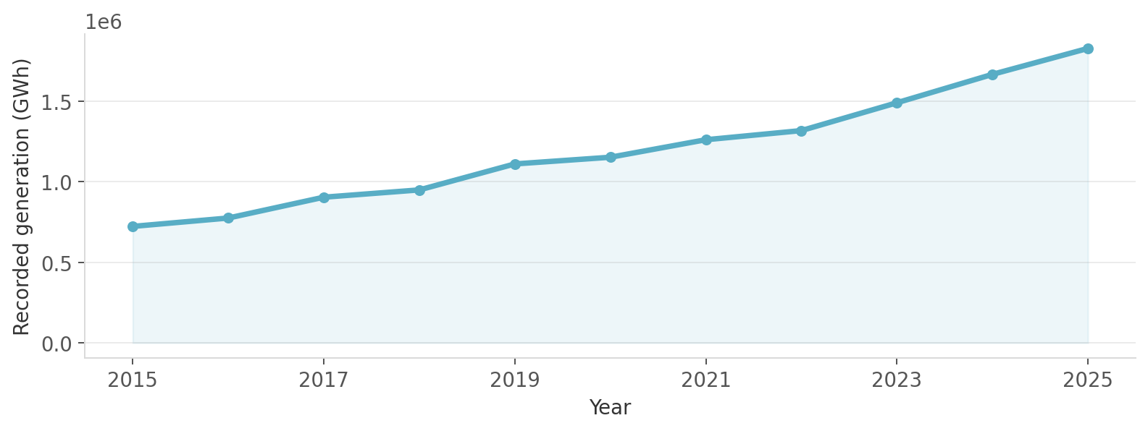
1 · Recorded generation has increased
723k GWh (2015) → 1.83m GWh (2025) in recorded dataset totals
Coverage expands from 29 to 34 countries; observed growth is not a verified Europe-wide growth rate.

Slide 5
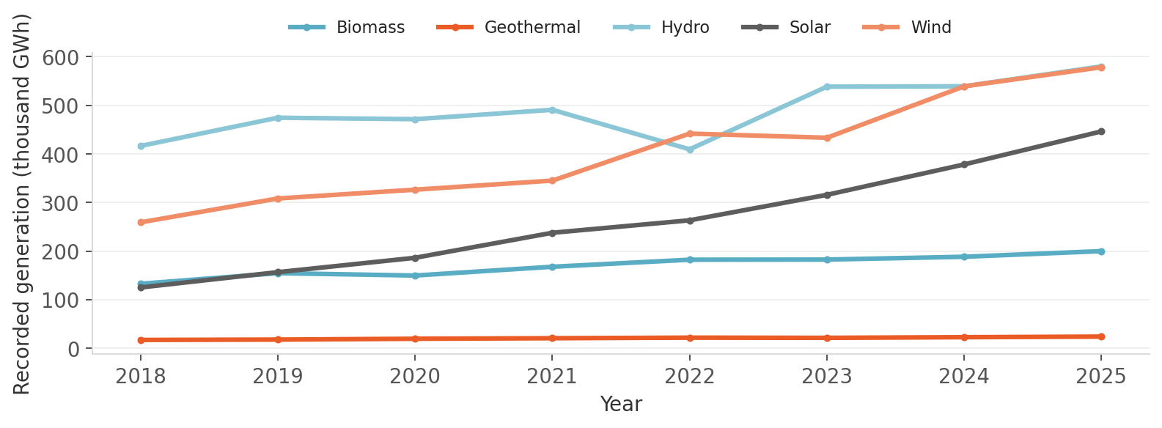
2 · Different renewables, different paths
Solar, wind, hydro, biomass and geothermal follow different trends.
2018–2025: 34 countries appear every year; monthly/source coverage may still differ.

Slide 6
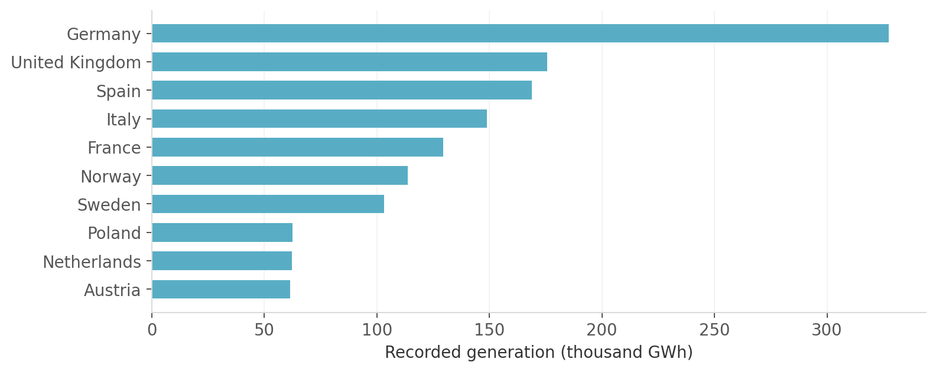
3 · Largest generators in 2025
Germany leads recorded total generation, followed by the UK and Spain.
Totals reflect country size and may be affected by missing monthly readings.

Slide 7
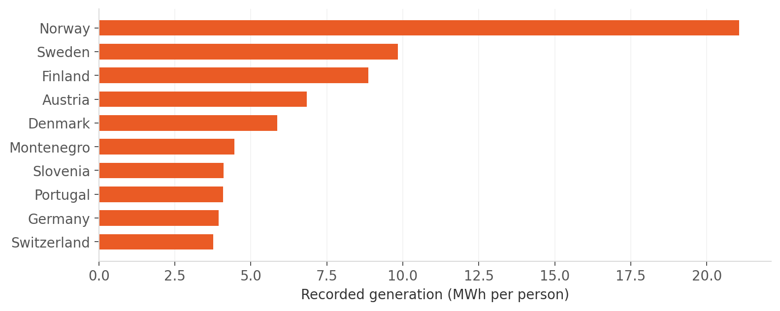
4 · Generation per person changes the ranking
Norway leads when generation is adjusted for population.
MWh/person = recorded generation (GWh) ÷ population (millions) ÷ 1,000.

Slide 8
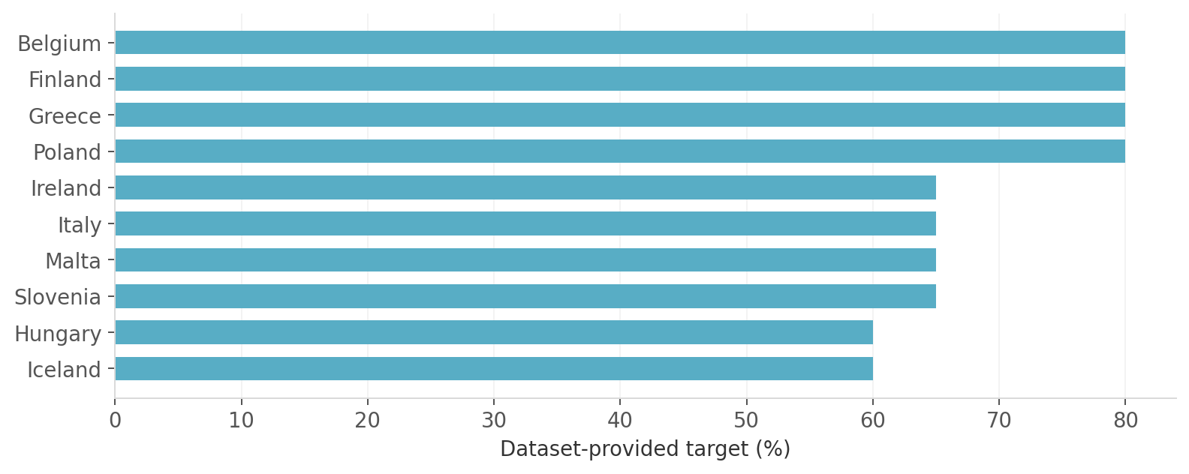
5 · Comparing 2030 targets
Several countries share the highest dataset-provided target of 80%.
These are targets in the supplied dataset—not verified policy pledges or progress toward targets.

Slide 9
What did we learn?
Three findings — and what they actually mean
Generation rose
Recorded annual generation totals increase across 2015–2025.
Rankings depend on the metric
Germany leads in total GWh; Norway leads per person.
Targets are not progress
The dataset lists 2030 targets but does not establish who is on track.

Slide 10
Limitations and responsible interpretation
Incomplete coverage
Countries and months are not equally represented in all periods.
Data quality
Missing and anomalous generation values require caution.
Different concepts
Generation, generation per person and renewable share are not the same.
2030 targets
A target list cannot establish whether a country is on track.

Slide 11
Is Europe getting greener?
The data shows rising recorded renewable generation.
But complete, comparable renewable-share data would be needed
to answer the question definitively.
Thank you! · Questions?

