Slide 1

Mid-term presentation
Project: SudMig
IP SDI SERVICES IMPLEMENTATION WT2023/24
Noah Greupner, Stamatina Tounta

Slide 2

Content
Topic & context
Objectives
Stakeholders
Data
Project Management
SDI Methods and components
SDI infrastructure
Problems/obstacles
Current status and outlook

Slide 3

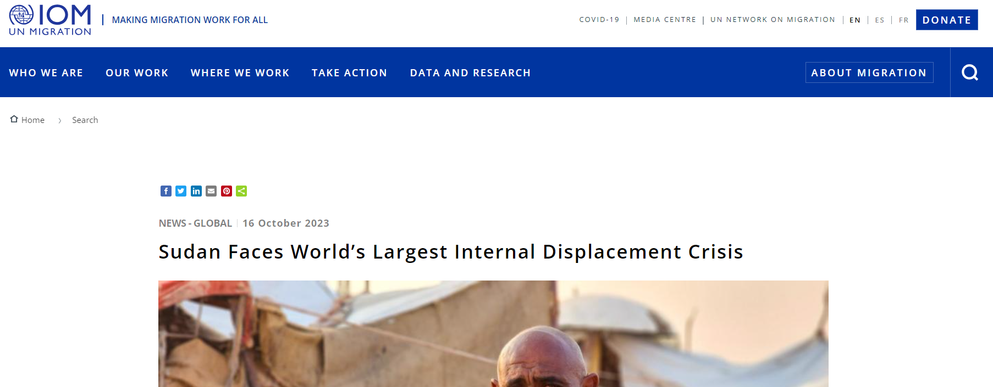
Topic and context
Title: "Sudan: monitoring migrant movements related to the 2023 conflict"
Ongoing conflict that broke out in Sudan in mid-April 2023
War between the Sudanese Armed Forces and the paramilitary Rapid Support Forces
Causes people to flee within Sudan or to neighbouring countries
Source: International Organization for Migration
Source: Pixabay.com

Slide 4
Objectives
Communicate spatiotemporal movements of Internally Displaced People (IDPs) in Sudan
Creation of an effective and transparent SDI that integrates statistical and geo-data
Collect and store open and up-to-date data on Sudan's internal migration in a DBMS
Share a set of (standardized) geo-services for data sharing and communication
Develop an interactive dashboard that supports data analytics and decision-making processes within the United Nations Authorities

Slide 5
Stakeholders
Name | Nadia | Malik | Kathrin
Organization | UNHCR* | UNOCHA** | UNDP***
Role | Field Coordinator | Humanitarian Analyst | Data Specialist
Main task | Coordination of on-the-ground UNHCR activities | Humanitarian data analysis and resource allocation | Analyzing development data and trends
Location | Sudan | Genf | New York
Needs and goals | Fast information on current refugee movements Monitoring camp capacities Coordination with other UN agencies and NGOs | Refugee information for humanitarian needs Analysis of resource allocations and shortages Derive security information | Understanding of socioeconomic impacts of refugee movements Identification of development projects in affected areas Collaboration with other UN agencies and government entities
*UNHCR = United Nations High Commissioner for Refugees
**UNOCHA = United Nations Office for the Coordinator of Humanitarian Affairs
***UNDP = United Nations Development Programme

Slide 6
Data
Statistics of Internally Displaced Persons (IDPs) in Sudan
Provided by: International Organization for Migration (IOM)
Available at: https://data.humdata.org/dataset/sudan-displacement-situation-idps-iom-dtm
Geodata
Sudan - Subnational Administrative Boundaries
Provided by: OCHA Regional Office for Southern and Eastern Africa (ROSEA)
Available at: https://data.humdata.org/dataset/cod-ab-sdn
World countries boundaries
Provided by: Eurostat
Available at: https://ec.europa.eu/eurostat/web/gisco/geodata/reference-data/administrative-units-statistical-units/countries
Variables to integrate and analyze
Date (timestamp)
Total estimate of recently displaced individuals
State of displacement of IDPs
States of origin of IDPs

Slide 7
Work Breakdown Structure
SudMig
0 Project Management
1 Topic and Data Identification
2 Data Processing
3 Services Creation
4 Data Communication
5 Documentation
Setting deadlines
Decide on topic
QC data
Define necessary services
Decide on platform
Contents
Team communication
Define stakeholders
Prepare data (IDPs & admin boundaries)
Decide on server
Design dashboard layout
Report template
Data search
Geocode/ geoenable data
Publish OGC Web Services
Integrate data
Compile report/Wiki
Set WPs
Select AOI & time period
Decide on DBMS
Add maps, graphs etc.
Maintain GitLab
Data download
Import data into DB
Update timesheets
Metadata creation and publish

Slide 8
SDI Methods and components
Using the PostGIS database for data storage
Publish data in a geospatial catalogue
Publish OGC WMS & WFS
ArcGIS Feature Layer & Map Image Layer (in case more functionality is needed to create the dashboard)
Using Geoserver or the ArcGIS Server (Z_GIS Geoportal) to host the services
Interactive dashboard either using ArcGIS Dashboards or QGIS Dashboards (QGIS plugin)

Slide 9






SDI Architecture
Data
Sudan administrative division
(KONTUR)
OGC Web Services
(WFS, WMS)
ArcGIS Operations Dashboard
Geocoding
/
Data
Publish
Communicate
IDPs (UN IOM)
Preprocessing
ArcGIS Feature Layer Map Image Layer
QGIS Dashboard
Metadata published in Geospatial Catalogue

Slide 10
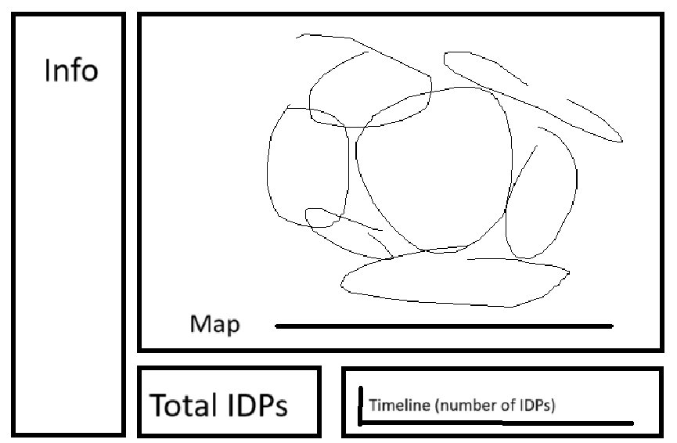
Dashboard draft

Slide 11
Obstacles
Inconsistent data structure requires manual data preparation -> limited possibilities for automated data updates
Data table structure (rows, columns) to fit the needs of the dashboard

Slide 12
Current status and outlook
Current status
Defined topic, objectives, and stakeholders
Defined SDI structure
Find and download data
Updated project overview document, Gantt chart, milestones
Outlook
Prepare data
Integrate them into the DBMS
Update GitLab

