Slide 1



G2M Case Study
U.S. Cab Industry
For use by XYZ Capital
Presentation by Noah Igram
July 19th 2022

Slide 2
Background of case study
The U.S. has seen significant growth in the cab industry within the past few years, and XYZ Capital is looking to make an investment into a key player in the space.
In this presentation we hope to provide relevant analysis of two of the largest cab companies in the U.S., Pink Cab and Yellow Cab.
The goal is to recommend one of the two companies, if either, for investment by XYZ capital
Our analysis is comprised of the following components:
Industry background, role of Pink Cab and Yellow Cab in space
Performance analysis of both companies (Profit analysis, user retention, etc.
Profit forecasting and investment recommendation targeting 3, 5, and 10 year investment horizons.
Timeline of case study
Data processing and organization
Industry analysis, user analysis
Performance analysis of both companies
Profit forecasting and recommendations

Slide 3

Data Processing and Organization
4 CSV files with cab transactions were given and used for analysis. Of the 440,098 transactions pulled from the csv files, 359,392 of them included data for all 12 features.
Data on the number of cab users for each city, as well as population for each city, was also helpful in our analysis.
Features of the data:
Transaction ID
Date of Travel
Company
City
KM Travelled
Price Charged
Pandas
Cost of trip
Customer ID
Payment mode
Gender
Age
Income (USD/Month)
Master dataframe
Transaction data was taken from cab rides across the US from 2016-01-31 to 2018-12-31

Slide 4
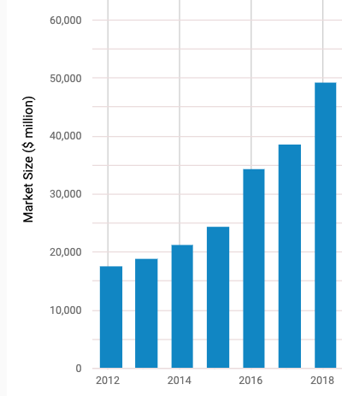
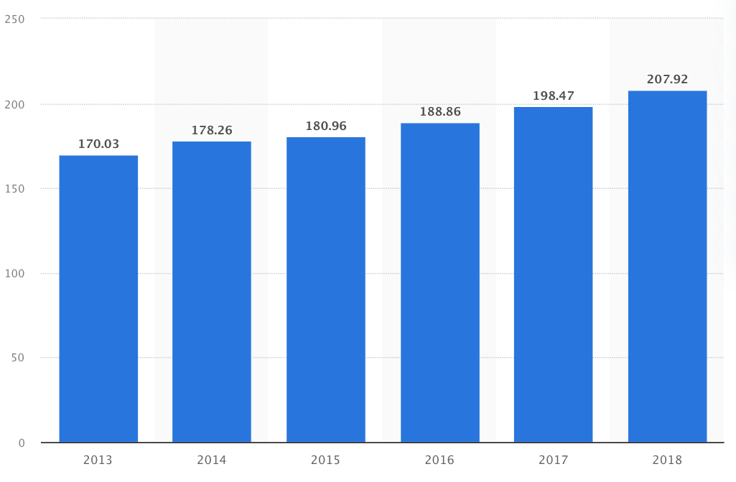
Overview of U.S. Cab Industry
Key stats of U.S. Cab industry:
Market size has increased from below $20B in 2012 to nearly $50B in 2018
We project it will increase to $100B by 2030
Number of drivers has been steadily increasing each year
Rideshare market slightly diluting cab market, will continue
U.S. Cab Market, 2012-2018
250
Number of Cab drivers, 2013-2018
200
150
Number of drivers, thousands
100
50
Figure taken from ibisworld.com
2013
2014
2015
2016
2017
2018

Slide 5
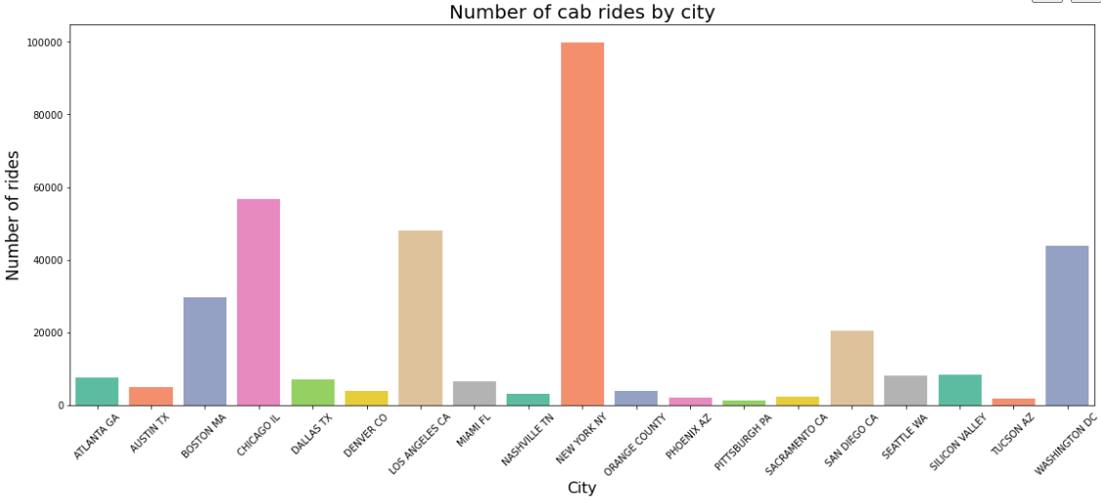
Overview of U.S. Cab Industry
Cities with highest cab usage:
New York City, NY
Chicago, IL
Los Angeles, CA
Washington DC
Boston, MA
Number of Cab Rides by City, Pink and Yellow Cab 2016 - 2018

Slide 6
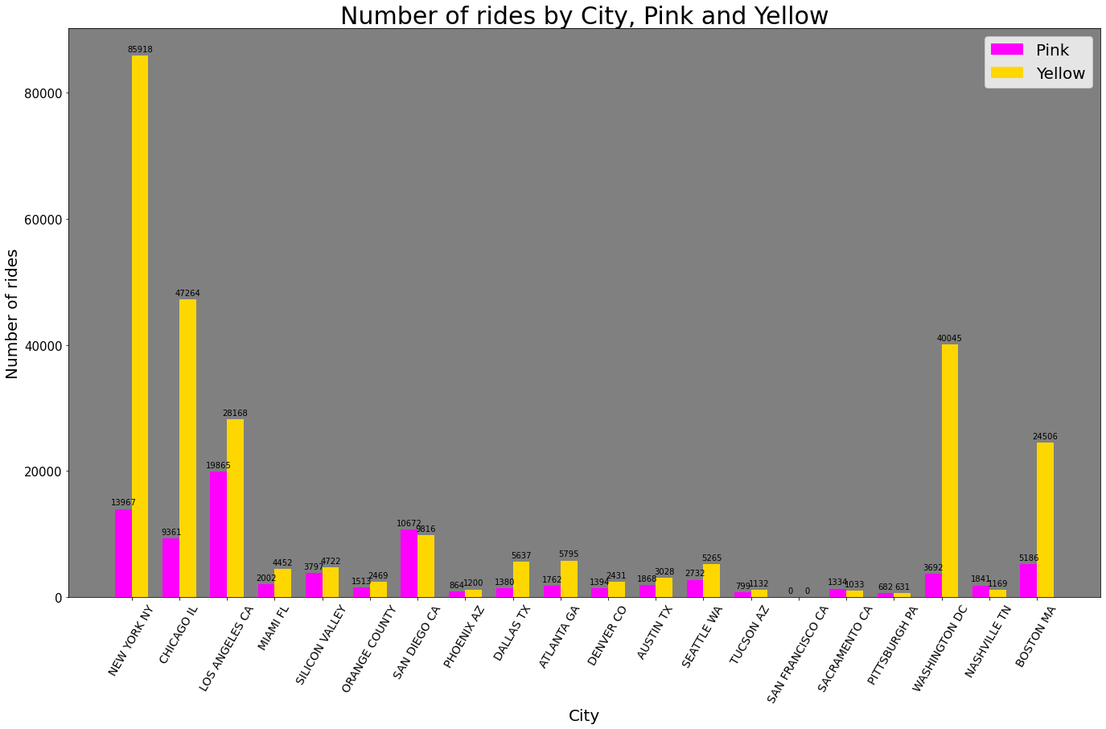
Customer Reach in Major U.S. Cities
How does location affect the market share of each of the two companies?
Yellow Cab gives more rides in most major U.S. cities
Pink only outperforms Yellow in San Diego, Sacramento, Pittsburgh, and Nashville

Slide 7
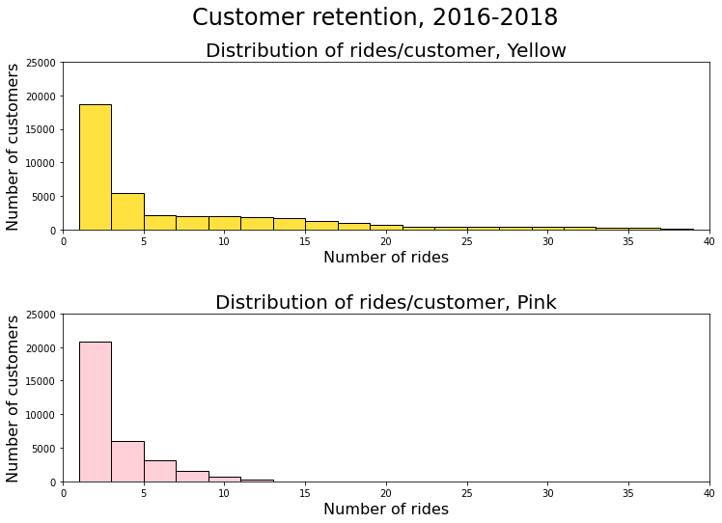
User Analysis: Customer retention
An important factor in understanding user preference is understanding if and how both Yellow and Pink Cab retain users.
The distribution of rides per customer for the two companies shows us…
Yellow Cab has significantly more ‘regular’ customers who ride Yellow Cab for more than 10 rides
Pink cab rarely gets customers returning for more than 10 rides
Our key takeaways from these findings:
Yellow Cab has better overall customer retention which may signify its users prefer riding with them over Pink Cab
Raises question of why Pink Cab users don’t return for a 10th ride

Slide 8
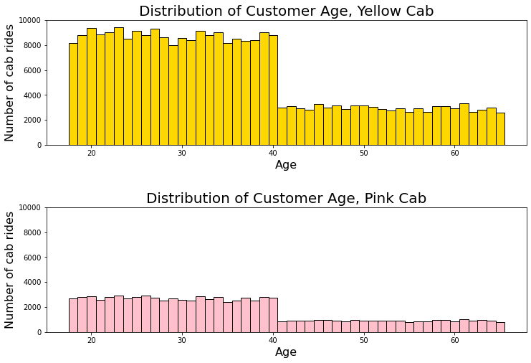
User Analysis: User age
Another factor in understanding user preference is understanding the ages of customers using each cab service.
Key findings:
Riders below 40 years of age make up approximately ⅔ of the customer base- the rest are mostly between 40 and 65 years old.
Yellow Cab and Pink Cab serve a very similar customer base in terms of age.
Age does not seem to affect which cab service a user takes.

Slide 9
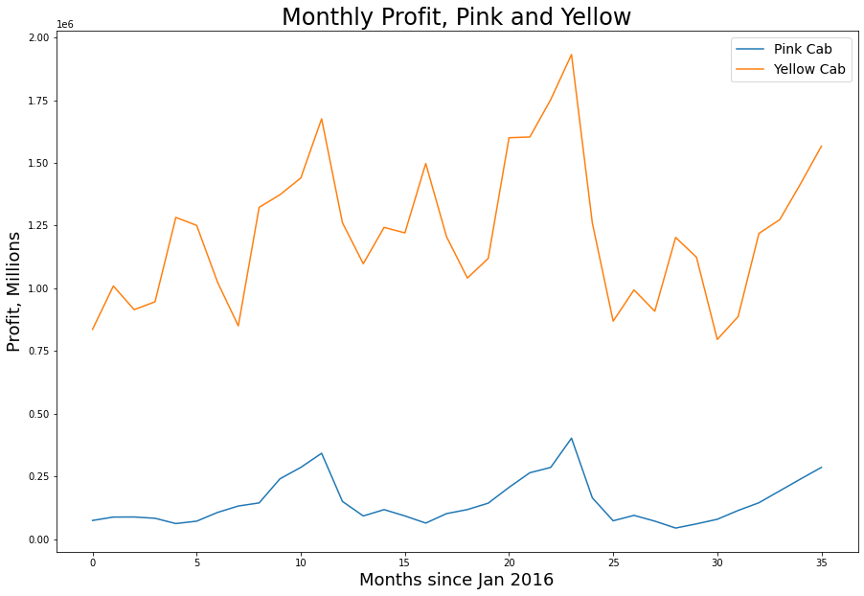
Profit Analysis
Profit Analysis
The following data outlines some of the key ride metrics for Pink and Yellow Cab from 2016 to 2018.
Company | Number of rides/ month | Average Profit/ Ride | Average Price of Ride | Average trip length (km)
Pink Cab | 2353 | $62.65 | $310.80 | 22.5
Yellow Cab | 7630 | $160.26 | $458.18 | 22.6
This data as well as month to month profits have shown us the following:
Yellow Cab has brought in more profit than Pink Cab year round from 2016 to 2018
Yellow Cab provides almost 3x the cab rides as Pink Cab
Yellow Cab charges significantly more per trip
The most significant takeaway is that Yellow Cab has a better pricing scheme and takes advantage of inelasticity in the demand for rides. Pink Cab could probably charge more per ride without missing out on customers.

Slide 10
Profit Forecasting
Revenue and projections
Data from 2016-2018 has shown us:
Yellow Cab’s profits have been consistently higher than Pink Cab’s
Yellow Cab’s profits are significantly more volatile than Pink Cab’s profits month to month
Regression analysis would be difficult because the profits are volatile and the profit data only spans 3 years. Assuming the U.S. cab market will continue to grow year over year, we can use this information to help us make predictions for the future
2016-2018 the U.S. cab industry grew 20.3% per year
Using a conservative estimate of 11% growth in revenue we estimate the following as the future profits
 | 2016 | 2017 | 2018 | 2020 Proj | 2025 Proj.
Pink Cab | $7.91 M | $9.58 M | $8.84 M | $9.8 M | $12.1 M
Yellow Cab | $38.48 M | $45.82 M | $41.55 M | $44.8 M | $55.2 M
Profits and projections
 | 2016 | 2017 | 2018 | 2020 | 2025 Proj.
Pink Cab | $1.71 M | $2.03 M | $1.56 M | $1.82 M | $2.49 M
Yellow Cab | $13.93 M | $16.58 M | $13.5 M | $16.6 M | $20.5 M

Slide 11
Final Recommendations
Our final recommendation is to invest in Yellow Cab over Pink Cab as it will yield a higher return on investment. We have based this on the following:
Market control: Yellow Cab provides more rides in 15 of the analyzed cities while Pink Cab only provides more rides in 5 of them. It is a larger company with more drivers, giving us reason to believe that it can survive through seasonal demand droughts thanks to its high profit months.
Customer Retention: Yellow Cab gets more regular customers than Pink Cab and has proven to be better for customer loyalty.
Better Pricing Scheme: Yellow Cab charges significantly more per KM travelled than Pink Cab. Because they continue to attract many more customers than pink, we have reason to believe that there is serious inelasticity in demand that allows them to get away with charging more.
Higher Profits: Yellow Cab pulls in 2.5x more profit per ride than Pink Cab and consistently profits more each month.

Slide 12
Thank you!

