Slide 1
Identifying Machine Learning Models to Predict Serious Credit Delinquency
Noah Keogh

Slide 2
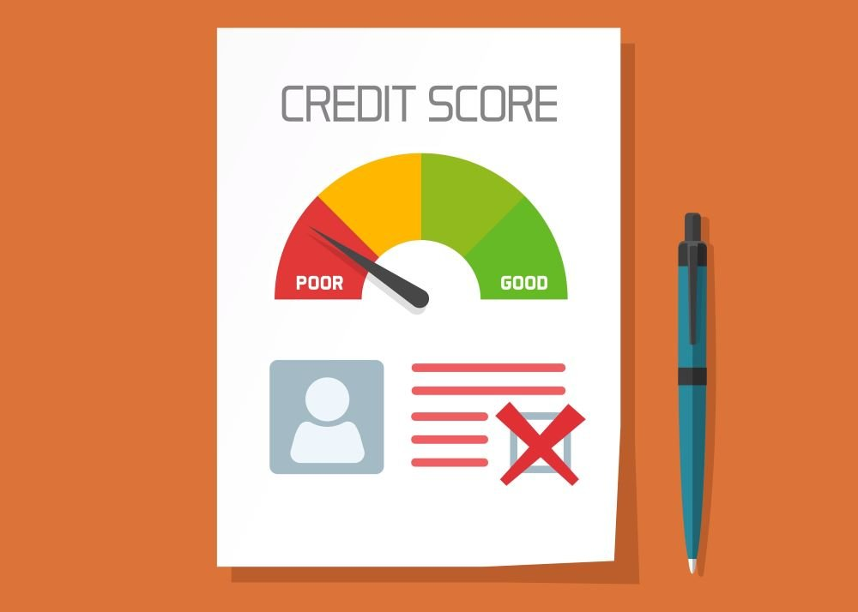
What is a Credit Score?
Created in 1989 with Introduction of FICO score [1].
Gives quantitative measure to a borrower’s potential riskiness [2].
Scores range from 300 to 850 [3].
Notes:
Credit scores, as they are known today, were invented in 1989, with the introduction of the FICO score.
The goal of credit scoring models are to assess or calculate the riskiness of a borrow.
This allows borrowers to make informed decision when approving loans.
Some traditional factors affecting credit scoring models are:
Credit history
Late payments
Age of credit
Credit scores are useful because they allow an objective measure of someone’s borrowing behavior.
In the 18th and 19th century (in America) loans and credits were based on very subjective measures such as how neighbors or close friends regarded the character of a given individual.
Thus, the introduction of a credit scoring model is beneficial since it provides a more objective measure rather than a subjective model.
Image: https://www.climb.ca/wp-content/uploads/2019/05/Credit-Score-2.jpeg

Slide 3
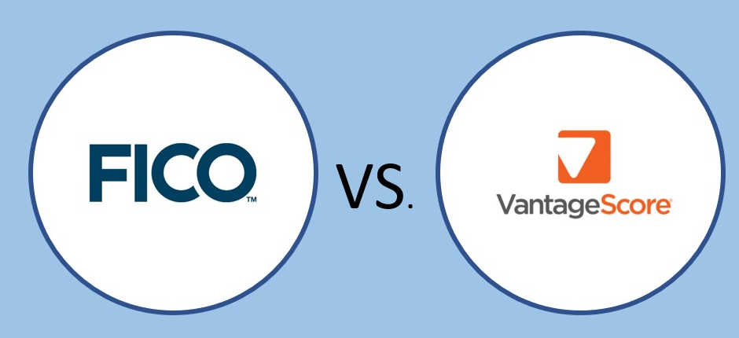
How do Models Calculate Credit Score?
Common Credit Score Factors:
Payment history
Credit utilization ratio
Total debt
Credit mix
Account age/depth of credit
Hard inquiries
Notes:
FICO and Vantage are the two major credit scoring methods.
Each use their own algorithms to calculate an individual’s credit score.
Each company is not transparent in the algorithms they use to asses a person’s credit score.
Each company also places a different importance on each of the factors listed above.
Both companies claim to use machine learning algorithms for predicting risky behaviors.
FICO claims that they have been doing so for over three decades now.
https://www.goamplify.com/blog/moneymanagement/credit-score-algorithms/
https://blogs.worldbank.org/developmenttalk/leveraging-big-data-and-machine-learning-credit-reporting
Image: https://th.bing.com/th/id/R.bce7cf8fcf3c7553fbf0d18306097034?rik=ofxHYLNgZbLkaw&pid=ImgRaw&r=0

Slide 4
Business Objective
Supervised Model: To classify a given person as being likely or not likely to experience serious delinquency.
Unsupervised Model: Any financial tendencies or behaviors of people in the dataset. Do these tendencies have any correlation to risk of serious delinquency?
Notes:
Two goals:
Supervised: To classify a given person as being likely or not likely to experience Serious Delinquency
Unsupervised:
These two goals or projects can be used to enhance or add to existing credit scoring model. It could be one more factor to be used in calculating a quantitative credit score for a given individual.
These are important business objectives because if we can identify people who are likely to experience serious delinquency, then we may want to reconsider loaning to them because they may be unlikely to pay back the money the have borrowed.
If, however, a person is not likely to experience delinquency then we may more greatly consider loaning money to them because they may be more likely to pay back the borrowed money.
Thus, this is how the results or model may be used to add to existing credit scoring models.

Slide 5
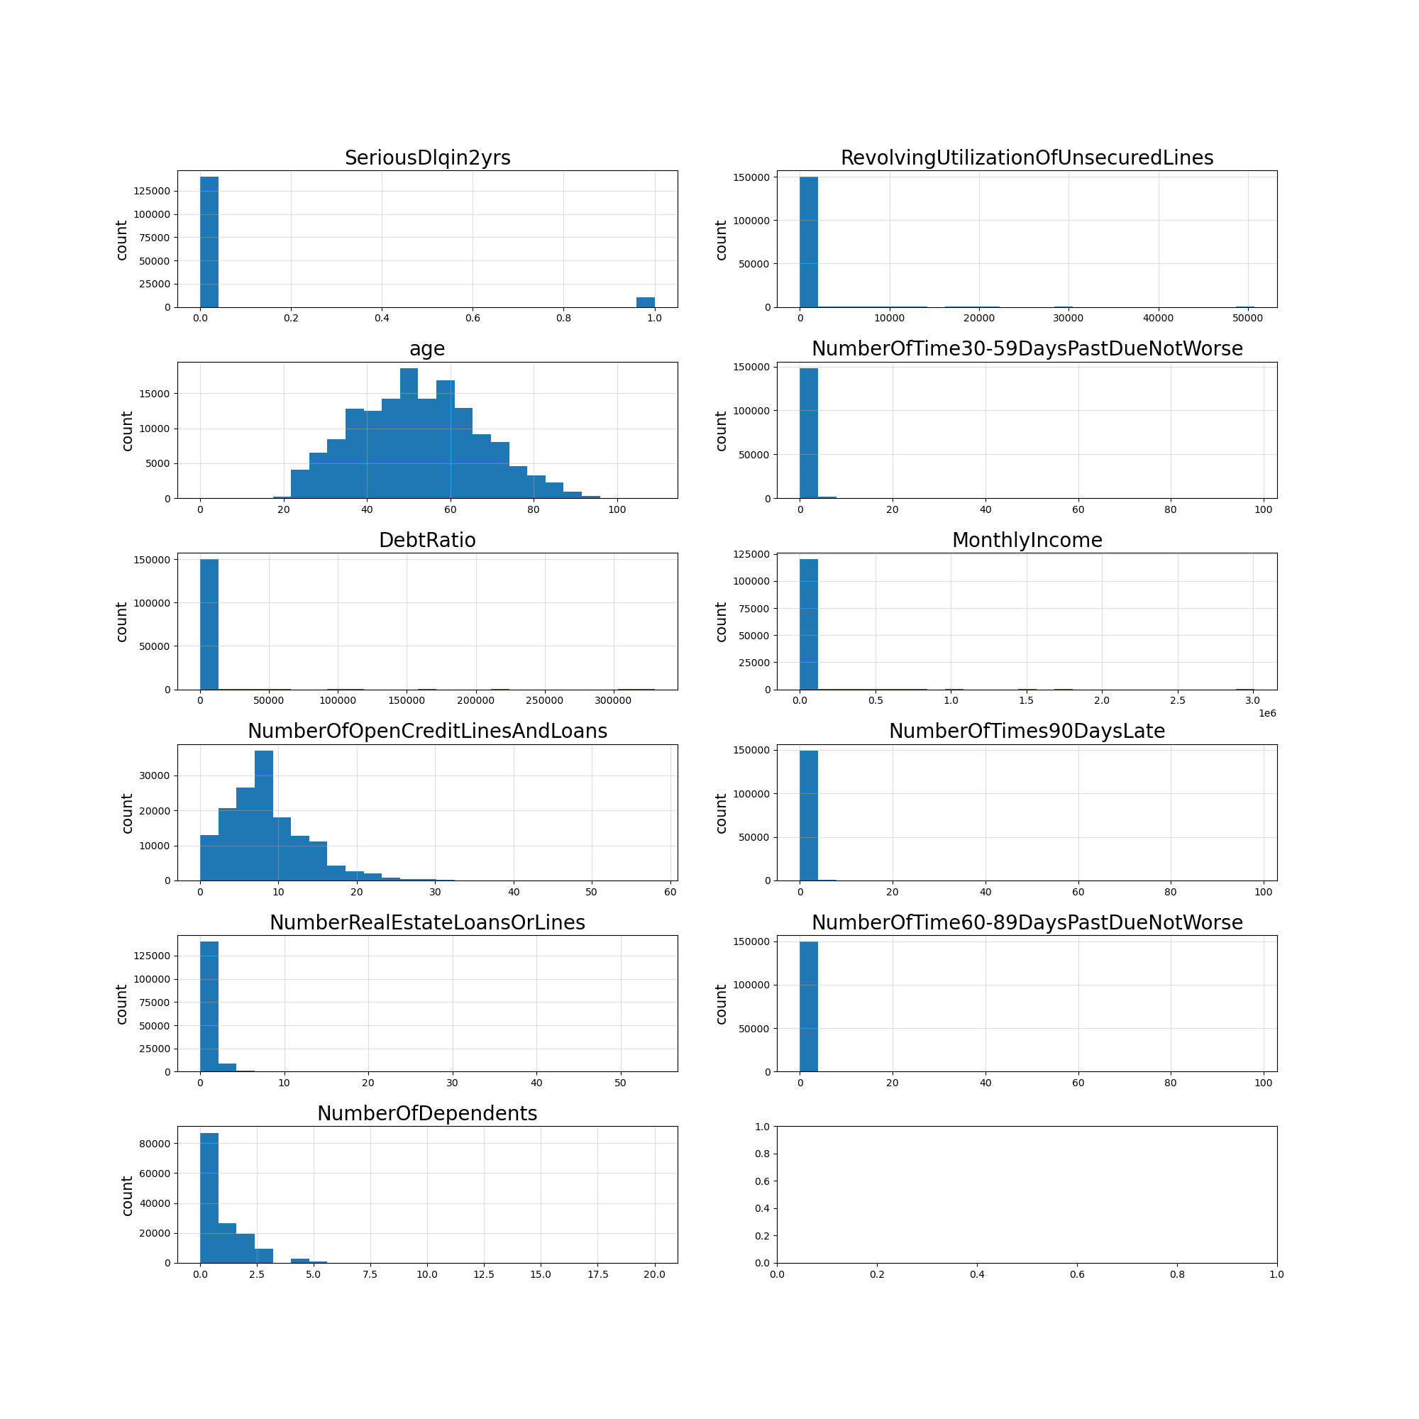
Dataset
Publicly Available on Kaggle
11 Features (one considered label)
Notes:
Give Me Some Credit | Kaggle
11 Features
SeriousDlin2yrs:
RevolvingUlizationOfUnsecuredLines:
Age
NumberOfTime30-59DaysPastDueNotWorse
DebtRatio
MonthlyIncome
NumberOfOpenCreditLinesAndLoans
NumberOfTimes90DaysLate
NumberRealEstateLoansOrLines
NumberOfTime60-89DaysPastDueNotWorse
NumberOfDependents

Slide 6
Data Wrangling
Label Count Check (Entire Dataset)
Class 1 (Delinquent): 10,026
Class 0 (Not Delinquent): 139,974
Train Dataset
Class 0: 111,979
Class 1: 8,021
Test Dataset
Class 0: 27,995
Class 1: 2,005
Under Sampling
Train Dataset
Class 0: 8,021
Class 1: 8,021
Notes:
The first I did was check the balance of the labels. These are the total number of labels in the entire dataset.
One thing I did to split my training and testing data was to perform a stratified shuffle split so I could get a good representation of the distribution of the features. This was also essential to ensuring that the test data and train data had representative portions of the positive label for training.
The entire dataset was then split into a training and testing data.
After splitting the training and testing dataset, it was apparent that something needed to be done about the balance of the labels.
Models could not be trained on such strongly imbalanced labels without introducing a bias towards one label.
Thus, under sampling of the major class (non-delinquent) class was performed until the number of samples of each class were equal.

Slide 7
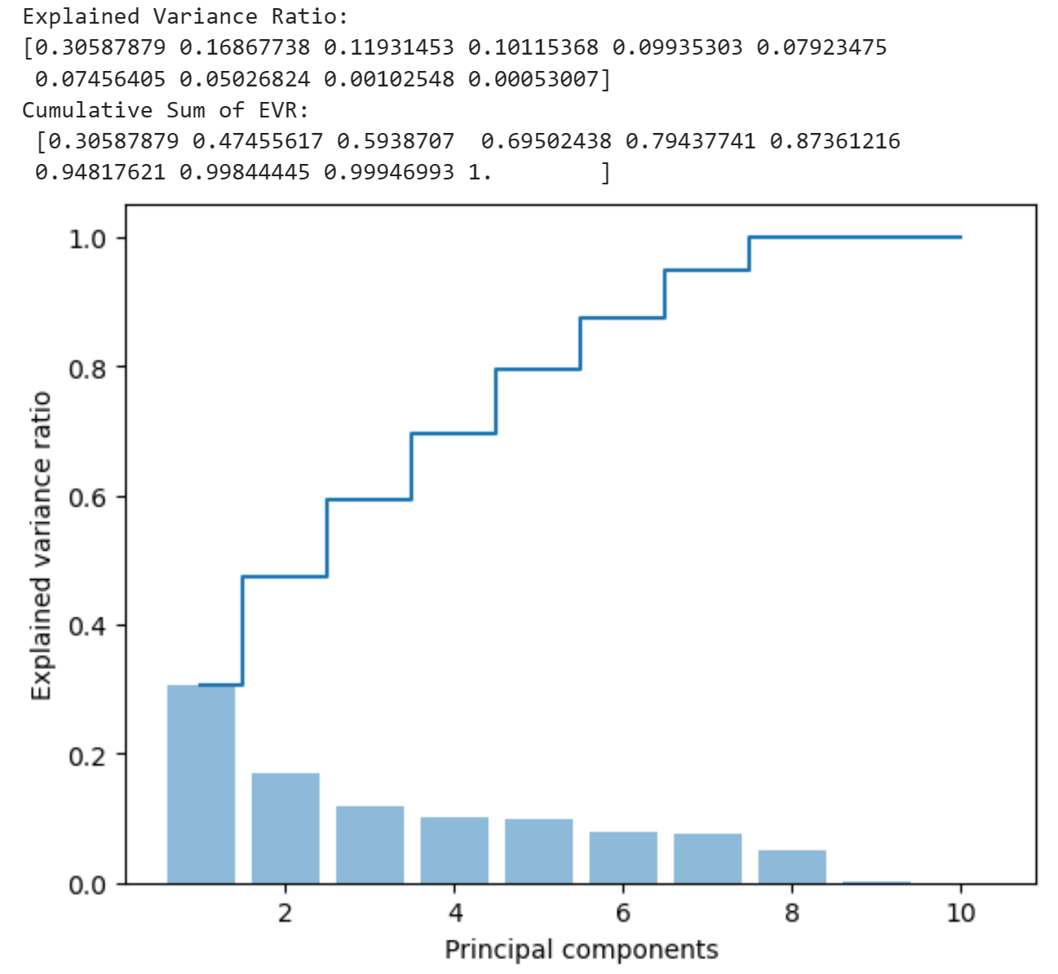
Data Wrangling
1) Missing Values (Entire Dataset):
Monthly Income: 29,731
Number of Dependents: 3,924
2) Label Balancing (under sampling)
3) Feature Standardization
4) PCA Dimensionality Reduction
10 dimensions → 7 dimensions (94.8% explained variance)
Notes:
The number of missing values in the dataset were examined. Only two features had missing values. In order to fill the missing values, an imputer was made using the median value strategy. The median value was calculated on the training dataset and applied to the training data before under sampling was performed.
This is because the larger dataset is more likely to represent the median value for each feature as compared to the under sampled training data.
Feature standardization was performed so that the features were of the same scale. The reason this was performed prior to PCA dimensionality reduction is because PCA is sensitive to the scale of the features, thus, not standardizing the features could lead to unwanted results.
In order to avoid the curse of dimensionality, PCA reduction was performed. An explained variance of 90% was desired, so 7 principal components were chosen for the dimensionality reduction.

Slide 8
Model Testing

Slide 9
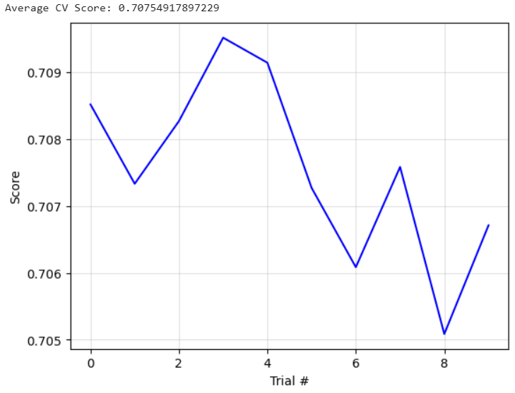
Data Modeling: Logistic Regression
Average Accuracy: 70.75%
Nested Cross Validation:
10 trials conducted
Parameters Tested
C: 1, 10, 100
Solver: lbfgs, liblinear
Notes:
10 trials of cross validation were performed with the average accuracy obtained of 70.75%.
Several hyperparameters were tested.
Overall, very small variation in accuracy over the trials.
Trained on the dataset that had missing values filled, under sampling of major class, feature standardization, PCA dimensionality reduction with 7 principal components.

Slide 10
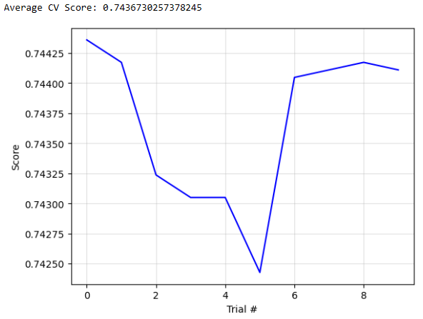
Data Modeling: Support Vector Machine (SVM)
Average Accuracy: 74.37%
Nested Cross Validation:
10 trials conducted
Parameters Tested
C: 1, 10
Gamma: 0.01, 0.1
Solver: rbf
Notes:
10 trials of cross validation were performed with the average accuracy obtained of 70.75%.
Several hyperparameters were tested.
Overall, very small variation in accuracy over the trials.
Trained on the dataset that had missing values filled, under sampling of major class, feature standardization, PCA dimensionality reduction with 7 principal components.

Slide 11
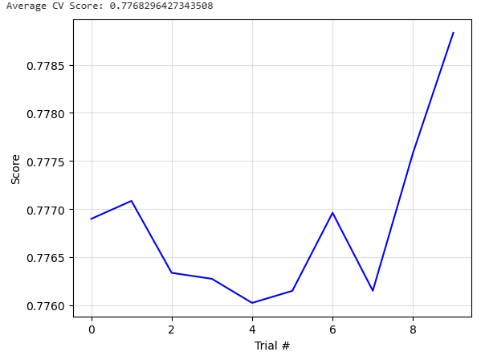
Data Modeling: Random Forest Classifier
Average Accuracy: 77.68%
Nested Cross Validation:
10 trials conducted
Parameters Tested
Max Depth: 4, 6, 8
Min Samples Leaf: 30, 100
Notes:
10 trials of cross validation were performed with the average accuracy obtained of 70.75%.
Several hyperparameters were tested.
Overall, very small variation in accuracy over the trials.
Trained on the dataset that had missing values filled, under sampling of major class, no other processing of the data had been performed since random forest models are robust to the scaling of the features and since it randomly subsamples the features and samples, dimensionality reduction was not performed.

Slide 12
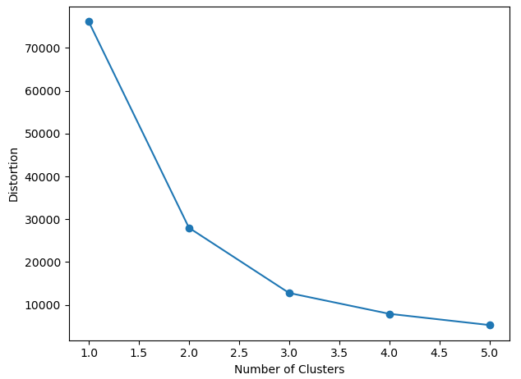
Data Modeling: K-Means-Clustering
1) Dimensionality Reduction
10 dimensions → 2 dimensions (47.46% variance)
2) Clustering
Use K=2 to perform clustering
Notes:
The K-means clustering (unsupervised model) was used.
The business objective was slightly different it was to identify: any financial tendencies or behaviors of people in the dataset. Do these tendencies have any correlation to risk of serious delinquency?
Certain groups of people such as do high income people have more real estate loans or open lines of credit?
What can we find out about the dataset?
2 Dimensions was used to better visualize the clustering.
Studied the contribution of each of

Slide 13
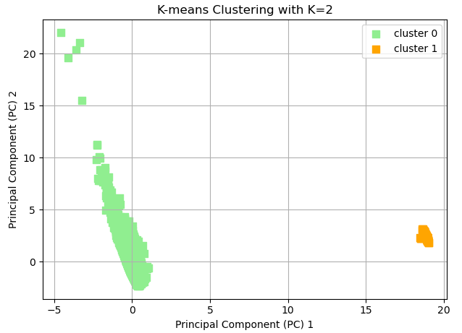
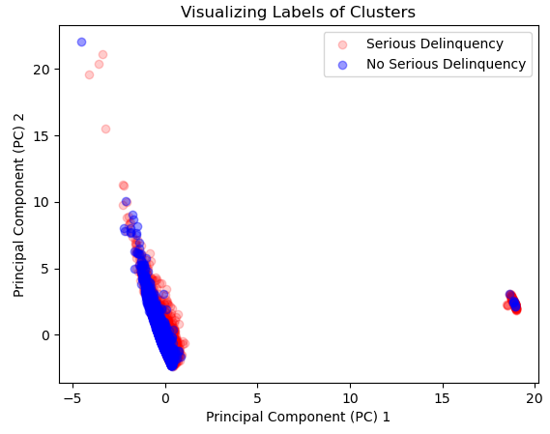
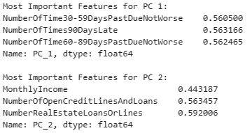
Data Modeling: K-Means-Clustering
Notes:
Looked at the contribution of each feature towards a principal component.
Only the highest contribution features were shown here.
Limit of three iterations, clustering was performed 10 different times using different initial centroids using the k-means++ algorithm to select initial centroids.
K-means clustering model, however, appeared to not be very insightful.
2 Clusters in the data.
It showed that there are people who are frequently late on payments with average income and others who are not late frequently but have a range of incomes and number of credit or real estate loans open.
These behaviors, however, did give any indication as to whether a given person in either cluster would be likely to have a serious delinquency. For these reasons, this model will not be investigated further.

Slide 14
Random Forest Classifier Optimization
Notes:
Random Forest Classifier model was selected for further parameterization optimization.
It showed the most promise out of all of the models tested.
Random Forest Classifier: 78%
Logistic Regression: 71%
SVM: 74%
K-means Clustering was not very insightful.

Slide 15
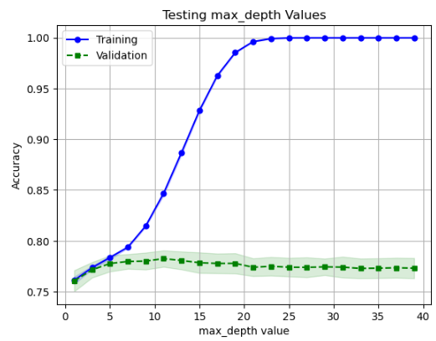
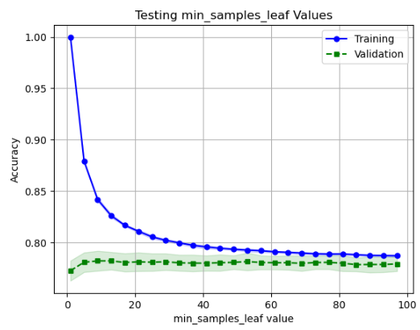
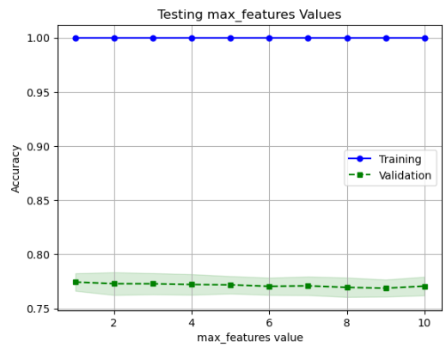
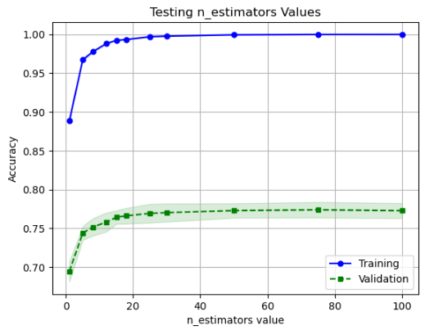
Hyperparameter Testing: Validation Curves
Optimal Values for Each Hyperparameter to Test in Randomized Search
max_depth: 3 to 8
min_samples_leaf: 45 to 100
max_features: 1 to 10
n_estimators: 15 to 25
Notes:
In order to get an idea for what values to search for an optimal model for each hyperparameter, validation curves were performed for each feature.
Max Depth: Parameter that controls the longest path allowed from the root of the tree to a leaf.
N Estimators: The number of decision trees that make up the random forest.
Min Samples Leaf: When the model is deciding to split a node using a feature, it will only perform the right and left splits if the left and right branches have the minimum number of samples.
Max Features: The number of features the model will consider when splitting a node.

Slide 16
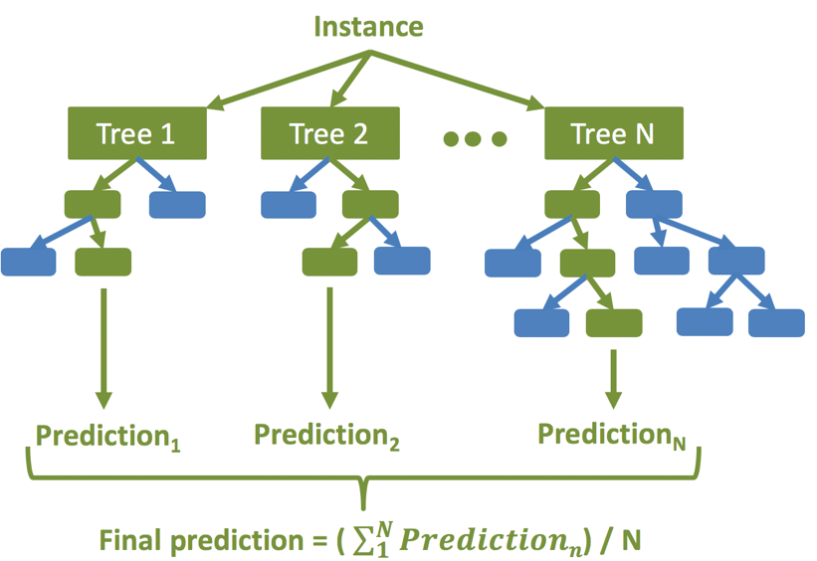
Randomized CV Search for Final Model
Accuracy in CV: 78.12%
Model Hyperparameters
max_depth: 7
max_features: 5
min_samples_leaf: 48
n_estimators: 19
Notes:
A randomized CV search was performed using the ranges for each of the hyperparameters found in the previous step by performing the validation curves.
50 models were tested in the randomized search cv with a cross validation split of 5. This was found to be the most accurate model obtained after performing cross validation.
This was the final model that was decided upon and will be used on the test data.
Image: https://www.bing.com/images/search?view=detailV2&ccid=Nphjoefp&id=D292D7624A350E882FD813AD5FE448275B3B958A&thid=OIP.Nphjoefpu0DDGa0YBQnNbQHaFF&mediaurl=https%3a%2f%2fwww.researchgate.net%2fprofile%2fTyler-Mccandless%2fpublication%2f333612054%2ffigure%2ffig7%2fAS%3a766120084664320%401559668670052%2fDiagram-of-the-random-forest-machine-learning-method-which-is-an-ensemble-of-regression.ppm&cdnurl=https%3a%2f%2fth.bing.com%2fth%2fid%2fR.369863a1e7e9bb40c319ad180509cd6d%3frik%3dipU7WydI5F%252btEw%26pid%3dImgRaw%26r%3d0&exph=564&expw=821&q=random+forest+model&simid=607994505822693197&FORM=IRPRST&ck=837C7C35B7FA54085BDA4B1FC20B33C0&selectedIndex=9&ajaxhist=0&ajaxserp=0

Slide 17
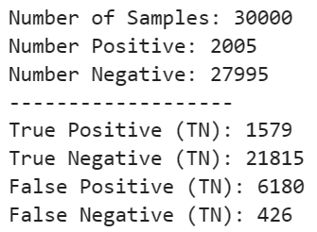
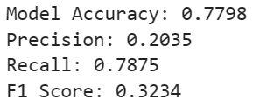
Assessing Accuracy
Test Dataset
Class 0: 27,995
Class 1: 2,005
Notes:
The model was tested on the test dataset. The test dataset was prepared in the same way that the training dataset was prepared.
This means that the imputer that was made using the training dataset median values was applied to the test dataset.
A basic confusion matrix was generated which grouped the predictions into TP, TN, FP, FN.
After classifying the prediction made by the model, common metrics were calculated:
Accuracy appeared relatively good and close to the accuracy obtained from randomized search CV on the training data.
Recall appeared to be good (portion of True Positives identified to all positives in the dataset)
Precision was not good (portion of True Positives identified to all samples the model identified as positive)
F1 score (calculated from precision and recall did not appear very good)
One thing to note however, is how imbalanced the labels are. There are very few positive samples compared to the number of non-delinquent samples.
This can have a large effect on the calculation of the recall since even if the model is only incorrectly identifying a small percentage of the negative samples since the number of negative of samples is so much greater than positive samples this will generate misleading precision and consequently F1 scores since these measures are not robust to imbalanced labels.
Thus, another metric was used to assess the model.

Slide 18
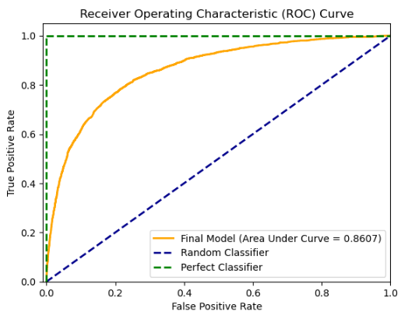
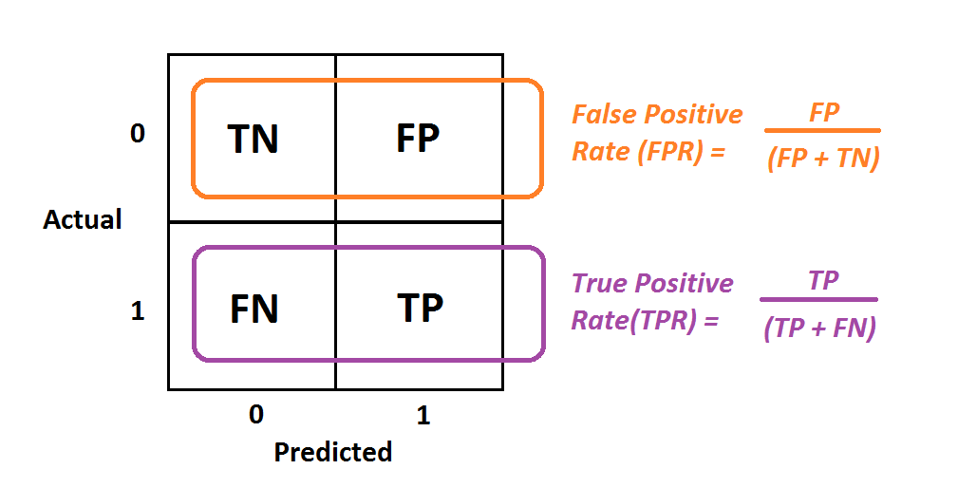
Assessing Accuracy
Notes:
Receiver Operating Characteristic Curves are more robust to imbalances labels in the dataset.
The reason being that it uses two metrics that are robust to imbalanced labels the TPR and FPR.
Since these metrics only measure the predictions made within a class, they are much more robust for imbalanced labels.
Thus, looking at the ROC curve which measures the TPR and FPR at different discrimination thresholds, the model appears to be performing quite well as it has an area under the curve of 0.86. This is much greater than a random classifier.
Thus, this metric more accurately represents the performance of the model on the test data.
Thus, the model appears to be performing quite well can achieve the business objective within a reasonable accuracy, there is obviously still room for improvement however since the model does not have an AUC of 1.
Image: https://www.bing.com/images/search?view=detailV2&ccid=v5upQ5m%2f&id=8E0CA1F916F80E9C65B613FF20E2D1F42E41911E&thid=OIP.v5upQ5m_liS_htEgowlQNAHaDx&mediaurl=https%3a%2f%2fmiro.medium.com%2fmax%2f1104%2f1*xhFLNjF82feNl8X6uinXMA.png&cdnurl=https%3a%2f%2fth.bing.com%2fth%2fid%2fR.bf9ba94399bf9624bf86d120a3095034%3frik%3dHpFBLvTR4iD%252fEw%26pid%3dImgRaw%26r%3d0&exph=514&expw=1009&q=tpr+and+fpr&simid=608021435248820175&FORM=IRPRST&ck=6E049E838E9D63A28DDD36C32F1B9EC5&selectedIndex=0&ajaxhist=0&ajaxserp=0

Slide 19
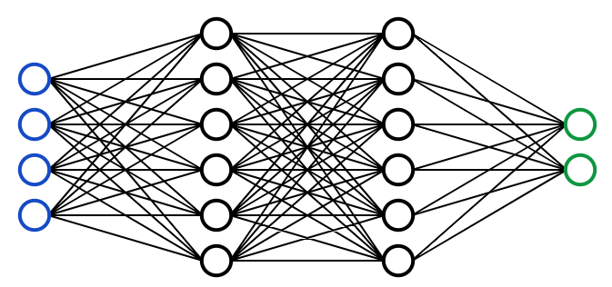
Future Explorations
Exploring different models such as neural networks.
Further optimizing tested models such as logistic regression and SVMs.
Collecting more data and training examples to improve performance.

Slide 20
Questions?

Slide 21
Sources
[1] https://www.creditrepair.com/blog/education/when-were-credit-scores-invented/
[2] https://www.onemainfinancial.com/resources/credit/credit-scoring-models#:~:text=A%20credit%20scoring%20model%20is%20an%20algorithm%20used,helps%20lenders%20make%20informed%20decisions%20when%20approving%20loans.
[3] https://www.bankrate.com/personal-finance/credit/no-credit-score-zero-credit/

