Slide 1
Tutoring Preparation
Gallery Walk

Slide 2
Why is this important?
The purpose of this lesson is to understand what we like about reading so that we can share that with younger students, what is the purpose of reading, and how we break down reading strategies.

Slide 3
Reading Memories
Turn to a partner and share:
Who taught you how to read?
Your favorite book as a child.

Slide 4
Reading Now
Turn to a partner and share:
What is your favorite book/author now?
Who do you read to?

Slide 5
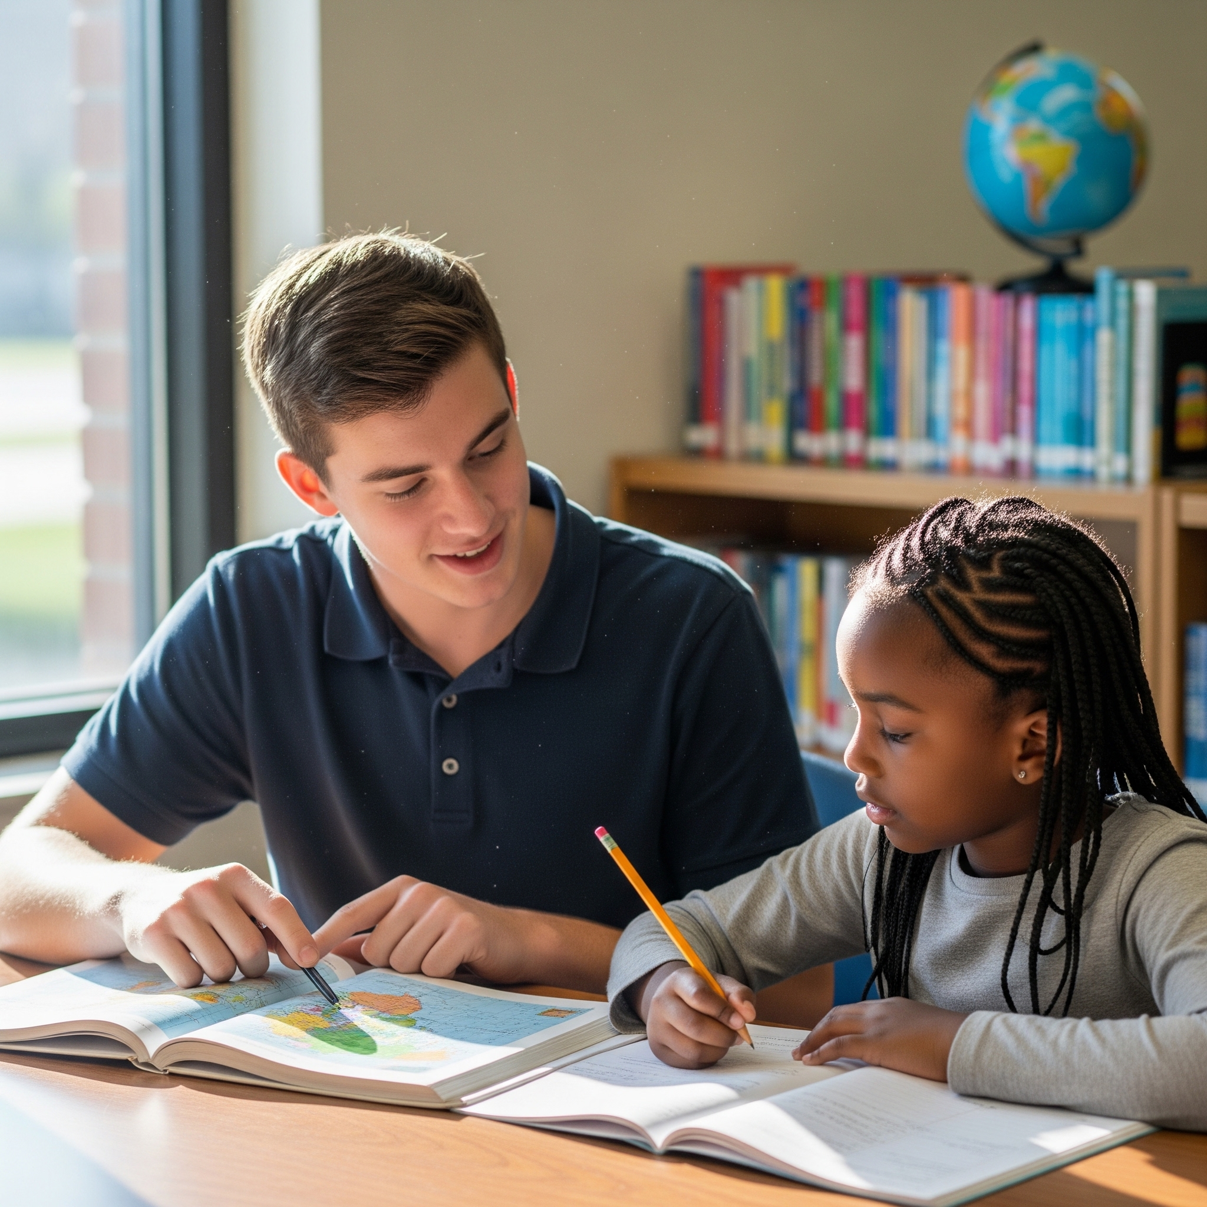
Roles & Responsibilities of Effective Tutors
What skills do you need to become an effective tutor in helping your tutee further develop their reading skills?

Slide 6
Gallery Walk
Students walk around to different posters.
Write new ideas on each poster.
Read what other students wrote.

Slide 7

Gallery Walk Expectations
Speak in a low voice when in the hallway.
Rotate when Mrs. Garcia tells you to.
Write appropriate ideas.
Everyone participates in writing/discussing ideas.
Put a checkmark next to ideas you agree with.

Slide 8
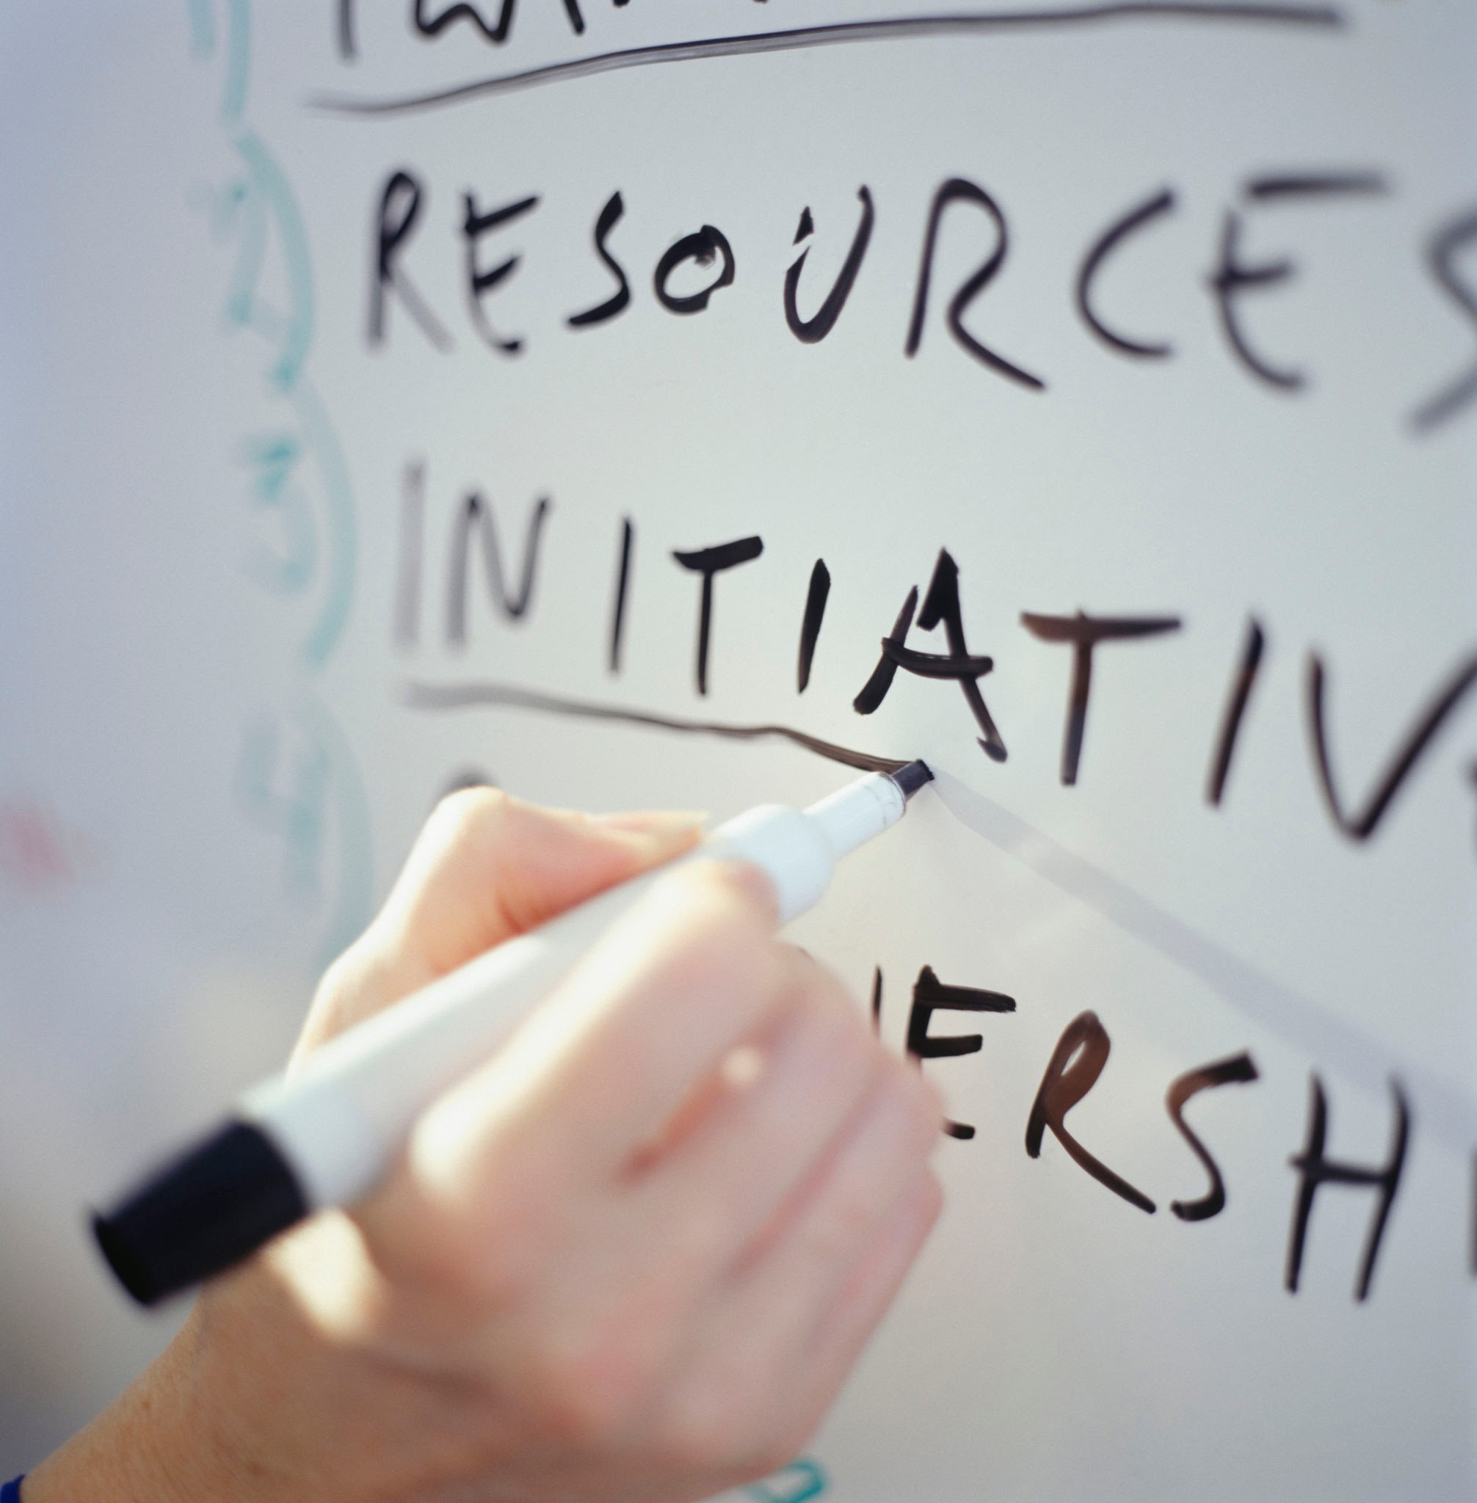
Gallery Walk Topics
Developing relationships with your tutee/mentee
Reading goals
Reading aloud
Discussion questions

Slide 9
Reflection 1
What were your thoughts as you participated in this activity?

Slide 10
Reflection 2
Why do you think it is important to explore ideas about reading and tutoring using the Gallery Walk activity?

Slide 11
Reflection 3
What will you do with what you learned during this Gallery Walk Process?

