Slide 1
WebAssembly:
It’s Cool!

Slide 2
What is WebAssembly?
It’s a new binary executable format for the web
Intended to be nearly as fast as native machine code
Not trying to replace JavaScript!
Compile to wasm from any language you want, as long as it’s C/C++ or Rust

Slide 3
How do you use it?
www.webassembly.org
(install the Emscripten compiler toolchain)
Linker flag -s WASM=1 will emit wasm
-o myFile.js will emit the js wrapper
Include the js wrapper file in your web project to expose the Module object
Call your functions from JavaScript!

Slide 4
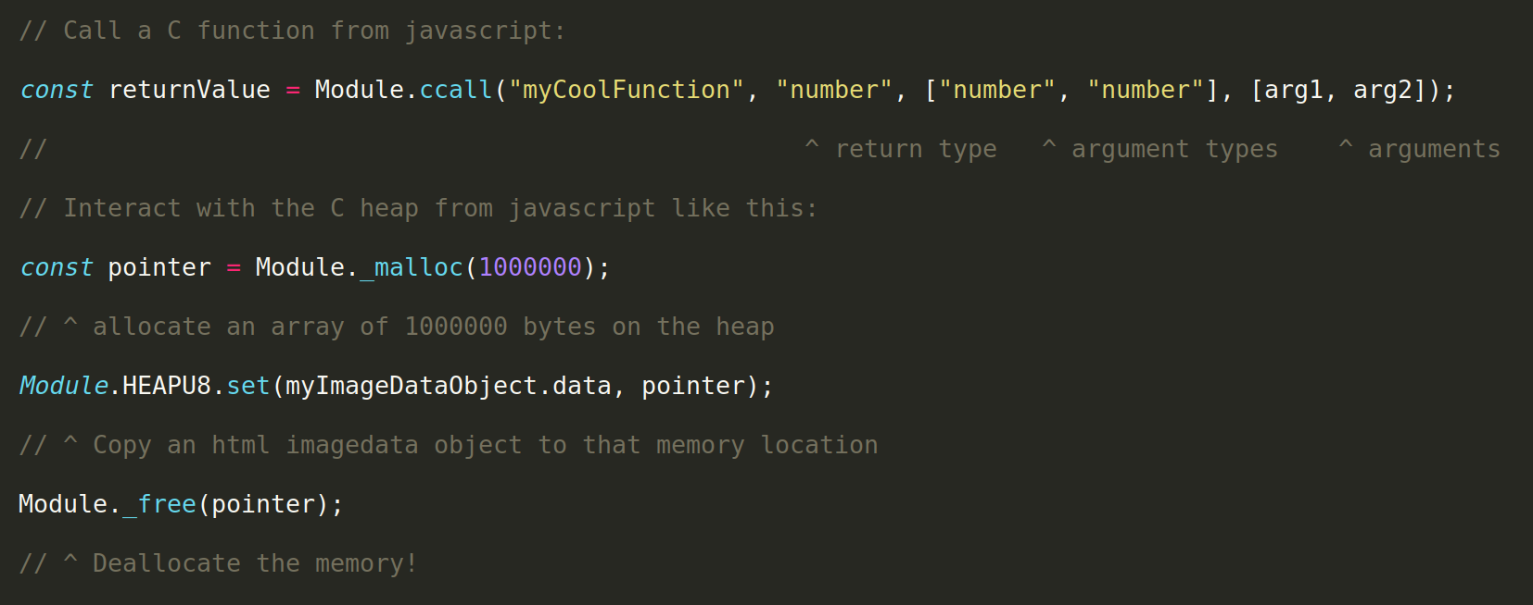
The Module Object

Slide 5
It’s a Sandboxed Environment
Weird free effects: JavaScript provides free read-only C array bounds checking (I think)
Cool for image edge handling and similar tasks
Optional linker flags permit unrestricted memory growth – create cool memory leaks!

Slide 6
Demo
Does it do what it says it does?
Canvas image processing functions:
JavaScript vs. C++ showdown

