Slide 1
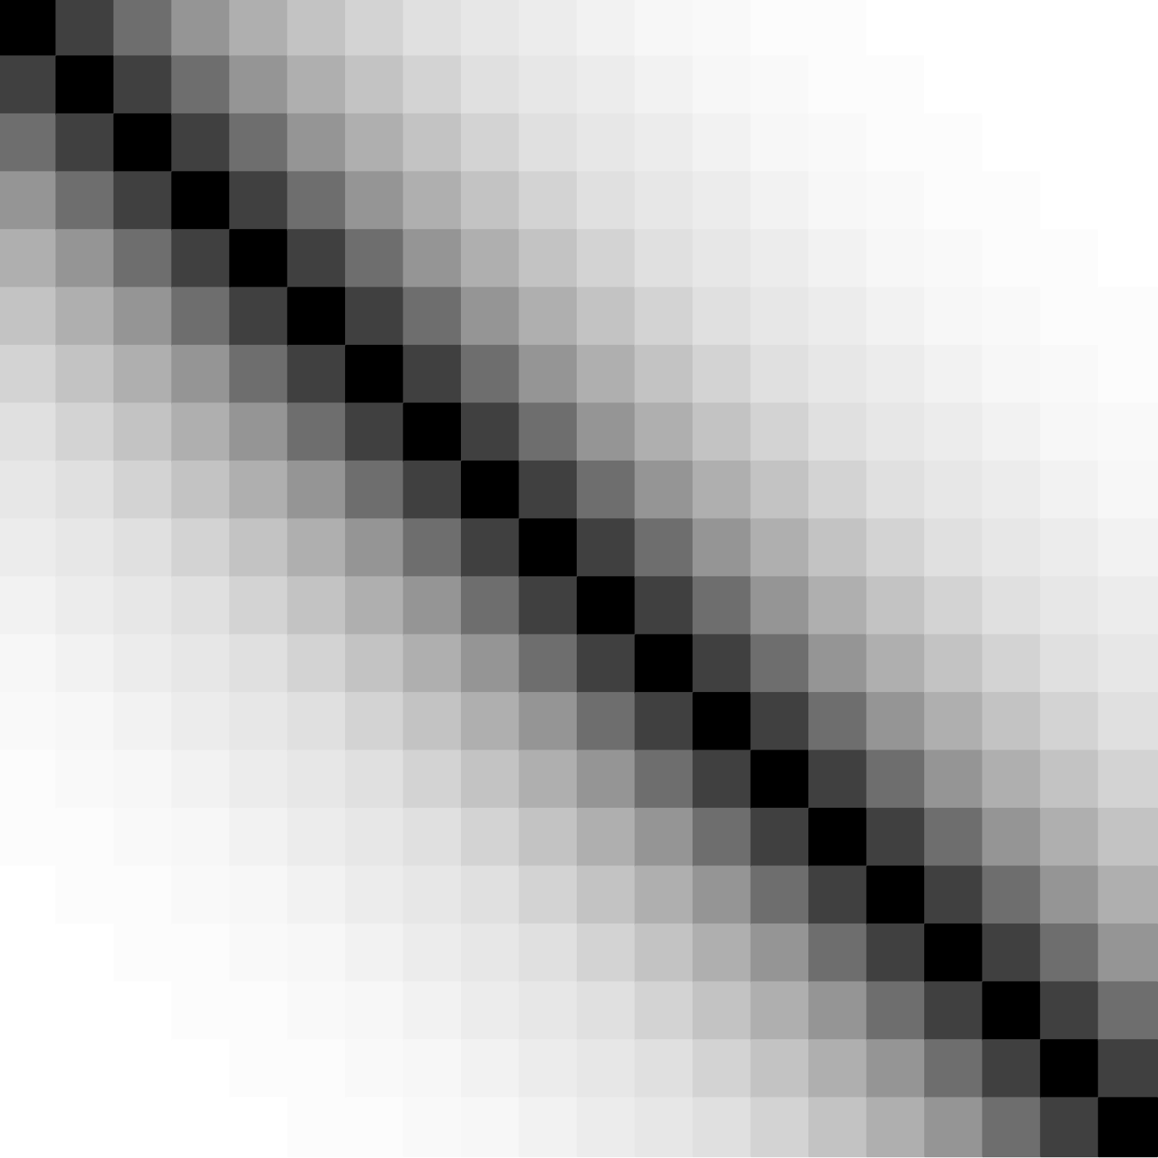
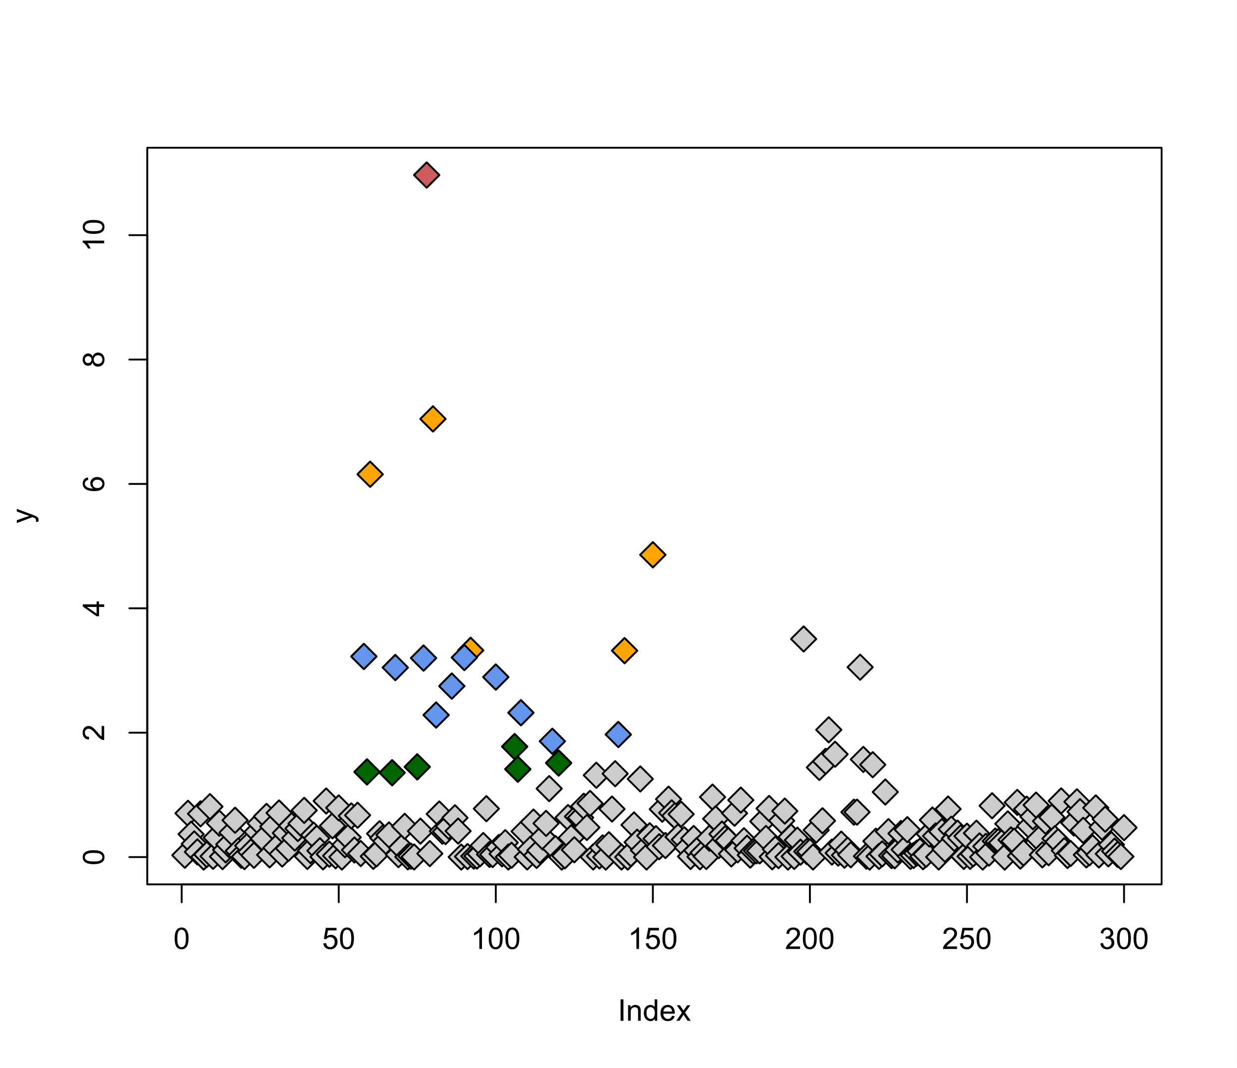




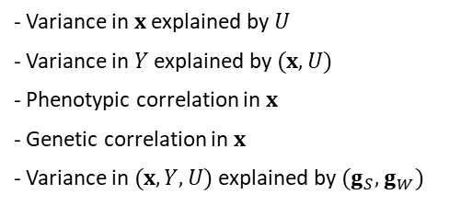


















Exposure(s) and outcome GWAS
Causal model for exposure SNPs and outcome
Selection of IV Set
Overlapping GWAS samples
$$γ^{C}$$
IV selection threshold
$$U$$
UHP
CHP
Valid IVs
Weak IVs
$$g_{S}$$
$$B_{strong}$$
$$Y$$
$$π_{x}$$
$$π_{Y}$$
$$X_{1}$$
$$θ$$
$−\log_{10}$ P-value
$$X_{2}$$
$$g_{W}$$
$$x$$
$$Y$$
$$⋮$$
$$⋮$$
$$B_{weak}$$
LD structure
$$X_{p}$$
$$γ^{U}$$
LD pruning of $r^{2}>κ$
- Variance in $x$ explained by $U$
- Variance in $Y$ explained by $(x, U)$
- Phenotypic correlation in $x$
- Genetic correlation in $x$
- Variance in $(x,Y,U)$ explained by $(g_{S},g_{W})$
- Number of causal SNPs ($g_{j}$’s)
- LD between SNPs in $g$
- Number of weak, UHP, & CHP SNPs
- Variance in $x$ explained by:
Weak SNPs, UHP $\left(γ^{U}\right)$, CHP $(γ^{C})$
- Significance threshold for IV selection,
based on test of:
$$H_{0j}:β_{j1}=β_{j2}=…=β_{jp}=0$$
- Joint test of association
- LD $r^{2}$ pruning threshold: $κ$
- Number of exposures
- GWAS sample sizes
- Exposure(s) GWASs overlap
- Exposure & outcome GWAS overlap
Users choose
Notes:
Far-right figure:
y=runif(500,-1,1)
y=abs(y)
y[50:150]=rnorm(101)
y[190:230]=rnorm(41,0,2/2.5)
y=y^2
y=y[1:300]
plot(y,pch=23,bg='gray80',cex=1.5)
leadix=which.max(y)
points(leadix,y[leadix],pch=23,bg='indianred',cex=1.5)
o=cbind(1:length(y),y); o=o[rev(order(o[,2])),]
o=o[o[,1]<180,]
fivemore=o[,1][2:6]
tenmore=o[,1][7:16]
fiveagain=o[,1][17:22]
points(fivemore,y[fivemore],pch=23,bg='orange',cex=1.5)
points(tenmore,y[tenmore],pch=23,bg='cornflowerblue',cex=1.5)
points(fiveagain,y[fiveagain],pch=23,bg='darkgreen',cex=1.5)

