Slide 1
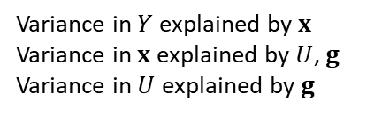
















$$γ_{C}$$
$$U$$
$$π_{x}$$
$$π_{Y}$$
$$B$$
$$θ$$
$$g$$
$$x$$
$$Y$$
Time in seconds to generate one simulated set of summary statistics
 |  | Size of 3 exposures and outcome GWAS
 |  | 10k | 20k | 30k | 40k | 50k
Number of instruments | 10 | 0.09 | 0.13 | 0.15 | 0.17 | 0.20
 | 50 | 0.19 | 0.31 | 0.45 | 0.59 | 0.70
 | 100 | 0.35 | 0.59 | 0.80 | 1.11 | 1.45
 | 250 | 0.83 | 1.42 | 2.03 | 2.83 | 3.84
 | 500 | 1.98 | 3.33 | 4.83 | 6.03 | 7.39
$$γ_{U}$$
Workflow
Setting overlap of GWAS participants
Variance in $Y$ explained by $x$
Variance in $x$ explained by $U$, $g$
Variance in $U$ explained by $g$
$$Y$$
$$X_{1}$$
$$X_{2}$$
$$⋮$$
$$⋮$$
$$X_{p}$$

Slide 2
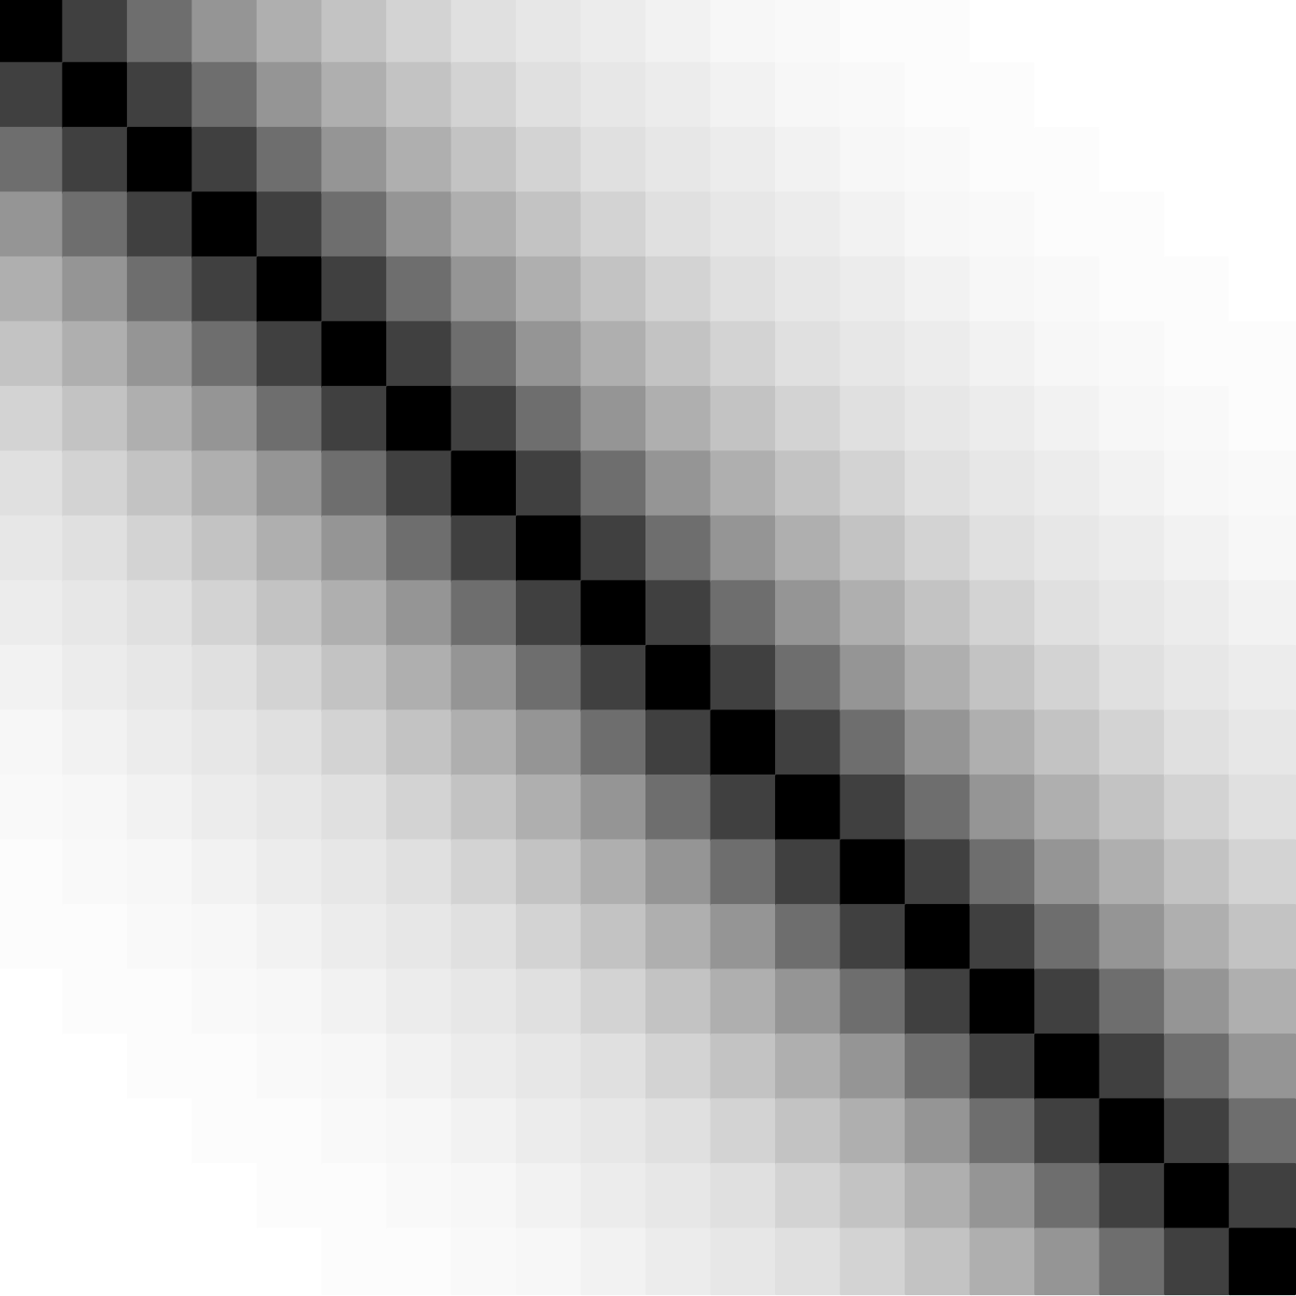



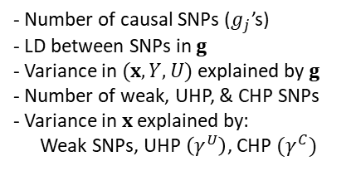
















Selection of IV Set
Exposure(s) and outcome GWAS
Causal model
$$γ^{C}$$
$$Y$$
$$g$$
$$B_{strong}$$
$$U$$
UHP
CHP
Valid IVs
Weak IVs
$$X_{1}$$
$$π_{x}$$
$$π_{Y}$$
$$X_{2}$$
$$g$$
$$θ$$
$$⋮$$
$$⋮$$
$$B_{weak}$$
$$x$$
$$Y$$
LD structure
$$X_{p}$$
$$γ^{U}$$
- Number of exposures
- GWAS sample sizes
- Overlap between exposure GWAS
- Overlap between exposure and outcome GWAS
- Variance in $x$ explained by $U$
- Variance in $Y$ explained by $(x, U)$
- Phenotypic correlation in $x$
- Genetic correlation in $x$
- Number of causal SNPs ($g_{j}$’s)
- LD between SNPs in $g$
- Variance in $(x,Y,U)$ explained by $g$
- Number of weak, UHP, & CHP SNPs
- Variance in $x$ explained by:
Weak SNPs, UHP $\left(γ^{U}\right)$, CHP $(γ^{C})$
Users set
Code

