Slide 1
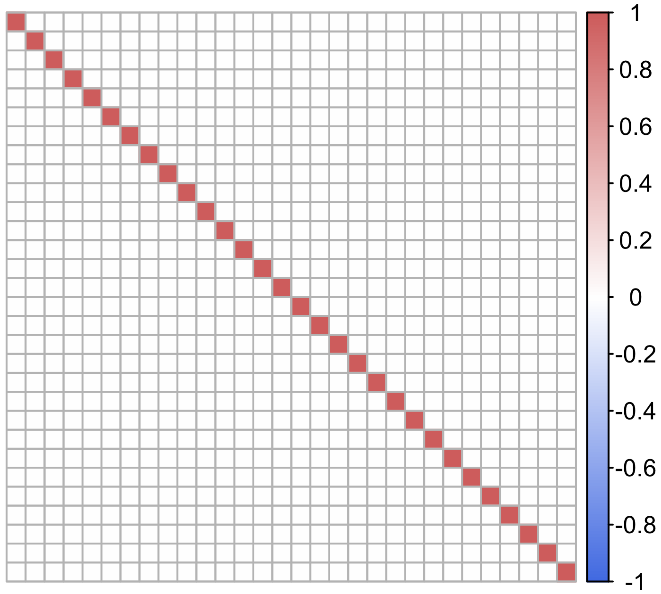
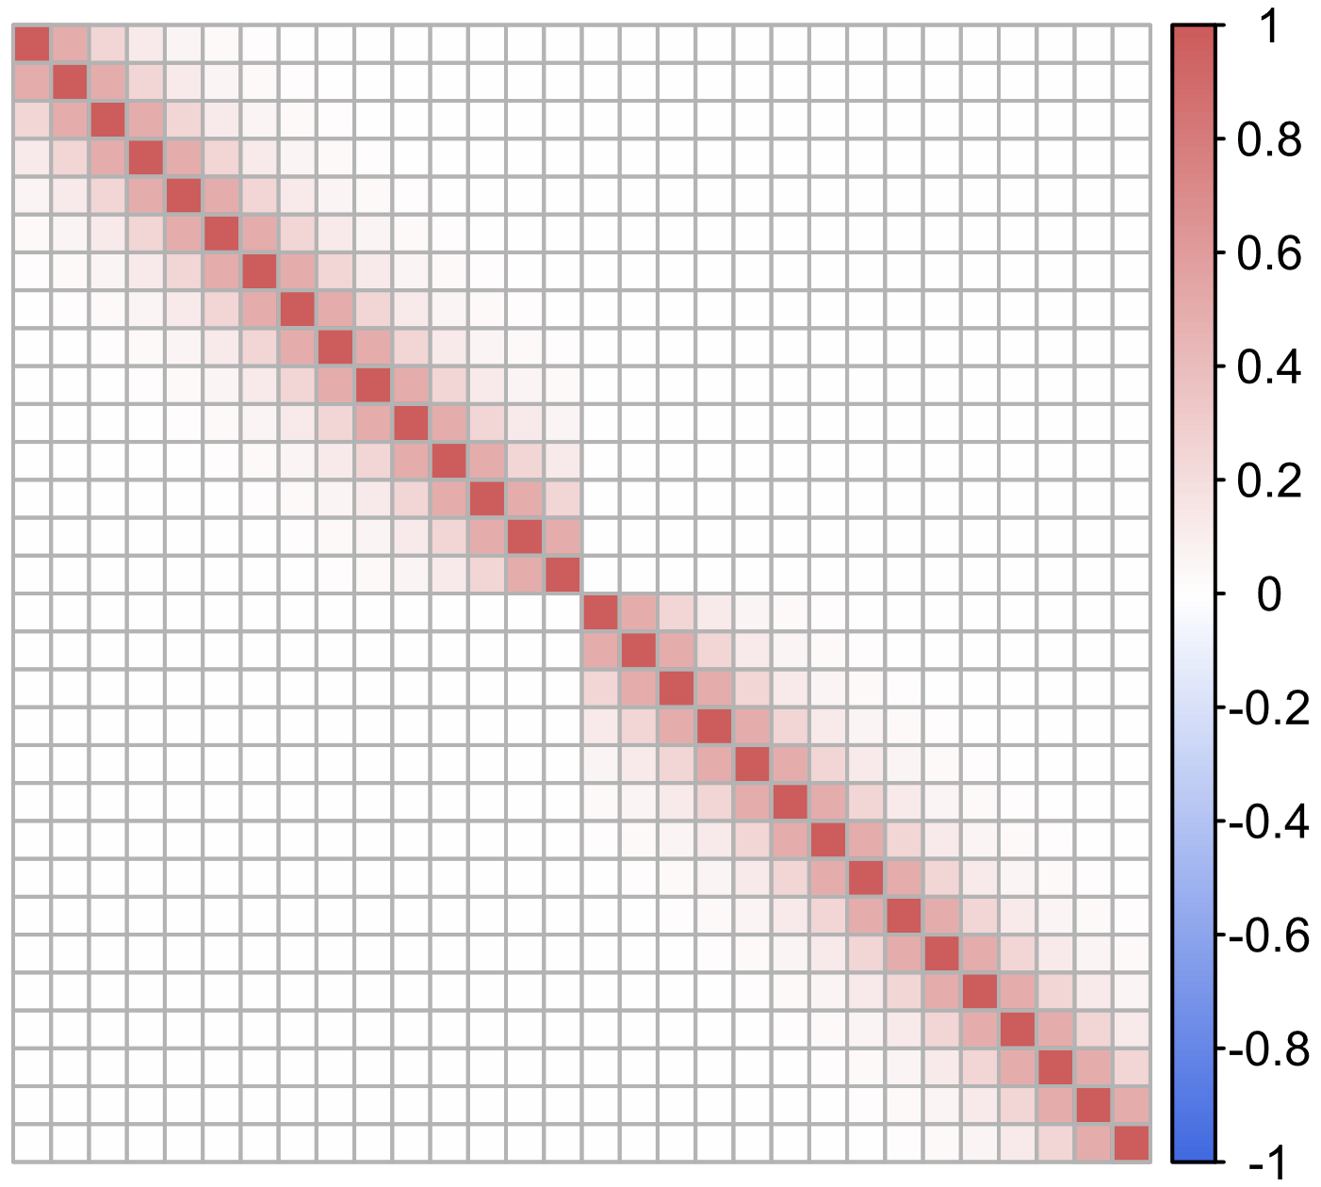
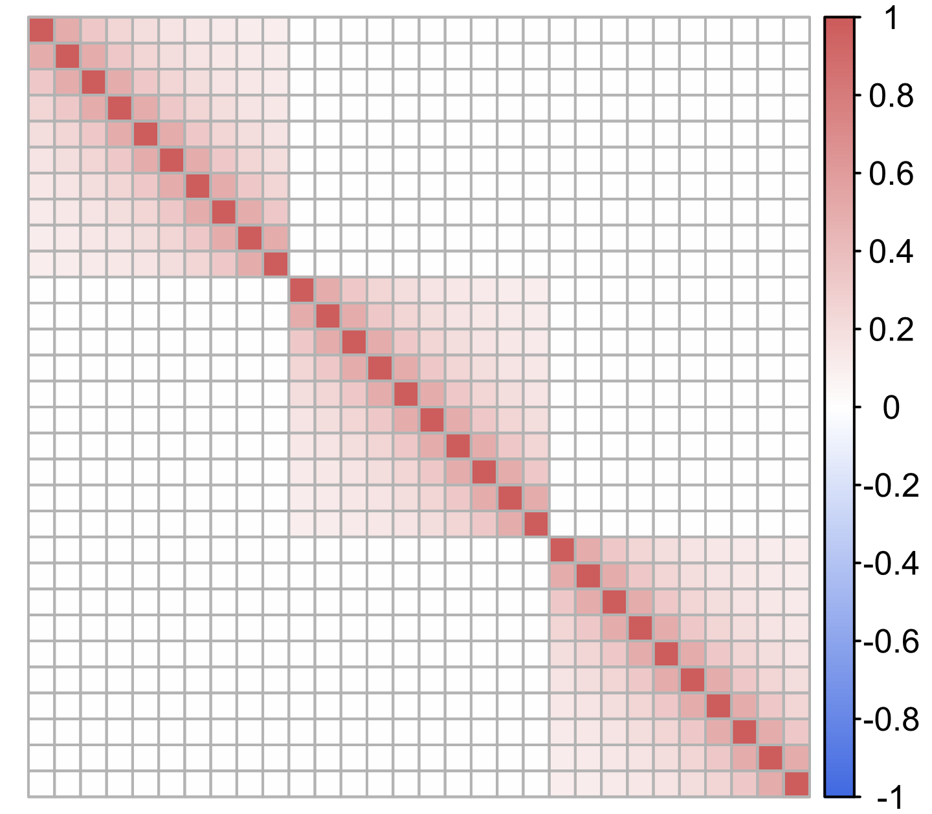
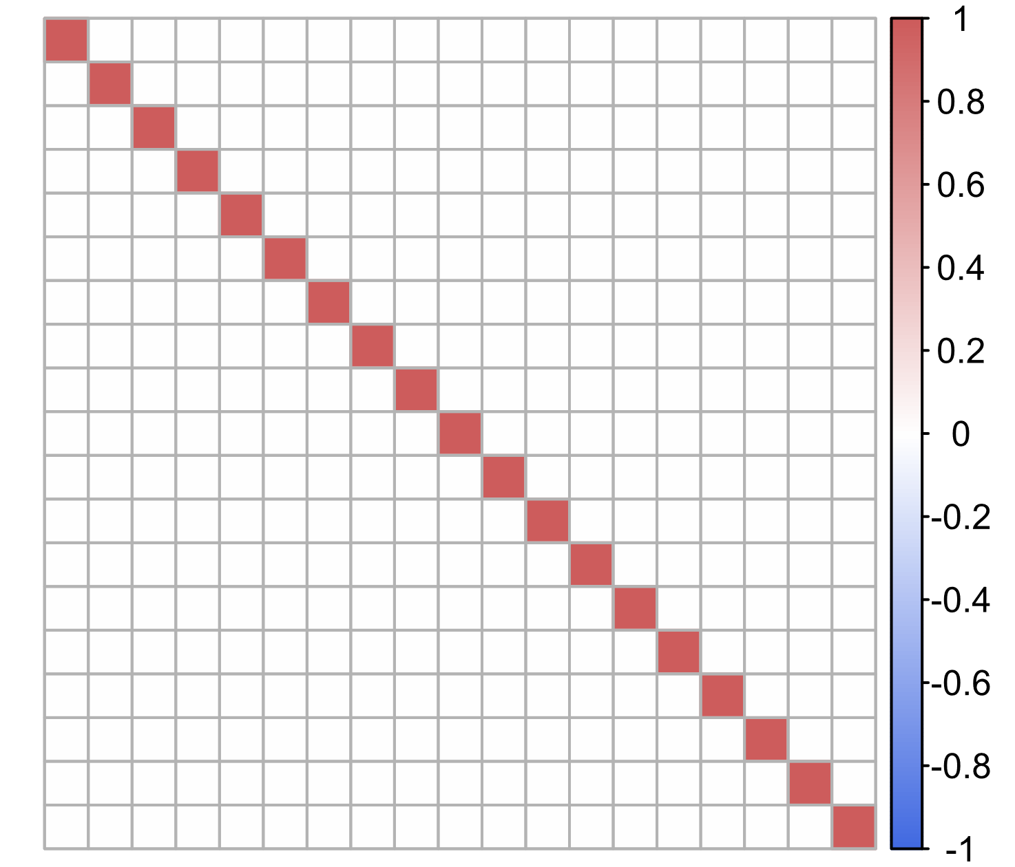
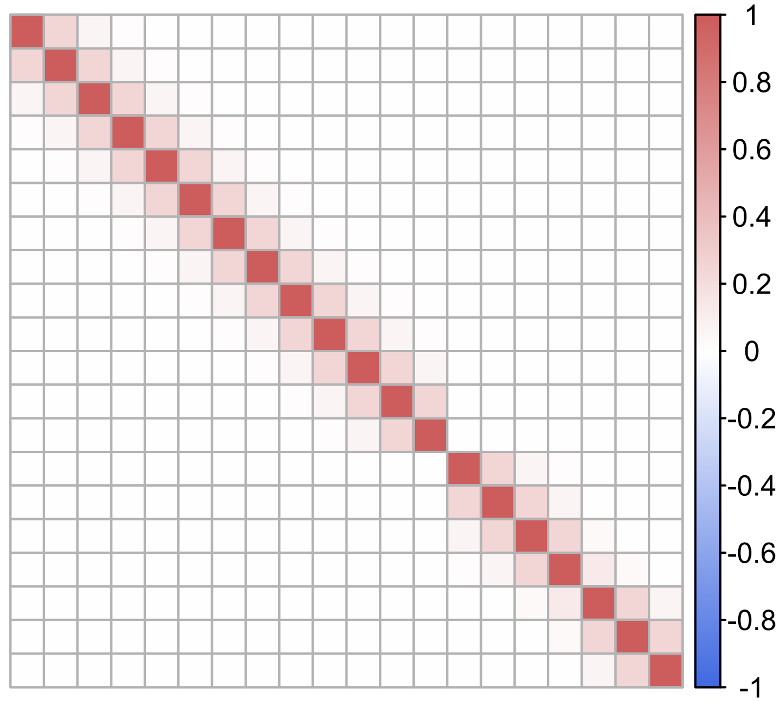
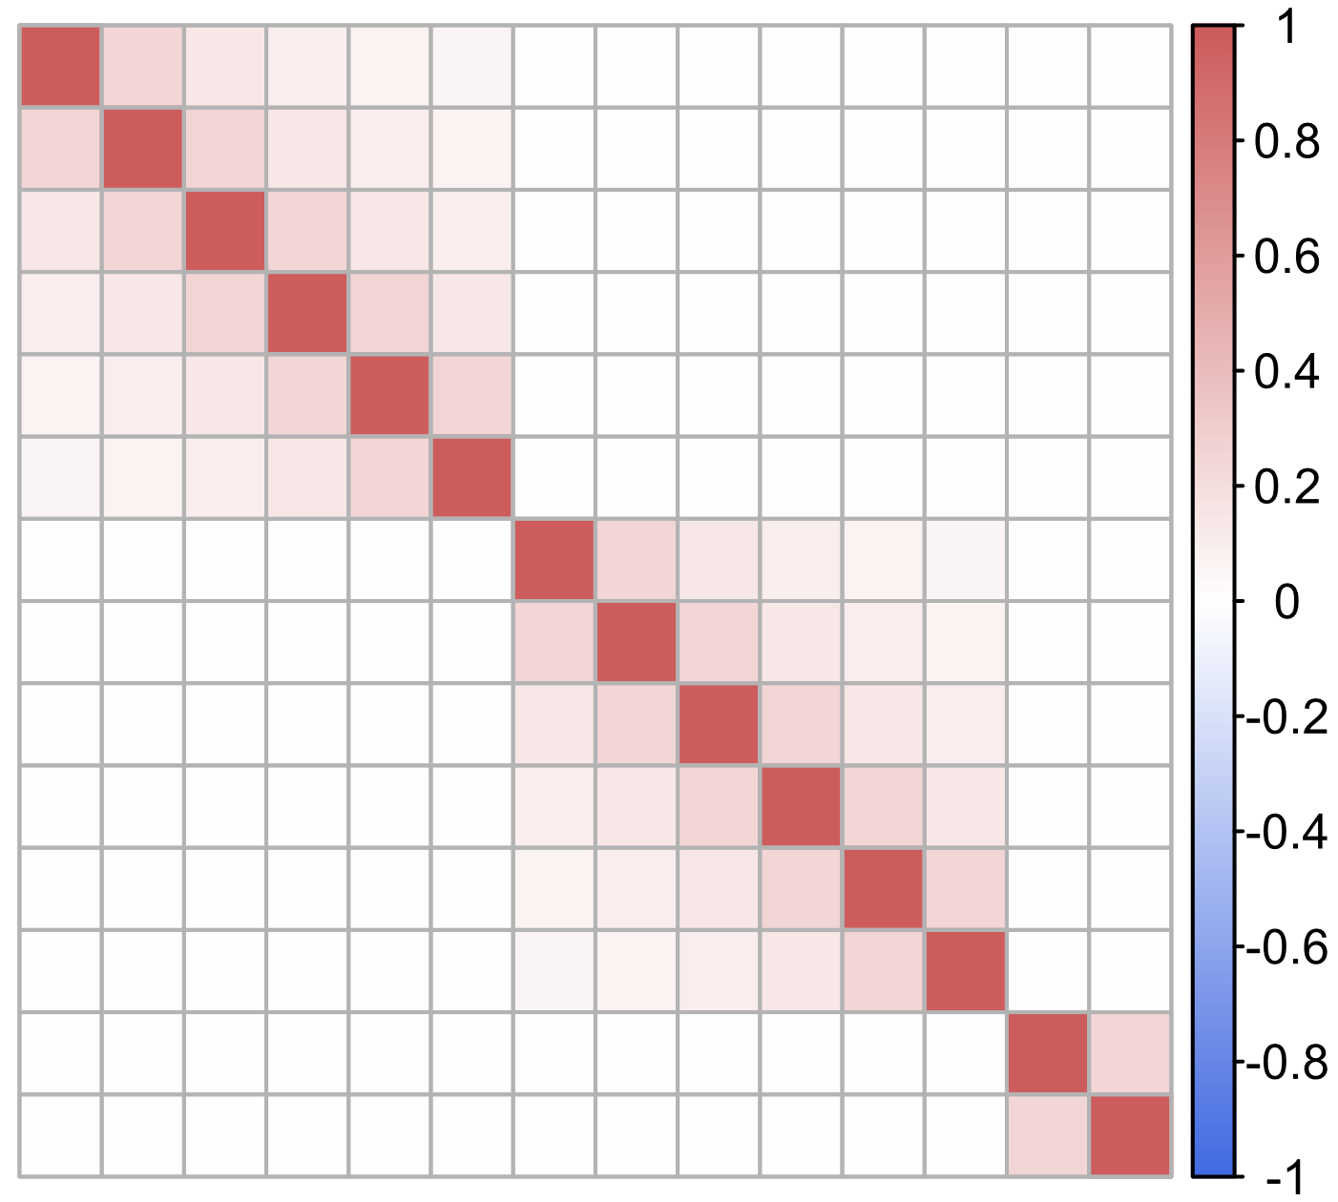
Independence
LD_causal_SNPs='I'
number_of_LD_blocks=1
Block-wise AR1(0.5)
LD_causal_SNPs='ar1(0.5)'
number_of_LD_blocks=2
Block-wise Toeplitz
LD_causal_SNPs='toeplitz'
number_of_LD_blocks=3
After applying LD pruning
IV_Pvalue_threshold=5e-8
LD_pruning_r2=0.1

