Slide 1
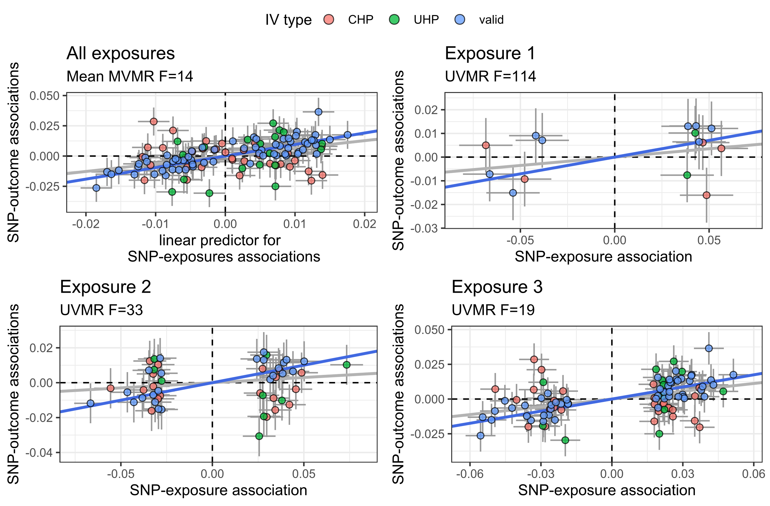
set.seed(74667)
library(MendelianRandomization)
library(simmr)
params=list(
sample_size_Xs=c(2e4,5e4,1e5),
sample_size_Y=3e4,
LD_causal_SNPs='ar1(0.5)', ...)
data=generate_summary(params)
obj=mr_mvinput(
bx=data$bx, by=data$by,
bxse=data$bxse, byse=data$byse,
correlation=data$LDhatMatrix)
plot_simdata(data,params)
mr_mvivw(obj)
mr_mvmedian(obj)
RhoME=data$RhoME[c(2:4,1),c(2:4,1)]
mr_mvcML(obj,n=2e4,rho_mat=RhoME)
MVMR Results |  |  | Exposure
 |  |  | 1 | 2 | 3
IVW | Estimate | Estimate | -0.305 | 0.014 | 0.202
 | P-value | P-value | 0.436 | 0.755 | 4.4E-7
MR Median | Estimate | Estimate | 0.017 | 0.142 | 0.198
 | P-value | P-value | 0.646 | 1.7E-5 | 6.1E-10
MR CML |  | Estimate | -0.017 | 0.103 | 0.215
 |  | P-value | 0.722 | 0.013 | 7.4E-13

