Slide 1

PayTrack
streamline payroll management by automating employee payments, tax deductions, leave tracking, and benefits contributions while ensuring accuracy and transparency through an audit trail.
Austin Chestnut
Jullian Phan
Noah Tubbs
Matthew Woodward

Slide 2

Conception
Need to address common inefficiencies in payroll management
Manual payroll often leads to errors
  Time delays
  Compliance issues
  Managing overtime
  Tax deductions
  Employee leave

Slide 3

Solution
Create an automated payroll
Easy to use
Friendly interface
Ensures
  Accuracy
  Transparency
  Accountability

Slide 4
Project
Overview
Objective:
Create a comprehensive, automated payroll management system designed to streamline the payroll process for organizations of all sizes.
Provide accurate, efficient, and transparent calculations of employee salaries, overtime, taxes, benefits, and deductions.
Maintain detailed audit trails to ensure compliance with financial regulations.

Slide 5

Features
Employee Management
Payroll Calculation
Leave & Attendance Tracking
Tax & Benefits Management
Audit & Compliance
Reports & Analytics
User Portals
  Admin
  Employee
  Audit
Notes:
Key Features:
Employee Management:
Stores employee information, including salary type (hourly or salaried), tax rates, hourly rates, and benefits.
Payroll Calculation:
Automatically calculates employee wages, including:
Base salary
Overtime pay (for hourly employees)
Bonuses and deductions
Tax and benefit contributions (e.g., pensions, insurance)
Leave adjustments (paid/unpaid leave)
Leave and Attendance Tracking:
Tracks employee attendance and calculates leave deductions based on leave types (e.g., paid, unpaid, sick leave).
Tax and Benefits Management:
Applies relevant tax rates and manages benefits contributions, ensuring the correct deductions for each pay cycle.
Audit and Compliance:
Provides a detailed audit trail of all payroll-related actions (creation, modification, deletion) to ensure transparency and accountability.
Reports and Analytics:
Generates detailed reports for payroll, taxes, overtime, and compliance. These reports can be exported in various formats for record-keeping and regulatory purposes.
User Portals:
Admin Dashboard: HR managers can generate payroll, manage employee details, review audit logs, and download payroll reports.
Employee Portal: Employees can log in to view and download their payslips, track leave balances, and see benefits information.
Audit Dashboard: Auditors can review historical payroll actions and generate compliance reports.

Slide 6
Admin
Login
Admin
Dashboard
Payroll
Calculation
Generate
Reports
Manage
Employees
Audit
Employee
Login
Employee
Portal
View Payslip
Download
Payslip
View Leave/
Benefits
Auditor
Login
Audit
Dashboard
View Audit
Logs
Generate
Reports

Slide 7
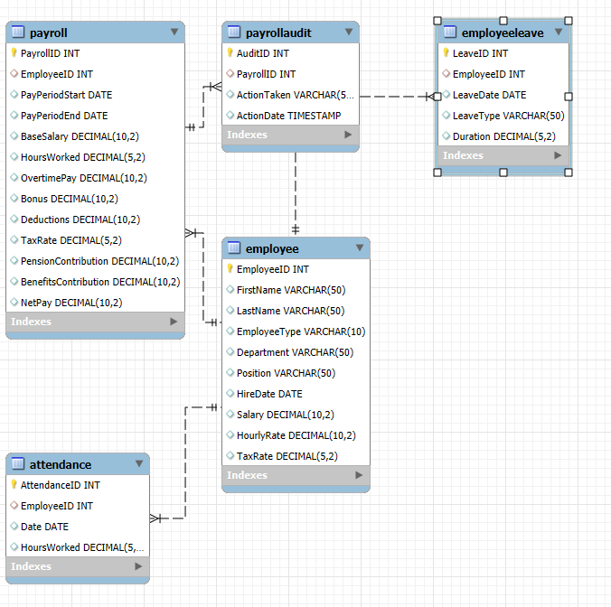
Schema using MySQL Workbench

Slide 8
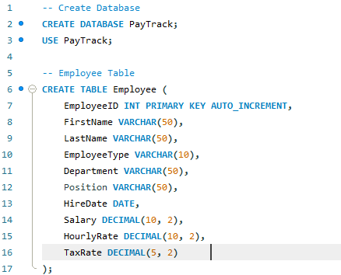
Employee Table code

Slide 9
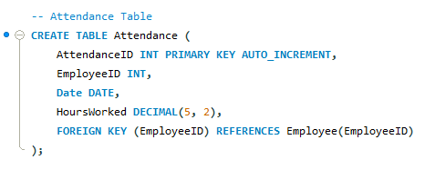
Attendance Table Code

Slide 10
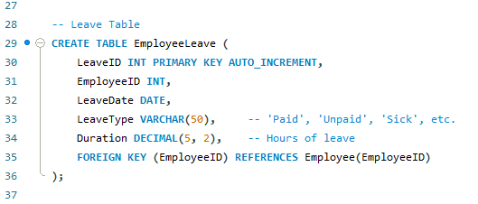
Employee Leave Table

Slide 11
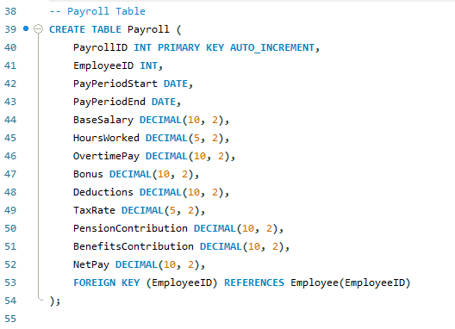
Payroll Table Code

Slide 12
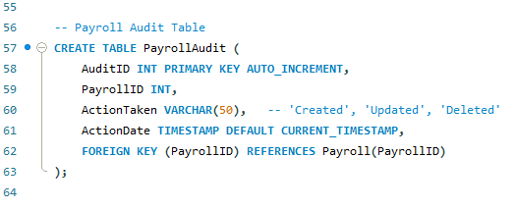
Audit Table Code

