Slide 1
On the weak diffusion
of the SEPAR cipher
Noah Ostle
UTS School of Computer Science
Supervised by Dr. Luke Mathieson
01
Notes:
In this work, we study the security of the SEPAR cipher from both a Linear perspective, and discuss earlier Differential cryptanalysis from the literature. We propose a key recovery algorithm that can recover the master key from as little as 2^27.8 chosen-IV chosen-Plaintext oracle queries.
We will discuss the weakness exposed by linear analysis, and describe the algorithm that exploits it.

Slide 2
Research background
2020
SEPAR proposal
Lightweight encryption for resource constrained IoT devices
2021
Differential security analysis
Claimed at least ten active S-boxes per rotor over four internal layers
Shakey justification for differential resistance, avoided necessary linear analysis
Research goal
Does the linear layer provide diffusion
as the security argument requires?
02
Notes:
SEPAR was proposed in 2020 by Vahi and Jassbi for devices with limited computing resources, particularly in the Internet of Things. The aim was to combine fast encryption with resistance to established attacks. As such, the paper argues how various properties of the cipher are designed to give resistance against a set of common weaknesses, and derives estimates that suggest the cipher has no better attack than bruteforce of the cipher’s 256 bit key.
The later differential analysis by Vahi and Mirnia argued that an XOR difference between two plaintexts has to pass through at least ten active S-boxes per rotor (Active meaning that the difference changes after both inputs are subsituted), or as there are 8 rotors in the cascade, 80 per encryption block.
However, The argument presented in their paper assumes good diffusion without proper justification for doing so. The work assumes that the bits are evenly mixed by the Linear Layer, and therefore the differences are too, and uses this assumption to estimate the differential resistance.
The lack of study on the Linear Layer despite using its assumed properties to justify security claims was the motivating factor behind my analysis of the cipher

Slide 3
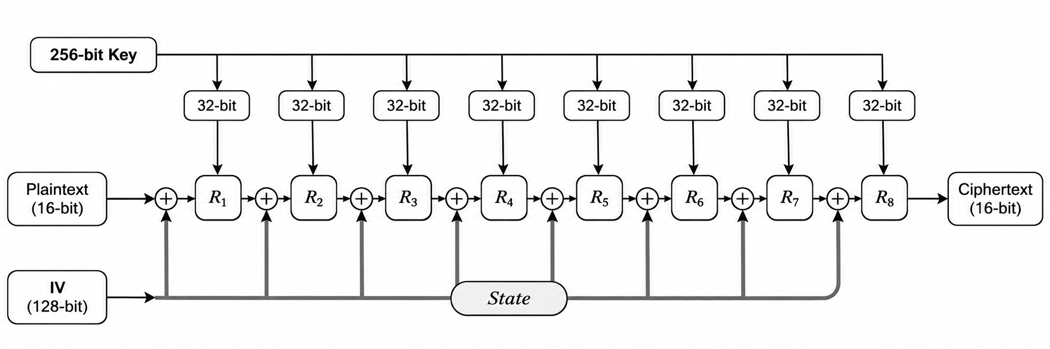
Research methodology
METHOD
01
Study the cipher
02
Analyse Linear security
Write recovery algorithm or
statistical tests
03
Prove new security bound
or report null findings.
04
03
Notes:
In order to properly assess the security of the cipher, my first step was to analyse its structure and understand the motivation behind each component, and what it added for security. SEPAR uses a 16-bit plaintext block size, a 256 bit key, and a 128 bit IV that goes through repeated transposition, substitution, and addition with a Linear Feedback Shift Register. Plaintext going through an encryption block passes through eight keyed "rotors“, as they are called by the authors, with a state addition before each rotor. Each rotor uses 32 bits of the master key.
My initial proposal for this research had a fairly rigorous methodology, with planning for an Agile process of iterative research and development and well structured timelines. In practice, however under scrutiny, the linear layer quickly yielded a significant weakness that was clearly worth pursuing, and the majority of the remaining time was spent engineering a recovery algorithm to exploit it, as doing so on the full cipher was significantly more difficult.

Slide 4
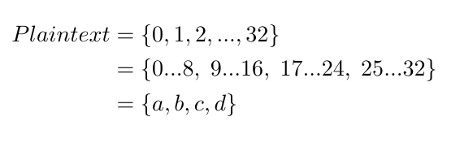
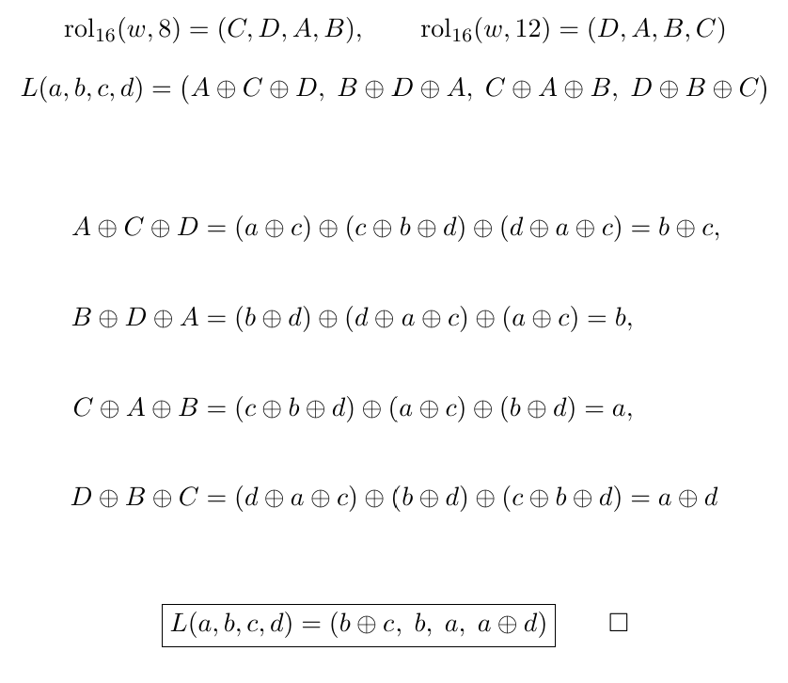
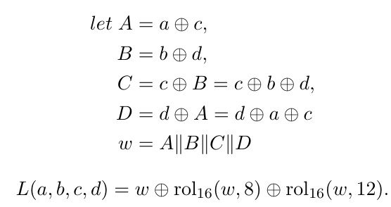
The Linear Layer
DEFINITION
ANALYSIS
04
Notes:
The analysis that I hinted to earlier which gave the strongest result was the work done on the Linear Layer. On the left, we see the definition of the SEPAR cipher’s linear layer.
In their definitions for upper A, B, C, and D, we see a well mixed linear layer, with the 16 bit block divided into four nibbles, and each nibble mixed with either 2 or 3 other nibbles.
Unfortunately however, SEPAR’s authors did not stop there, and added the result two itself passed through a ‘rotate left’ function twice. The problem here however is that both parameters for the size of the shift are divisible by four, and therefore act on nibbles rather than bits.
As you can see in my analysis on the right, these rotation functions are therefore able to be represented in terms of their upper A,B,C and D’s. We can therefore write the Linear Layer as an algebraic function of XOR’s working on the four nibbles of the plaintext. Algebraicly simplifying this function, we are left with the identity at the bottom, which does much less mixing even compared to the Upper A,B,C and D’s – that is, the rotation functions have cancelled some of the mixing out.
The second nibble is left completely untouched (which will have consequences for differential analysis as well), and the nibbles in general are mixed with only 2 or one other nibble. This Linear Layer is applied 4 times per rotor, but as we will that does not mitigate the weakness of the diffusion given here.

Slide 5
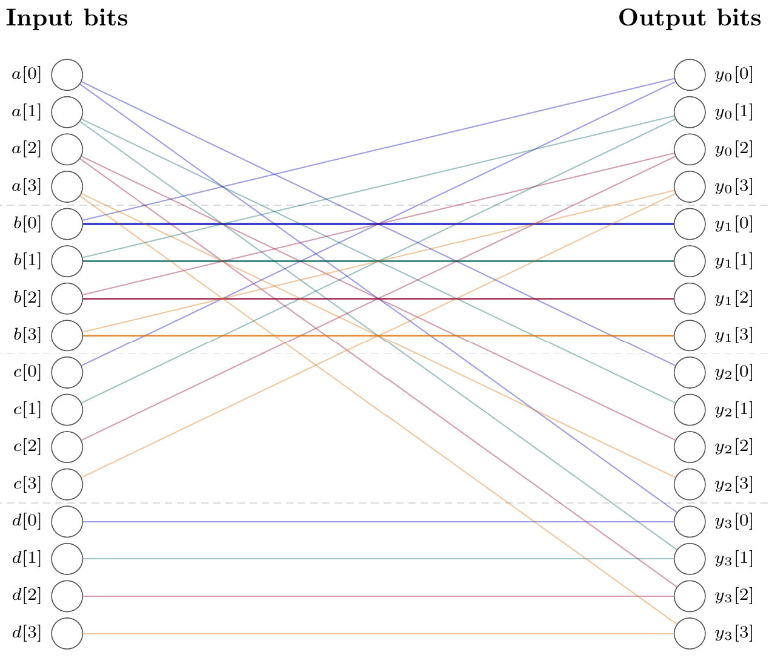
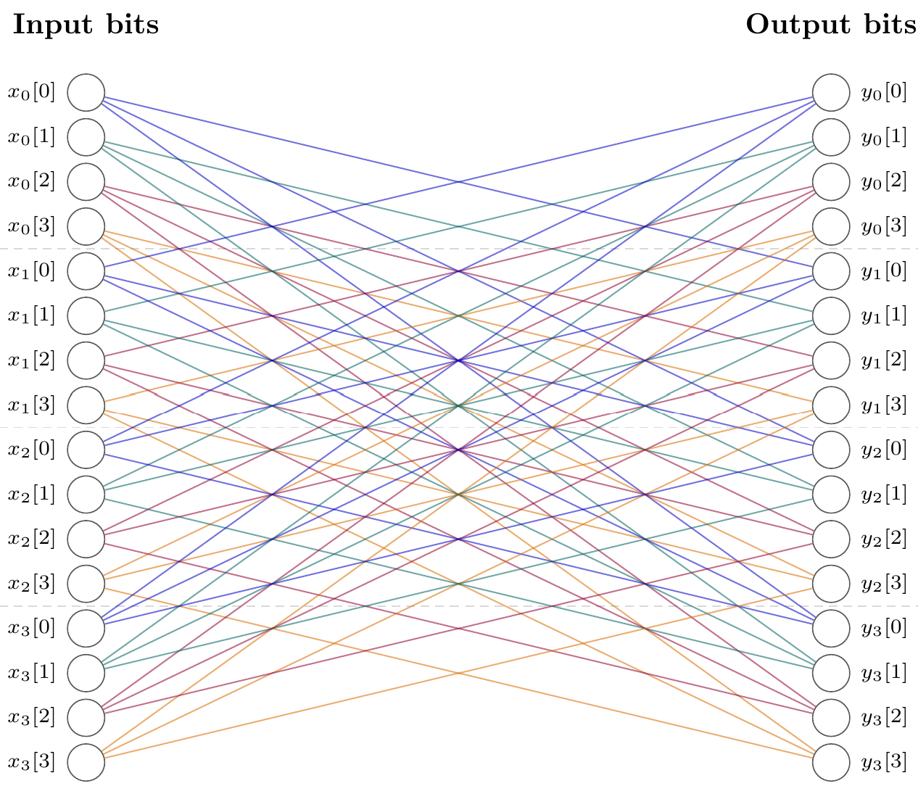
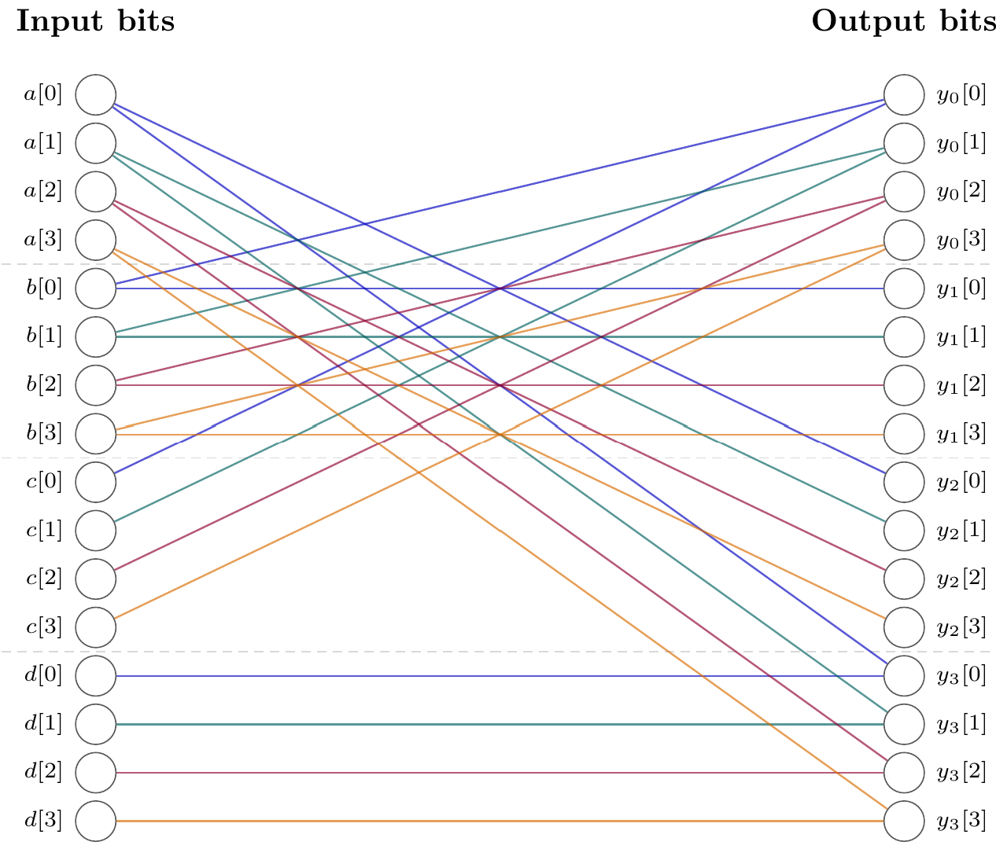
The Linear Layer
SEPAR
MIDORI64
04
Notes:
Here is a diagram of SEPAR’s 16 bit linear layer, compared to a another 16-bit block cipher, Midori64.

Slide 6
The Linear Layer’s affect on the Rotor
Layers | First output | Second output | Third output | Fourth output
0 | a | b | c | d
1 | b, c | b | a | a, d
2 | a, b | b | b, c | a, b, c, d
3 | b, c | b | a, b | a, b, c, d
4 | a, b | b | b, c | a, b, c, d
b remains unmixed
Changing d leaves the first twelve output bits unchanged
-> Poor Diffusion
05

Slide 7
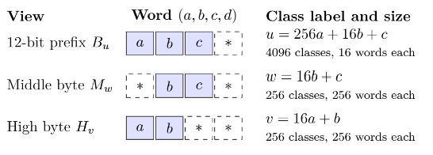
Preserved Classes
We define these classes.
The classes above are preserved exactly.
The rotor will permute these classes
The mapping/order of classes depends on the key, decoding it gives key information
06

Slide 8
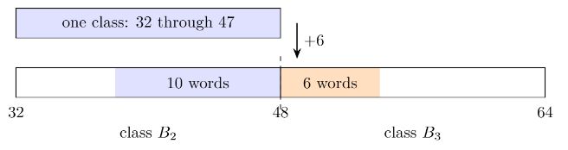
State Additions
State additions are performed between each rotor, of which there are 8 per Enc block
They can shift points out of their class
Use the oracle to find IV’s that don’t disturb the classes too much
07

Slide 9
Generating outer key candidates
01
Read the class mappings of the outer rotor
By querying the oracle and tracking the outputs against the input classes
02
Guess partial rotor subkeys based on b
Plaintext b only touches four nibbles of the subkey due to poor diffusion.
03
Filter guesses using the class mappings
Calculate the cycles induced by the guess and compare it to the observed mappings.
04
Extend into full rotor subkeys through key schedule
Reverse the SEPAR key schedule to create full key candidates through the partial keys
05
Filter full subkeys using class mappings
As in 03.
06
Repeat for all 8 rotors
And the full key is recovered
09

Slide 10
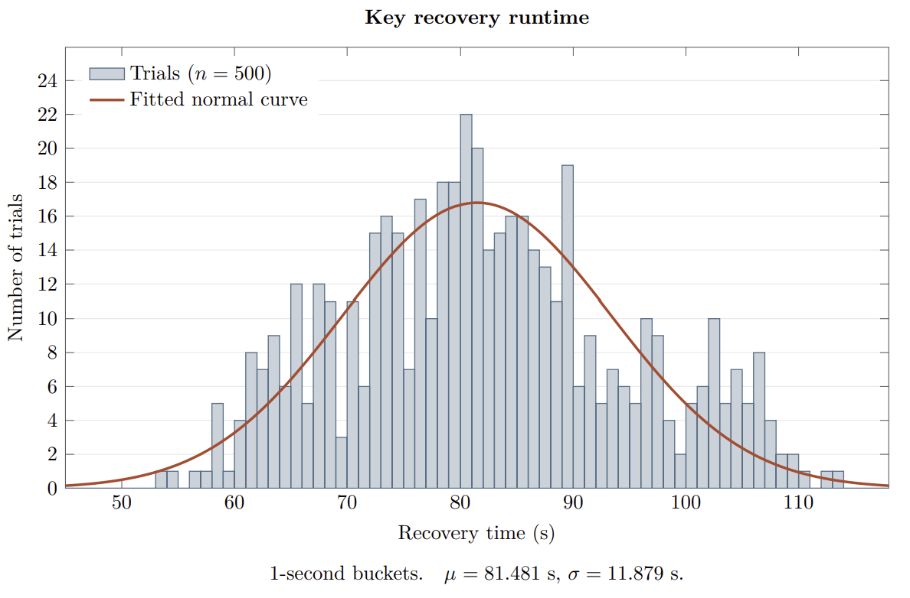
500 trials each returned one key
81.48 s
Mean wall time
≈2^{27.83}
Mean oracle queries
(16-bit data)
Single threaded AMD Ryzen 9 8945HS
10

Slide 11
Success Bound
≥ 99.9999983%
Probability that the returned list contains the true master key
≈2²²
≈2²³
outer IVs
inward IVs per outer candidate
Open question: a general bound on the number of surviving keys
11

Slide 12
Implications for SEPAR's security
Differential resistance
Proven contradiction on later work by the same author “On the Differential Cryptanalysis of SEPAR Cipher”, Vahi and Mirnia.
Linear analysis
While this attack requires certain conditions to be practical (chosen IV, ability to perform millions of queries), this paper has demonstrated a severe weakness in diffusion.
Security claim
The proposed ≈2²⁸ attack is a significant weakening compared to bruteforce (2²⁵⁶)
12

Slide 13
Conclusions and next work
Regardless of the attack engineering, the Linear Layer is enough justification to not use this cipher.
NEXT WORK
Bound the number of surviving keys
Study a differential attack on the full cipher
13

