Slide 1
Mini Project – update Progress
Group 2
Shantnu Bhalla , Kingsley Ho , Umur Kose , Lynn Pham , Noah Provenzano
Notes:
Hi everyone, this is Group 2's quick update on our mini project.
We’re experimenting with different ways to make large language models reason more effectively.
The idea is to build two model variants and compare how they perform when solving problems that require deeper thinking.

Slide 2
MISSION STATEMENT <Why We’re Doing This?>
LLMs today “think” by spitting out long chains of text (CoT) → expensive, memory‑hungry
Hypothesis: Let them “think harder” internally instead of talking out loud
Goal: Compare internal (latent) reasoning vs. external (token) reasoning
Notes:
Traditional language models solve complex problems by generating long outputs, like a step-by-step explanation.
This chain of thought” method works, but it’s expensive in terms of memory and compute.
We’re exploring an alternative: instead of thinking out loud, can the model think silently, deeper in its own hidden space?
This could lead to smaller models that still perform well on tough reasoning tasks.

Slide 3
Project Goal
Build and benchmark two model variants on the same data base on measurement of accuracy, perplexity, and compute efficiency
loop in hidden space before decoding
Latent‑recurrence
loop by feeding back tokens (CoT style)
Token‑recurrence
Notes:
We’re testing two different test-time reasoning strategies, using the exact same model architecture.
First is latent-space recurrence: the model loops internally before speaking, kind of like silently thinking something over.
Second is token-space recurrence: the model generates intermediate reasoning steps as tokens, like traditional chain-of-thought.
We want to see which method leads to better accuracy, lower perplexity, and less compute needed per task.

Slide 4
Data & Loader
nampdn-ai/tiny-strange-textbooks

Slide 5
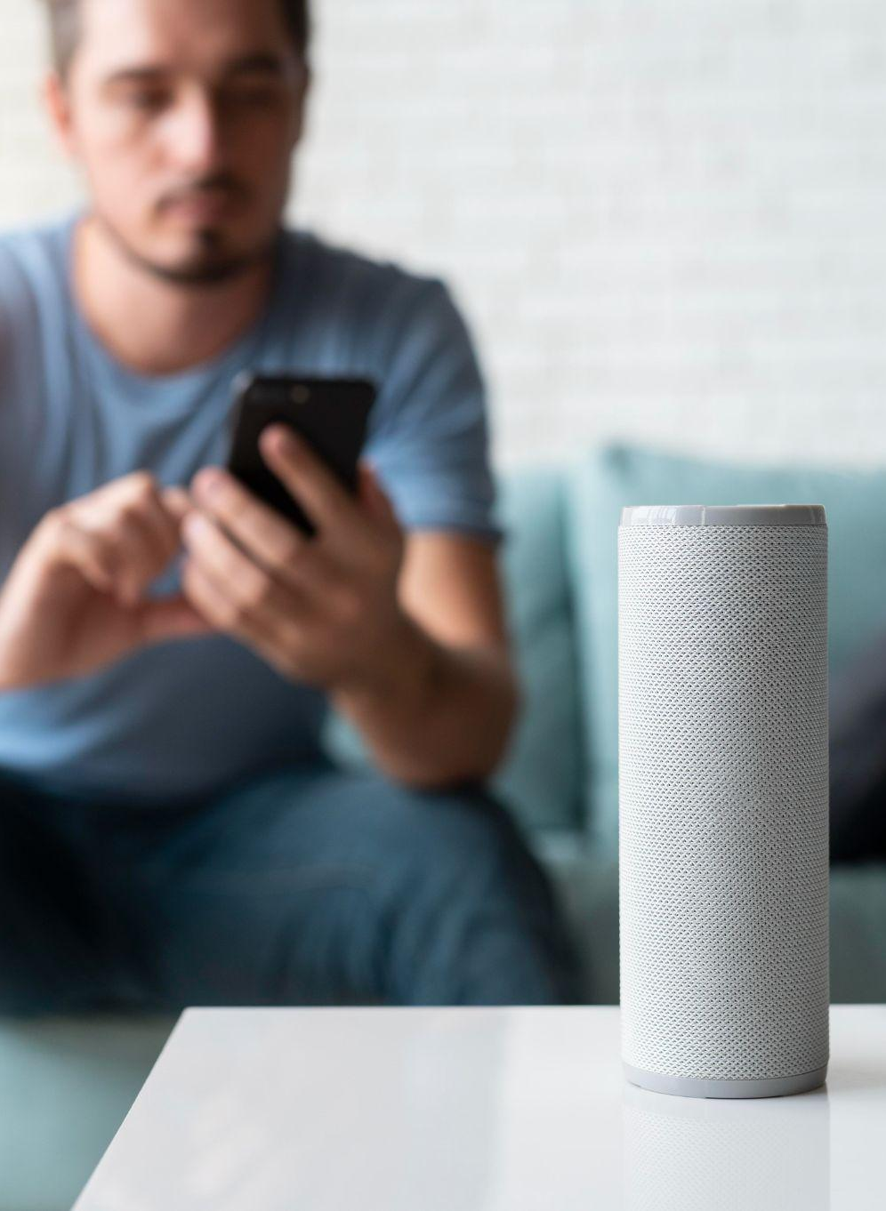
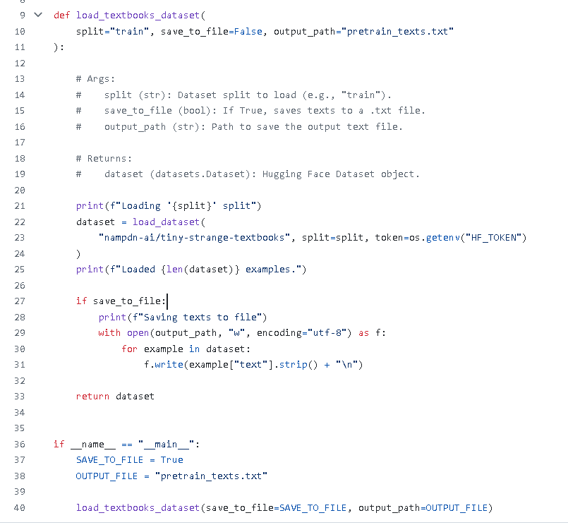
Data
Name & Link: nampdn-ai/tiny-strange-textbooks
2.7 million fully synthetic “tiny” textbooks (AI‑generated), totalling ~16 GB of raw text
Field: text (string) - the full contents of each mini‑textbook
Languages: English
License: Apache‑2.0
Notes:
For training, we’re using the Tiny Strange Textbooks dataset from Hugging Face.
It’s fully synthetic, around 2.7 million short textbooks, covering a variety of topics.
The text is clean and varied, making it a great fit for early-stage pretraining.
We load it using datasets.load_dataset and save the contents into a .txt file for simplicity during training.
This gives us an efficient way to pretrain both model variants without needing massive hardware.

Slide 6
Model
Variant A:
Variant B:
Latent‑Space Recurrence
Loop the Core block r > 1 times at test time
“Think” internally before emitting each token
No change to output length—extra compute in hidden space
Token‑Space Recurrence
Run the Core block once per generated token
Feed each generated token back into the Prelude
Simulates a Chain‑of‑Thought by extending the sequence
Notes:
Model code is actively being built
Will include both variants with the same architecture and training loop
Once code is ready, we’ll start training both models and run evaluations

Slide 7
Model Code (to be added)
MERCURY
VENUS
MARS
It’s the closest planet to the Sun and the smallest in the Solar System
Venus has a beautiful name and is the second planet from the Sun
Despite being red, Mars is actually a cold place. It’s full of iron oxide dust

