Slide 1

Ph.D. Qualifying Exam
Watch2Track: Smartwatch-Smartphone Monitoring of Daily Energy Intake
Brycen Havens & Noah Carter
1

Slide 2
Real-World Relevance
World prevalence: 2.5 billion adults (43%) are overweight, and 880 million adults (16%) are obese (WHO 2024).
Marie N, et al. "National-level and state-level prevalence of overweight and obesity…" Lancet, 2024.
2

Slide 3
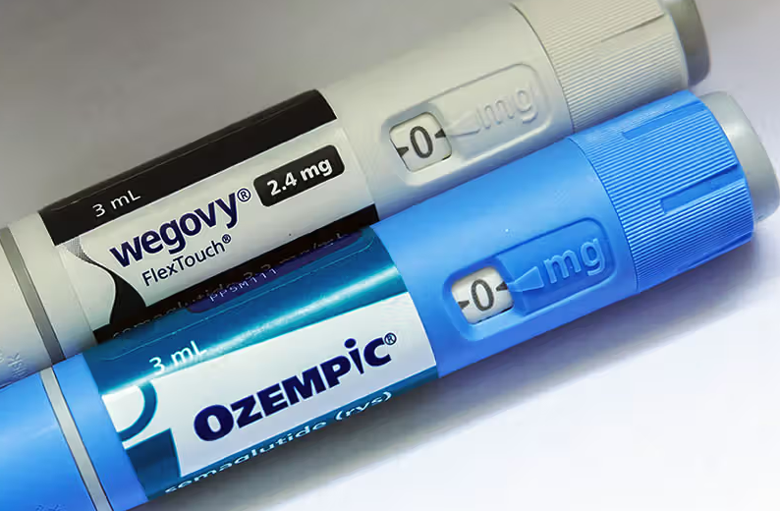
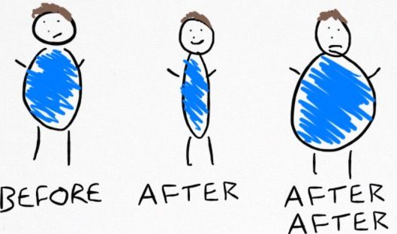


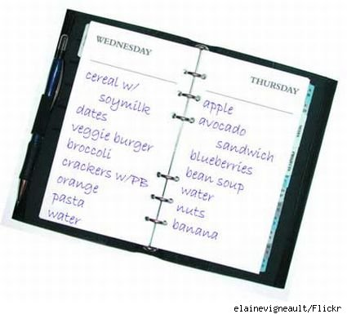
Modern Day Solutions and Limitations
Solution: GLP-1 Drugs
Pro: Shown to be effective for weight loss [1]
Con: Weight regain is common after stopping GLP-1 [2]
Solution: Self-monitoring
Pro: Associated with successful weight loss/maintenance [3]
Con 1: Difficult to maintain over long period of time, low compliance
Con 2: Underestimation/underreporting bias (dozens of studies show ranges from 10-50%)
[1] Moiz A, et al. "The expanding role of GLP-1 receptor agonists: a narrative review …“, Lancet 2025.
[2] Wilding J, et al. "Weight regain and cardiometabolic effects after withdrawal of semaglutide" Diabetes, Obesity and Metabolism 2022.
[3] Paixão, Catarina, et al. "Successful weight loss maintenance: a systematic review of weight control registries." Obesity Reviews vol. 21 no. 5, 2020.
3

Slide 4
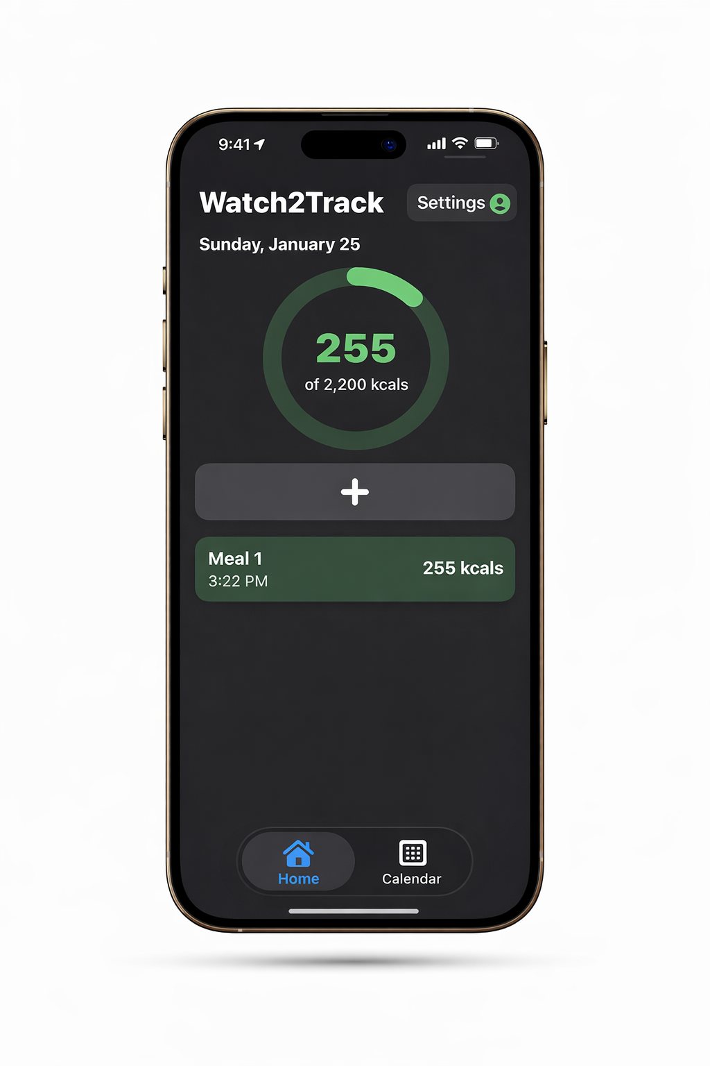
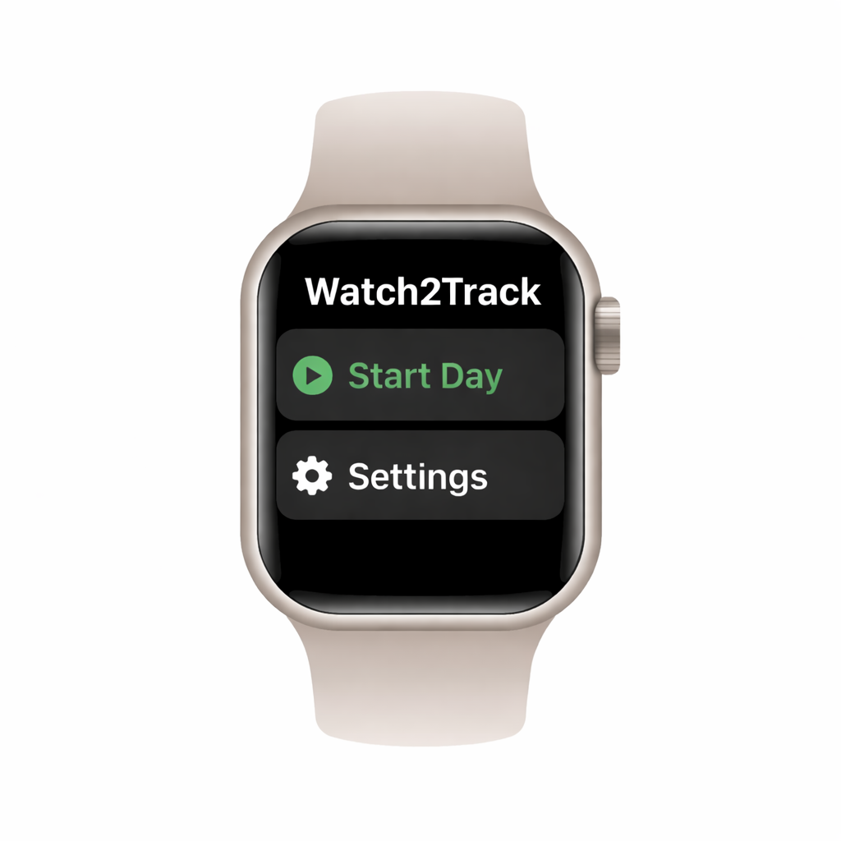
Our Solution to Self-monitoring Limitations
Watch2Track
Smartwatch-Smartphone application available on Apple and Android devices
Automates detection and estimation of meal calories
Designed to reduce burden and support long-term compliance
Sensor-based EI estimation to reduce underreporting bias found in self-monitoring
4

Slide 5

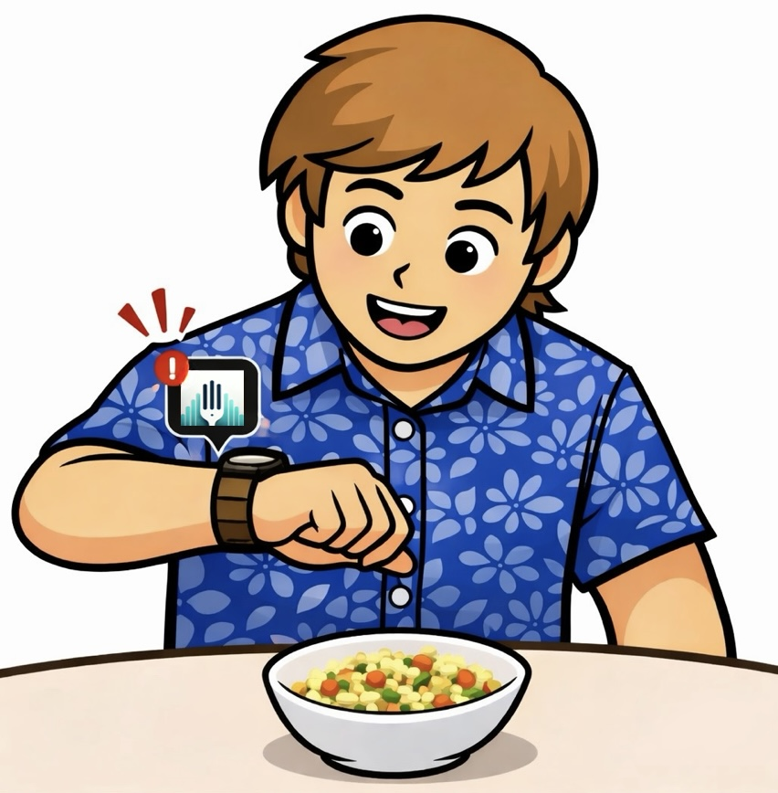
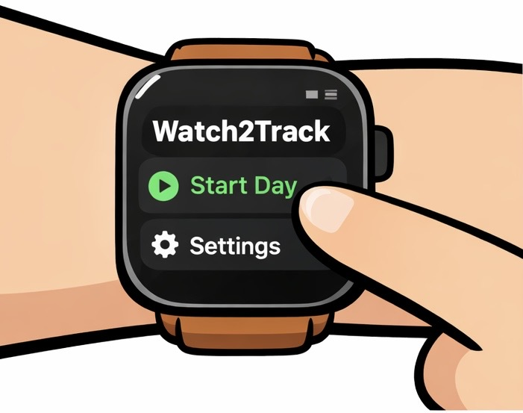
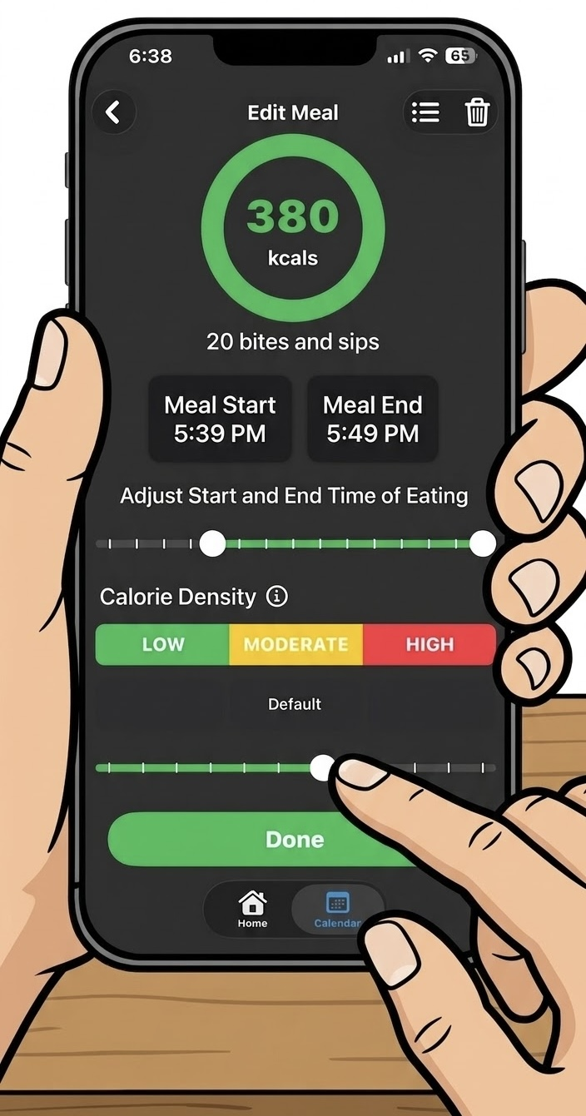
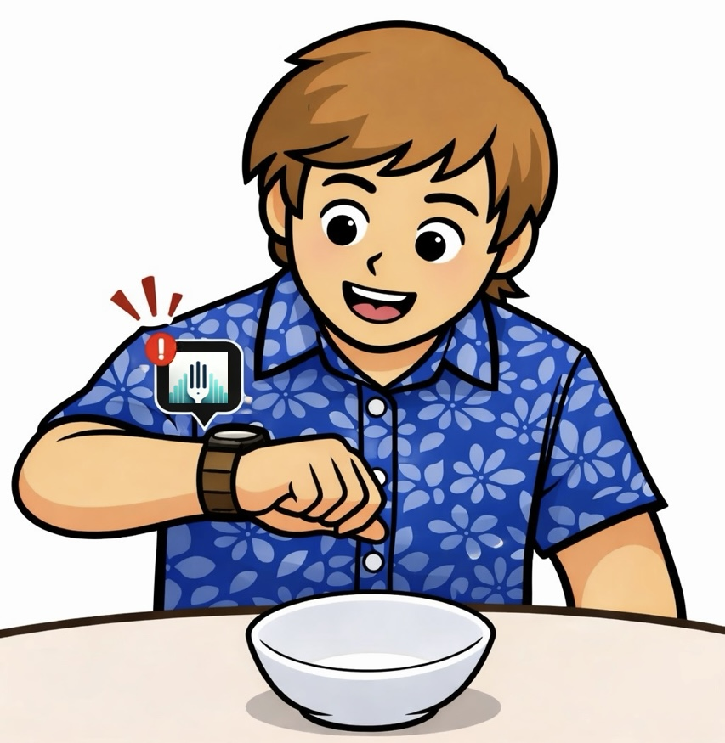


Daily User Experience
Meal Detected / Start Meal
Put on watch
Start Recording
End of meal detected / End meal
Eat Meal
Adjust meal
5

Slide 6
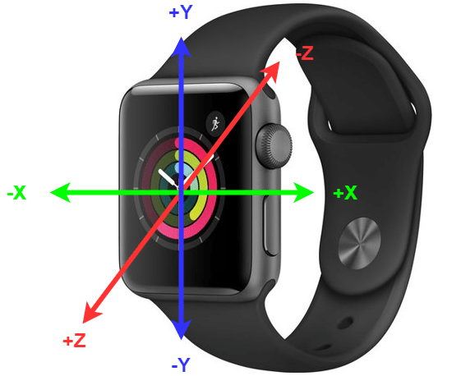
Watch2Track Core Components
IMU data acquisition from smartwatch
Accelerometer (a_{x},a_{y},a_{z})
Gyroscope (g_{x},g_{y},g_{z})
Eating detection model [4]
Detects when eating is occurring
Inferenced in real time on smartwatch
Bite detection model [5]
Detects number of intake gestures (bites)
Inferenced post-meal on smartphone
Acquire IMU data
Eating Detection Model
Detect meal start/end
Bite Detection Model
Estimate bites within meal
[4] Sharma et al. Top-down detection of eating episodes by analyzing large windows of wrist motion using a convolutional neural network. Bioengineering, 9(2):70, 2022.
[5] James Jolly et al. TallyNet: Detecting intake gestures as a variable count of events during a window of time. Unpublished manuscript, submitted for publication.
6

Slide 7
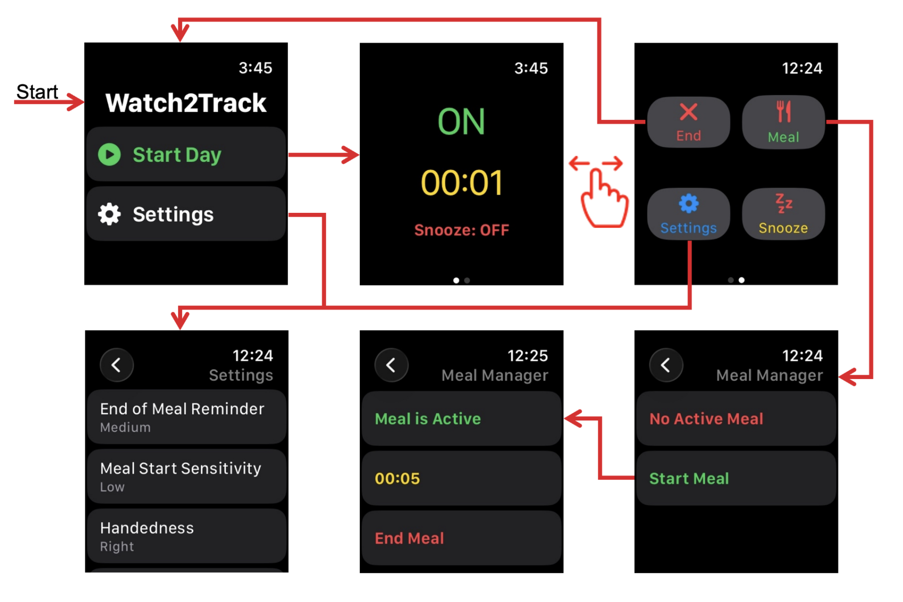
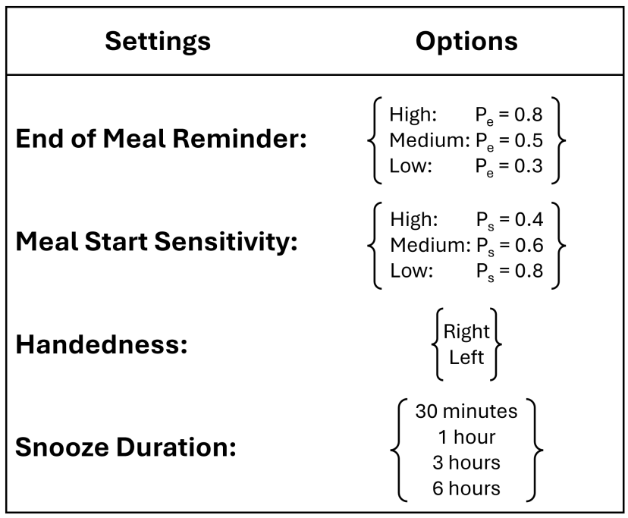
Watch App Design
10

Slide 8
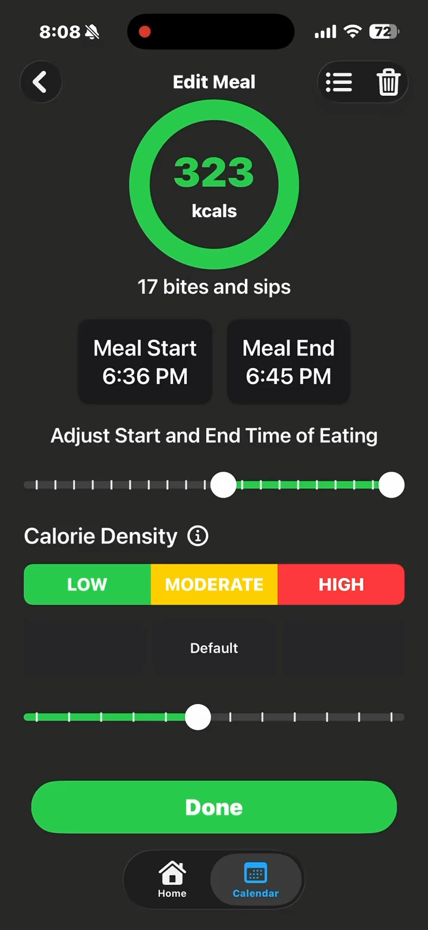
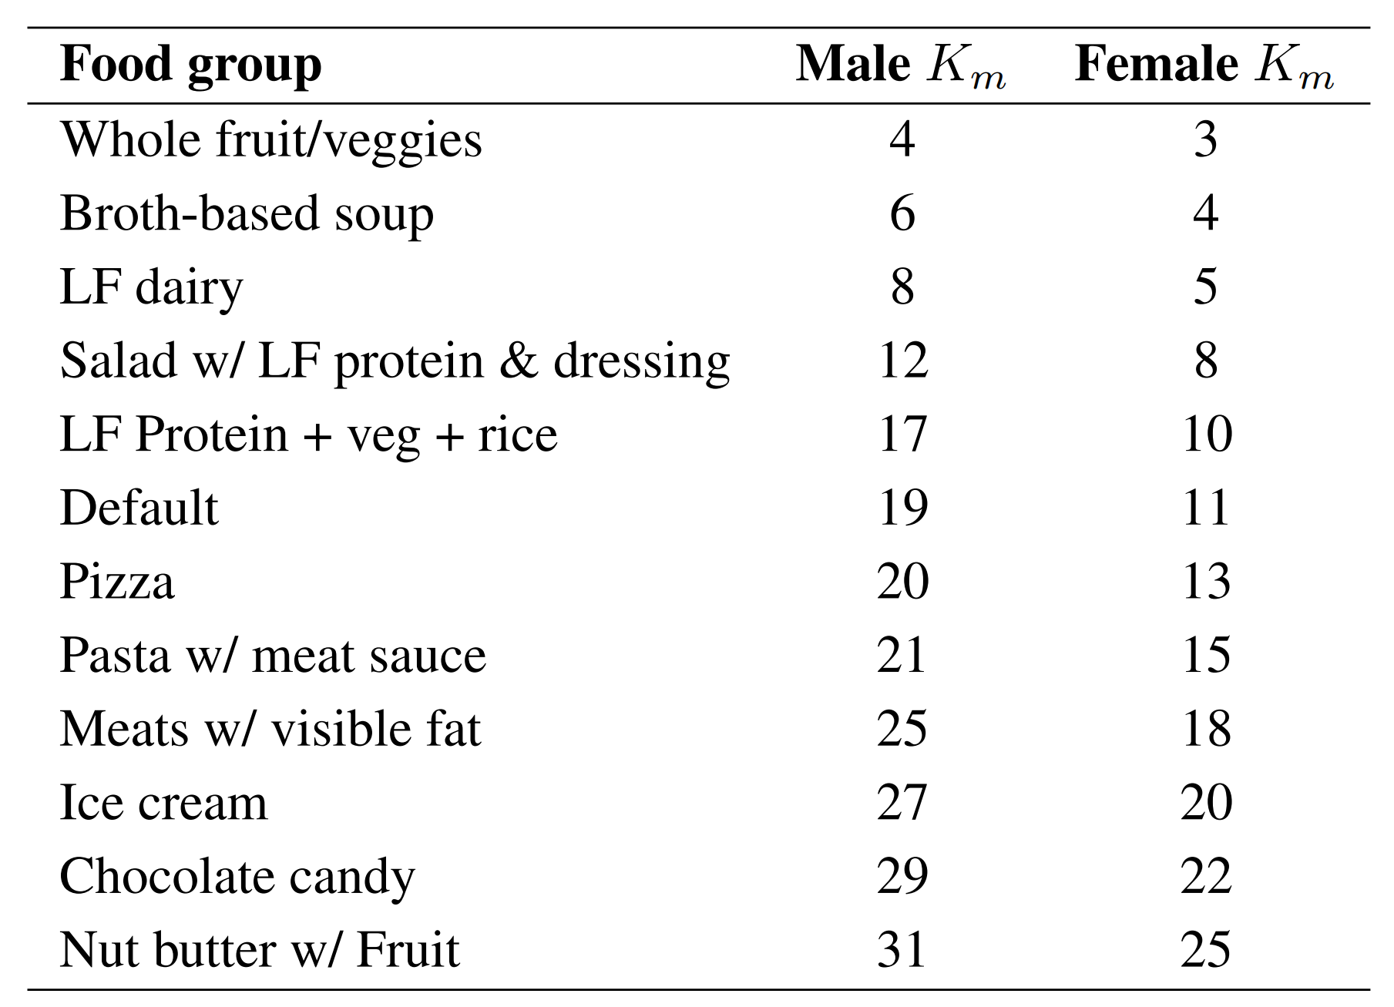


Meal Refinement: KPB Bar
11

Slide 9
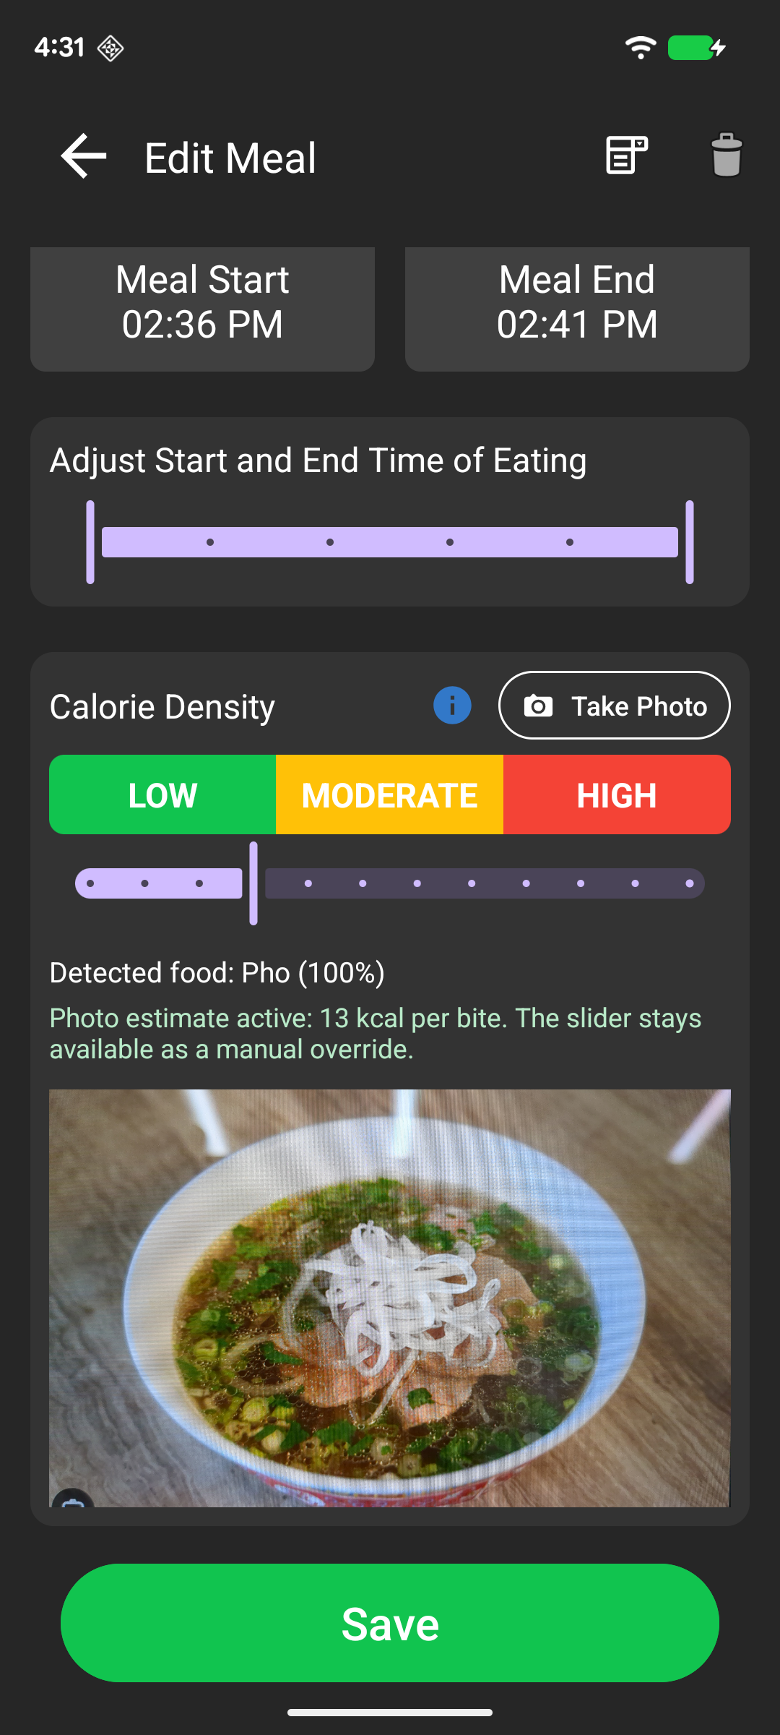
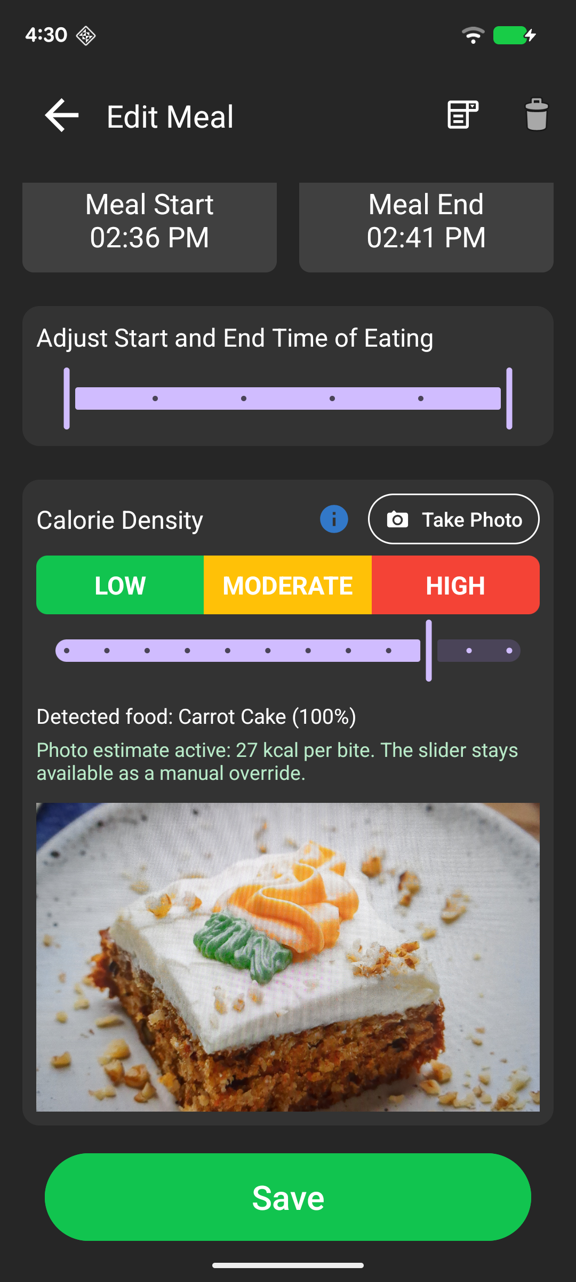
Meal Refinement: KPB IR Model
11

Slide 10
Questions
20

Slide 11
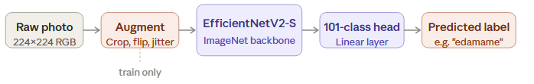
Food Detection Model
Dataset split
75,750 train
25,250 test
Input
224×224 RGB
Output spec
1 of 101 classes
Training Config
20 epochs Max
Batch size 32
Adam LR 0.003
StepLR ÷ 2 every 5 epochs

Slide 12
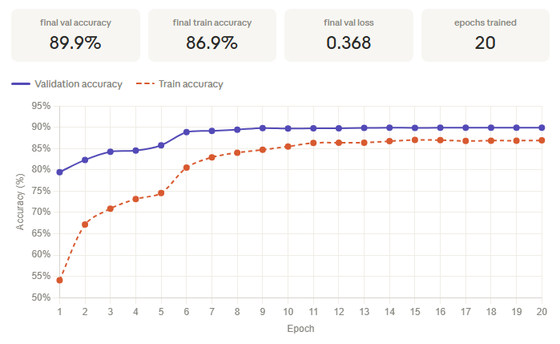
General Model Accuracies

Slide 13
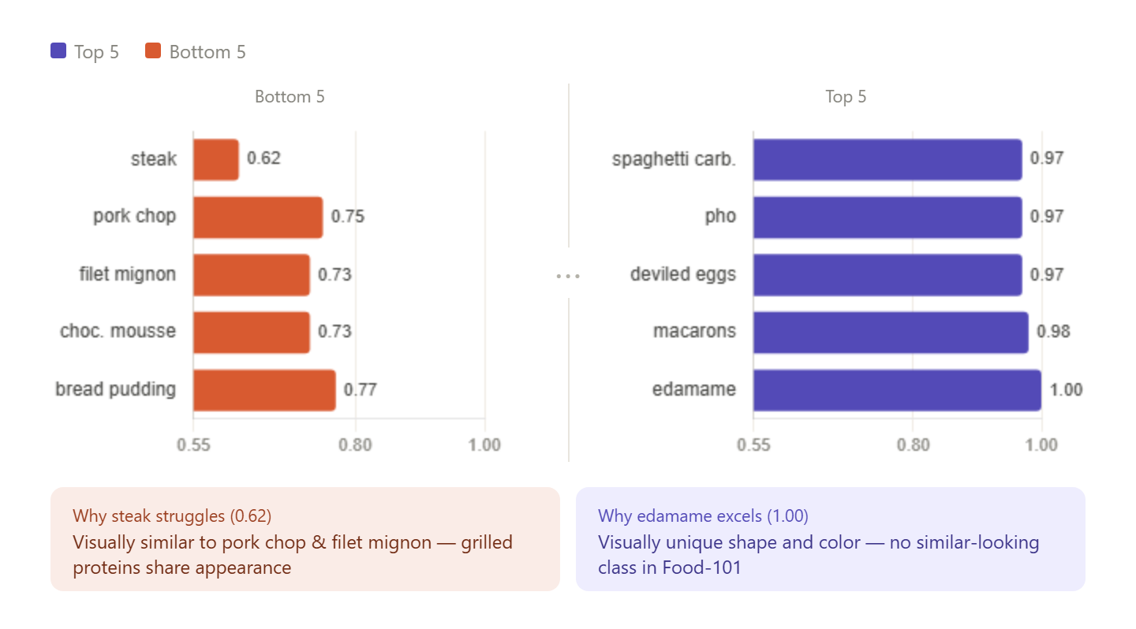
Per-class Performance

