Slide 1

SELF-HOSTED · LOCAL-FIRST · WINDOWS
JARVIS
A Local AI Voice Assistant, Built From Scratch
By
STACK
Noah Rohlinger
C# / .NET 8 · LM Studio

Slide 2
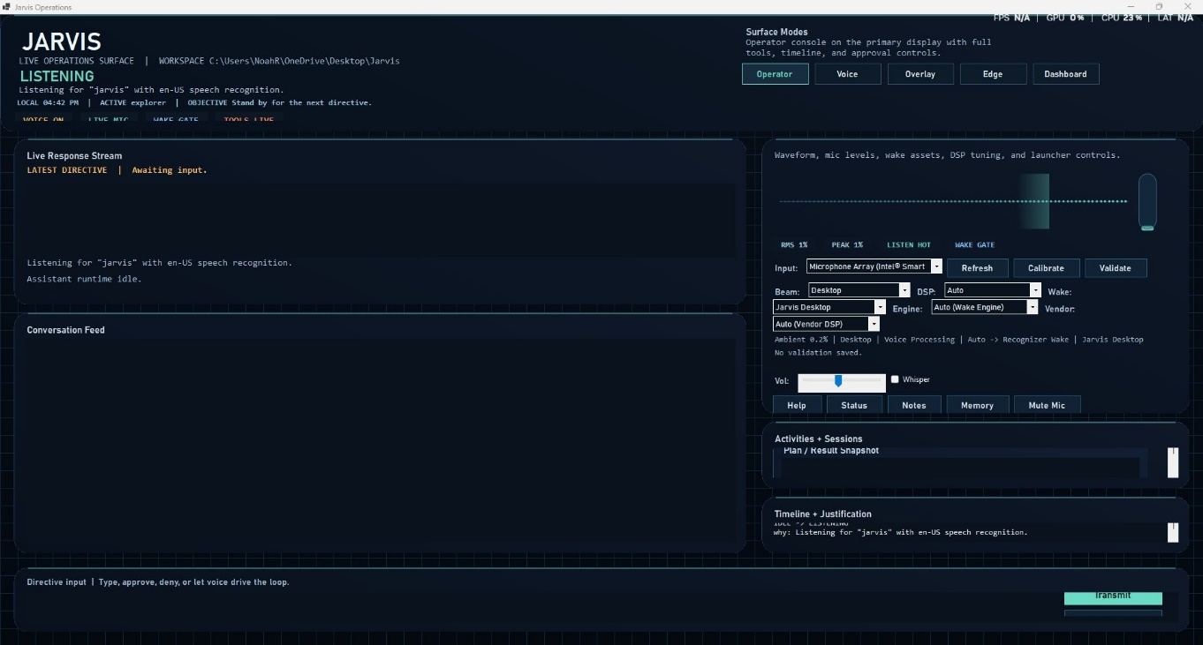


System Architecture & the Visual Workbench
Jarvis.Core
Class library — AI planning engine, tool dispatch, safety, and the memory system. The reasoning brain, with no UI attached.
Jarvis.App
The WinForms dashboard — audio waveform, mic controls, wake-word status, and Windows automation hooks. The face Jarvis shows you.
Jarvis.App — the live operations surface: conversation feed, waveform, and status header cycling Listening → Thinking → Acting → Speaking.
JARVIS // LOCAL AI ASSISTANT
02

Slide 3
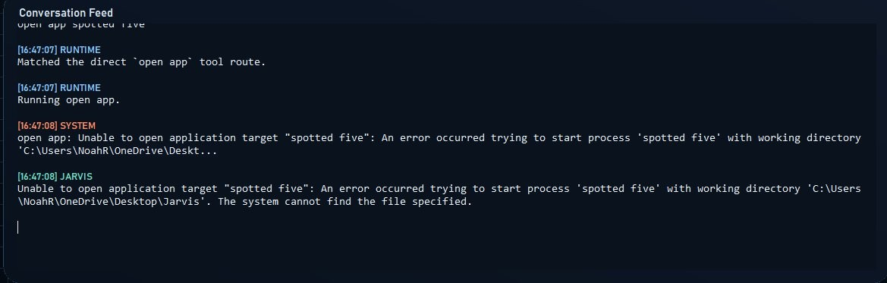


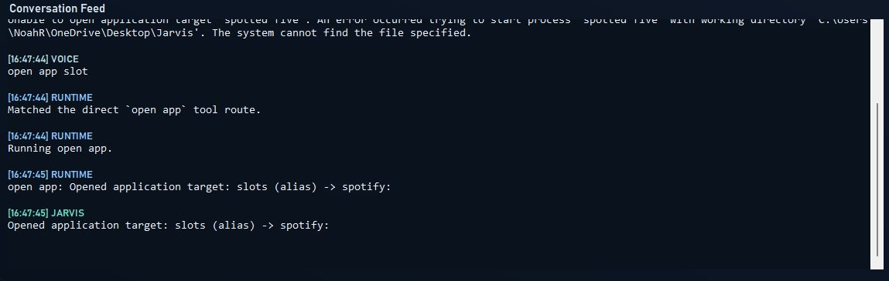
Voice Processing & Phonetic Routing
The Problem
Misheard words fail silently when matched against process names — “Spotify” becomes “spotted five,” and Jarvis can't find an app by that name.
Voice recognition mishears “Spotify” as “spotted five” — no known app matches, command fails.
The Fix
An applicationAliases map in jarvis.settings.json routes known mishears — “spotted five,” “spotty,” “slots” — straight to Spotify.
A follow-up mishear (“open app slot”) resolves through the alias table and Spotify opens correctly.
JARVIS // LOCAL AI ASSISTANT
03

Slide 4
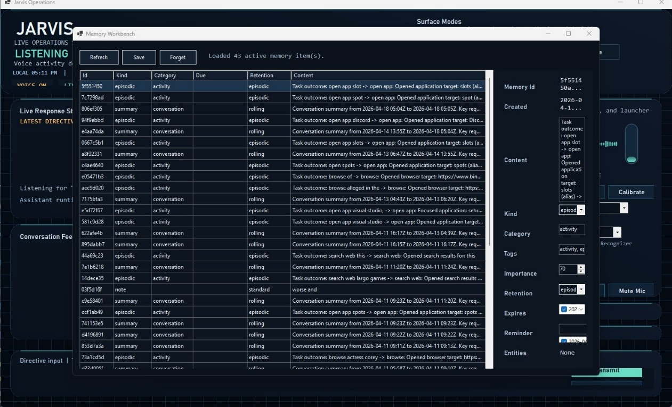



Desktop Automation, Vision & Memory
Launch & Control Apps
Open, focus, snap, and resize windows by name.
Screen Vision
Screenshots piped to a vision model for live description.
Persistent Memory
Indexes preferences & activity so nothing resets between sessions.
The Memory Workbench — 43 active items spanning episodic records, conversation summaries, and manual notes, each with kind, category, importance, and retention settings.
JARVIS // LOCAL AI ASSISTANT
04

Slide 5
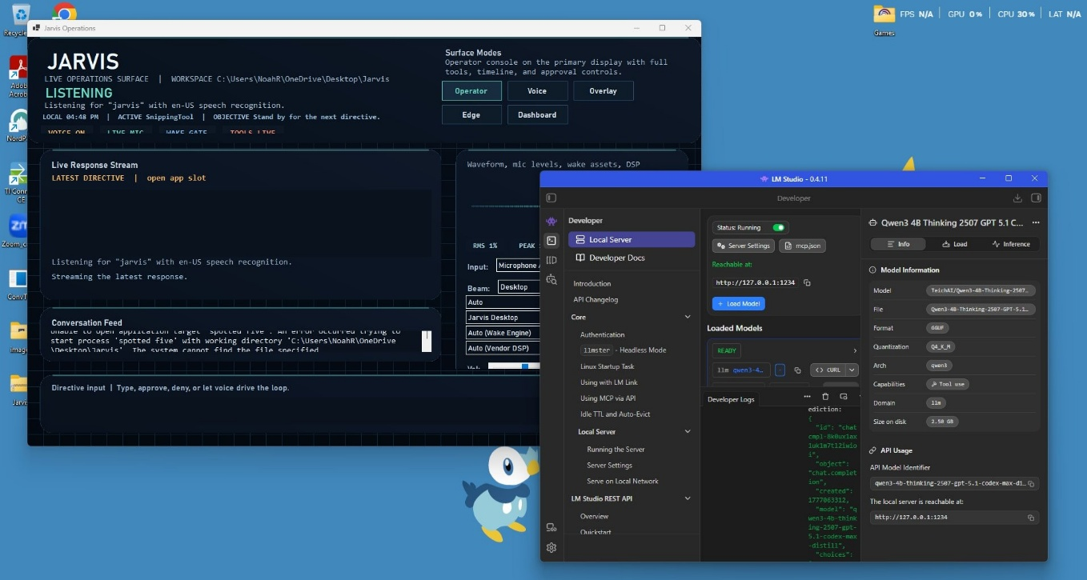


Local Inference & Remote Connectivity
Remote Access Flow
secondary laptop
ngrok tunnel
host PC · Jarvis
LM Studio running alongside Jarvis with the Qwen3 4B Thinking model loaded (2.5 GB GGUF) — local server live at 127.0.0.1:1234.
JARVIS // LOCAL AI ASSISTANT
05

Slide 6
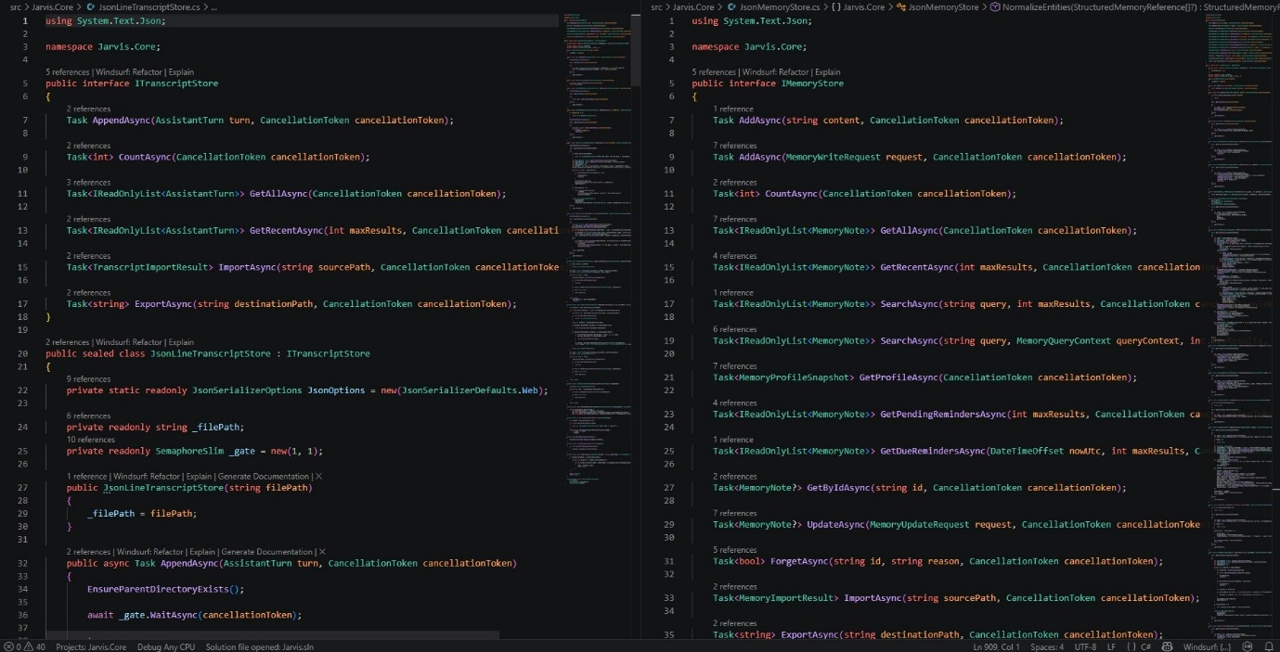


Development & Environment Setup Friction
What Went Wrong
The project's local .NET 8 bootstrapping script clashed with my globally-installed .NET version — the build resolved against the wrong runtime and threw cryptic assembly errors that pointed to missing assemblies instead of the real version conflict.
The Fix
Manually scrubbed every dotnet entry from the system PATH and re-ran the build script so it could bootstrap cleanly into its own local tools folder — just to get the project to compile.
The Jarvis.Core C# source — ITranscriptStore and IMemoryStore — the depth of codebase that had to be understood to diagnose the build issue.
TERMINAL · AFTER THE FIX
> Ensuring local .NET SDK...
.NET SDK 8.0.400 already available at C:\...\Jarvis\tools\dotnet.
Building Jarvis desktop app...
JARVIS // LOCAL AI ASSISTANT
06

Slide 7
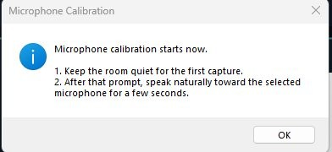
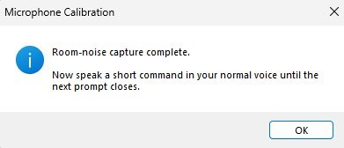


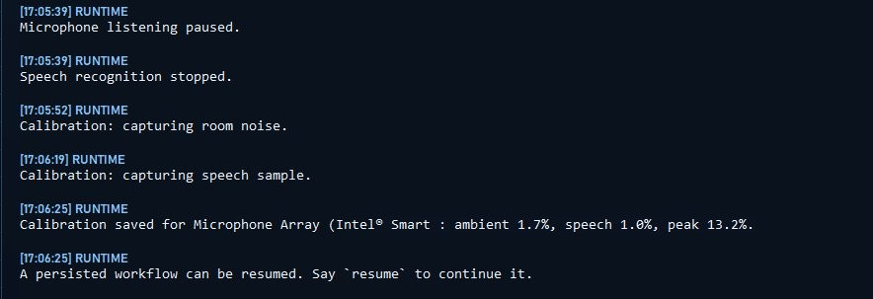
Voice Pipeline Nightmares & Calibration
Talking to Itself
In full-duplex mode, Jarvis picked up its own speaker output through the mic and got stuck in endless loops responding to itself.
Custom Calibration Tool
Built a UI calibration tool that captures an ambient noise baseline before listening begins — measuring ambient, speech, and peak levels to reduce false triggers.
The Microphone Calibration dialog — step one captures room silence, step two records a speech sample.
JARVIS // LOCAL AI ASSISTANT
07
The conversation feed logging the full calibration sequence — ambient 1.7%, speech 1.0%, peak 13.2%, then saved as the new baseline.

Slide 8
The Qwen3 Thinking Model Disaster
Qwen3 is a thinking model — it generates long blocks of internal reasoning before producing an answer. Jarvis's planner needs strict JSON, and that verbose reasoning consistently broke the parser, stalling execution.
QWEN3 OUTPUT · BREAKS THE PARSER
<think>
Okay, the user wants me to open Notepad.
Let me consider the available tools...
Actually, I should first check if...
[several more paragraphs of reasoning]
</think>
{"tool": "open_app", "target": "notepad"
Attempts to fix it:
plannerLocalContextLength
increased repeatedly to give the model more room to think
plannerMaxIterations
WHAT THE PLANNER NEEDS
reduced to prevent runaway loops
{"tool": "open_app", "target": "notepad"}
plannerReflectionEnabled
turned off — reflection on an already-verbose model made things worse
Even after every adjustment, the model could produce a clean response — then fall apart on the very next request with no obvious explanation.
JARVIS // LOCAL AI ASSISTANT
08

Slide 9



Automation Friction & Mobile Limitations
Modern Web Apps Resist Automation
OCR Was Slow
Mobile Broke Down Completely
Browsers and Electron apps render their own UI, so automated keypresses often land on the wrong element — or nowhere at all.
Screen capture, encode, send-to-vision-model, and describe took 10–20 seconds on my hardware — impractical for anything time-sensitive.
The WinForms UI wasn't built for small screens, and voice capture failed outright since the microphone is locked to the host desktop.
JARVIS // LOCAL AI ASSISTANT
09

Slide 10
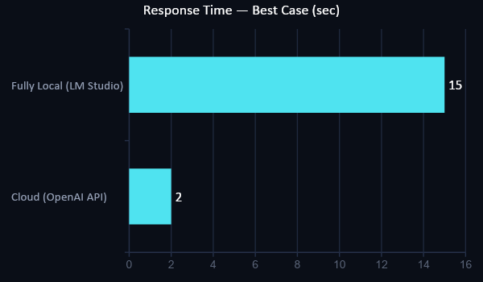
Performance Trade-offs & Benchmarks
All figures below reflect my personal system specs, not a controlled benchmark environment.
CLOUD MODE
< 2 sec
Fast and accurate — but every command leaves the machine, trading away the core privacy motivation.
95% accuracy
FULLY LOCAL MODE
8–15 sec
Nothing leaves the PC — but on this hardware, waiting 8–15 seconds per command is a real cost.
100% private
Privacy and speed traded directly against each other on this hardware — a faster local machine would close some, not all, of the gap.
JARVIS // LOCAL AI ASSISTANT
10

Slide 11





Retrospective & Future Roadmap
The Real Takeaway
ROADMAP
Thinking-Model Prompt Parser
This project went better than expected. Within a few hours of setup, Jarvis was listening for a wake word, automating the desktop, searching the web, and holding a persistent memory across sessions — capability that would've taken months from scratch a few years ago.
A dedicated parser/template so Qwen3-style reasoning no longer breaks the planner.
Home Assistant Integration
Close the smart-home gap — lights, thermostats, and plugs, Alexa's killer feature.
Hardware Wake-Word Engine
Porcupine or OpenWakeWord for always-on listening without a CPU-hungry recognizer.
Confirmed: privacy, offline capability, and customization all held up — and customization exceeded expectations.
Not fully resolved: the Qwen3 thinking-model compatibility problem remains the single biggest open issue in the project.
Setup Wizard
A real installer so a non-technical friend doesn't need hand-holding through the settings file.
JARVIS // LOCAL AI ASSISTANT
11

