Slide 1
Mathematical Modelling of the Knee for ACL Repair effects of Graft and Fixation Stiffness
Introduction to the Project
Noah Saad

Slide 2
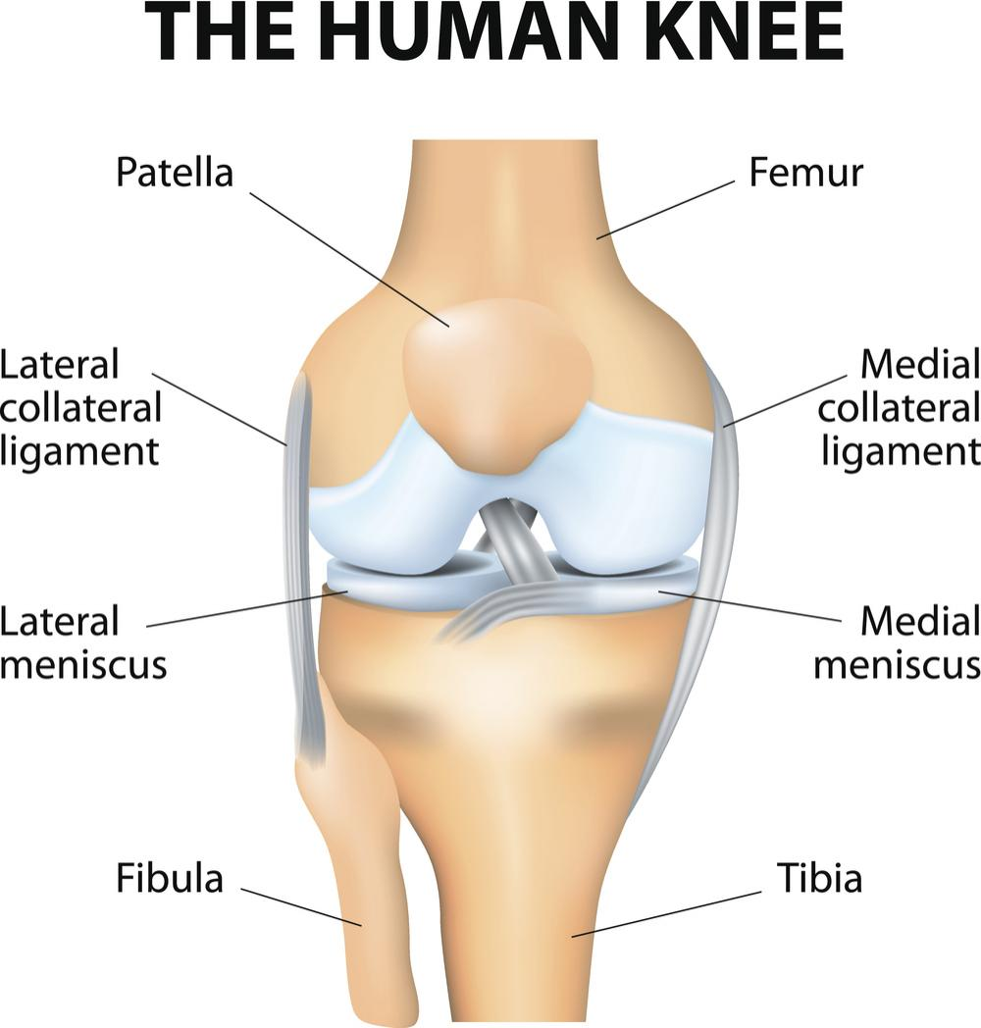
Knee Anatomy
Posterior Cruciate Ligament
Anterior Cruciate Ligament

Slide 3
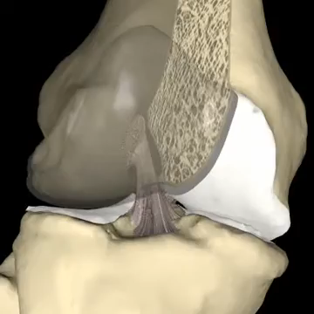
ACL during flexion and extension

Slide 4
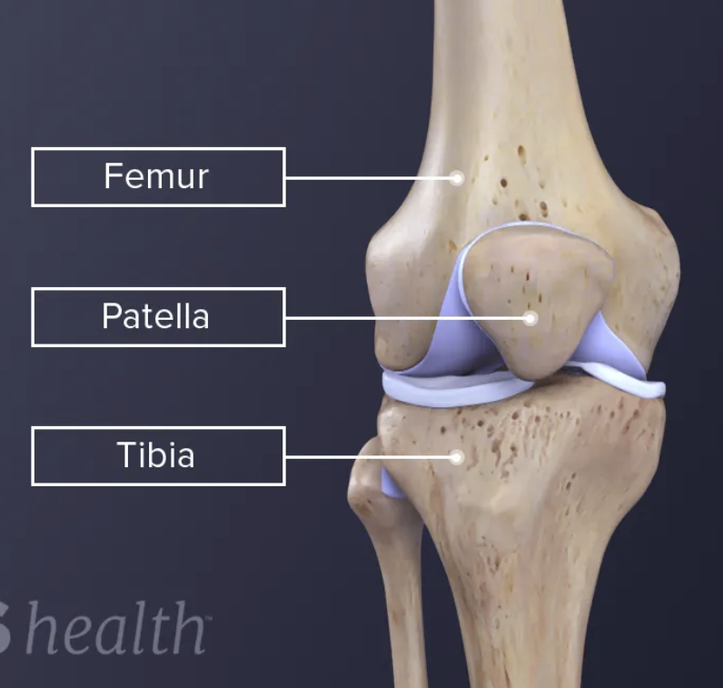
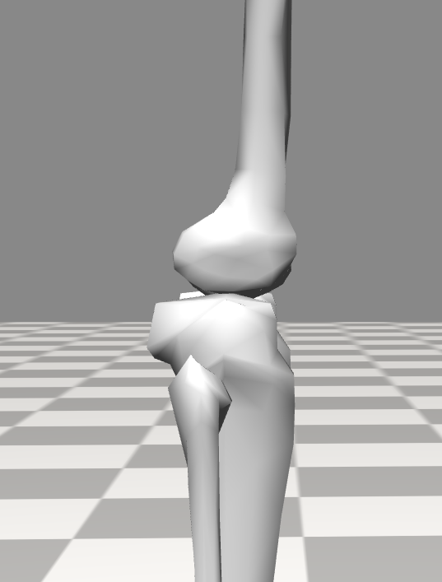
ACL injuries
Lateral Rotation
Hyperextension

Slide 5
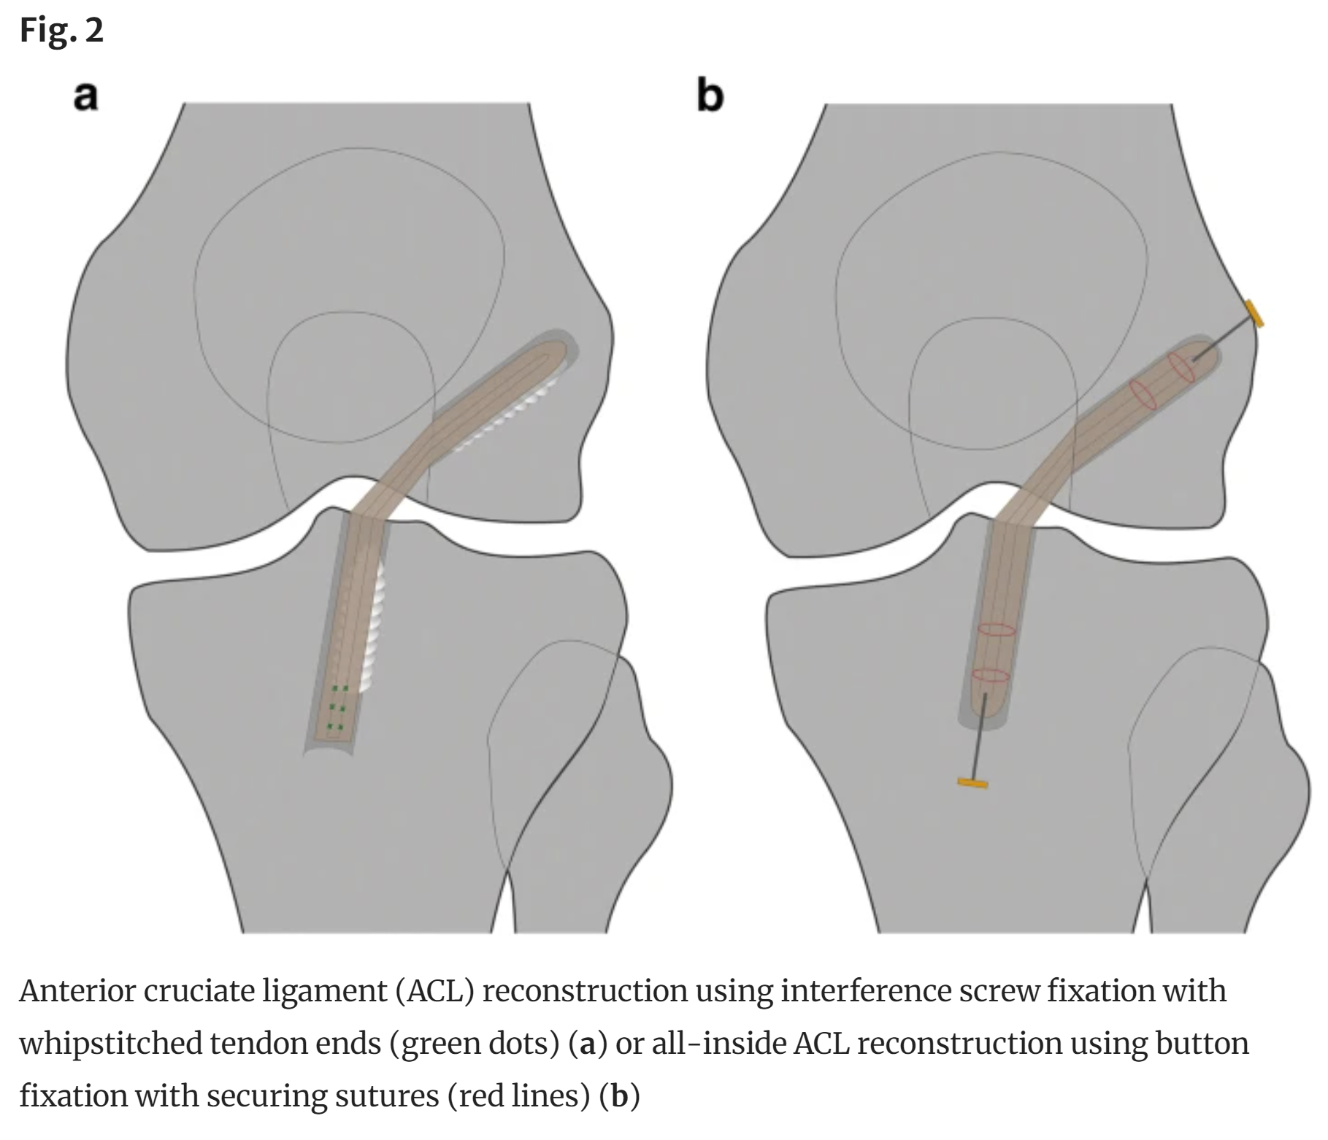
ACL reconstruction
Usually uses hamstring or quadriceps tendon for new graft
Graft preparation
Tunnel creation in femur and tibia
Fixated using screws or buttons

Slide 6
The problem
Tendon strength and stiffness is patient-specific
Currently, the fixation stiffness is determined by the surgeon (experience)
2.9% graft failure rate and 3.5% incidence of grade 2 or higher pivot shift results
77% may be the result of improper tensioning

Slide 7
Research Question
Can we find a model to determine initial graft stiffness based on patient tendon strength and stiffness?

Slide 8
Potential Pipeline
Determine Model to be used,
DoF?
What movements need to be analysed?
How will these movements be captured or described?
TRC, function…
Ste

Slide 9
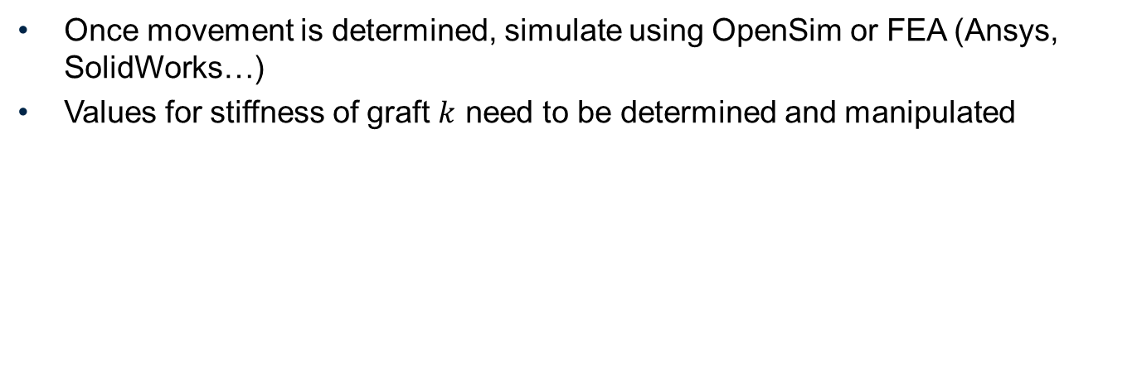
Once movement is determined, simulate using OpenSim or FEA (Ansys, SolidWorks…)
Values for stiffness of graft $k$ need to be determined and manipulated

Slide 10
Two situations
Situation 1
Situation 2
Graft is too loose → Unnatural biomechanical movements which can result in osteoarthritis.
Graft is too stiff → Risk of graft failure

Slide 11
Mathematical model of the knee

Slide 12
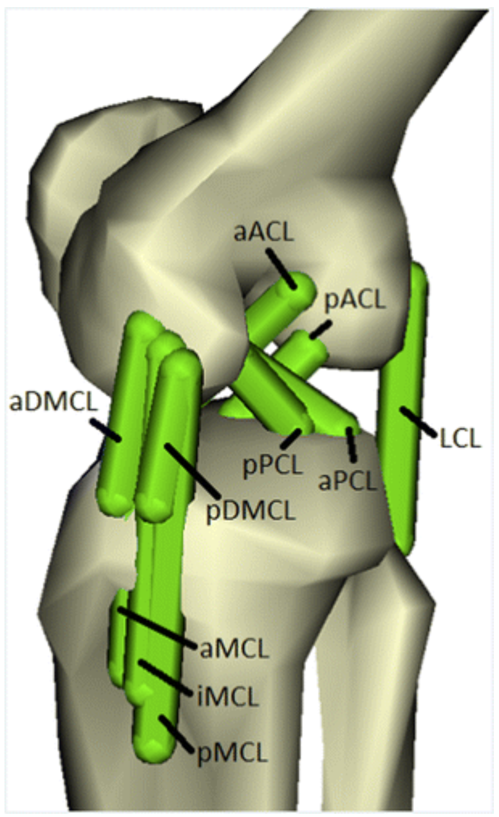
The attachment sites of knee ligament bundles. The abbreviation of ligament bundles are:
aACL, anterior bundle of the ACL; pACL, posterior bundle of the ACL;
aPCL, anterior bundle of the PCL; pPCL, posterior bundle of the PCL;
aMCL, anterior bundle of the superficial layer of the MCL; iMCL, inferior bundle of the superficial layer of the MCL; pMCL, posterior bundle of the superficial layer of the MCL;
aDMCL, anterior bundle of the deep layer of the MCL; pDMCL, posterior bundle of the deep layer of the MCL.
LCL, lateral collateral ligament

Slide 13
Example of Model in OpenSim that could be used
MATLAB will be used for OpenSim API

Slide 14
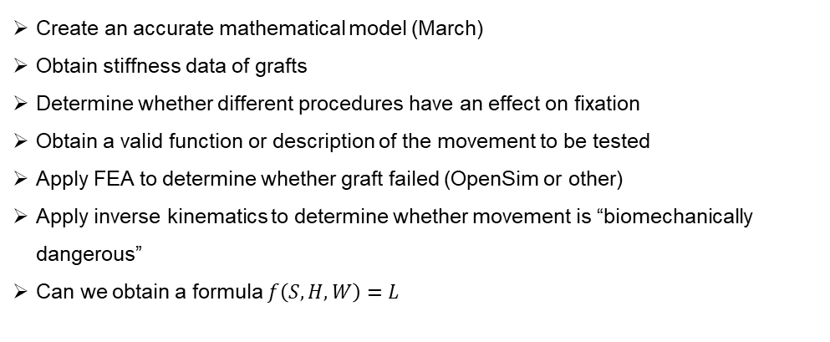
Potential Milestones
Create an accurate mathematical model (March)
Obtain stiffness data of grafts
Determine whether different procedures have an effect on fixation
Obtain a valid function or description of the movement to be tested
Apply FEA to determine whether graft failed (OpenSim or other)
Apply inverse kinematics to determine whether movement is “biomechanically dangerous”
Can we obtain a formula $f\left(S, H, W\right)=L$

Slide 15
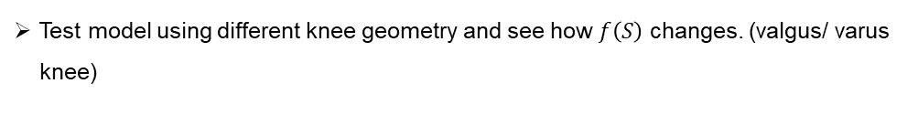
If we have time
Test model using different knee geometry and see how $f\left(S\right)$ changes. (valgus/ varus knee)

Slide 16
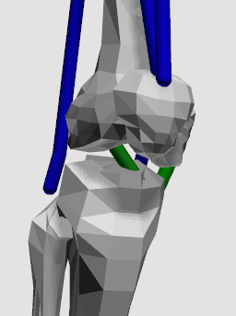









$$T={r×F}_{ACL }$$
$$F_{ACL}=F_{initial}+F_{elastic}$$
$$F$$
$$k$$
$$F_{elastic}$$
$$F_{ACL}$$
$$F_{initial}$$
$$Δx$$
$$T$$

Slide 17

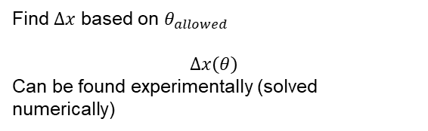




What do we do for different tendon properties?
$$F$$
Determine allowable knee internal/ external rotation
$$k$$
$$k$$
Find $Δx$ based on $θ_{allowed}$
$$Δx\left(θ\right)$$
Can be found experimentally (solved numerically)
$$k$$
$$Δx$$

Slide 18














Change the initial tension to have a desired $θ$
$$F_{yield}$$
$$F$$
$$F_{yield}$$
$$F$$
$$k$$
$$k$$
$$F_{elastic}$$
$$F_{elastic}$$
$$F_{initial}$$
$$F_{initial}$$
$$x_{0}$$
$$x_{final}$$
$$x_{0}$$
$$x_{final}$$
$$x$$
$$x$$

Slide 19









For a given torsion $T$,
$$F$$
$$F$$
$$T$$
$$F_{elastic}$$
$$T$$
$$F_{elastic}$$
$$F_{initial}$$
$$F_{initial}$$
$$x_{0}$$
$$x_{final}$$
$$x_{0}$$
$$x_{final}$$
$$x$$
$$x$$

