Slide 1
An Open-source Discrete Element Knee Model
Anne Schmitz

Slide 2
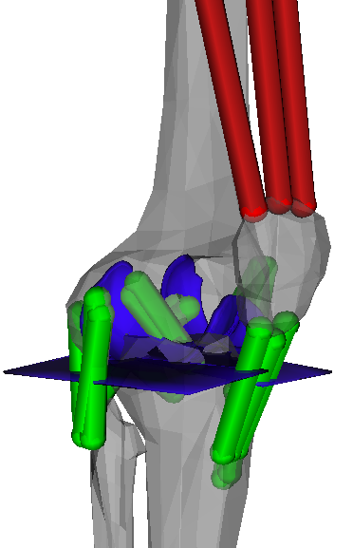
Main Model Components
Joints
6 DoF tibiofemoral
1 DoF patellofemoral
18 ligament bundles
ACL (2), PCL (2), MCL (5), LCL (1), PFL (1), posterior capsule (4), patellar tendon (3)
Positioned using anatomical landmarks
Modeled as nonlinear springs with properties from literature (modeling and tensile testing)
Articular contact geometry
Femur cartilage from MRI (OpenKnee)
Tibial plateaus as planes (also used by other knee models like this)
Each compartment modeled separately so contact forces are resolved into medial and lateral sides
Contact
Linear elastic foundation model contact between bones (as used by other models)
Contact between MCL and femur to avoid penetration

Slide 3
Segment Coordinate Systems
Bone embedded reference adapted from (Arnold, et al., 2010)
In anatomical position, x‐axis pointed anteriorly, y‐axis superiorly, and the z‐axis to the right.
Aligned with the inertial axes of each bone.
Femur
Origin at center of the femoral head
Y‐axis placed along a line connecting the femoral head and the center of the femoral condyles.
Patella
Origin located at proximal pole
Tibia
Origin at the midpoint of the femoral condyles with the knee in full extension

Slide 4
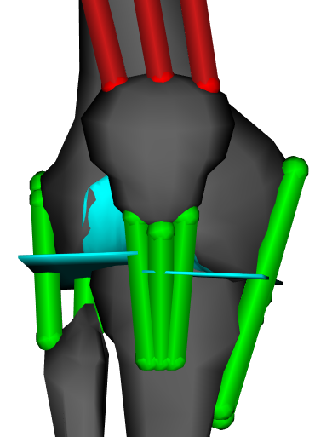
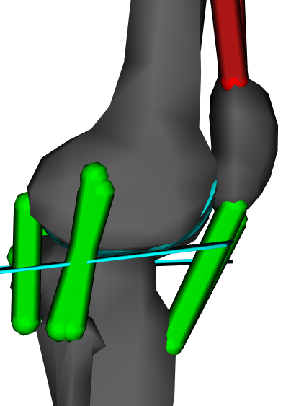
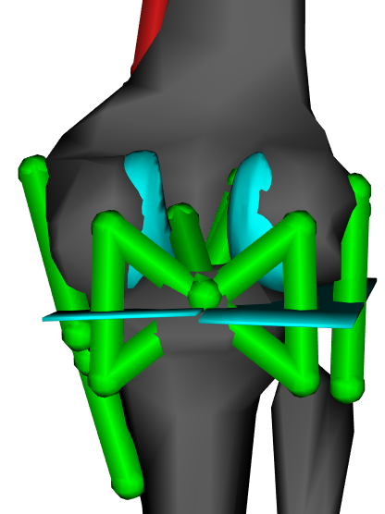
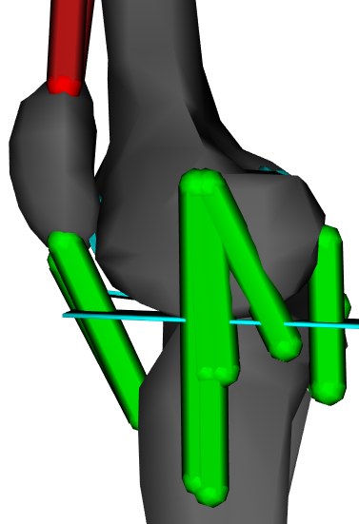
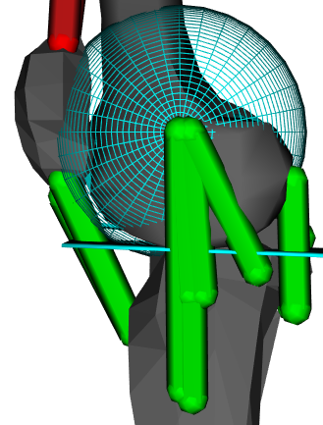
Ligaments
anterolateral bundle of posterior cruciate
anteromedial bundle of anterior cruciate
posteromedial bundle of posterior cruciate
posterolateral bundle of anterior cruciate
posterior bundle of superficial medial collateral
anterior bundle of deep medial collateral
posterior bundle of deep medial collateral
anterior bundle of superficial medial collateral
central bundle of superficial medial collateral
lateral collateral
medial bundle of posterior capsule
lateral bundle of posterior capsule
patellar tendon
popliteofibular
spherical wrapping surface for medial collateral
arcuate popliteal bundle of posterior capsule
oblique popliteal bundle of posterior capsule

Slide 5
Patellofemoral Joint

Slide 6
How to run the passive flexion-extension test
Click to run ‘passiveFlexion_analysis.bat’
The results will be stored in the folder ‘Passive_Flexion’.
To analyze the data and plot results, run the function ‘passiveFlexionProcess.m’ in the ‘Matlab’ folder.

Slide 7
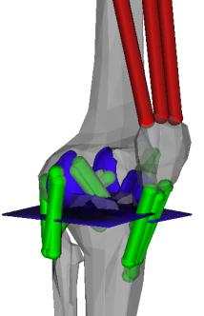
Passive Flexion-Extension

Slide 8
Passive Flexion-Extension

Slide 9
Contact Model

Slide 10
How to run the anterior-posterior stiffness test
Click to run ‘ap_analysis.cmd’
The results will be stored in the folder ‘AP_Laxity’.
To analyze the data and plot results, run the function ‘apLaxProcess.m’ in the ‘Matlab’ folder.

Slide 11
Anterior-Posterior Stiffness

Slide 12
Anterior-Posterior Stiffness

Slide 13
Anterior-Posterior Stiffness

Slide 14
Anterior-Posterior Stiffness

Slide 15
How to run the axial rotation stiffness test
Click to run ‘ie_analysis.bat’
The results will be stored in the folder ‘IE_Laxity’.
To analyze the data and plot results, run the function ‘ieLaxProcess.m’ in the ‘Matlab’ folder.

Slide 16
Axial Rotation Stiffness

Slide 17
Axial Rotation Stiffness

Slide 18
Axial Rotation Stiffness

Slide 19
Axial Rotation Stiffness

Slide 20
How to run the ab-adduction stiffness test
Click to run ‘vv_analysis.bat’
The results will be stored in the folder ‘VV_Laxity’.
To analyze the data and plot results, run the function ‘vvLaxProcess.m’ in the ‘Matlab’ folder.

Slide 21
Ab-Adduction Stiffness

Slide 22
Ab-Adduction Stiffness

Slide 23
Ab-Adduction Stiffness

Slide 24
Ab-Adduction Stiffness

Slide 25
Ligament Properties

Slide 26
Limitations
Model components come from different sources
Bones: based on cadaveric study
Muscle attachments: based on bone geometry
Ligaments: based on bone geometry
Femur for contact: based on OpenKnee MRI geometry
Tibia for contact: simplified geometry
Ligament properties: based on other models and tensile testing of cadaveric tissue
Model seems a little stiff. However, further loosening would cause more intercondylar lift-off during passive flexion-extension
Simplified patellofemoral joint and tibial geometry to increase computational speed
No scaling method…yet

Slide 27
Summary
Why is this novel?
First model like this that is open-source
Model is physiologically reasonable in passive motion, stiffness, ligament properties, and ligament function

